Slide 1
聚类算法在天文中的应用
王伟华
常州工学院计算机信息工程学院
*

Slide 2
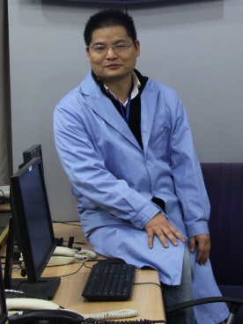
自我介绍
王伟华
常州工学院计算机信息工程学院教授
原中科院上海天文台正研高工，嫦娥三号任务突出贡献者
擅长领域
主要经历
Python 科学计算、数据可视化与数据分析
机器学习/深度学习/数据挖掘商业BI
大数据平台与应用
深空探测与射电天文技术
1998-2003 中科院上海天文台博士
2003-2016 中科院上海天文台助研，副研，正研高工。
2017-2018 厦门宽投-机器学习与量化金融
2018-2020 智汇-共享科学，数据科学初创企业合伙人、Python数据分析培训
2020-至今 常州工学院计算机信息工程大学教授
在线学习AI平台A+实验室创始人

Slide 3
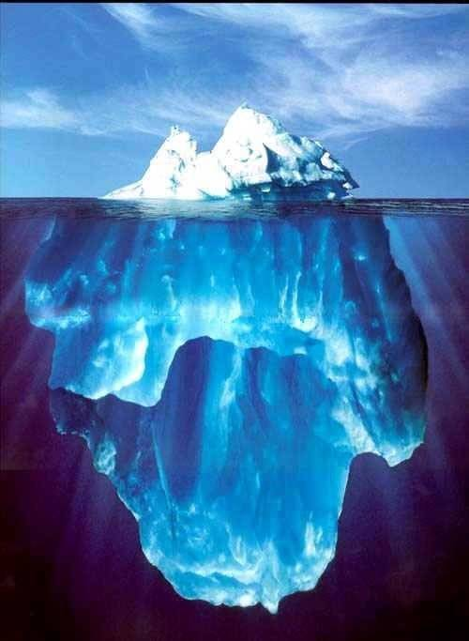
目录
1. 介绍
2. 天文应用：疏散星团成员星的认证
3. 总结和下一步计划

Slide 4
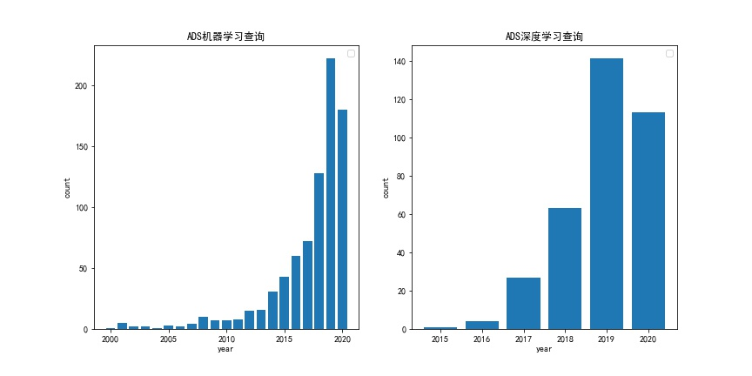
1. 介绍
1 什么是计算机视觉
机器学习与深度学习应用趋势
基于LAMOST数据回归Gaia DR2中恒星的消光, 国家天文台白宇副研究员、刘继峰研究员等
基于Gaia DR2 星团搜索得到的16个疏散星团,紫金山天文台郝超杰博士、徐烨研究员等。
人工智能助力发现强引力透镜候选体,云南天文台龙潜研究员等。
基于GAIA DR2巡天数据在Blanco 1星团发现潮汐尾结构，新疆天文台光学研究室张余研究员等.
ADS 查询统计
标题包含机器学习与深度学习

Slide 5
介绍
六大应用场景和问题
分类问题（Classification）
回归问题（Regression）
聚类问题（Clustering）
关联问题（Association）
异常检测（Outlier Detection）
序列问题（Sequence）
预测建模/有监督学习
非监督学习

Slide 6
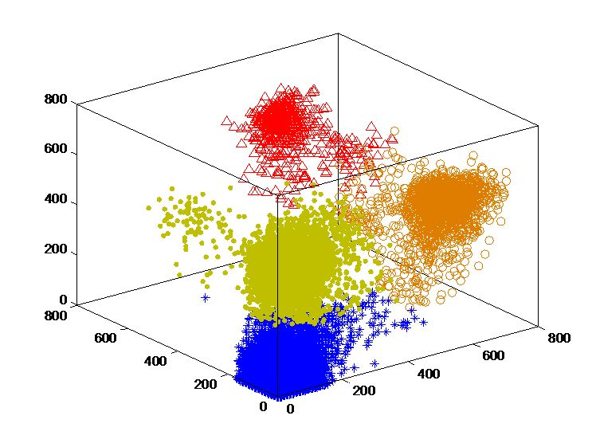
介绍
聚类问题（Clustering）
从数据中探索样本之间的相似性，把特征相似的样本聚为一类，是一种无目标的探索性分析
物以类聚，人以群分
典型的聚类问题：
客户细分
文章聚类

Slide 7
介绍
聚类问题（Clustering）
分门别类：把一些事物按照特性和特征分别归入各种门类。
聚类：从数据中探索样本之间的相似性，把特征相似的样本聚为一类。
Group 2
Group 3
Group 1
Group 4
Group 5

Slide 8
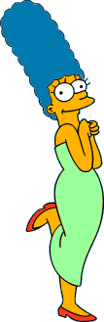




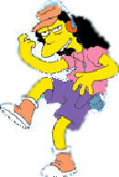



介绍
辛普森一家
在下面的这些人物中，天然的分组是什么？
聚类是主观的！
Simpson's Family
School Employees
Females
Males

Slide 9


介绍
聚类算法
基于层次的（Hierarchical ）：根据两个样本的距离大小逐层合并的方法
基于划分的方法（Partitional）：挑选类中心点对数据进行迭代划分。Kmeans
基于图论的聚类方法：谱聚类
基于密度（Density）的方法：DBSCAN
基于模型的方法：高斯混合模型（GMM）
层次聚类方法
基于划分的方法

Slide 10
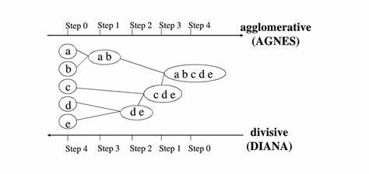
3. 更多聚类算法介绍
凝聚层次聚类
存在两种方式构成层次聚类：从小到大；从大到小
凝聚层级聚类(HAC)是自下而上的聚类算法：
首先将每个数据点视为一个单一的簇
然后计算所有簇之间的距离来合并簇
直到知道所有的簇聚合成为一个簇为止。
Notes:
Here I’m showing some data to cluster
Let’s say high-D data, but projected it down to 2 most important dimensions for clustering
It’s obvious to us even with 2-D projection that red points shouldn’t be in same cluster
But, standard clustering algorithm like GAC needs to compare these using all dimensions of the data
However, different story for the blue points.
Here, using the projection, we don’t know if they are in the same cluster.
We’d want to use the high-D metric to determine if there should be clustered together or apart.
We can encode exactly this type of information in an overlapping clustering of the data created by the inexpensive distance metric

Slide 11
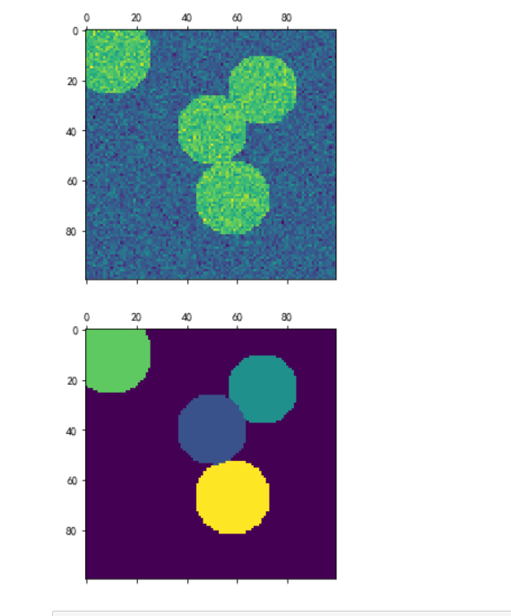
3. 更多聚类算法介绍
谱聚类
谱聚类是一种基于图论的聚类方法，可以理解为将高维空间的数据映射到低维，然后其它聚类算法（如KMeans）进行聚类。
类别个数较小的时候，谱聚类的效果会很好；
谱聚类算法使用了降维的技术，更加适用于高维数据的聚类；
对于处理稀疏数据的聚类很有效。
具有能在任意形状的样本空间上聚类且收敛于全局最优解
谱聚类对相似度图的改变和聚类参数的选择非常的敏感
谱聚类适用于均衡分类问题
Notes:
Here I’m showing some data to cluster
Let’s say high-D data, but projected it down to 2 most important dimensions for clustering
It’s obvious to us even with 2-D projection that red points shouldn’t be in same cluster
But, standard clustering algorithm like GAC needs to compare these using all dimensions of the data
However, different story for the blue points.
Here, using the projection, we don’t know if they are in the same cluster.
We’d want to use the high-D metric to determine if there should be clustered together or apart.
We can encode exactly this type of information in an overlapping clustering of the data created by the inexpensive distance metric

Slide 12
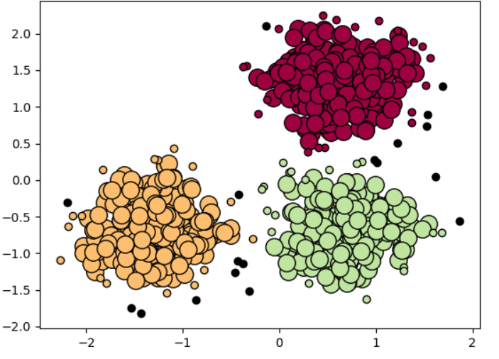
介绍
DBSCAN聚类算法
DBSCAN是基于密度的聚类算法。能够自动的发现密度最大的3个区域
Notes:
Here I’m showing some data to cluster
Let’s say high-D data, but projected it down to 2 most important dimensions for clustering
It’s obvious to us even with 2-D projection that red points shouldn’t be in same cluster
But, standard clustering algorithm like GAC needs to compare these using all dimensions of the data
However, different story for the blue points.
Here, using the projection, we don’t know if they are in the same cluster.
We’d want to use the high-D metric to determine if there should be clustered together or apart.
We can encode exactly this type of information in an overlapping clustering of the data created by the inexpensive distance metric

Slide 13
介绍
高斯混合模型（Gaussian mixture model，GMM）
k-means算法缺陷：
在实际聚类的过程中，两个簇往往会存在重合部分。对于重合部分的点被分配到哪个簇缺乏一个评估方案，也没有度量簇的分配概率或不确定性的方法。
k-means要求这些簇的模型必须是圆形，实际数据分布可能是椭圆的。
高斯混合模型就是用高斯概率密度函数精确的量化事物，将一个事物分解为若干基于高斯概率密度函数行程的模型。意思就是任何一个曲线，都可以用若干个高斯曲线来无限逼近它，这就是高斯混合模型的基本思想。
GMM的目的就是找到一个合适的高斯分布，使得这个高斯分布能产生这组样本的可能性尽可能大其分类结果由概率表示，概率大者，则认为属于这一类。
Notes:
Here I’m showing some data to cluster
Let’s say high-D data, but projected it down to 2 most important dimensions for clustering
It’s obvious to us even with 2-D projection that red points shouldn’t be in same cluster
But, standard clustering algorithm like GAC needs to compare these using all dimensions of the data
However, different story for the blue points.
Here, using the projection, we don’t know if they are in the same cluster.
We’d want to use the high-D metric to determine if there should be clustered together or apart.
We can encode exactly this type of information in an overlapping clustering of the data created by the inexpensive distance metric

Slide 14
1. 介绍
2
2. 天文应用：疏散星团成员星的认证
Section
3. 总结和下一步计划

Slide 15
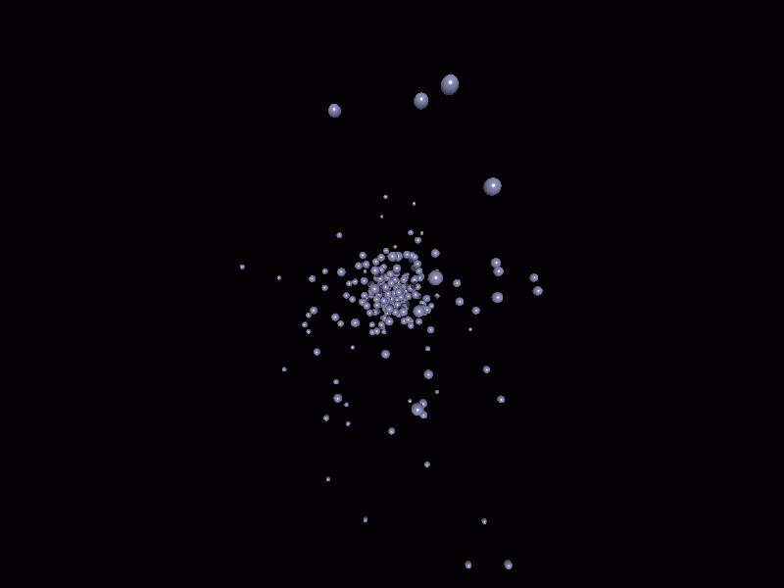
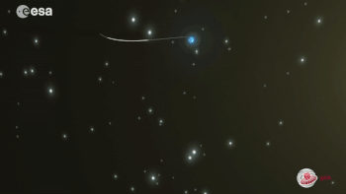
2. 天文应用：疏散星团成员星的认证
1 什么是计算机视觉
疏散星团
疏散星团Hyades (毕星团)
Gaia

Slide 16
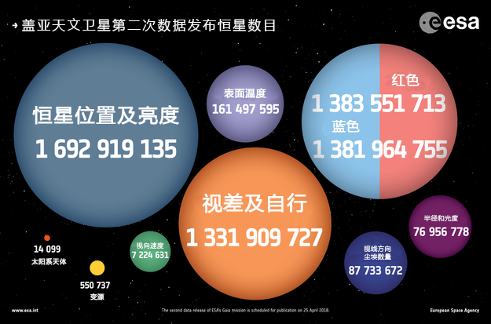
天文应用：疏散星团成员星的认证
一
Gaia卫星DR2数据
GAIA DR2包含：
超过16.9亿颗恒星的位置及亮度信息
13.3亿颗恒星的视差和自行数据
约13.8亿颗恒星的颜色
超过七百万颗恒星的视向速度
55万个变源数据等。
赤道坐标系

Slide 17
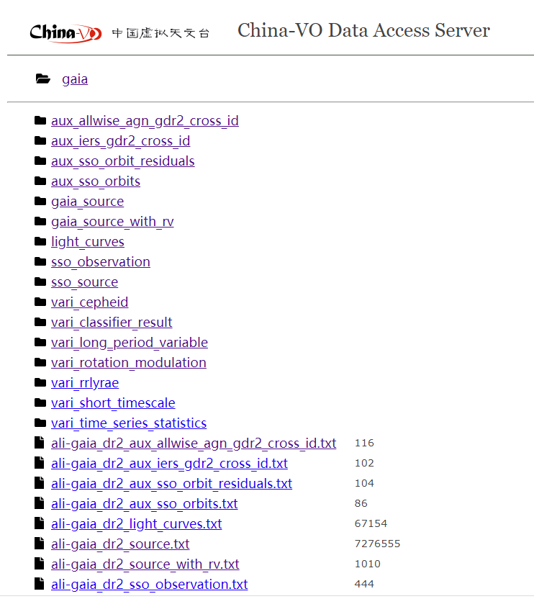
天文应用：疏散星团成员星的认证
一
Gaia卫星DR2数据-阿里云
使用python或java实现批处理下载。
大约7万个文件，500多GB，花费了一周时间。
建议使用 S3 ！
赤道坐标系

Slide 18
天文应用：疏散星团成员星的认证
疏散星团M67
Detection of tidal tails around the open cluster M 67 using principal component analysis (Gao, X. 2020, PASJ, 72, 47)
疏散星团M67周围6万多颗恒星的5维天体测量数据（位置，自行，三角视差）
Hao et al. PASP 132 034502
Notes:
Here I’m showing some data to cluster
Let’s say high-D data, but projected it down to 2 most important dimensions for clustering
It’s obvious to us even with 2-D projection that red points shouldn’t be in same cluster
But, standard clustering algorithm like GAC needs to compare these using all dimensions of the data
However, different story for the blue points.
Here, using the projection, we don’t know if they are in the same cluster.
We’d want to use the high-D metric to determine if there should be clustered together or apart.
We can encode exactly this type of information in an overlapping clustering of the data created by the inexpensive distance metric

Slide 19
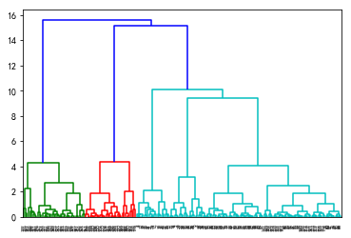
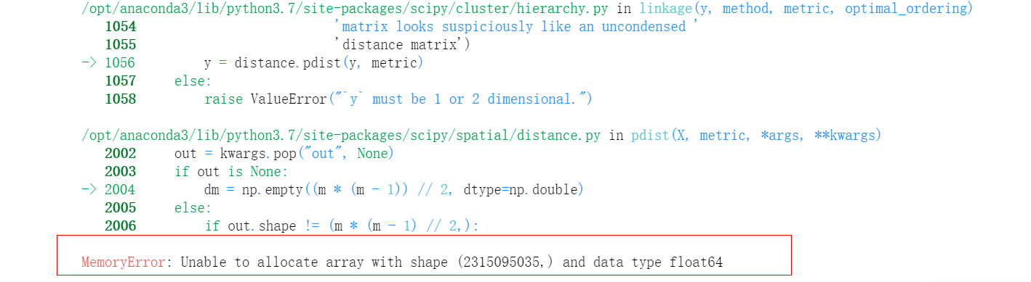
天文应用：疏散星团成员星的认证
分层聚类应用结果
Notes:
Here I’m showing some data to cluster
Let’s say high-D data, but projected it down to 2 most important dimensions for clustering
It’s obvious to us even with 2-D projection that red points shouldn’t be in same cluster
But, standard clustering algorithm like GAC needs to compare these using all dimensions of the data
However, different story for the blue points.
Here, using the projection, we don’t know if they are in the same cluster.
We’d want to use the high-D metric to determine if there should be clustered together or apart.
We can encode exactly this type of information in an overlapping clustering of the data created by the inexpensive distance metric

Slide 20
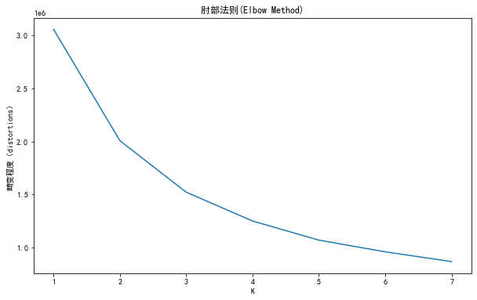
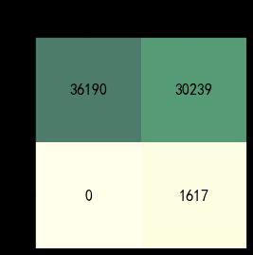
天文应用：疏散星团成员星的认证
K 均值聚类
Notes:
Here I’m showing some data to cluster
Let’s say high-D data, but projected it down to 2 most important dimensions for clustering
It’s obvious to us even with 2-D projection that red points shouldn’t be in same cluster
But, standard clustering algorithm like GAC needs to compare these using all dimensions of the data
However, different story for the blue points.
Here, using the projection, we don’t know if they are in the same cluster.
We’d want to use the high-D metric to determine if there should be clustered together or apart.
We can encode exactly this type of information in an overlapping clustering of the data created by the inexpensive distance metric

Slide 21
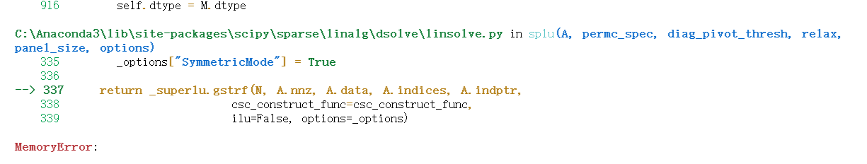
天文应用：疏散星团成员星的认证
谱聚类应用结果
Notes:
Here I’m showing some data to cluster
Let’s say high-D data, but projected it down to 2 most important dimensions for clustering
It’s obvious to us even with 2-D projection that red points shouldn’t be in same cluster
But, standard clustering algorithm like GAC needs to compare these using all dimensions of the data
However, different story for the blue points.
Here, using the projection, we don’t know if they are in the same cluster.
We’d want to use the high-D metric to determine if there should be clustered together or apart.
We can encode exactly this type of information in an overlapping clustering of the data created by the inexpensive distance metric

Slide 22
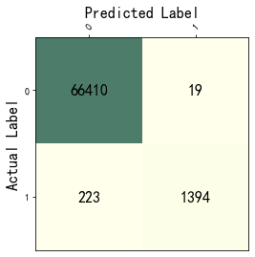
天文应用：疏散星团成员星的认证
DBSCAN聚类应用结果
缺点：
如果样本集的密度不均匀、聚类间距差相差很大时，聚类质量较差，这时用DBSCAN聚类一般不适合。
如果样本集较大时，聚类收敛时间较长
调参比K均值算法稍复杂，主要需要对Eps和MinPts联合调参
Notes:
Here I’m showing some data to cluster
Let’s say high-D data, but projected it down to 2 most important dimensions for clustering
It’s obvious to us even with 2-D projection that red points shouldn’t be in same cluster
But, standard clustering algorithm like GAC needs to compare these using all dimensions of the data
However, different story for the blue points.
Here, using the projection, we don’t know if they are in the same cluster.
We’d want to use the high-D metric to determine if there should be clustered together or apart.
We can encode exactly this type of information in an overlapping clustering of the data created by the inexpensive distance metric

Slide 23
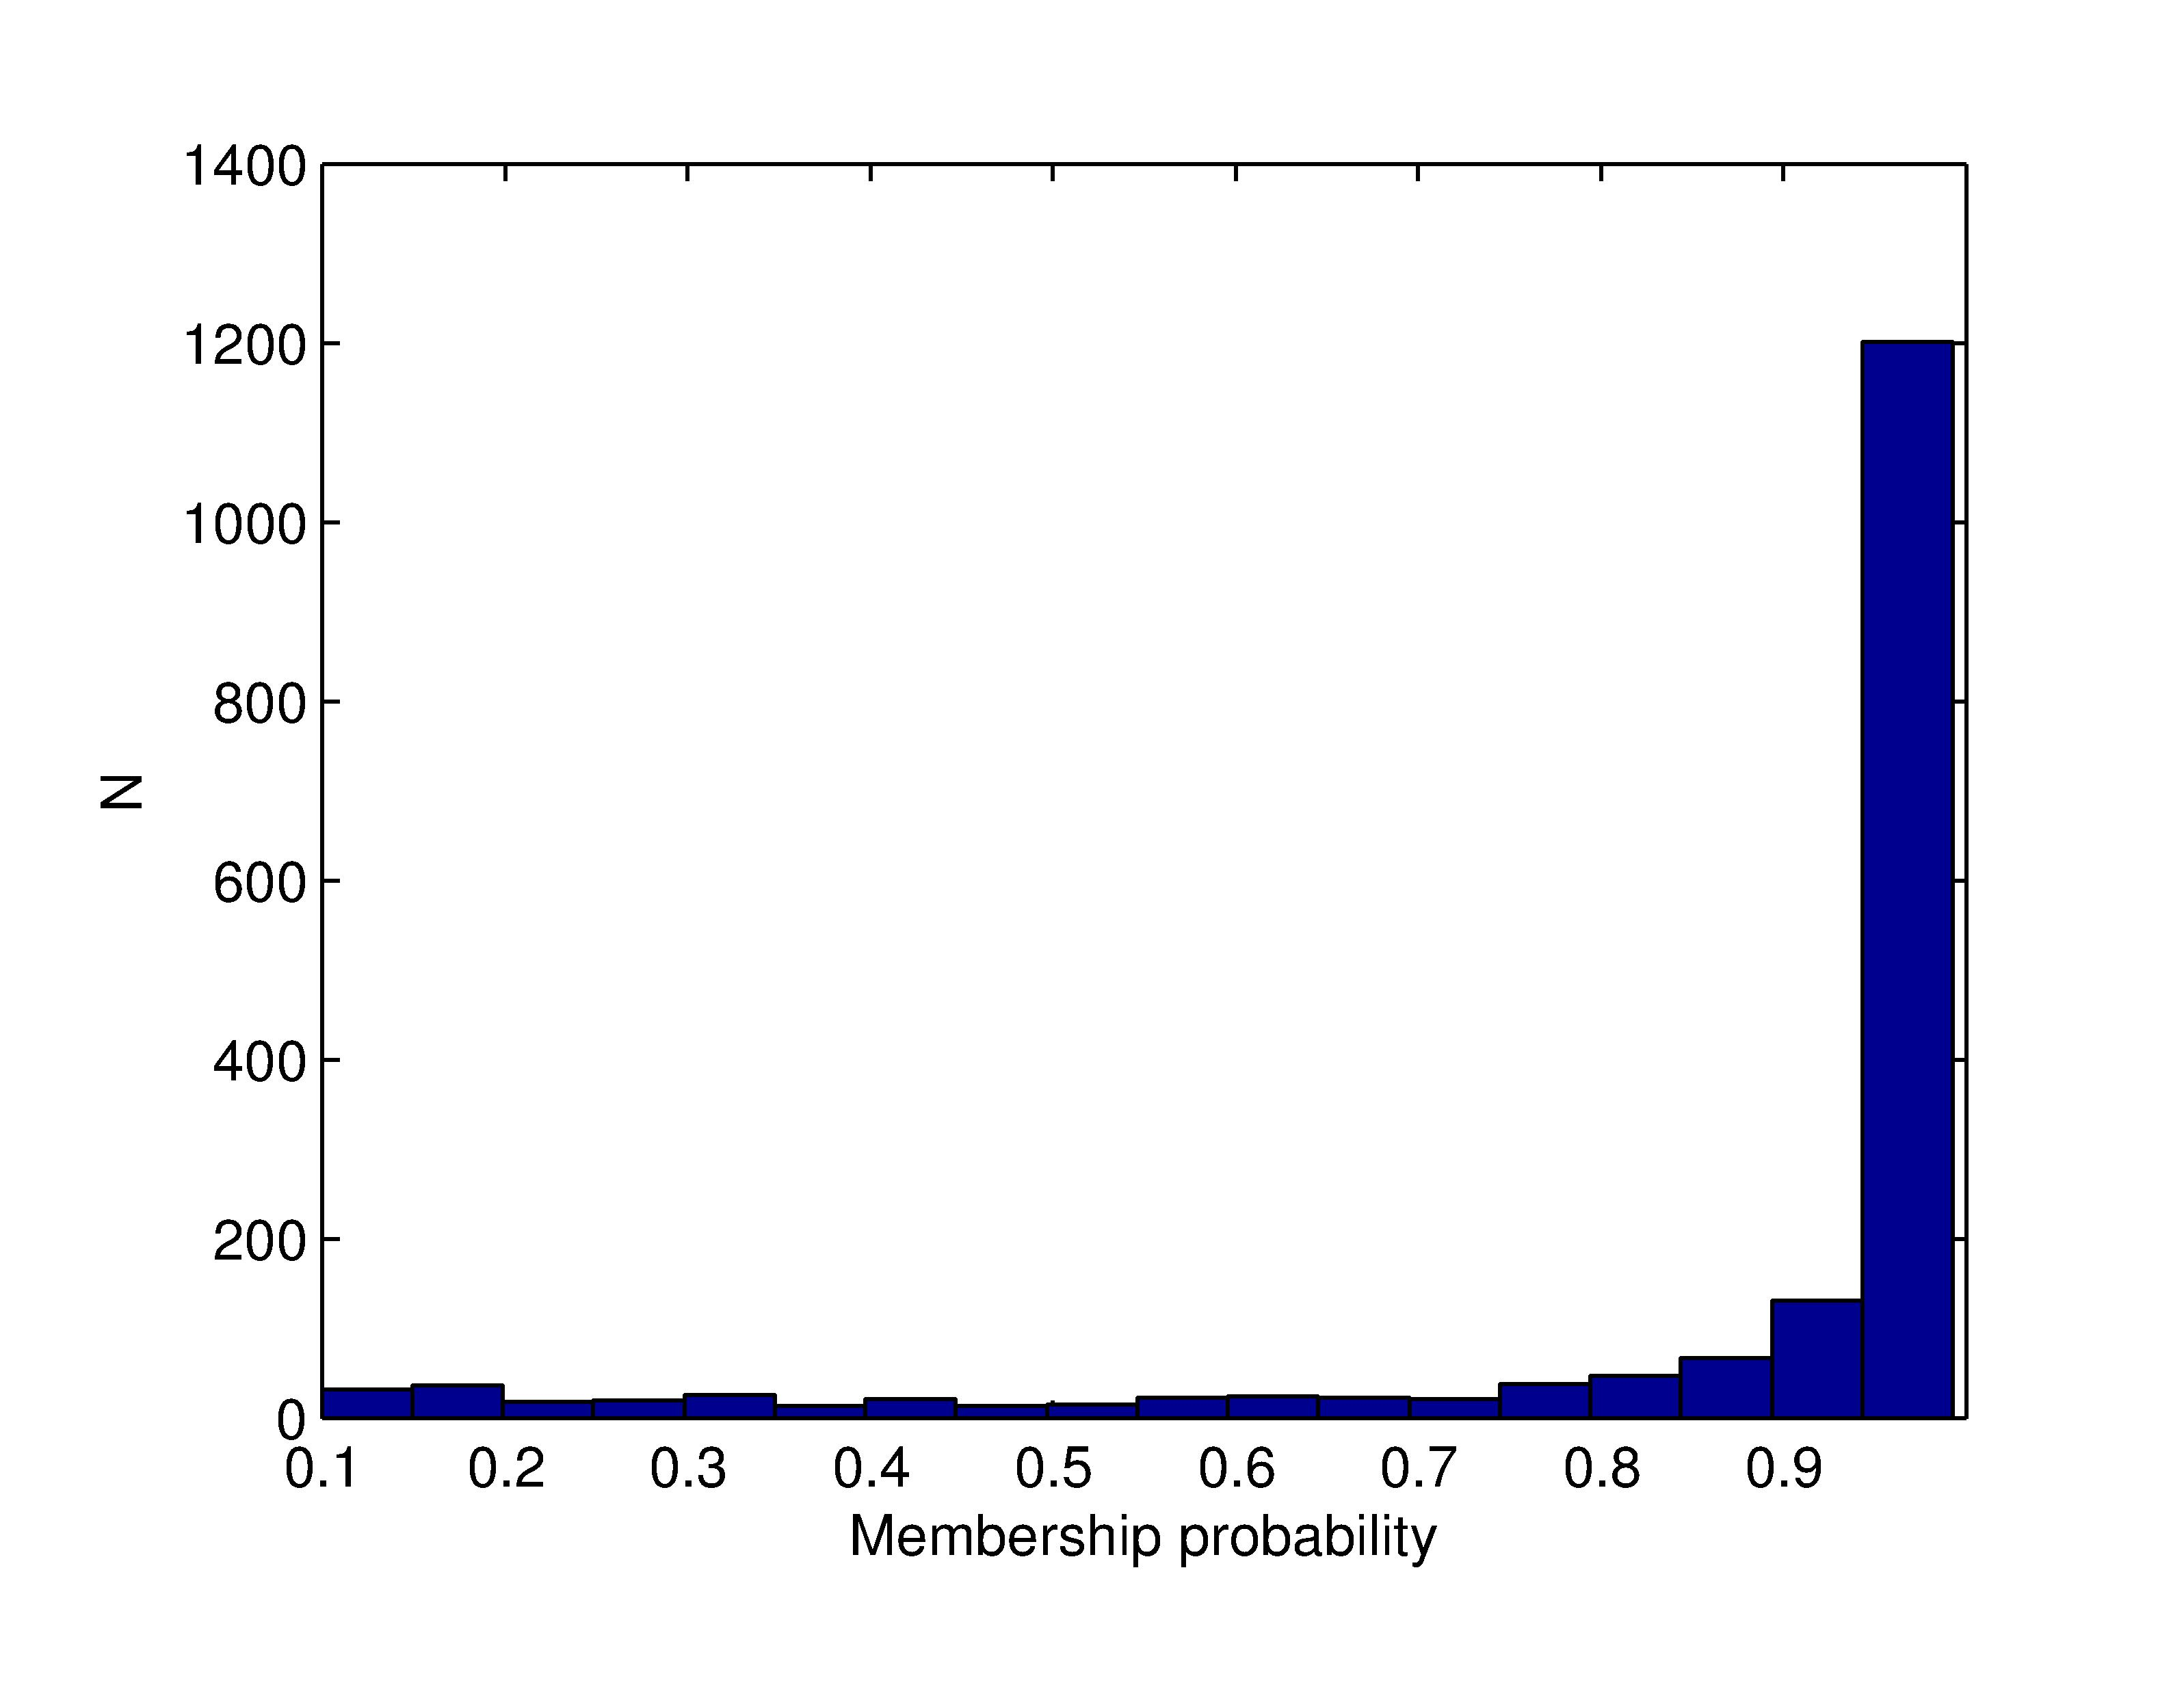
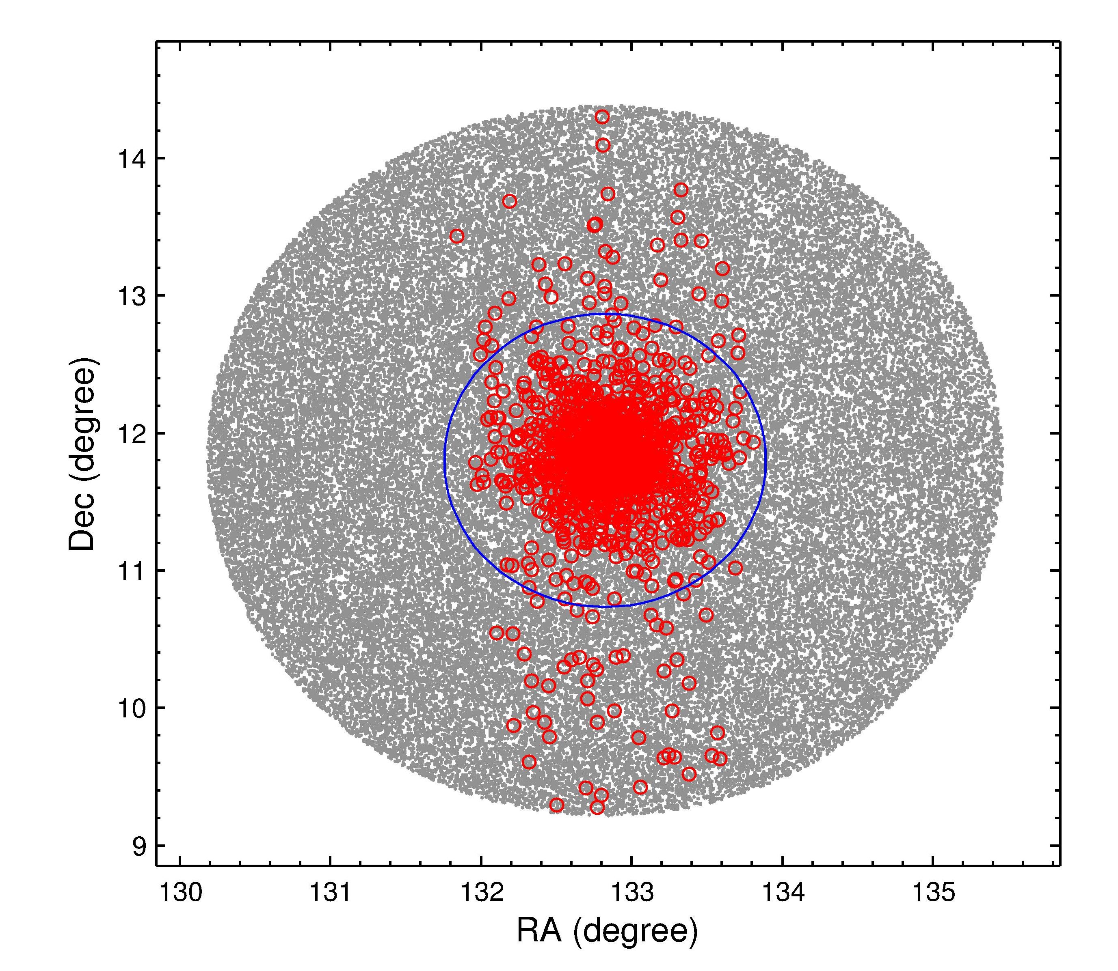
天文应用：疏散星团成员星的认证
高斯混合模型应用结果
Notes:
Here I’m showing some data to cluster
Let’s say high-D data, but projected it down to 2 most important dimensions for clustering
It’s obvious to us even with 2-D projection that red points shouldn’t be in same cluster
But, standard clustering algorithm like GAC needs to compare these using all dimensions of the data
However, different story for the blue points.
Here, using the projection, we don’t know if they are in the same cluster.
We’d want to use the high-D metric to determine if there should be clustered together or apart.
We can encode exactly this type of information in an overlapping clustering of the data created by the inexpensive distance metric

Slide 24
1. 介绍
3
2. 天文应用：疏散星团成员星的认证
Section
3. 总结和下一步计划

Slide 25
3. 总结
1 什么是计算机视觉
总结与下一步计划
机器学习的结果还是不错的。
聚类是主观的
不同数据适用不同的聚类算法
天文大数据的机器学习是昂贵的

Slide 26
4. 下一步计划
1 什么是计算机视觉
总结与下一步计划
基于大数据的机器学习算法
基于神经网络的聚类算法
基于Web的机器学习操作

