Slide 1
Wide binaries in Gaia DR2
虚拟天文台与天文信息学2020年学术年会
Dan Qiu (CTGU)
Haijun Tian (CTGU-CASS), Kareem El-Badry (UC Berkeley), Hans-Walter Rix (MPIA), etc.
2020-11-27

Slide 2
outline
Basic Concepts: Binaries and Wide Binaries
The Separation Distribution of Ultra-Wide Binaries Varies across Galactic Populations (Tian+ 2020)
Discovery of an equal-mass “twin” binary population reaching 1000+ AU separations (El-Badry+ 2019)
Precise Ages of Field Stars from White Dwarf Companions (Qiu+2020, submitted)
Conclusion

Slide 3
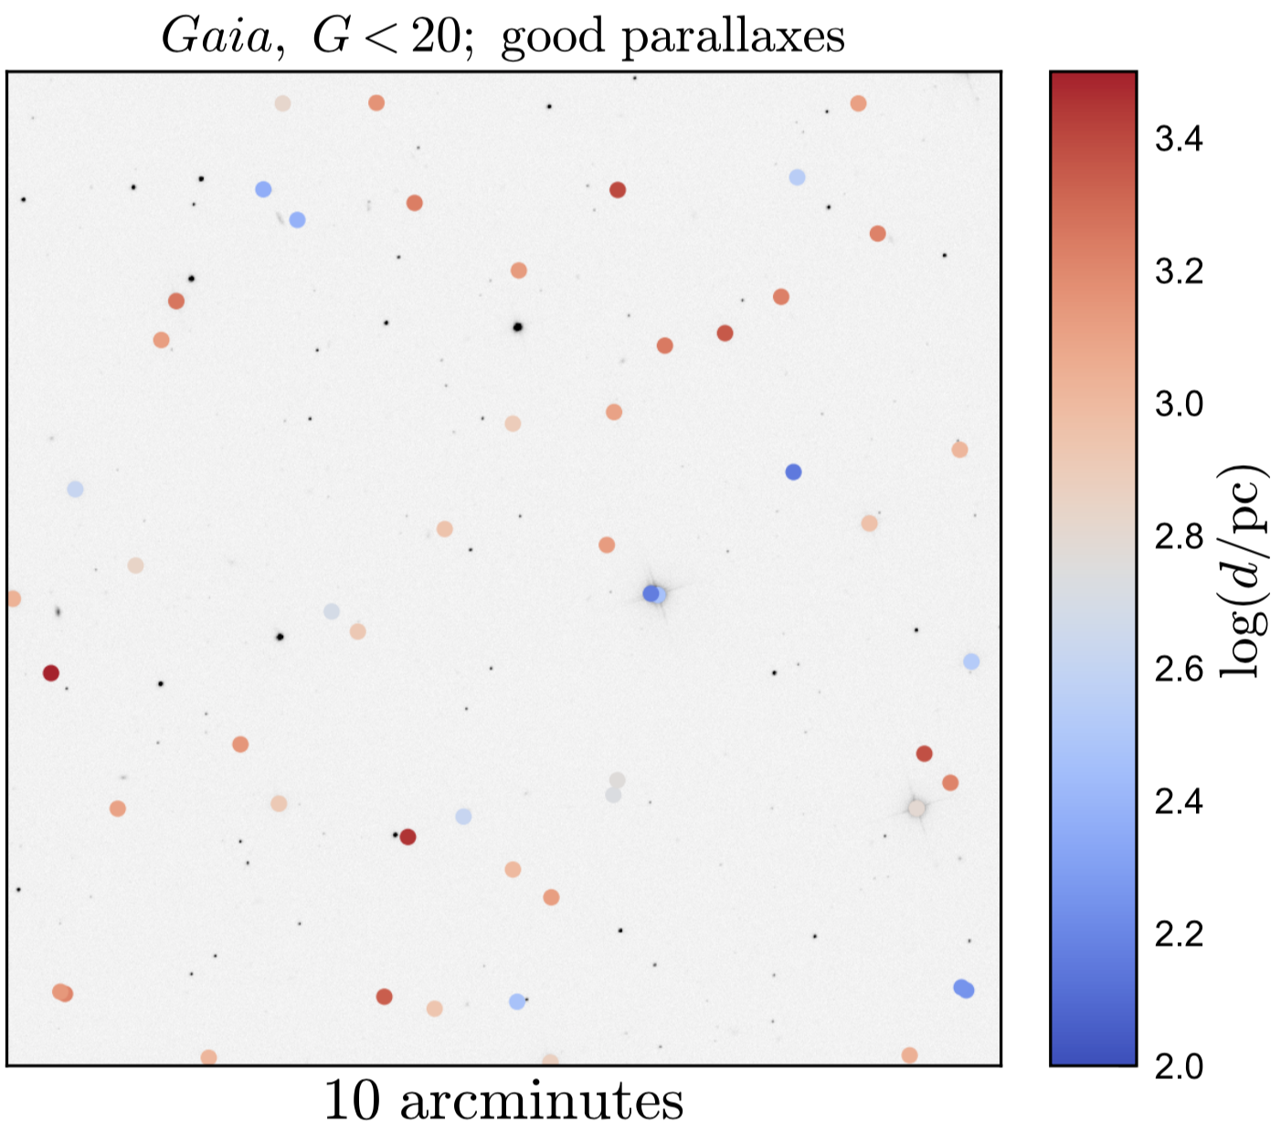
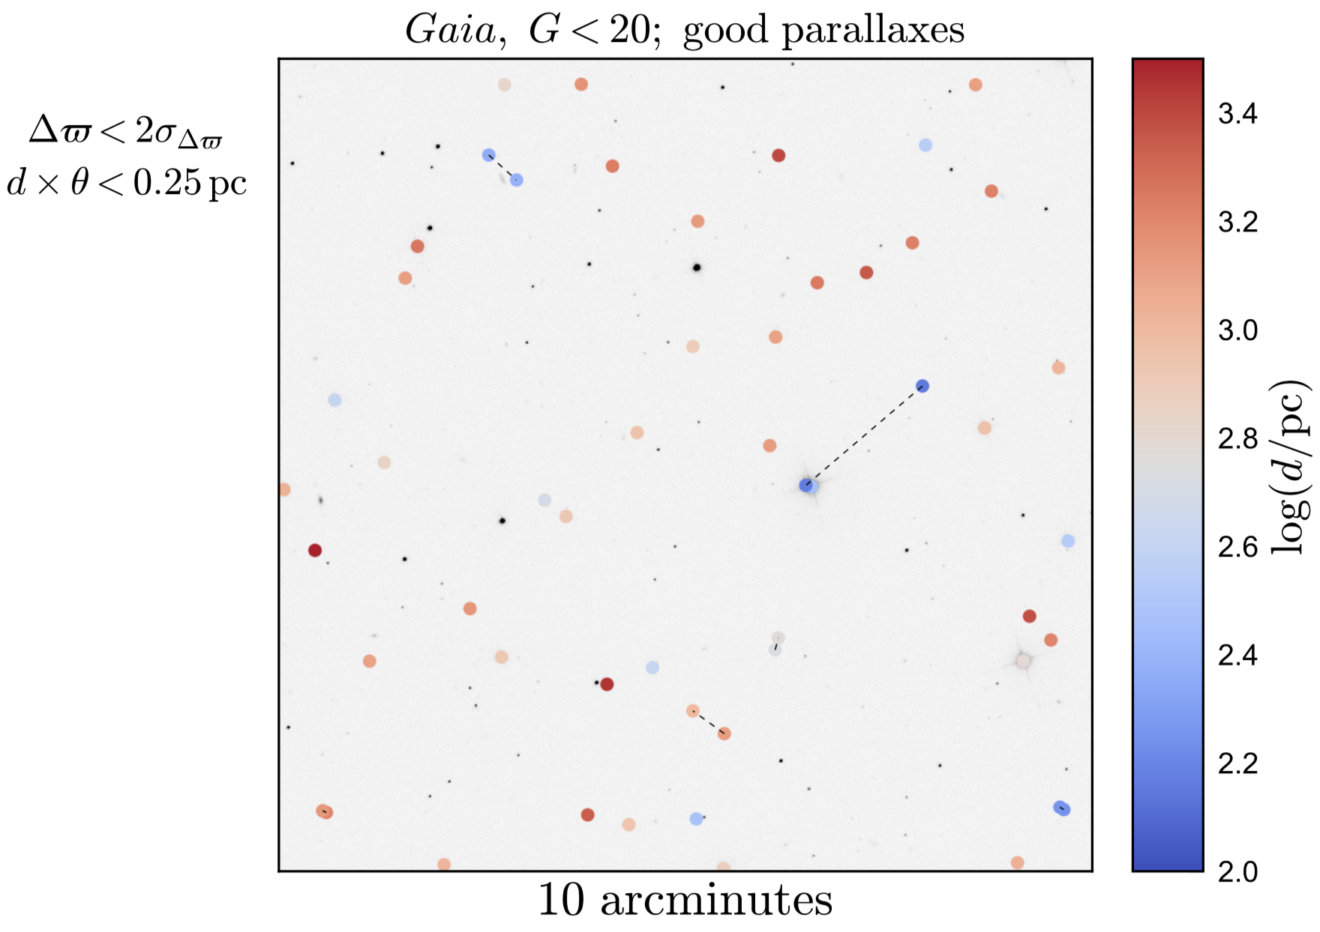
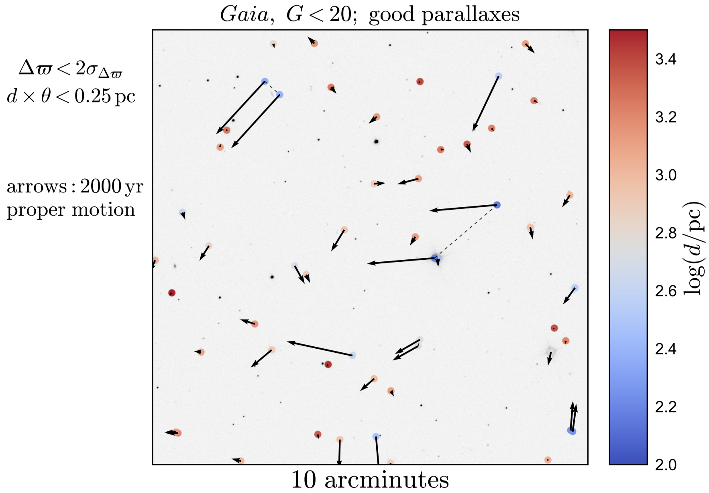
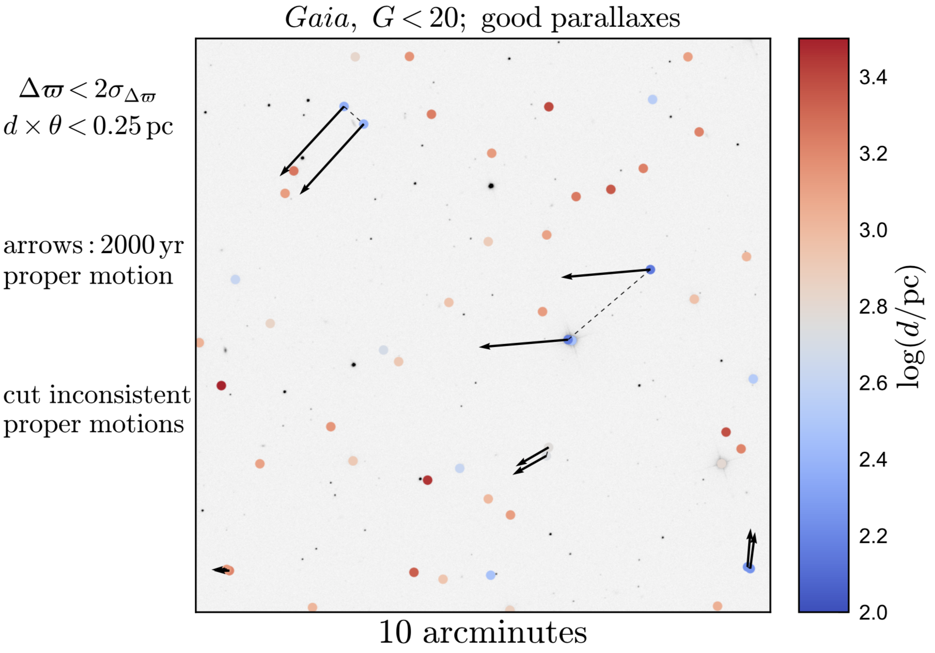
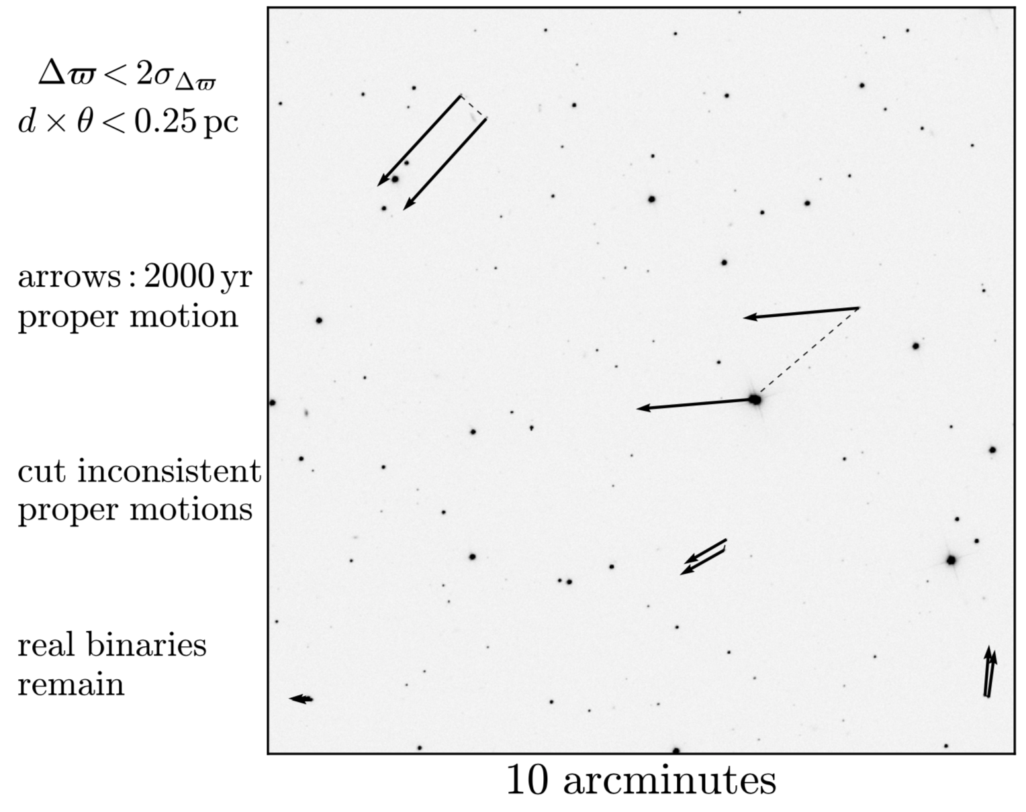
binaries

Slide 4
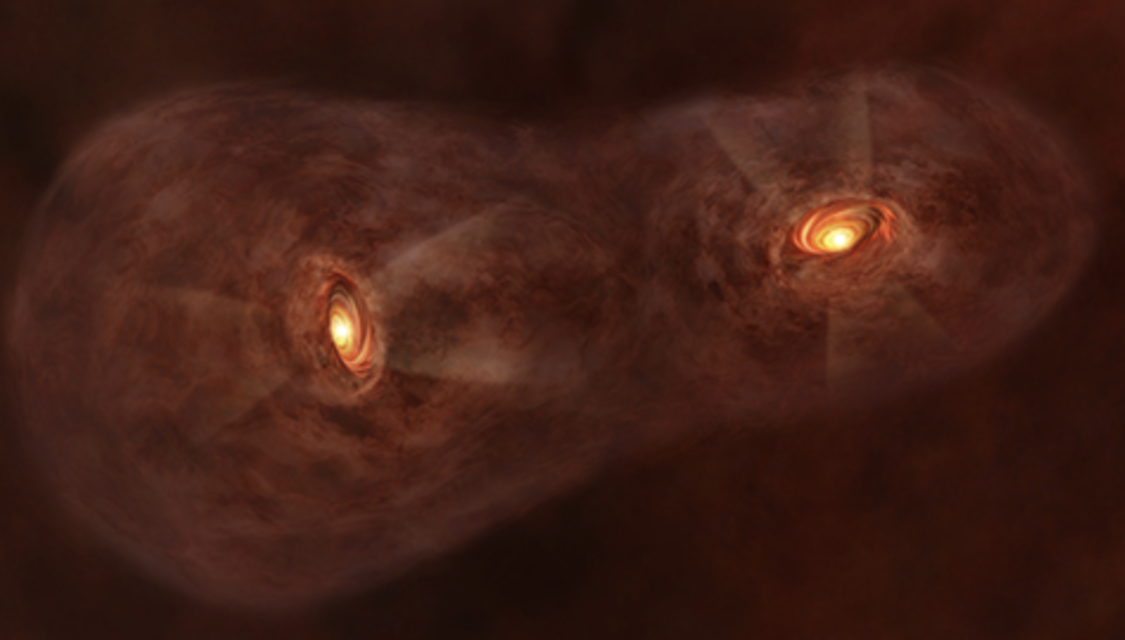
Wide binaries
(Properties)
- Same distance in uncertainty
- Co-motion (same v_los, proper motions)
- Separation s > 100 AU
- Their orbits are so fragile (v_escape<km/s), easily unbound by external perturbations, e.g., flyby stars, compact objects, even molecular clouds, or internal perturbations.

Slide 5
Wide binaries
(applications)
- Separation Distribution:
- MACHO constraint (Yoo+2004; Quinn+2009)
- White dwarf recoil (El-Badry & Rix 2018)
- Mass Ratio Distribution (El-Badry, Rix, Tian+ 2019)
- Precise stellar age determination (Fouesneau et al. 2019; Qiu, Tian, in press)
- Others: eccentricity distribution, testing gravity, abundances for white dwarf progenitors, …

Slide 6
Wide binaries
(applications: what’s MACHO)
MACHO (Massive Compact Halo Object) : one of promising candidates of dark matter.
Constraints:
- 10⁶ M⊙: destroy disk (Lacey&Ostriker 1985)
- 10^{-7.5} < M/M⊙ < 30: microlensing (MACHO: Alock+2001; EROS: Afonso+2003)
- M < 10^{-7.0} M⊙: evaporated away in Galactic time scale
- > 43M⊙: wide binaries (Yoo+2004; Quinn+2009)
MACHO IS OVER?

Slide 7
The Separation Distribution of Ultra-Wide Binaries Varies across Galactic Populations (Tian+ 2020)

Slide 8
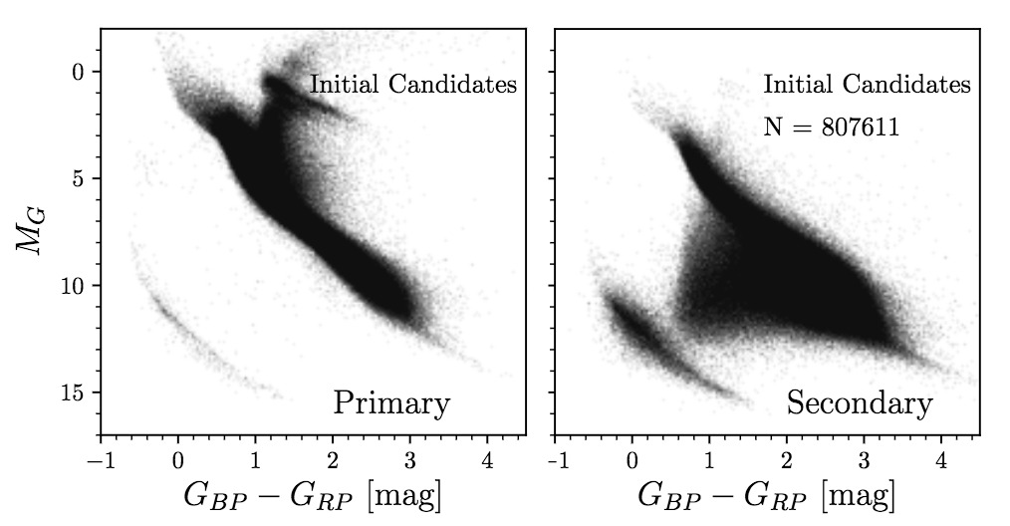
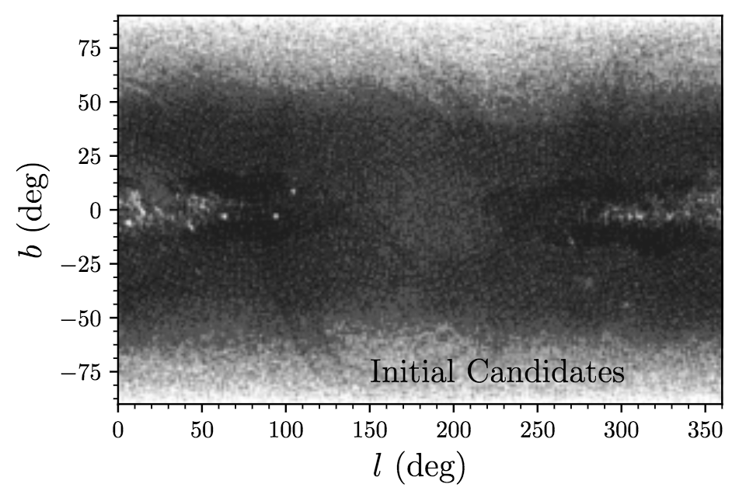
Wide binaries in Gaia Dr2
(sample selection)
General criteria for the wide binary query (proper motions, distance<4kpc, separation<1pc)
Quality cuts (astrometry & photometry)
Removing clusters, moving groups, and pairs in high density regions
==>807, 611 binary candidates

Slide 9
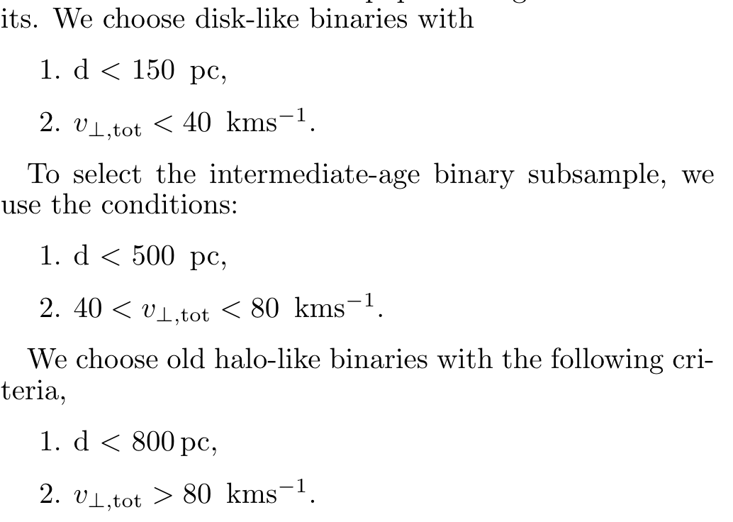
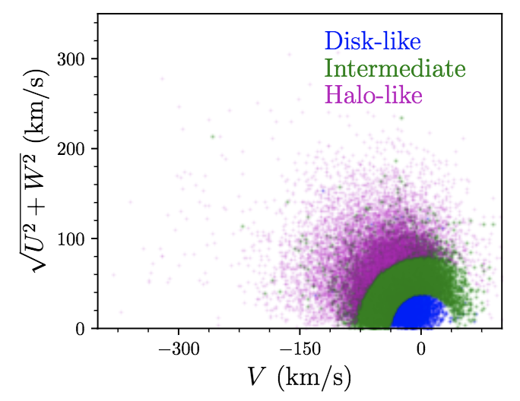
Ultra-Wide Separation Distribution
(three pure subsamples with different age)
Toomre Diagram

Slide 10
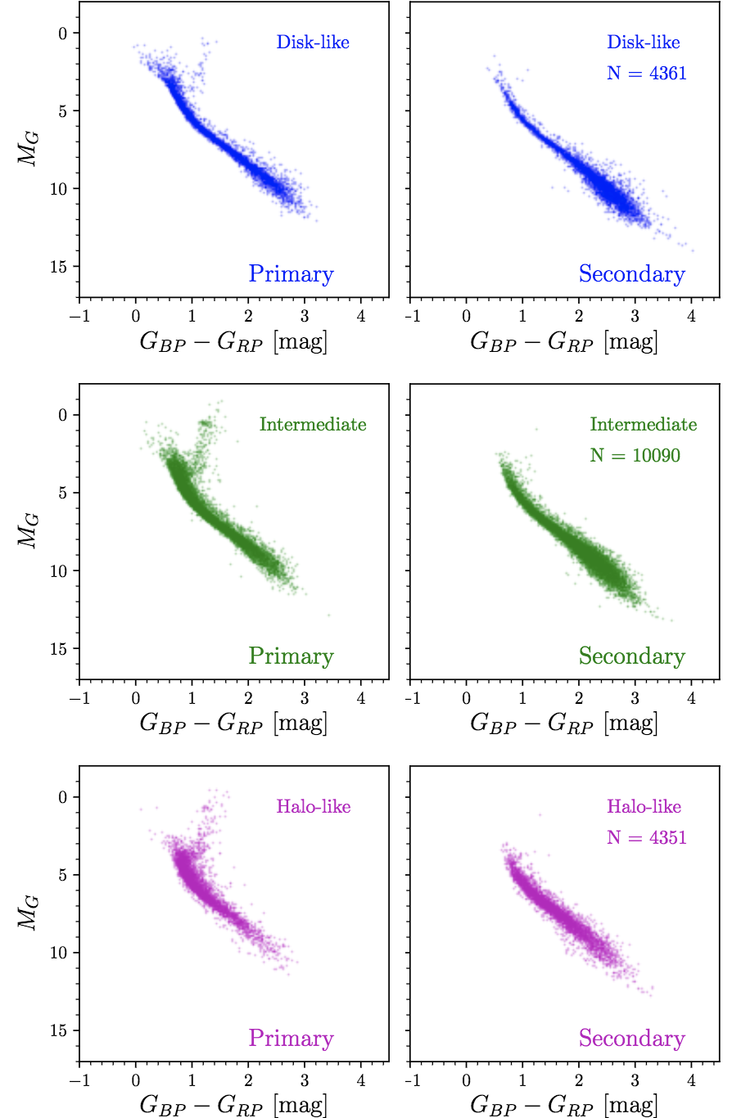
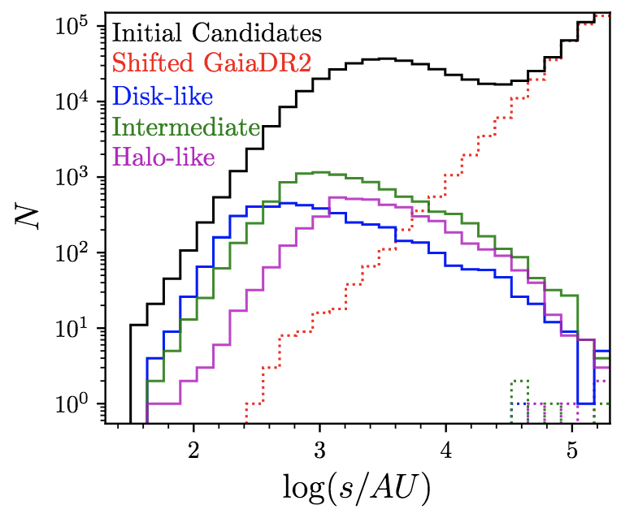
Ultra-Wide Separation Distribution
(three pure subsamples with different age)

Slide 11
Ultra-Wide Separation Distribution
(method)
Selection Function
Smoothly Broken Power Law
Likelihood

Slide 12
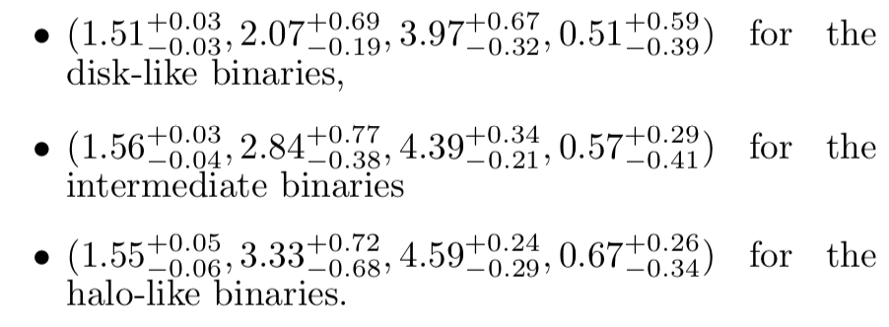
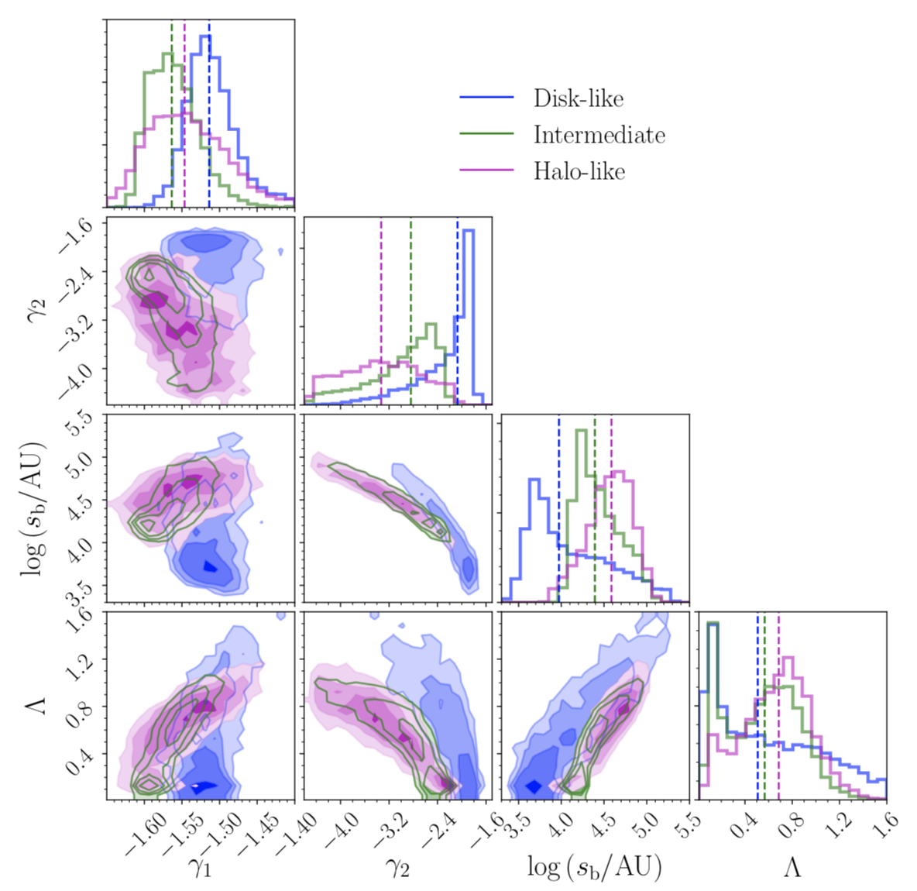
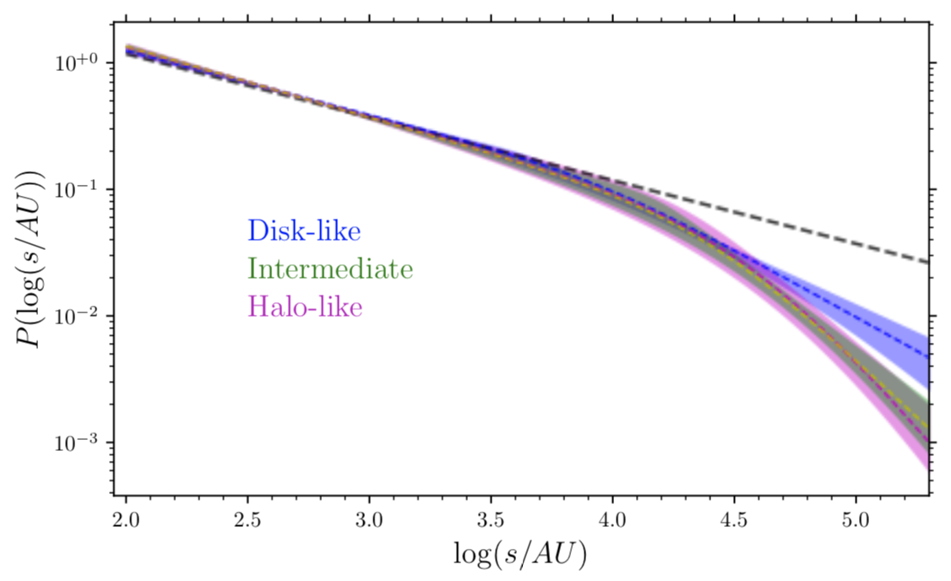
Ultra-Wide Separation Distribution
(intrinsic separation distribution)
MACHO or Intrinsically?

Slide 13
Discovery of an equal-mass “twin” binary population reaching 1000+ AU separations (El-Badry+ 2019)

Slide 14
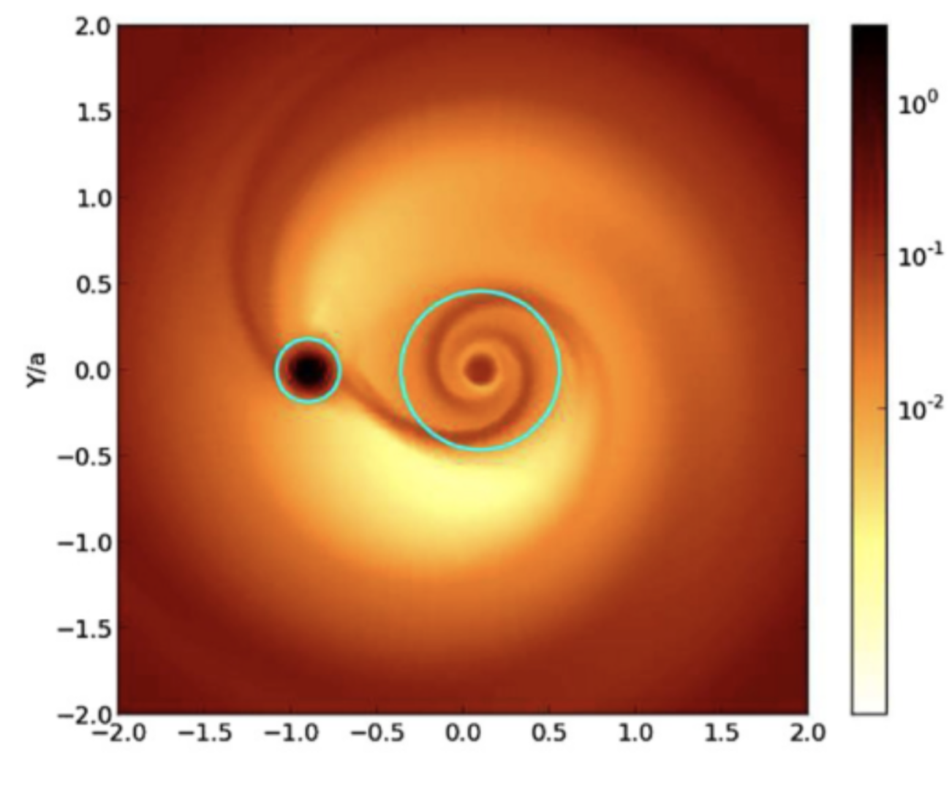
Discovery of an equal-mass “twin” binary population
(equal mass and brightness )
Formation mechanism still uncertain. Likely circumbinary disks + some kind of dynamical widening

Slide 15
PRECISE AGES OF FIELD STARS FROM WHITE DWARF COMPANIONS WITH GAIA DR2 WIDE BINARIES
(QIU+ 2020)

Slide 16
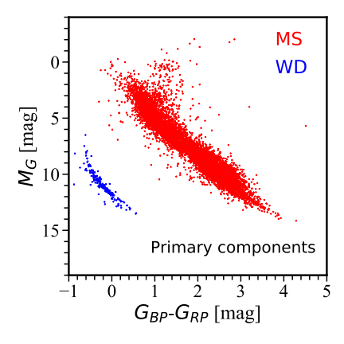
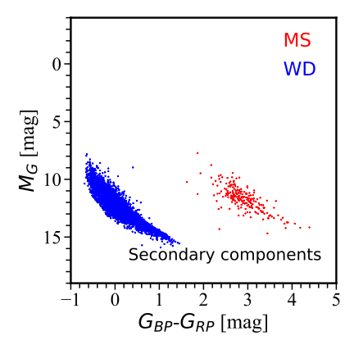
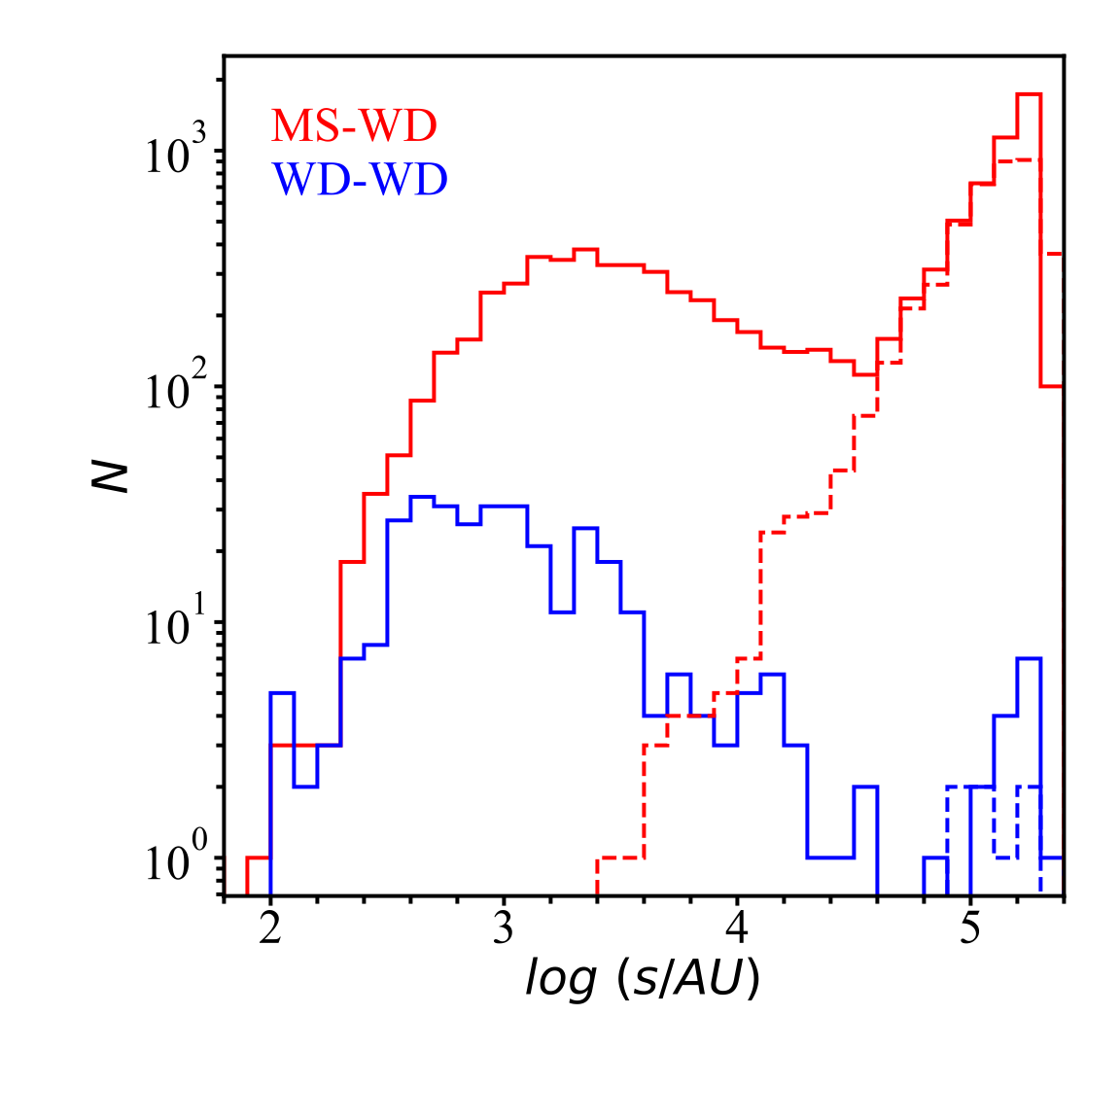
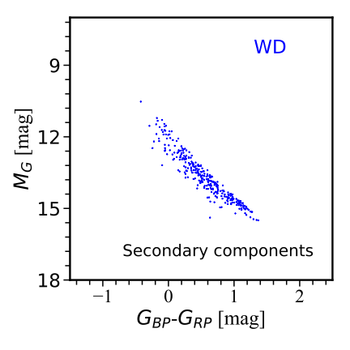
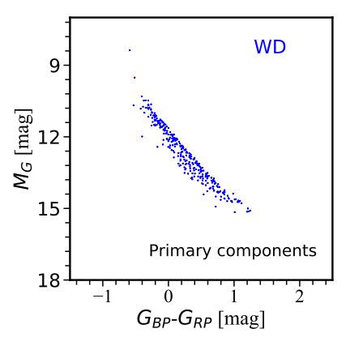
PRECISE AGES OF FIELD STARS FROM WHITE DWARF COMPANIONS
(equal age )
4050 pairs MS-WD
236 pairs WD-WD

Slide 17
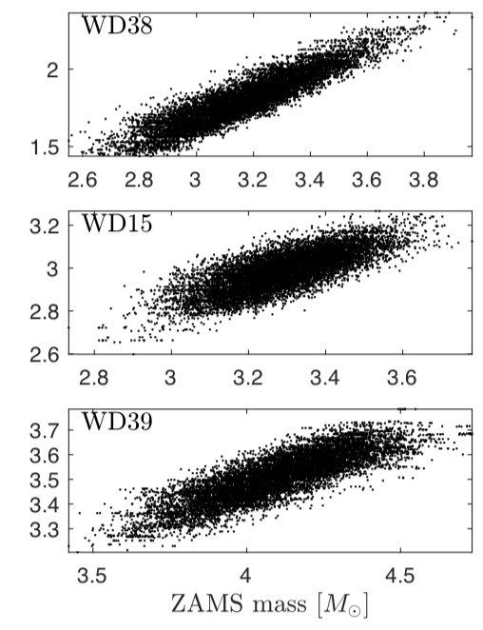
PRECISE AGES OF FIELD STARS FROM WHITE DWARF COMPANIONS
(BASE-9 )
BASE-9 serves as a flexible software package that combines stellar evolution models, an IFMR, WD interior cooling mod- els, and WD atmosphere models, with photometric constraints in a wide range of possible passbands.
Age
ZAMS

Slide 18
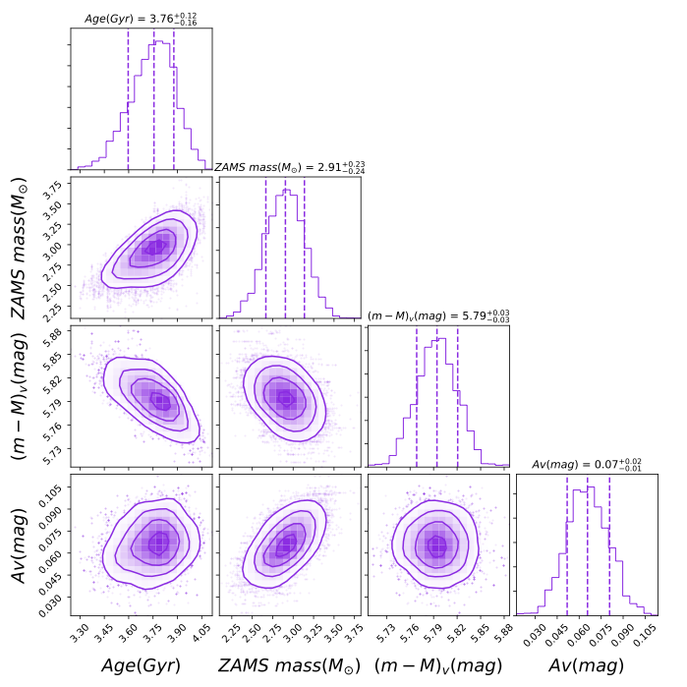
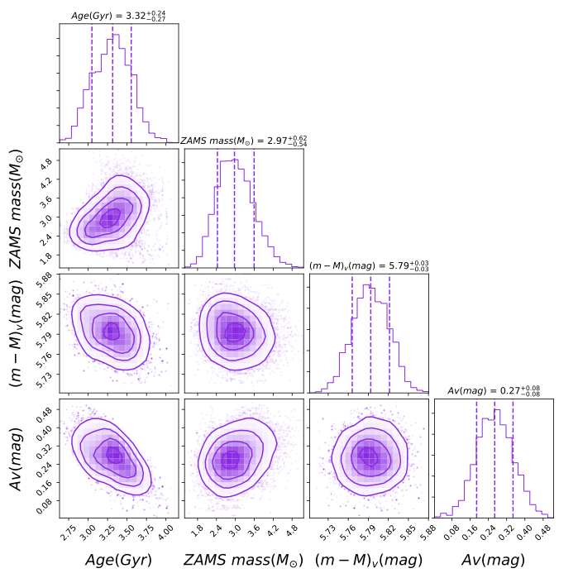
PRECISE AGES OF FIELD STARS FROM WHITE DWARF COMPANIONS
(BASE-9 )

Slide 19
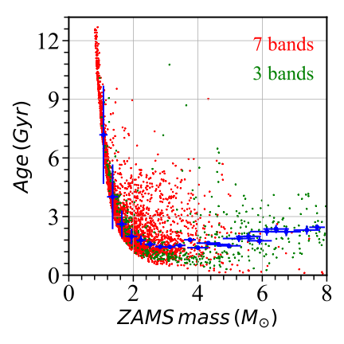
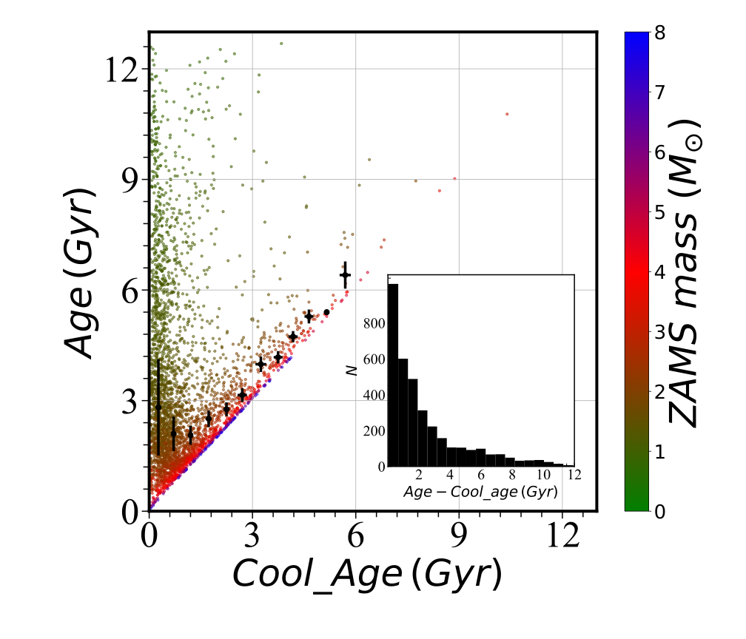
PRECISE AGES OF FIELD STARS FROM WHITE DWARF COMPANIONS
(BASE-9 )

Slide 20
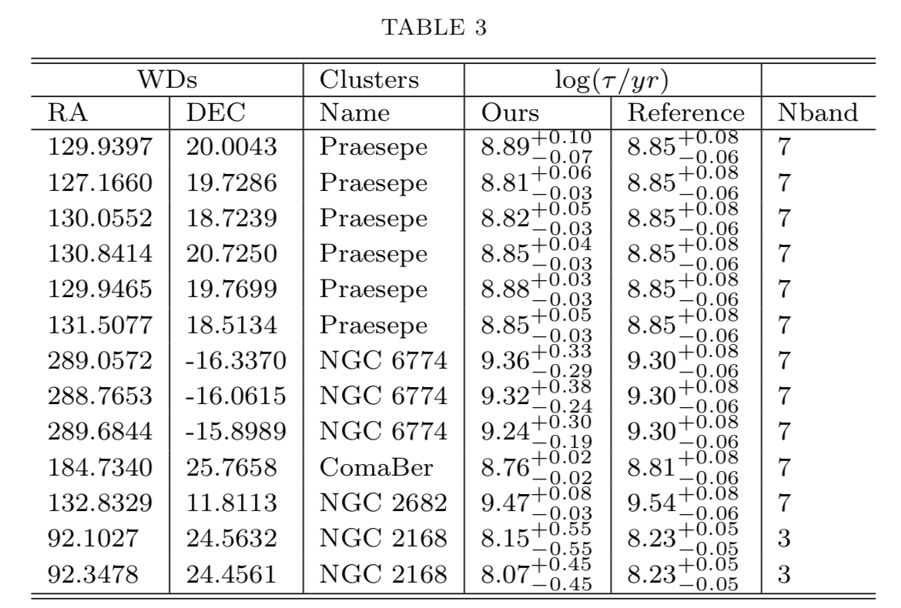
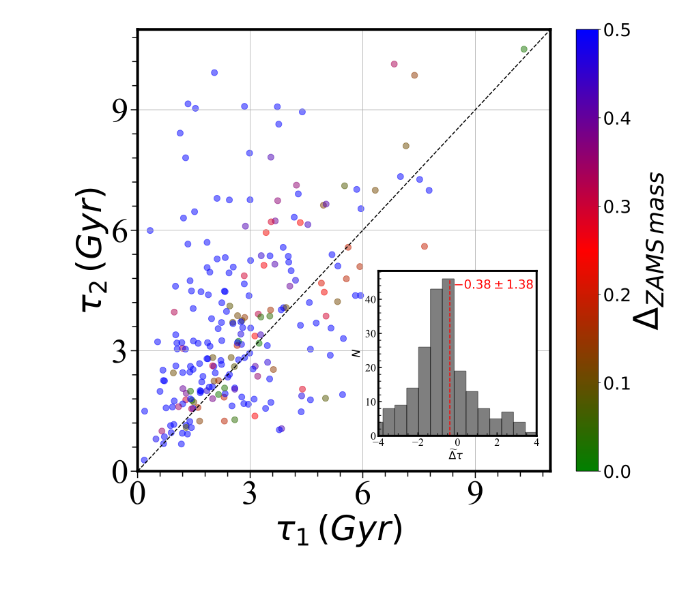
PRECISE AGES OF FIELD STARS FROM WHITE DWARF COMPANIONS
(performance )

Slide 21
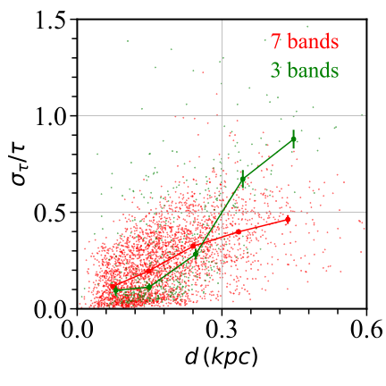
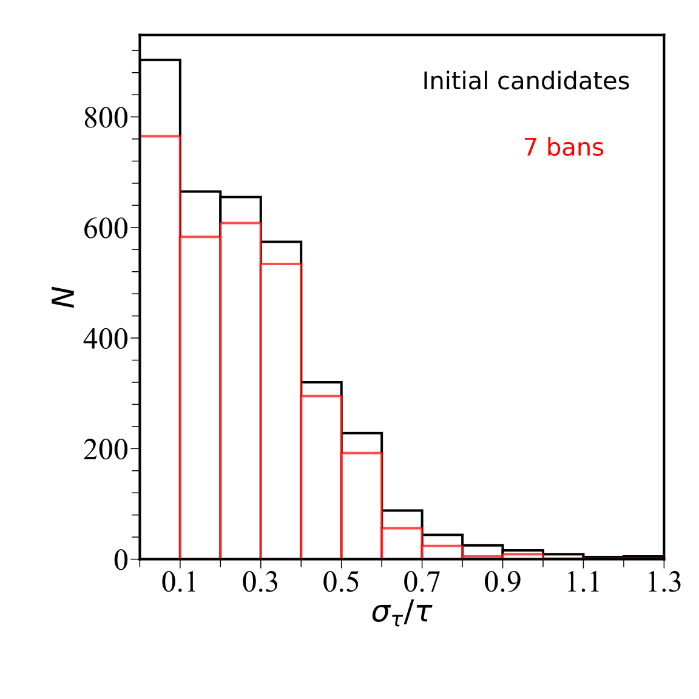
PRECISE AGES OF FIELD STARS FROM WHITE DWARF COMPANIONS
(performance )

Slide 22
conclusion
(take-to-home points)
- The Separation Distribution of Ultra-Wide Binaries Varies across Galactic Populations
· At log(s/AU)=2.5-4, a same single power law with γ ~ -1.5
· At log(s/AU)>4, a strong hit of a slope-chance across populations
· Two explanations: MACHOs, or Intrinsically?
The “twin” phenomenon is striking and unambiguous. Not limited to close binaries, but extends to 1000+ AU (mechanism still uncertain)
Release a catalog containing thousands of stars with high age precisions (<20%,Fouesneau 2019, Qiu+2020, press)

Slide 23
Thanks!

