Slide 1

Seeing at Dome A, Antarctica: automatic measurements & results
Bin MA
(NAOC)
2020-11-26 @ Xiamen

Slide 2
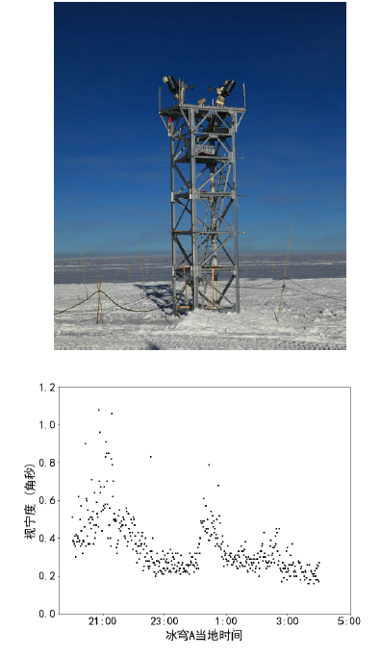
outline
1 Introduction
2 KL-DIMM for Dome A
3 Operations of KL-DIMM
4 Seeing results from Dome A
5 Summary

Slide 3
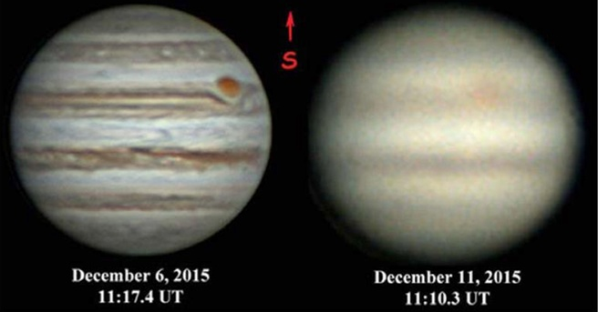
1 Introduction
good <== seeing ==> bad
Seeing: a key parameter in site-testing
The best mid-latitude sites: 0.6 – 0.8”
Turbulence in the atmosphere
  Boundary layer (BL)
  Free atmosphere
Antarcitca: thin BL
Dome C:
  BL thickness ~ 30 m
  seeing obove BL ~ 0.3”
britastro.org
Marks+1999
boundary layer
free atmosphere

Slide 4
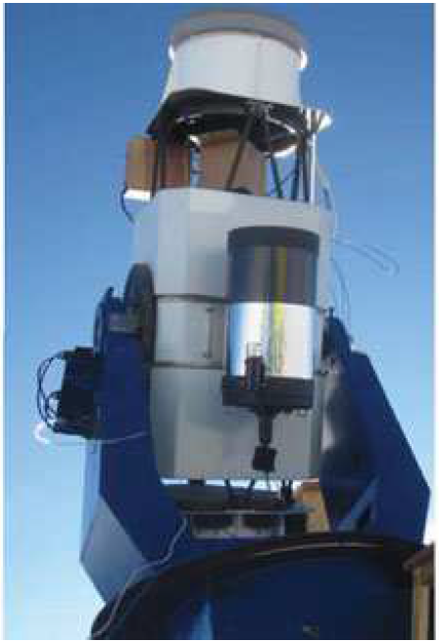
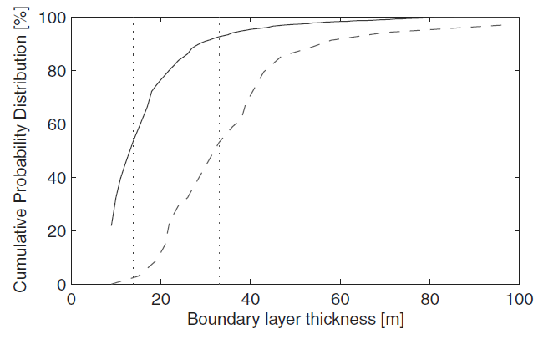
Dome A (Kunlun Station)
credit: Dome C group
the highest point (4093 m) in Antarctic plateau
  BL thickness ~ 14 m by Snodar
  yet only daytime seeing:
  median 0.8” @ 3 m by
  DIMM (Differential Image
  Motion Monitor)
Pei+2013
Dome A C
Bonner+2010

Slide 5
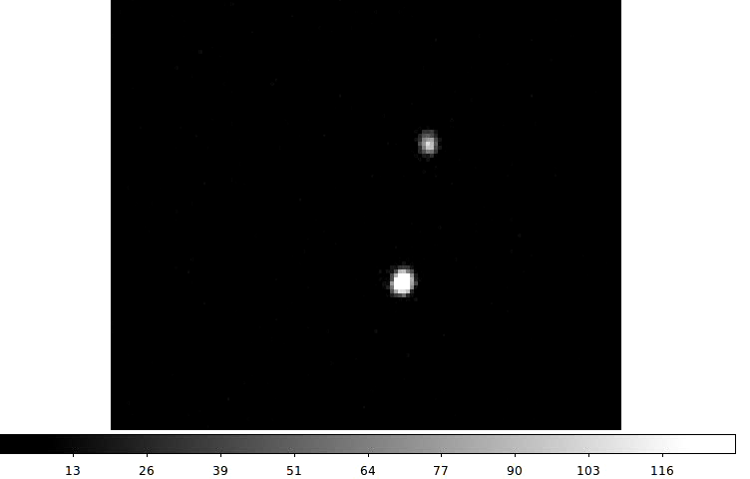
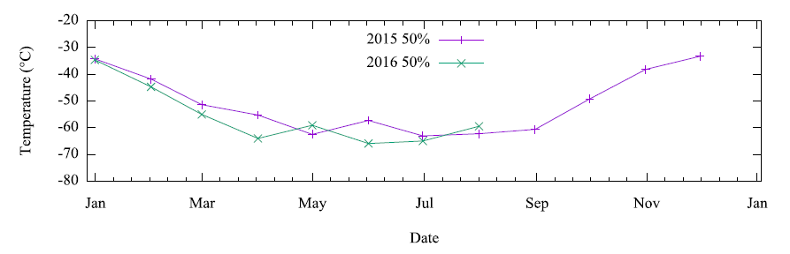
night-time seeing @ Dome A?
Challenges
  Unattended for almost a year
  Low temperature
  Limited power supply & network
  Small FoV of DIMM
  A tower for DIMM
Hu+2019

Slide 6
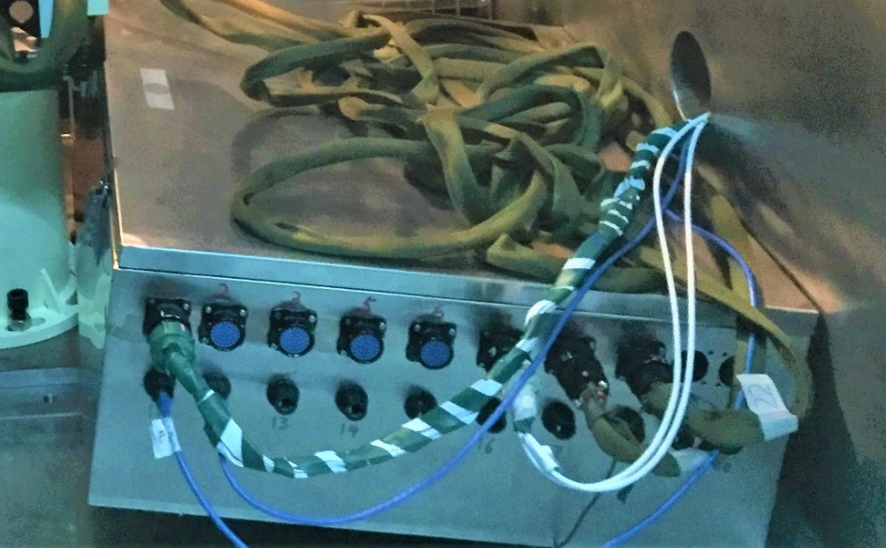
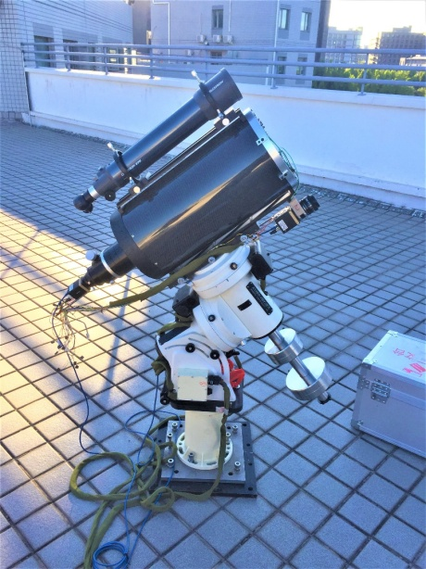
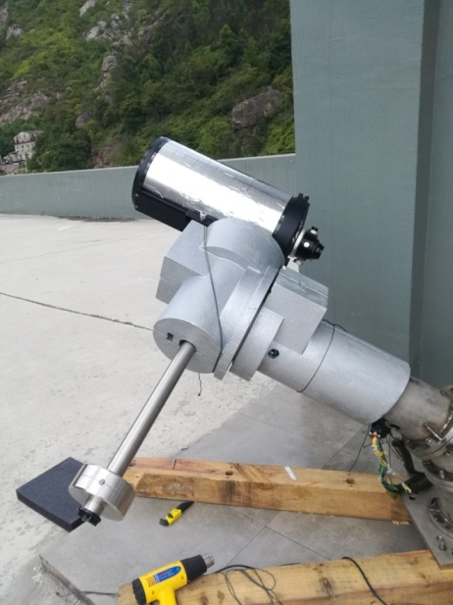
2 KL-DIMM for Dome A
KL-DIMM: the automatic DIMM
for KunLun station (ambient -80℃)
  Active thermal control for electronics
  Mechanical improvement
  two KL-DIMMs for redundancy
Tower: 8 m designed by TJU
  Logistical limit
  BL < 9 m for 25% time

Slide 7
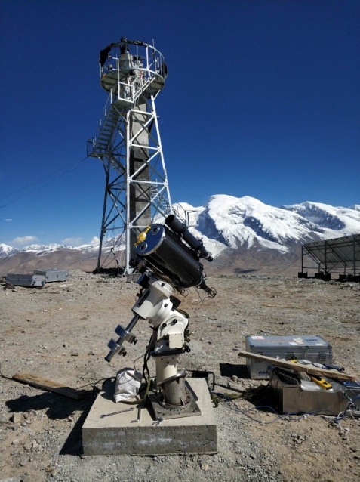
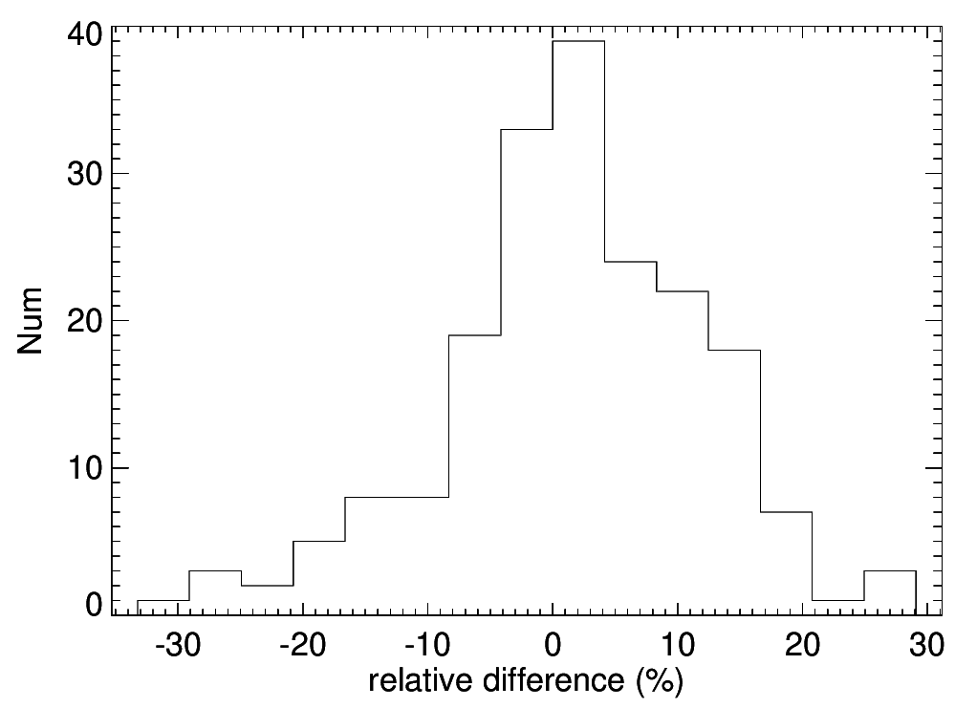
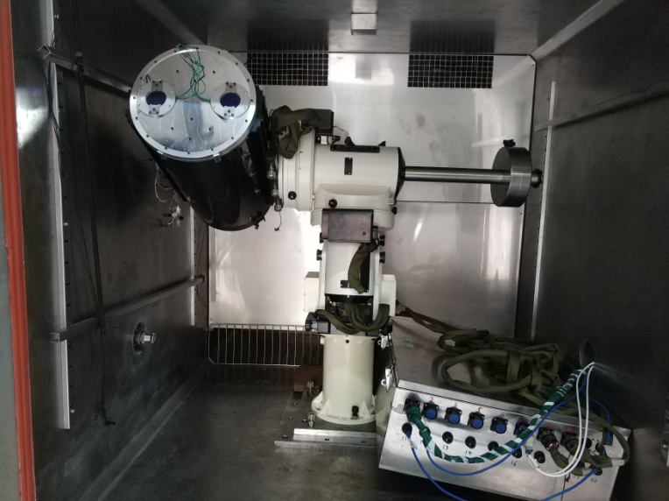
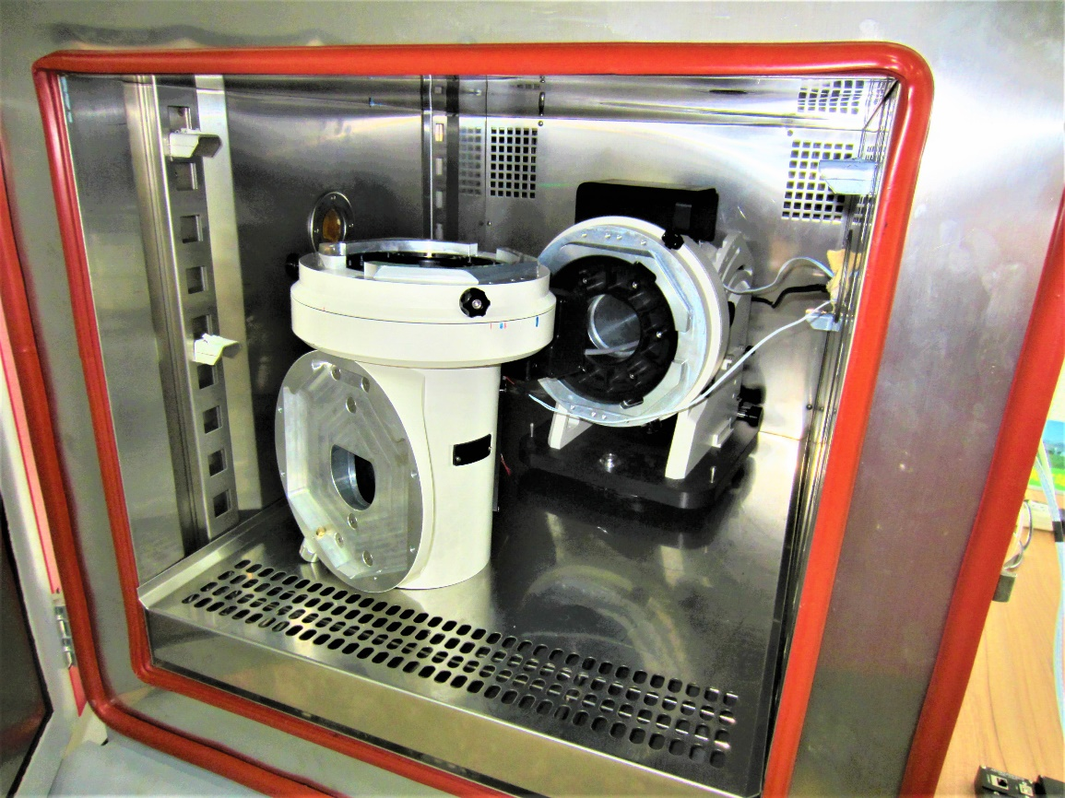
cold tests: single-part/whole system
  working/rebooting correctly at -70C
  ~100W including heaters
test obs @ Muztagh Ata: seeing precision ~ 10%
low temperature chamber @ NIAOT

Slide 8
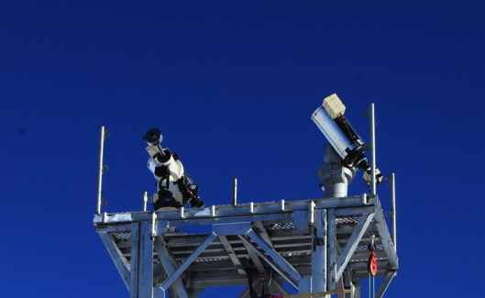
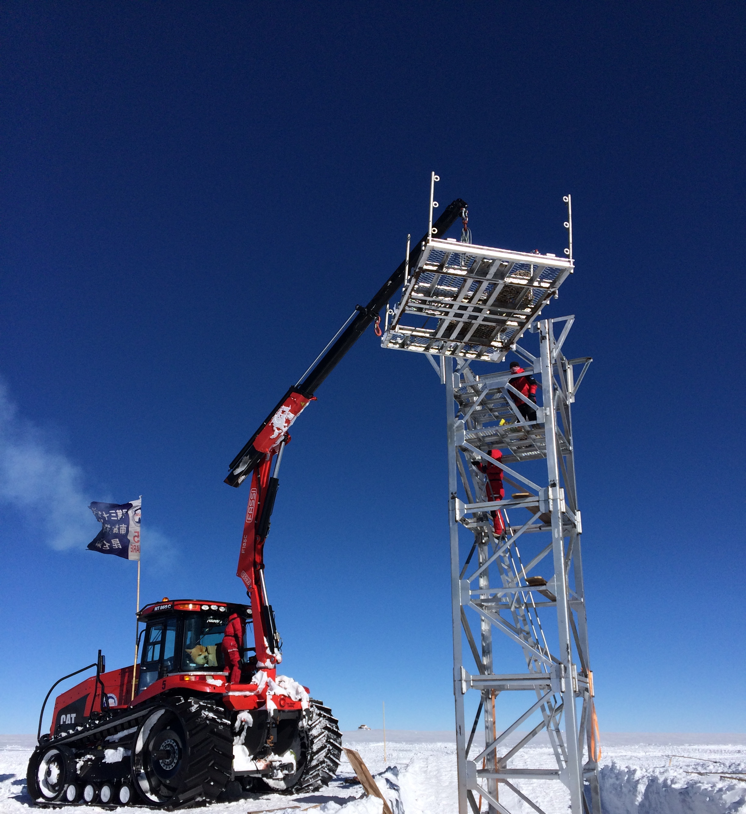
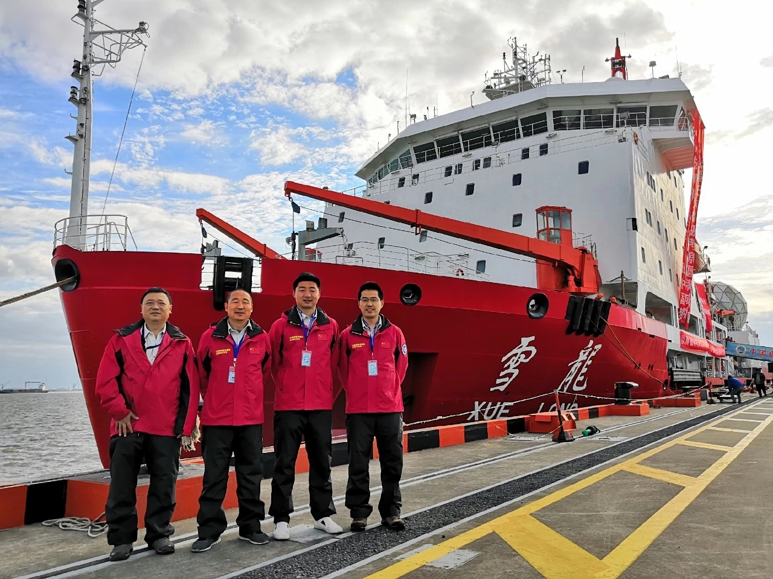
2 KL-DIMMs were installed at Dome A in 2019
2 members from NAOC + help from
another 2 astronomers
+ the traverse team
supported by PLATO-A

Slide 9
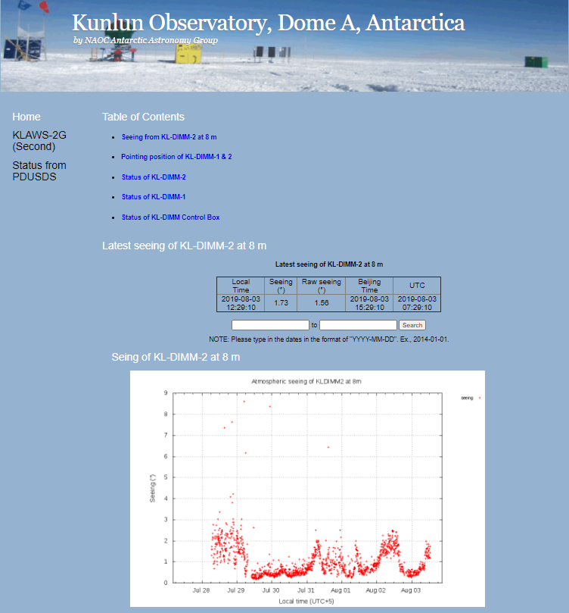
3 Operations of KL-DIMM
in-situ work
  installation
  rough polar alignment
  searching the target
fully automatic observation
data processing in real-time
seeing results were sent back
every 30 min, and shown in website

Slide 10
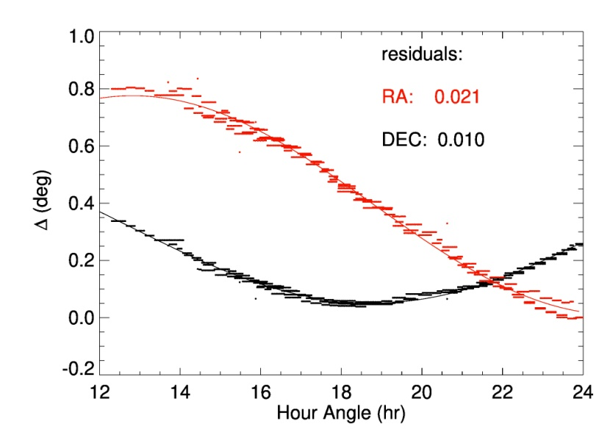
software system
experience from Antarctic Survey Telescopes (AST3)
hardware control
  telecope, camera, heaters, sensors ...
observation flow:
  pointing correction
  imaging & close-loop tracking
  short-exposure sequence
  real-time data analysis
  transfering results to Beijing
polar misalignment:
<0.3 deg in left-right
<0.1 deg vertically

Slide 11
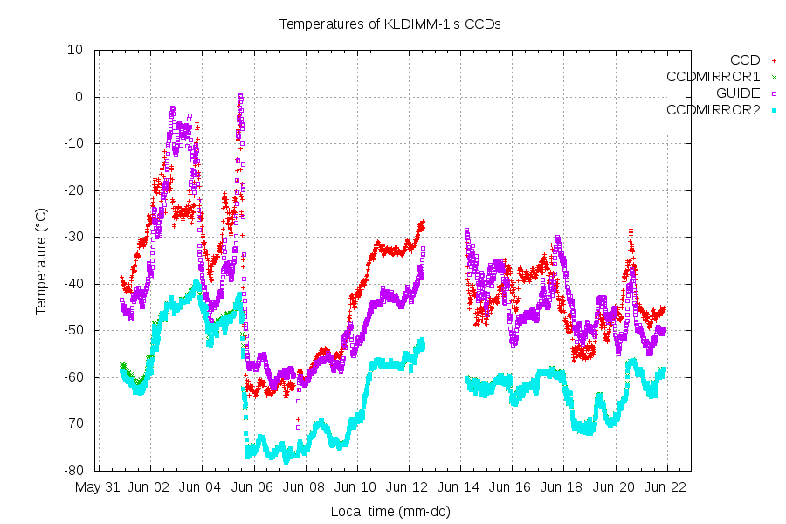
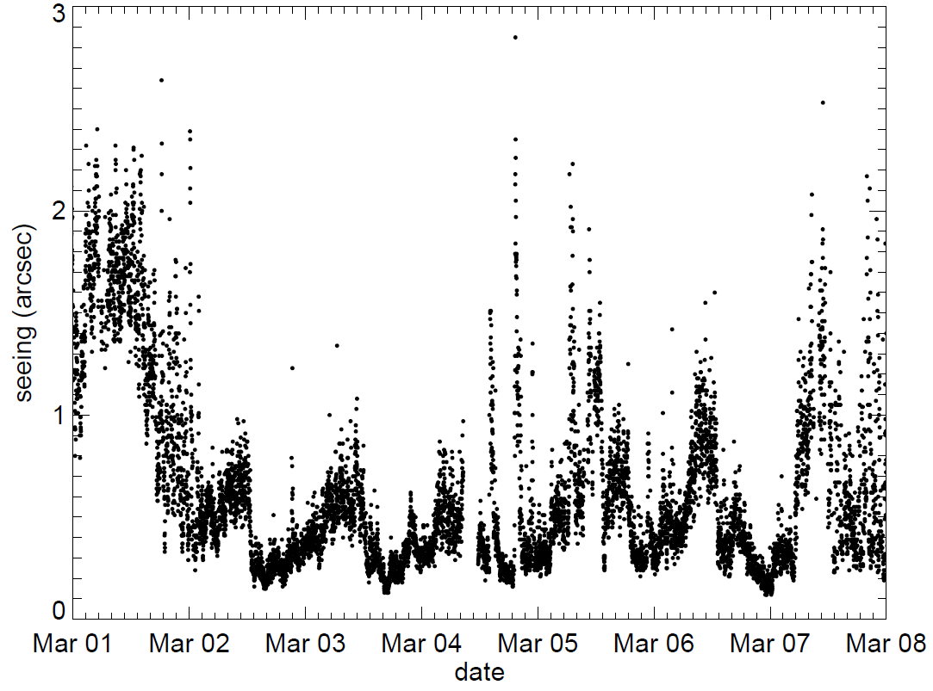
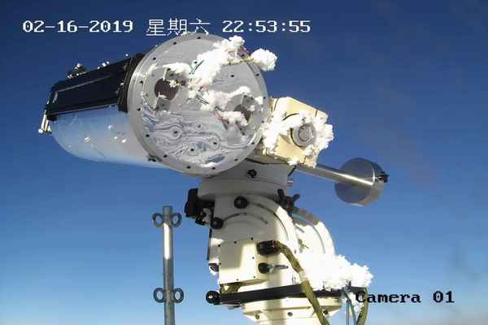
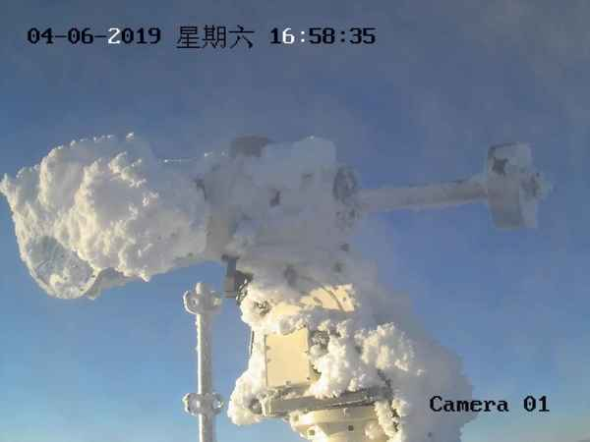
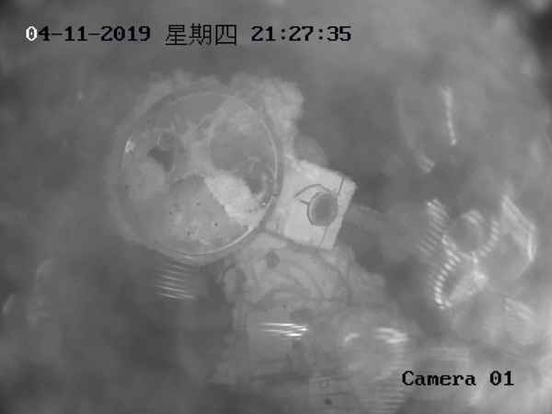
KL-DIMM2 functioned well, while
KL-DIMM1 had some issues
special issue at Dome A:
de-icing by ITO heating
first DIMM operations in the winter at Dome A
working well even T < -75℃
7 x 24 hr operation

Slide 12
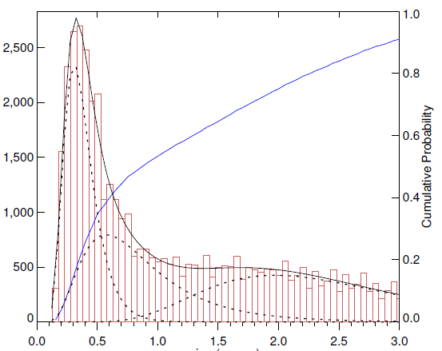
4 Seeing results from Dome A
April - Aug 2019
histogram of night-time seeing:
a sharp peak (<0.5”) + a long tail (up to >3”)
log-normal distribution in mid-latitude sites
2 or 3 log-normal components in Antarctica
Dome C
Aristidi+2009
Dome A
Ma+2020
Muztagh Ata
Xu+2020

Slide 13
Number
the 3 components in the histogram:
FA, BL & intermediate seeing
caused by the variation of BL thickness
at just 8 m, FA seeing was obtained for 31% of the time, when the median was 0.31”
Snodar: BL < 9 m for 25% time
Ma+2020
Seeing (”)
FA ~ 0.3”
8 m
boundary layer
---> time

Slide 14
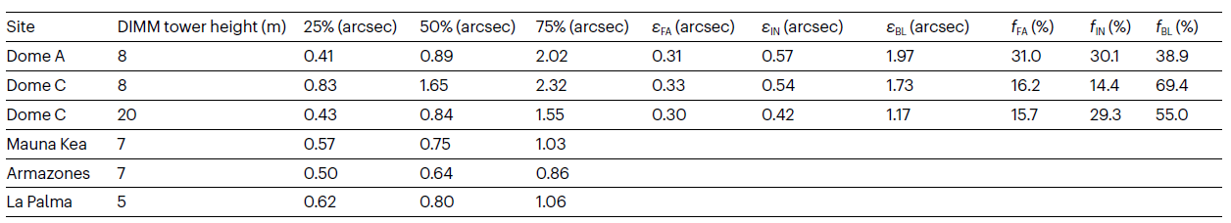
Dome C
Aristidi+2009
Dome A, 8 m
Ma+2020
the seeing could be improved on a higher tower:
more FA seeing, smaller BL seeing

Slide 15
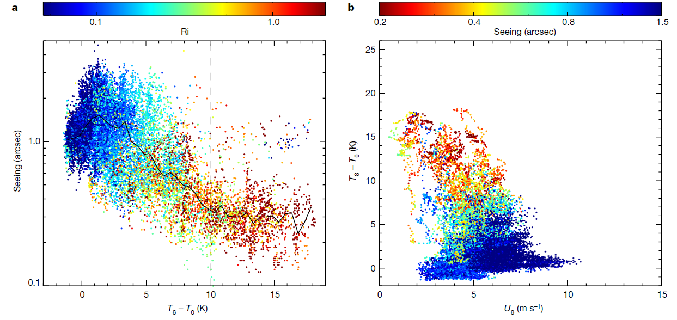
KLAWS: weather data on multi-heights between 0 - 14 m
simultaneous operations: Jan - March
larger temp gradient => thinner BL
winter data in 2015: 50% time when h_{BL}<14 m
Ma+2020

Slide 16

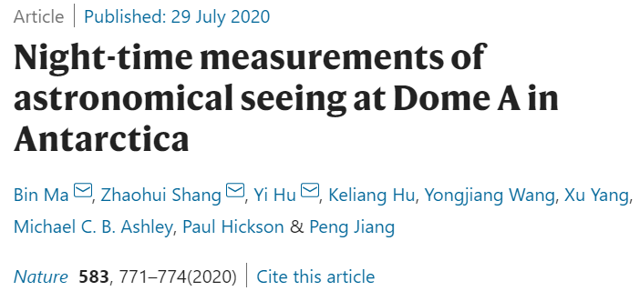
5 Summary
KL-DIMM: successful operations @ Dome A
  -75℃ & fully automatic
  could be used for other sites
direct measurements prove the superb seeing @ Dome A
with many other advantages (Shang 2020 RAA), Dome A is potentially the best optical/IR/THz site on the earth

Slide 17
Thank you！
acknowledgement
the Chinese Antarctic expedition team
Dr Z. Li, F. Du, Z. Hu, T. Song, E. Aristidi and K. Agabi

