Slide 1
Mining the BIG spectral dataset of LAMOST -- Update of LAMOST data
A-Li Luo, Jian-Jun Chen, Xiao Kong, Rui Wang, Yan-Xin GuoWen Hou, Ke-Fei Wu, Meng-Xin Wang
NAOC
USTC 2020/11/26

Slide 2
Outline
The data releases of LAMOST
Footprint accumulation
Mag and Color distribution of stars in DR7
Updates of stellar parameters for DR6 (V2)
Accuracy and precision of stellar parameters
Mining the Med-Res spectra

Slide 3
The data releases of LAMOST
Phase I
DR1
DR2
DR3
DR4
DR5
Spectra: 2.2 M 4.1 M 5.8 M 7.6 M 9.0 M
Stellar 1.1 M 2.2 M 3.2 M 4.5 M 5.4 M
Parameter:
Phase II
DR9
DR8
DR7
DR6
Spectra: （Low） +0.4 M 10.6 M 9.9 M
（Med） +1.7. M 3.9 M 1.4 M
Stellar （Low） +0.3 M 6.2 M 5.8 M
Parameter: （Med） + 0.5 M 0.8 M 0.4 M
+2M ?
+1M ？

Slide 4
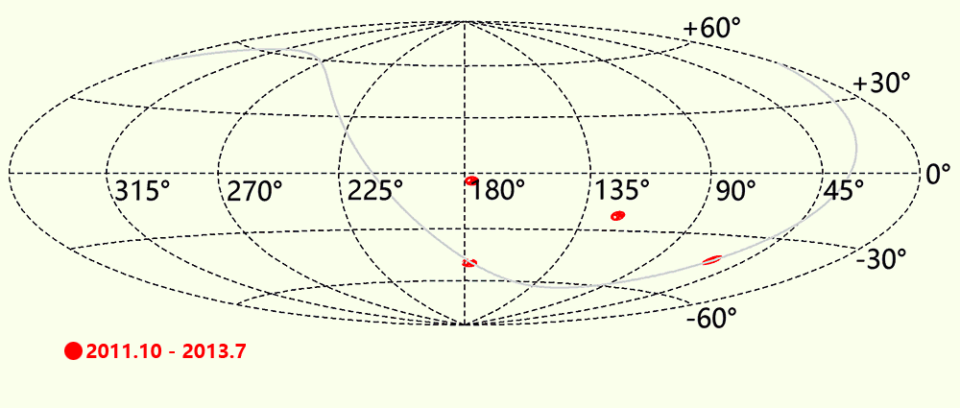
Footprint Accumulation_Low Res(DR1-DR8)
Made by Kong X

Slide 5
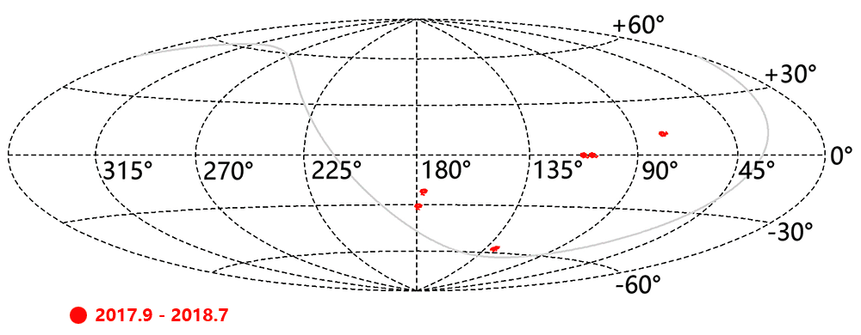
Footprint Accumulation Med_Res(DR6-DR8)
Made by Kong X

Slide 6
Distribution of S/N (DR7 low_res)
S/N>10
S/N>5

Slide 7
Distribution of color (DR7 low_res)
S/N_g
S/N_i

Slide 8
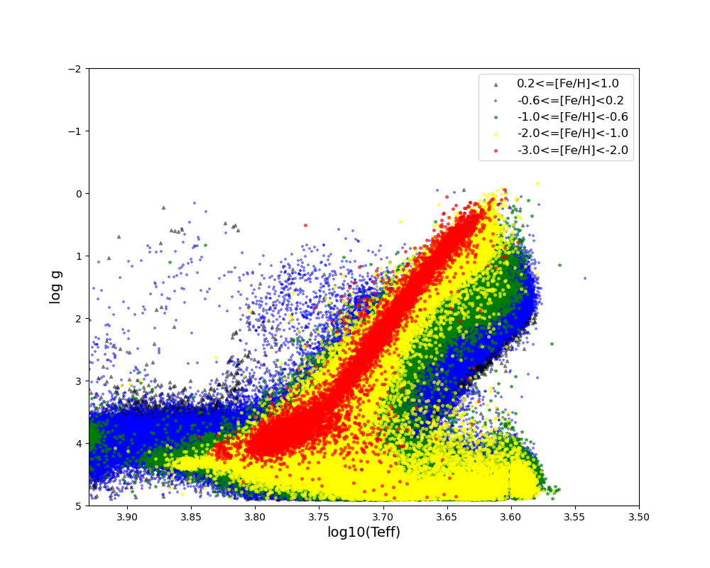
DR6 V2 Stellar Parameters(v2.9.8)
Low-Res
5.8 M AFGK-type + 0.64M M-type:
rv，Teff， log g and [Fe/H]
Med-Res
0.36 M AFGKM-type:
rv，Teff， log g, [M/H], [Alpha/M],
Vsini and abundance of 12 more elements

Slide 9
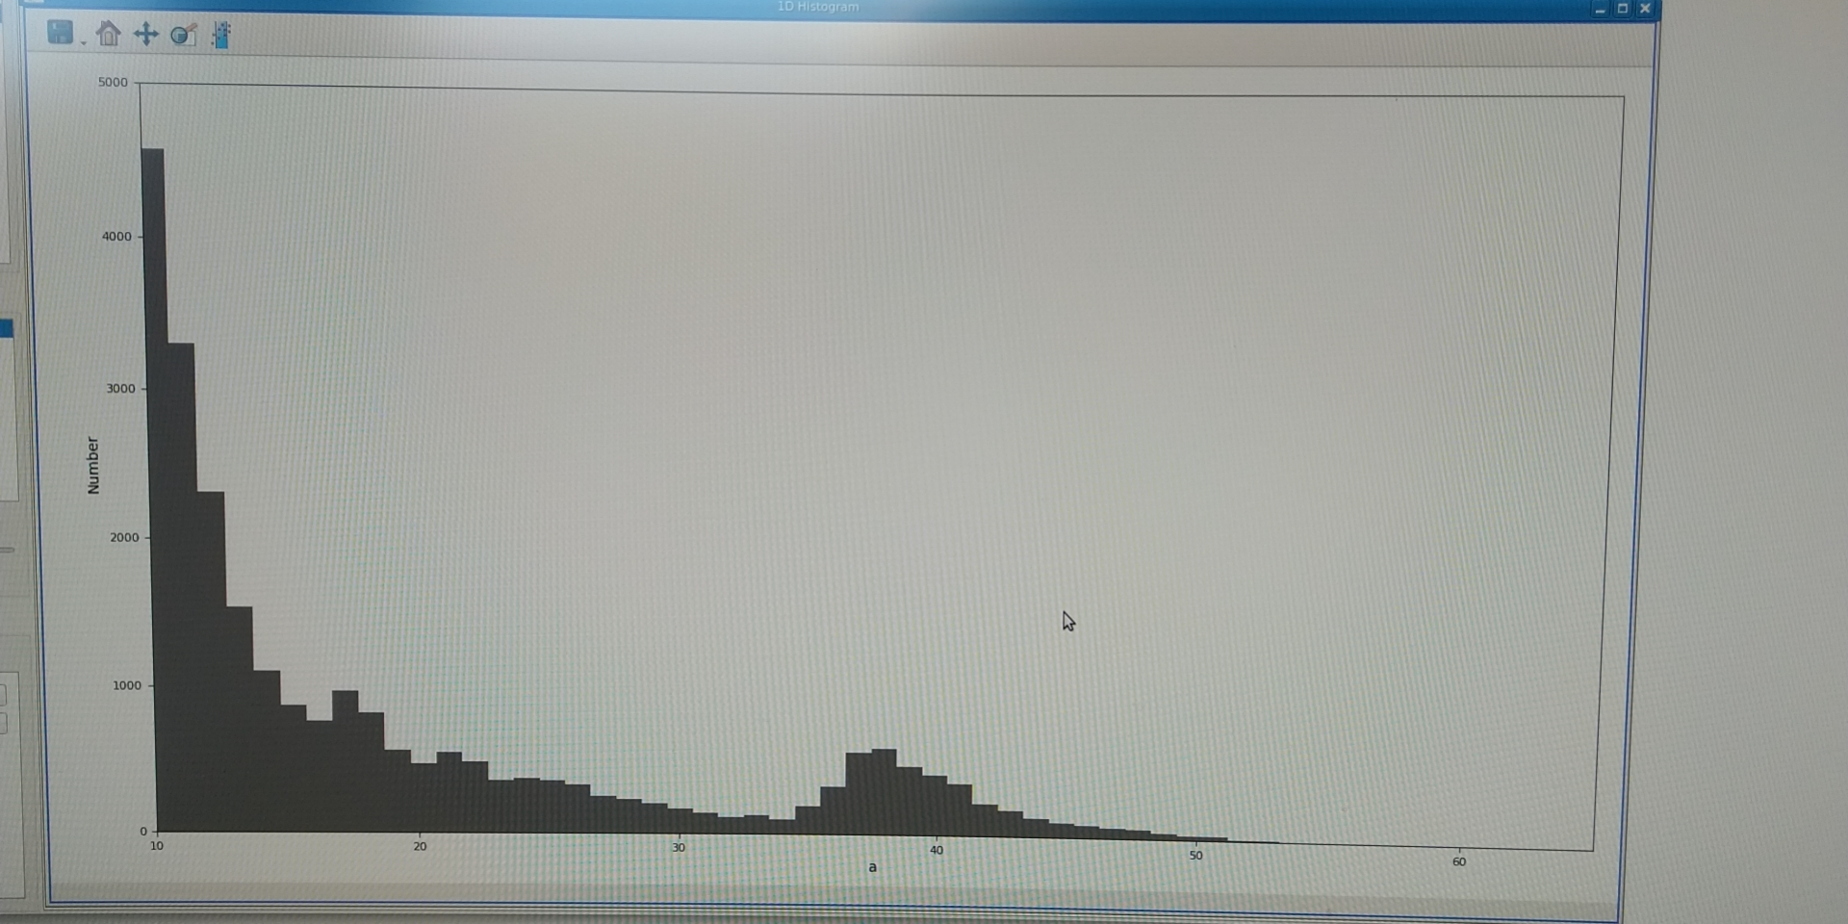
Error estimates
Using both the std of repeat observations and the relationship between computing error and S/N，scale the computational error to repeating error.

Slide 10
Precision varies with S/N (low_res)

Slide 11
Precision varies with S/N (med_res)

Slide 12
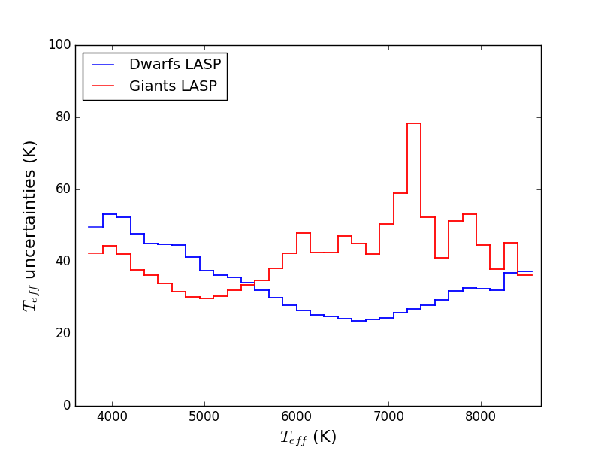
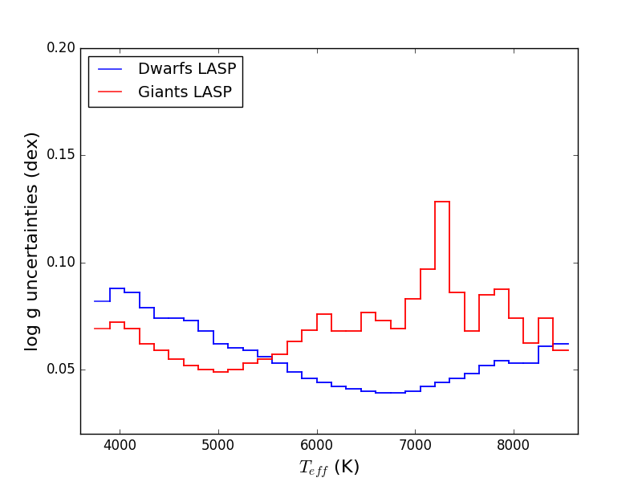
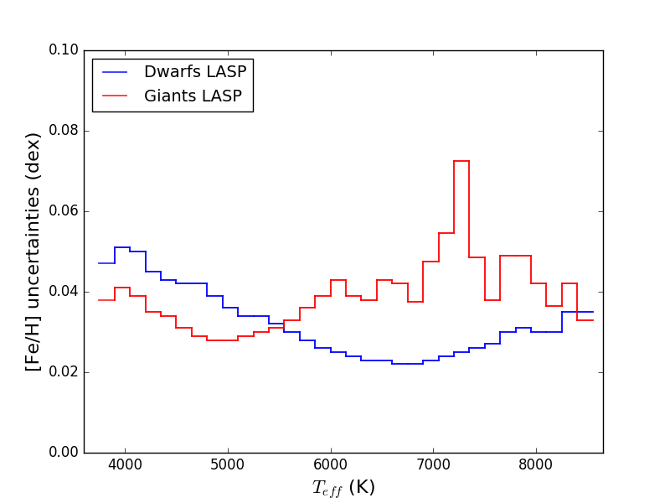
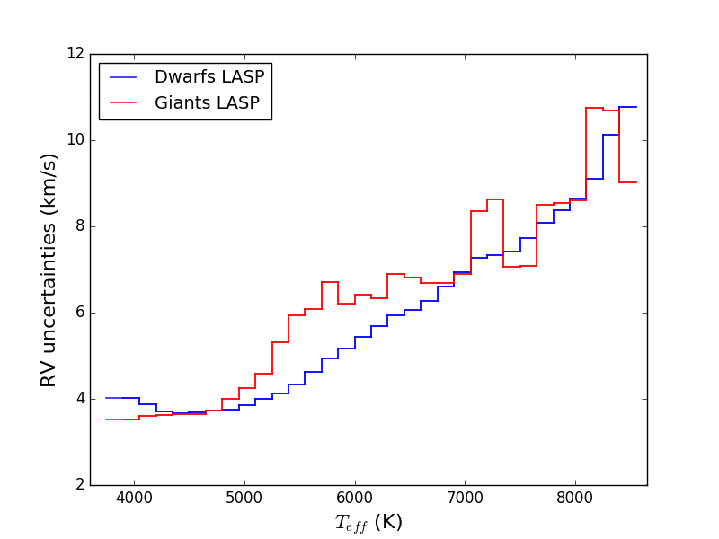
Precision varies with spectral type （S/N>50）

Slide 13
External error（Comparison with Apogee）

Slide 14
External error（Comparison with Apogee）

Slide 15
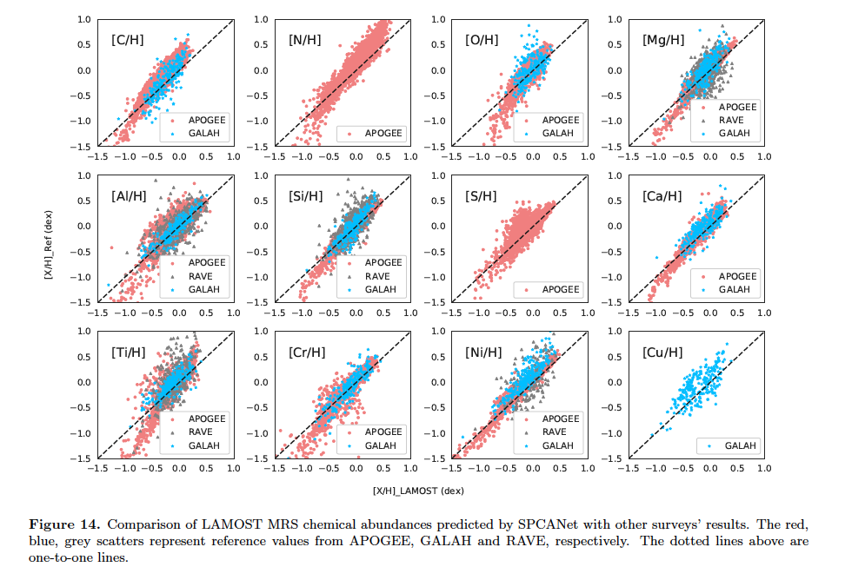
Abundance of 12 elements

Slide 16
Clusting of the med_res spectra
normal

Slide 17
Clusting of the med_res spectra
Giant/Dwarf

Slide 18
Clusting of the med_res spectra
Bad in one arm

Slide 19
Clusting of the med_res spectra
Hot stars

Slide 20
Clusting of the med_res spectra
M type stars

Slide 21
Clusting of the med_res spectra
Similar with Low ress

Slide 22
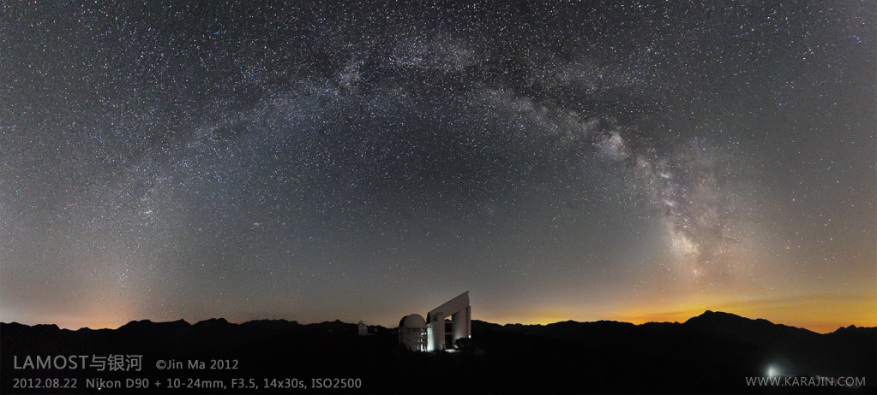
谢谢！

