Slide 1

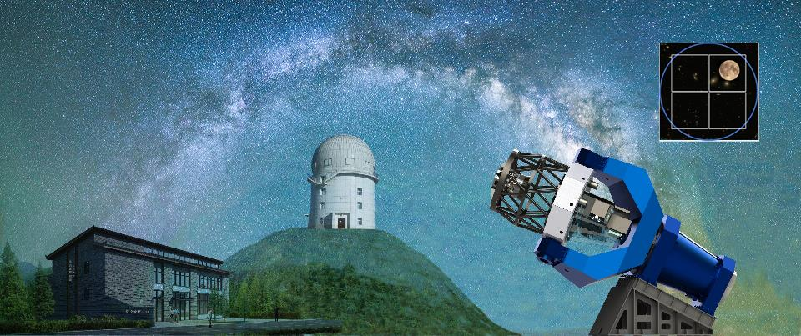



Multi-channel Photometric Survey Telescope
— Mephisto
2020/11/26
Xiamen University
South-Western Institute for Astronomy Research

Slide 2
Outline
Introduction and motivations
Telescope, cameras, site
Surveys, software preparation
Selected scientific topics
Big data and challenge

Slide 3
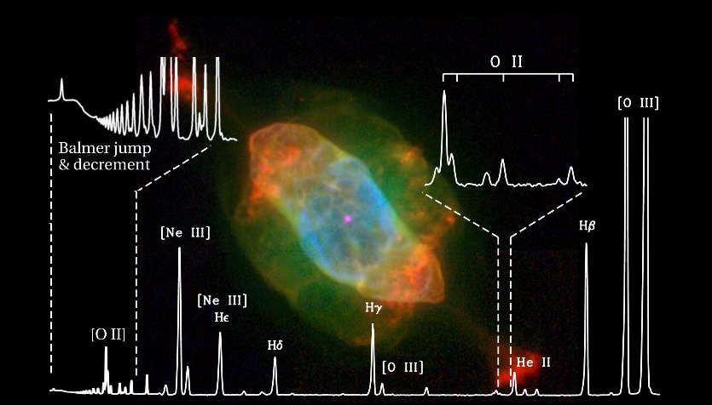
Astronomical observations
Astronomical observations can be loosely grouped into
  Imaging and spectroscopy
  Single object (photometer, long-slit), multi-object observations/surveys
  Single and multi-epoch
北京大学天文学系

Slide 4
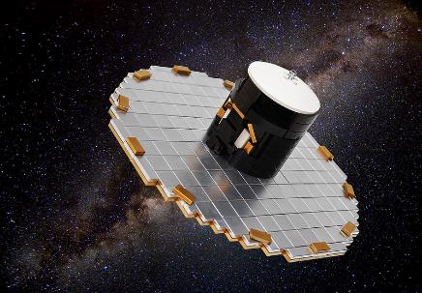
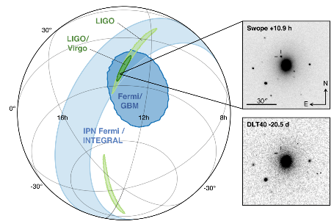
Imaging (astrometric & photometric) observations
Multi-epoch observations/surveys
  1) Parallax π (distance d)
  2) Proper motions (μ_{α}, μ_{δ}) + d → tangential velocities (V_{α}, V_{δ})
  3) Variables (binaries, pulsating stars, extrasolar planets -- microlensing)
  4) Transits (extrasolar planets, novae, SNe, γ−ray bursts, GW sources, TDEs)
Gaia
GW170817

Slide 5
Spectroscopic (spectrophotometric) observations
Single epoch observations/surveys
  1) Celestial motions (radial, expansion, thermal)
  2) Physical properties (temperature, density and mass)
  3) Chemical composition (metallicity, elemental abundances)
  4) Magnetic fields
Multi-epoch observations/surveys
  1) Variations in (radial) motion (binaries, extrasolar planets)
  2) Transits (novae, SNe, γ−ray bursts, GW sources)

Slide 6
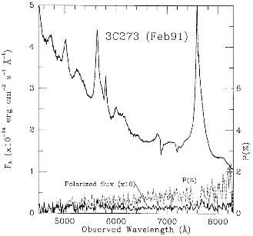
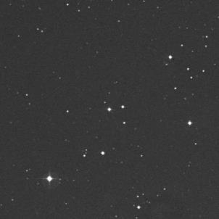
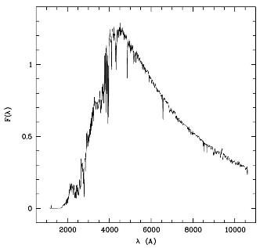
Imaging versus spectroscopy
QSO 3C 273： z=0.158
Schmidt, M., 1963, Nature, 197, 1040
Smith et al., 1993, ApJ, 409, 604
[O III] λ5007
Hβ
3C273
Hα
Hβ
Hα
Star BD +02 2547：F5
One image is worth a thousand words; One spectrum is worth a thousand images.

Slide 7
Imaging versus spectroscopy
Photometry + Spectroscopy
(Spectrophotometry)
Imaging
+
Spectroscopy
3D spatial position
3D velocity
Physical properties
Chemical composition

Slide 8
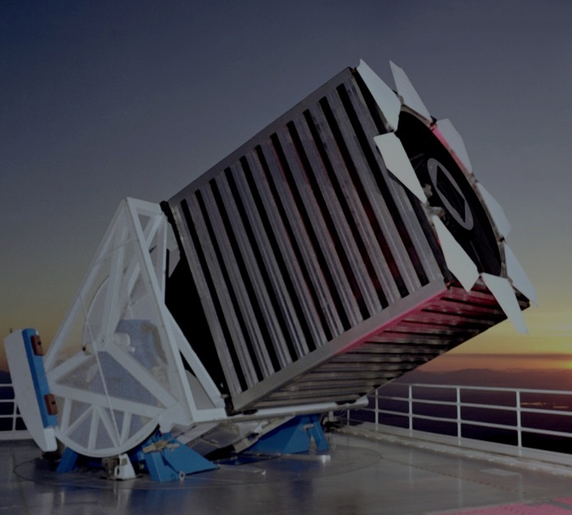
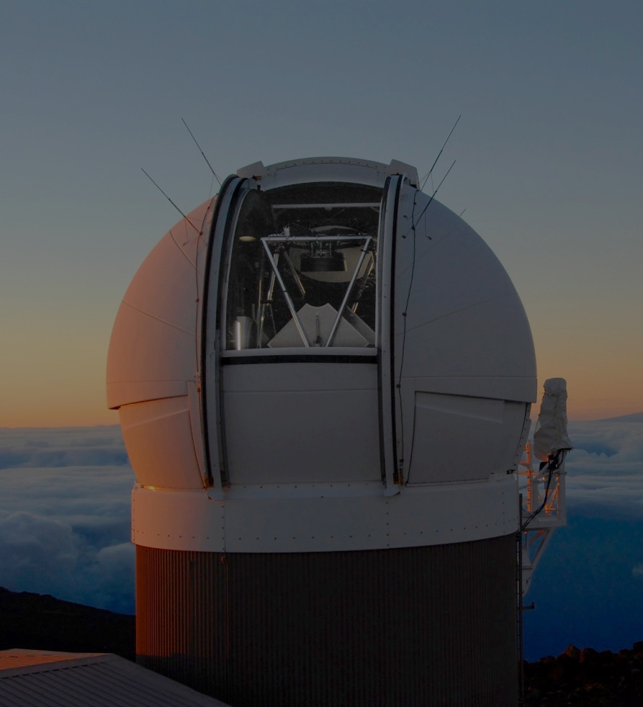
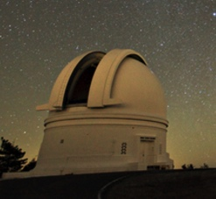
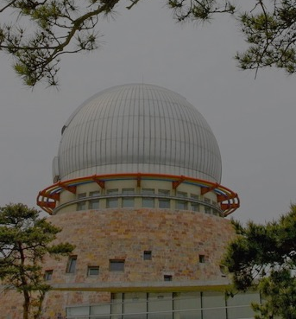
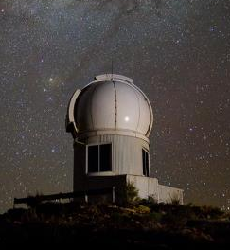
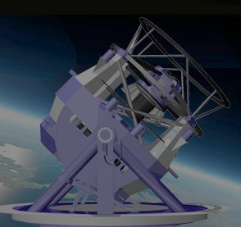
(Digital) Large-scale astronomical surveys with large format CCD mosaic play a key role in modern astrophysics, leading to new discoveries and revolutionizing our understanding of the origin and evolution of the universe.
Bigger Étendue = A⋅𝜴 (m²deg²) & → Faster, Wider & Deeper
SDSS
2.5m, 7deg², ugriz
r < 22
PS1
1.8m, 7deg², grizY
r < 22.8
ZTF
1.2m, 47deg², gr
r < 20.4
Snapshots
Monochromatic documentary
XSTPS-GAC
1.04m, 3.8deg², gri
r < 19
Skymapper
1.35m, 5.7deg², uvgriz
r < 22.6
LSST
8.4m, 10deg², ugrizy
r < 27.8

Slide 9
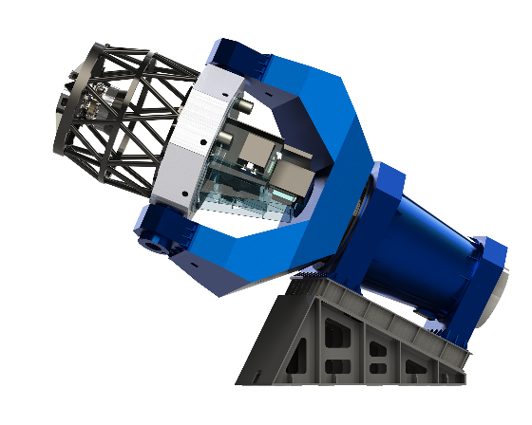
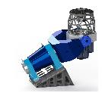
Mephisto in one sentence
Mephisto, a 1.6m multi-channel photometric survey telescope, will
Deliver real-time, high-quality colours of unprecedented accuracy for celestial objects,
Enable fast and robust classification of variables and transients, and for the first time,
Deliver a panchromatic documentary of our evolving universe.
3 CCD mosaic cameras (4×4 e2v CCD-290-99 mosaic) for the blue-, yellow- and red-channels

Slide 10
Selected optical surveys
Name | Aperture (m) | FOV (deg²) | Filter set | Limiting magnitude | Sky area | Hemi- sphere | First Light | Time domain
SDSS | 2.5 | 1.5 | ugriz | 22 (r) | 15000 | N | Complete | NO
XSTPS-GAC | 1.0/1.2 | 3.76 | gri | 19 (r) | 7000 | N | Complete | NO
PS1 | 1.8 | 7.0 | (grizY)_{P1} | 22.8 (r) | 30000 | N | Complete | YES
Gaia | 1.0 | 0.45 | G | 20 (G) | 41000 | NS | 2014 | YES
Skymapper | 1.35 | 5.2 | uvgriz | 22.6 (r) | 20000 | S | 2014 | YES
ZTF | 1.2/1.8 | 47.0 | gr | 20.4 (r) | 30000 | N | 2017 | YES
LSST | 6.4/8.4 | 9.6 | ugrizy | 24.7/27.5 (r) | 20000 | S | 2021 | YES
MEPHISTO | 1.6 | 2.0 | uvgriz | 22.5/24.8 (r) | 26000 | N | 2021 | YES
MEPHISTO: A true-colour survey telescope with a survey speed comparable to that of the LSST, albert to a much shallow depth compared to the latter.
Étendue = 3 × 4.8 m²deg² (LSST: 319 m²deg²)

Slide 11
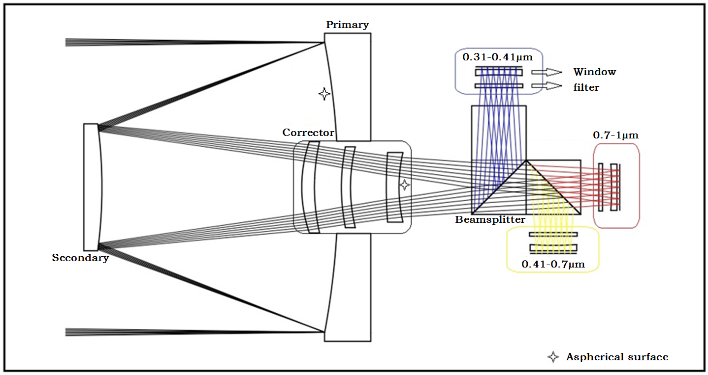
Mephisto light path
Ritchey-Chretien (RC) system with correctors → Large aperture + Large FoV
Films coated on cubic prisms for beam-splitting → 3-channel + High imaging quality over the whole FoV
Blue camera u/v
Cubic
prisms
Red camera i/z
Yellow camera g/r

Slide 12
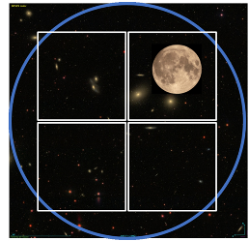
Focal plane assembly
Three CCD mosaic cameras (4×4 e2v CCD-290-99 mosaic) for the B-, Y- & R-channels
Films coated on cubic prisms for beam-splitting
252mm, 2 deg, 0.286′′/pixel
MEPHISTO | LSST
1.0 Gigapix | 3.2 Gigapix
3 × 2.0 deg² | 9.6 deg²
0.286′′/pixel | 0.2′′/pixel
Étendue = 3 × 4.8 m²deg² (LSST: 319 m²deg²)
Notes:
Equatorial mount

Slide 13
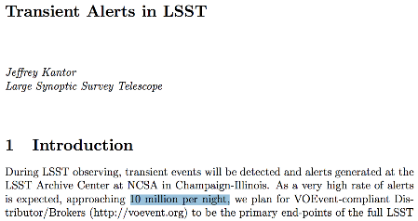
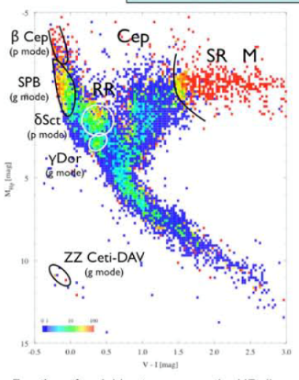
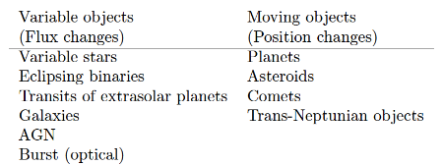
The power of colours
Object colours are distance-independent (excluding the dust reddening effects) and provide info of physical quantities (T_{eff}, log g, [Fe/H] …… )
Colour-colour or colour-magnitude diagrams allow fast and robust identification and classification of variables/transients for follow-up observations, thus solving the bottleneck of time-domain astronomy
~10 M/night

Slide 14
Skymapper filters
Filter set similar to Skymapper – uvgriz
By tweaking the u-band and adding a new v-band, the system is very powerful for stellar/galactic astrophysics.
u v g
Optimized for stellar and galactic astrophysics, allowing precise parameter determinations (T_{eff}, log g, [Fe/H]) for stars and stellar populations.

Slide 15
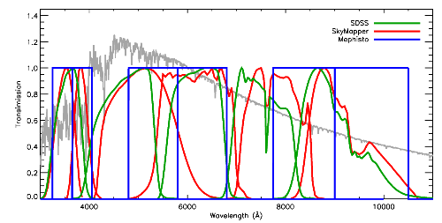
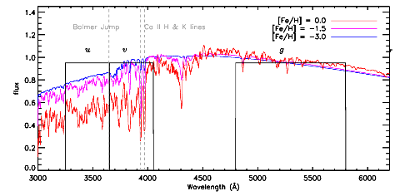
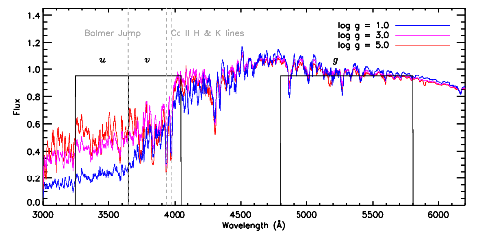
Mephisto filters
u v g r i z
For G dwarfs
[Fe/H] (dex) [−1.0,+0.5] [−2.0,−1.0] [−3.0,−2.0] [−3.0,−4.0]
∆(v − g)/∆[Fe/H] (mag/dex) 0.27 0.15 0.07 0.02
For G Giants
[Fe/H] (dex) [−1.0,+0.5] [−2.0,−1.0] [−3.0,−2.0] [−3.0,−4.0]
∆(v − g)/∆[Fe/H] (mag/dex) 0.32 0.13 0.05 0.03
For stars of T_{eff} = 5800 K and [Fe/H] = 0.0
log g (dex) < 4.0 > 4.0
∆(u − v)/∆log g (mag/dex) 0.23 0.07

Slide 16
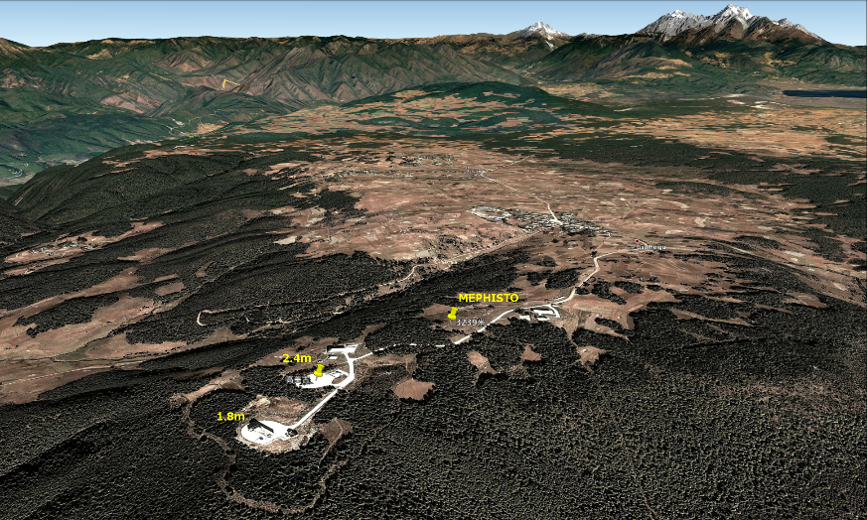
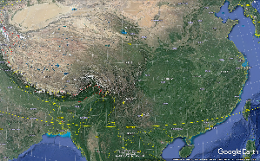
Site
Gaomeigu, Lijiang (100°2′ E, 26°42′ N, 3200m)
  - Median seeing: 1.28”
  - Observable time: 1831 hours/year (2015-2017 average)
Gaomeigu
YNAO 2.4m@GMG

Slide 17
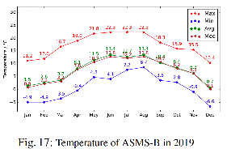
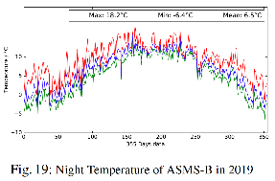
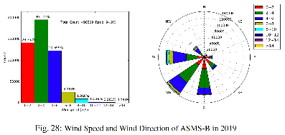
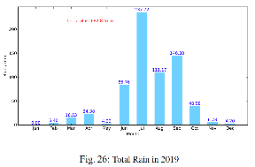
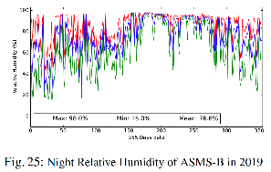
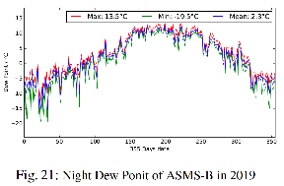
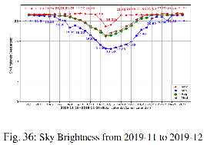
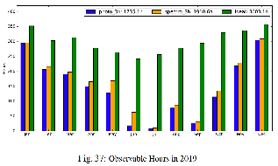
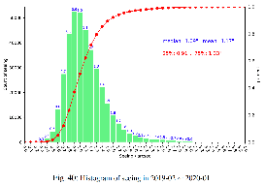
Statistics (2019)
Xin et al. 2020, RAA, in press
Zenith sky brightness V = 21.89 mag
Photometric: 1735 hr, spectroscopic: 1910 hr
Total night time: 3603 hr
Medium = 1.09 arcs, Mean = 1.17 arcs
25%: 0.91 arcs, 75%: 1.33 arcs

Slide 18
Mephisto schedule
2016 | 2017 | 2018 | 2019 | 2020 | 2021 | 2022 | … | 2031
Design
In-house testing
Construction of telescope
Site construction
Camera development
Commissioning
Pilot survey
Regular survey
Data release
Now

Slide 19
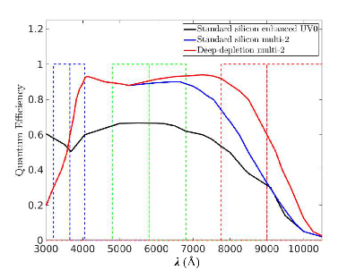
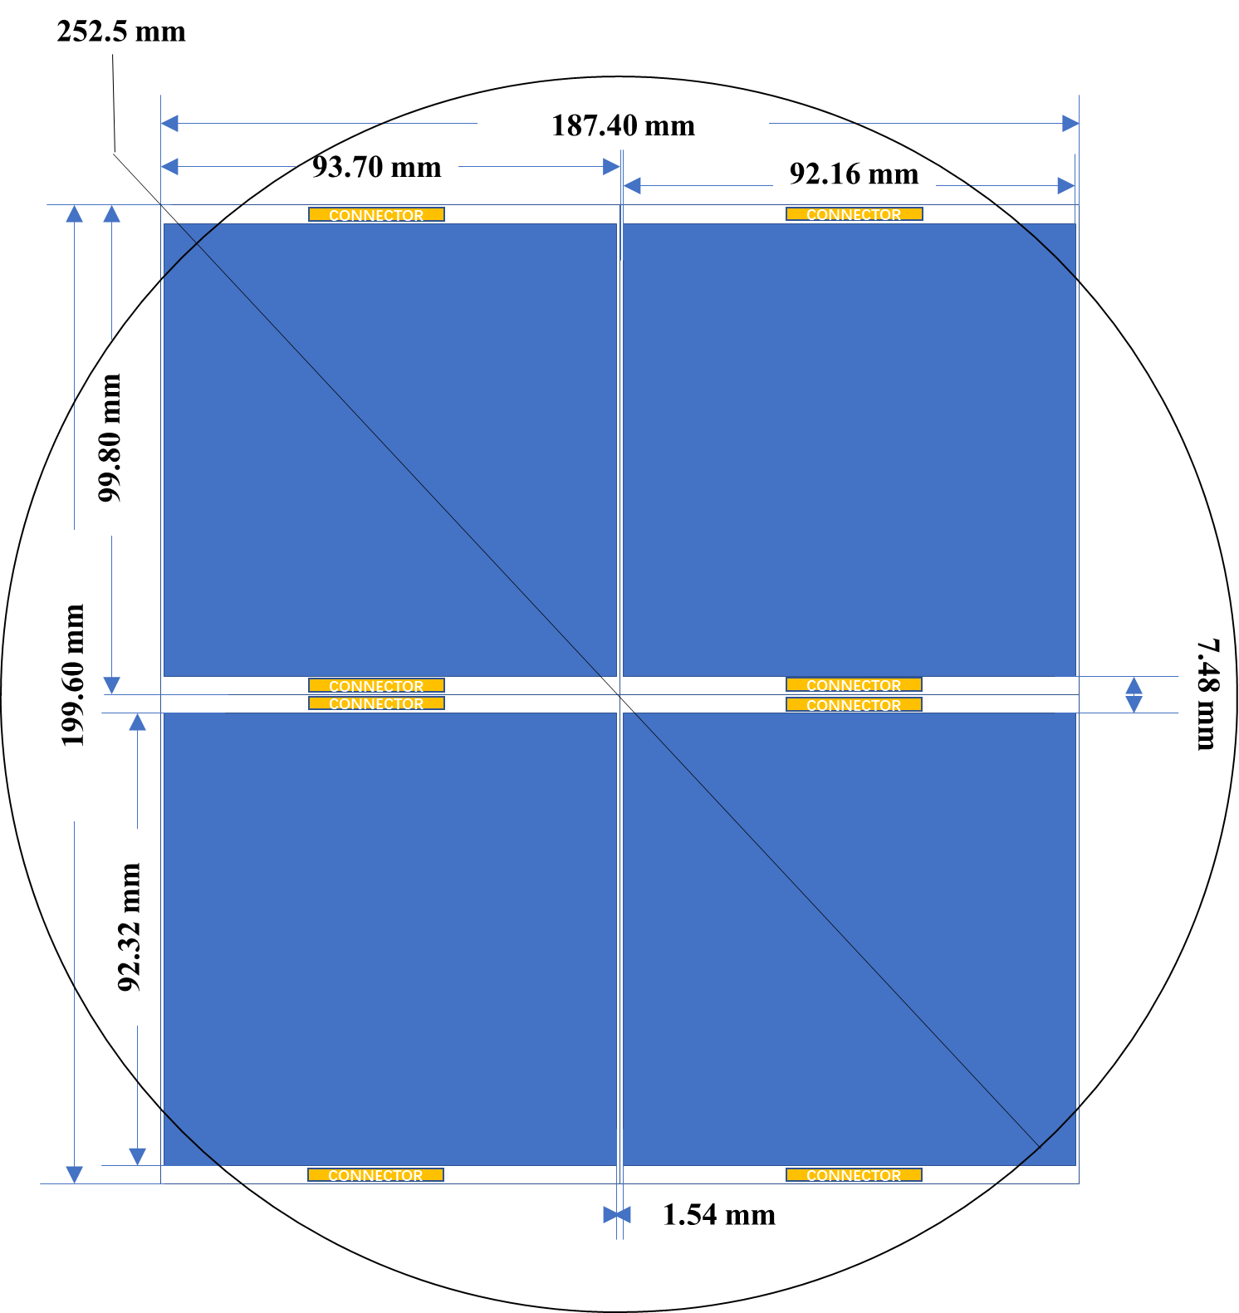
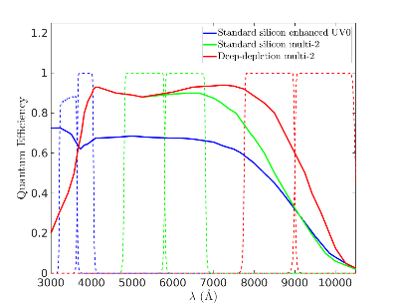
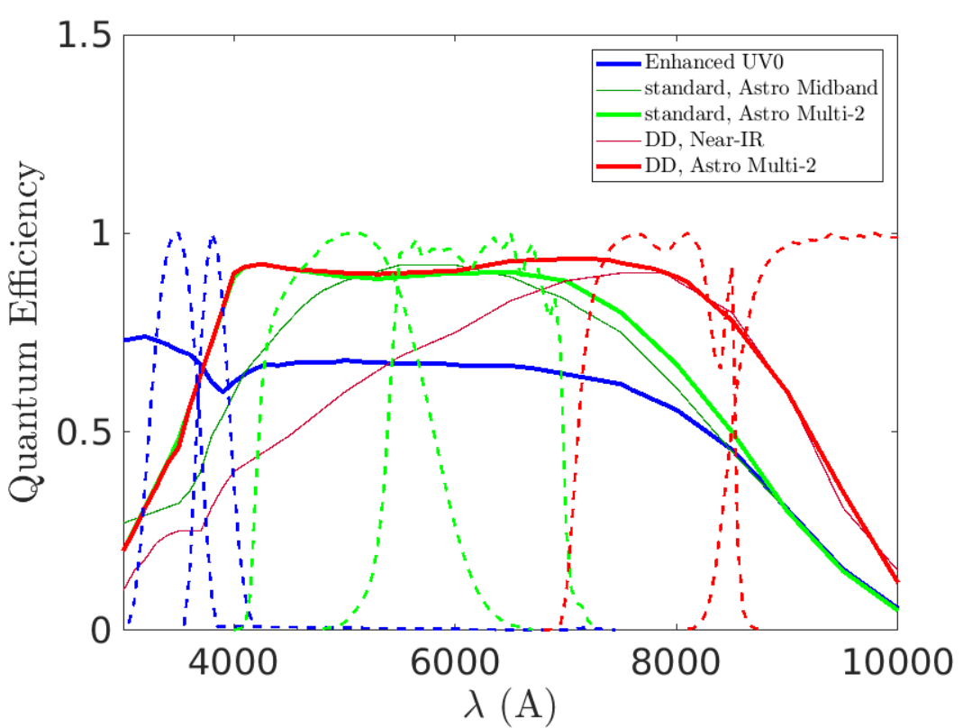

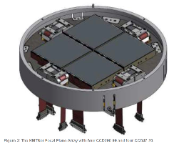
Current status: CCD and camera
CCD mosaic cameras
  15 e2v CCD 290-99 9216×9232 10μm back-illuminated sensors
    5 standard silicon enhanced UV0
    5 standard silicon multi-2
    5 deep-depletion multi-2
  Single chip and 2×2 mosaic CCD cameras building from 2020/1 by NAOC
e2v CCD 290-99
KMTNet

Slide 20
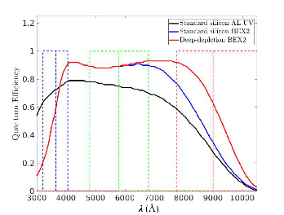
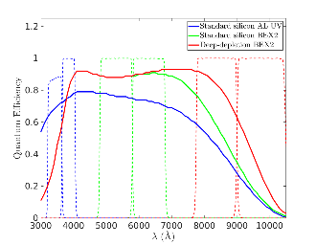
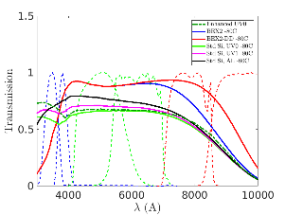
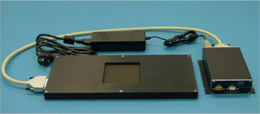
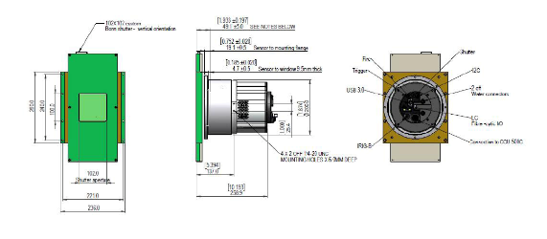
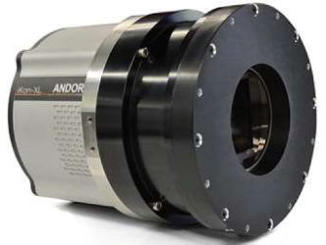
Pilot cameras
Oxford Instruments/Andor Technology iKon-XXL CCD cameras
  e2v CCD 231-C6 6144×6160 15μm back-illuminated sensors
    Standard silicon AL UV
    Standard silicon BEX2
    Deep-depletion BEX2
Bonn Shutter
102mm×102mm

Slide 21
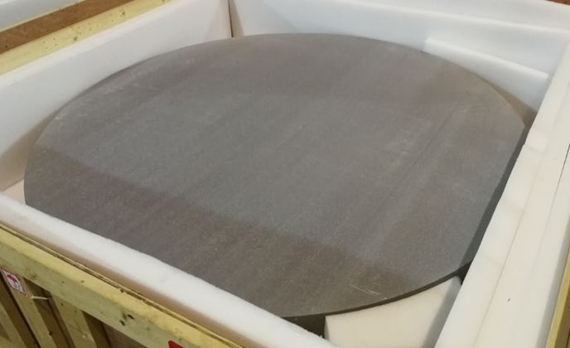
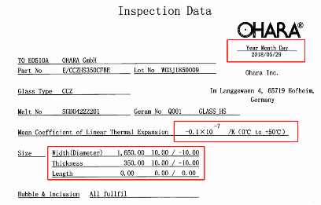
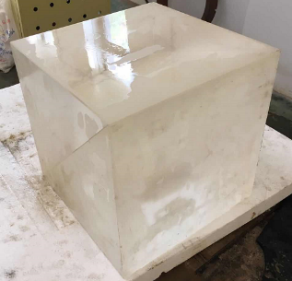
Current status: Mirrors
Telescope under construction by NIAOT, completion expected 2020/12
1650mm primary arrived at NIAOT in 2018/08
300mm uncoated cubic prism arrived at NIAOT in 2018/10

Slide 22
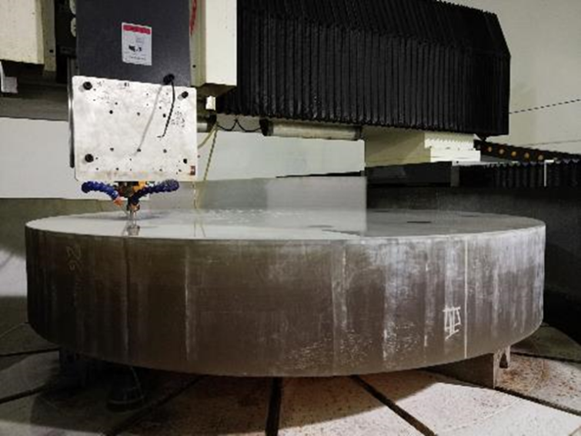
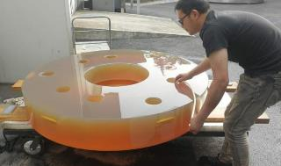




Current status: Mirrors
2018/12
2020/5
2020/9
1650mm M1 primary under polish
M1 test and coating units
700mm M2 under polish
M2 test unit
2020/5
Support unit for big corrector lenses
A test unit for big lenses
Test result < 1/40λ @ 632.8 nm

Slide 23










Telescope frame base arrived at NIAOT
M1 house under assembling
Declination axis under test

Slide 24







Current status: Site and dome
Site and dome (NAIRC, Nanjing) construction by YNAO starting from 2019/9
2020/5/22
2020/6/24
2020/3/26
D.C.
Mephisto
50cm Array
2020/8/27
2020/8/21
2020/6/24

Slide 25
Working groups & project meetings
5 working groups
Project meetings every 2 weeks
Sciences
Survey strategy and scheduler
Image processing pipeline:
Astrometric & photometric calibration
Transits and variables: Identification and classification
Observatory control system
Data storage & processing centre

Slide 26

Mephisto survey
Mephisto surveys will last for 10 years:
  The Northern hemisphere 26,000 deg² multi-channel photometric survey (Mephisto-W)
  The multi-channel surveys of variables and transients with various cadences of time intervals from days to minutes (Mephisto-D, Mephisto-H and Mephisto-M).
Survey | Area | Cadence
Mephisto-W | 26000 deg² | ~ Month
Mephisto-D | N*1800 deg² | > Day
Mephisto-H | N*180 deg² | > Hour
Mephisto-M | N*18 deg² | > Minute
Mephisto-M H D W
Ivezic et al. (2008)

Slide 27
Mephisto-W survey
All the time of 2022 and 30% time of 2023-2031
  Single visit of 2 × 20s exposures, typical 5σ depth r ~ 22.37 mag
1st year: 5 visits of any field in both the ugi and vrz filter combinations
  10-year operation: 18 visits for both the ugi and vrz filter combinations
ugi/vrz
ugi/vrz
No. of visits for the 1st year
No. of visits for the 10 years
Optimization
For a given filter (ugi/vrz), uniform (limiting magnitude, image quality – seeing, airmass, sky brightness) as much as possible over the whole survey footprint
Matching limiting magnitudes amongst the filters (e.g. u− v for log g, v−g for [Fe/H])

Slide 28
Limiting magnitudes & observing conditions for the 1st year
u
v
g
Co-added limiting magnitude for the 1st year
r
i
z
Co-added limiting magnitude for the 1st year
Average observational conditions for the 1st year

Slide 29
Mephisto-D, H & M
From 2nd year, 70% observing time will be allocated to Mephisto-D, -H and -M surveys.
Real-time colours & variations: Fast & robust transient classifications
Survey | Area | Cadence
Mephisto-D | N*1800 deg² | > Day
Mephisto-H | N*180 deg² | > Hour
Mephisto-M | N*18 deg² | > Minute

Slide 30


Example D, H & M footprints
H1: Galactic disk
M1：High latitudes
H2: M31/M33
D1：Ecliptic plane
Ecliptic plane: Small bodies in the Solar System, near-Earth objects;
Galactic disk: Rotation of young stars, disk structure, chemistry and kinematics, variable stars, binaries, exoplanets;
M31/M33: (Variable) stars; globular clusters and satellite galaxies; time-domain sciences; structure, chemistry and kinematics of M31, proper motion of M31
High Galactic latitudes: Cosmic transients, galaxies and quasars, Galactic halo

Slide 31



Test of MIPP—point source
astrometry
distortion map
MIPP V1.0 test on CFHT image
photometry
  Five modules: pre-processing (regular/fast) + image quality feedbacks + single-epoch processing (photometry + astrometry) + multi-epoch processing (photometry + astrometry + variables) + photometric calibrations

Slide 32
Photometry of extended sources

Slide 33

Transients and Variables
TransFinder: transient detection and classification

Slide 34


Transients and Variables
TransFinder: preliminary test on Mephisto-like simulated images

Slide 35

OCS Observatory Control System
Mephisto Subsystems:
Telescope Control System(TCS):
- Operates all telescope hard wares
- Providing pointing and tracking
Instrument Control System(ICS):
- Control all instruments
- Coordinate data collection
Site Monitor System:
- User management
- Time allocation
- Target/ToO schedule
- Weather, Cloudy, All-Sky…
Data Management System(DMS):
- High speed data flow
- Online data process/look up
- Offline data process
- Data Storage
Observation Schedule System(DMS):
- Observation schedule generation
SMS
TCS
ICS
Status DB
Sci
DB
OCS
Science
OSS
DMS
Data
DB
Notes:
OCS is the master control system that commands, coordinates, and monitors the observatory. The OCS provides the means to support safe observatory operations during day and night including:
Providing high level observatory operations (including user interfaces, sequencing, resource allocation and system monitoring and maintenance)
Coordinating the camera, telescope, data management subsystems for an integrated operation during the survey.
Locally and remotely starting, monitoring, adjusting and stopping the system during operation.
Controlling and monitoring all instruments of the observatory
Orchestrating and controlling all aspects of the observatory for all observations (science, calibration, and engineering) and all operation modes.
For these purposes, several sub-systems are provides to support the OCS

Slide 36
Data storage & processing centre
Distributed Storage
30 Controllers with Dual CPU
1 GB, 10GB and IB Interface
1024 * 8TB SATA Disk
60 * 600GB SAS disk
Extendable
Mass Storage
High Performance Computing
30 Computing Node
2 Manage Node
File Manage Software: Lustre
CPU: 2*Xeon 6126, 2.6G Hz
Cores: 12 Core/CPU, total: 720 cores
FLOPS: 499.2 GFlops
Mass Storage
(≥ 5PB)
High Speed
I/O
(≥ 1.2GB/10s)
HPC
(≥5.3GB/60s)
High Speed I/O
InfiniBand Framework: 100Gbps
Fiber Network: 40Gbps
Ethernet: 10Gbps
SSD, 10Krpm SAS
Mephisto Data Storage and Process Hardware Requirements

Slide 37




Mephisto key sciences
Reveal the true multi-dimensional structure and evolution history of the Milky Way
Mephisto-M H D W
Cosmic transients and physics in extremely conditions
The large scale structure of the universe;
Galaxy formation and evolution;
The nature of dark matter and dark energy

Slide 38

Mapping the Milky Way
MEPHISTO-W will detect > 1% Galactic stars. The high quality colour and astrometric data, in particular those of the u and v bands will yield:
2B MS stars and 50M giants with accurate distance and extinction estimates
Metallicities for MS stars of accuracy 0.1-0.15 dex, for giants of accuracy 0.15-0.2 dex
Effective temperatures for MS and giant stars of uncertainties 50-100 K
Tangential speeds accurate to 10-20 km/s for stars out to 10 kpc
Type | Distance
M0 dwarf | 10 kpc
MS turn-off | 100 kpc
Red giant | 500 kpc
M_{V}
1 Mpc
100 kpc
(g-i)₀

Slide 39


Mapping the Milky Way with MEPHISTO:
The interstellar medium
Galactic structure/substructure, chemistry and kinematics
Satellite galaxies

Slide 40


EMP stars
Extremely Metal-Poor stars are fundamental probers of the nature of the first generation stars and the formation of the Milky Way.
High precision colours are key to select candidates of [Fe/H] < −3.0 dex.
}
G. Da Costa
The most metal-poor star, SMSS J0313-6708 ([Fe/H] < −7.1 dex) found by Skymapper (Keller et al. 2014, Nature; Nordlander et al. 2016)
 | Colour Accuracy | 10-σ depth | Sky area | Time
MEPHISTO | 0.2 - 0.5% | r = 24.3 | North 26000 deg² | 2022－2031
Skymapper | 1 - 5% | r = 22 | South 20000 deg² | 2015－2020
MEPHISTO-W will detect ~ 20,000 EMP stars

Slide 41

Example science: Cosmic transients
Mephisto-M H D W
Ivezic et al. (2008)
Mephisto-W, -D, -H, -M surveys probe transients and variables of time-scales from minutes to years
Accurate real-time colour and multi-band light curves: Fast and robust classifications of transients and variables

Slide 42

SNIa: cosmological distance indicator
“Standard candle”
  Measure Dark Energy &H0
  Nobel Prize 2011
However, Hubble tension!
  Different physics between low-z and high-z universe?!
  >4 sigma significance
  Real new physics or systematics?
Largest systematic: model variance
(Brout et al. 2019, Jones et al. 2019, Jones et al. 2020)
Notes:
In SN cosmology, the systematic uncertainty in DE are dominated by low-z sample, i.e.: the intrinsic variance in Sne

Slide 43


SNIa intrinsic variation
Mechanism and sub-population?
Taubenberger 2018

Slide 44




EM counterparts of GW events
Kilonova
Notes:
For example for the electromagnetic counterparts of the gravitational waves: the Kilonova.
Mephisto high-quality real-time colours allow
Rapidly classification of Kilonovae
Differentiate between NS-NS and NS-BH mergers
Help identify weak GW events

Slide 45
Big data challenge
Total data
  One exposure: ~1 GB,
  3.6 TB /night, >1 PB /year, ~10 PB in total.
  Store and analysis
Transient search and identification
  Thousands of transients or variables /night (10M by LSST)
  Large number of faked ones
  4 mins for one run of TransFind (each exposure)
  Find out the interesting one, rapid alert & follow up

Slide 46
Mephisto in one sentence
Mephisto, a 1.6m multi-channel survey telescope, will deliver real-time, high-quality colours for celestial objects, enable fast and robust classification of variables and transients, and deliver, for the first time, a panchromatic documentary of our evolving universe.
Call for science proposals!
Welcome to join us!

Slide 47
Mephisto features
Mephisto will be the first multi-channel photometric survey telescope that shall deliver:
  Real-time colours (and variations) of astronomical objects, enabling fast and robust search and classification of different types of transients and variables for follow-up spectroscopic identification and observation;
  Superb colour accuracies, 0.2-0.5%, better than LSST (0.7-1.4%), enabling accurate parameter determinations of stars and galaxies;
  Fast survey speed: 1800 deg² in 3 bands per night, comparable to LSST;

Slide 49

Selected optical surveys
Constant A Ω t
Mephisto
In terms of limiting magnitude, Mephisto does not stand out.

Slide 50
Data release: W-survey
1st year, Release of the first true-colour sky map, plus one-year-long 5-point multi-band light and real-time colour curves for all detected sources
  Co-added 5σ depth (u, v, g, r, i, z) = (22.5, 22.6, 23.5, 23.3, 22.9, 22.0)
  Astrometry better than 0.01”, photometry better than 1%
  Precision of colour calibration 0.3% (0.5% for u and v)
Final data release: Deep true-colour sky map and 10-year coverage 18-sampling-point multi-band light and real-time colour curves for all detected objects.
  Co-added 5σ depth (u, v, g, r, i, z) = (23.2, 23.3, 24.2, 24.0, 23.6, 22.7)
  Astrometry better than 0.013”@r=20mag, photometry better than 0.6%
  Precision of colour calibration 0.2% (0.5% for u and v)
  Parallaxes for (r = 18, 20, 22) = (2.5, 6.4, 30.8) mas
  Proper motions for (r = 18, 20, 22) = (1.2, 3.2, 15.6) mas/yr

Slide 51



Photometry of extended sources
A photometric pipeline based on GALFIT for galaxy+point-like variables
MIPP magnitude
MIPP flux
SDSS result from Dilday et al. 2008
MIPP results

Slide 52





Mephisto science themes
  Probing the transients
  Galactic archeology
  Galaxies and cosmology
MEPHISTO
Real-T, high-Q colours
Large FOV
High survey efficiency
恒星物理
  The Solar system objects
  Stellar and stellar population astrophysics

Slide 53
Main specifications

Slide 54




Telescope — structure
Telescope 28 ton, focal plane assembly 2 ton
Telescope main structure: Maximum displacement 0.89mm; fundamental frequency 15 Hz
CCD cameras: Maximum rotation (6.1, 13, −4.9) arcs in the three directions, maximum displacement 0.07mm, maximum stress 5.2 MPa
Primary-secondary alignment: Maximum z-axis displacement 0.05 mm, maximum radial displacement 0.07 mm, maximum rotation around x-axis 8.5 arcs; adjusted by a 5-D movement mechanism of M2 (better than ±10 μm in 3D displacement, ±3.6 arcs in 2D rotation)
?

Slide 55



M2 5D movement mechanism
M2 5D mechanism assembled and under test
Updated truss design allowing observations down to +25 deg Altitude towards south

Slide 56
Limiting magnitudes (5σ) and astrometry
Filter | u | v | g | r | i | z
single visits (2x20s) | 21.63 | 21.65 | 22.60 | 22.37 | 21.99 | 21.14
One year (~5 visits) | 22.54 | 22.56 | 23.51 | 23.27 | 22.89 | 22.04
Ten years (~18 visits) | 23.25 | 23.27 | 24.21 | 23.98 | 23.59 | 22.74
 | Single visit |  | Ten-year Survey
r (mag) | SNR | Position errors (mas) | SNR | Position errors (mas) | Parallax errors (mas) | Proper motion errors (mas/yr)
18 | 118 | 15 | 502 | 10 | 2.5 | 1.2
20 | 35 | 38 | 146 | 13 | 6.4 | 3.2
22 | 7 | 185 | 29 | 45 | 30.8 | 15.6
For sky brightness V = 21.5 mag, Seeing = 1.28 arcs and airmass = 1.2

Slide 57


SNe Cosmology: Mephsito solution
Targets
  Provide a sample at z: [0.05-0.15]
  Obtain the light&colour curves as early as we can
Mephisto will perform D-survey:
  E.g. 60 second exposure, 1 month 80 SqDeg
Total expected ~100 SNIa (5 early)
A fair sample with
  Light curve in multi-bands
  Peak
  Stretch/$Δm_{15}$
  Colour
Rapid follow up by Lijiang 2.4m

Slide 58


Cubic prism dichroic
300mm cubic prism
Incident light
S
39
45
51
Crossover wavelength and reflection/transmission efficiency depend on incident angle (39 – 51 deg) and S/P polarization.
Filter transmission curves vary with focal plane position → colour effects across the focal plane, at the level of a few percent
Filter central wavelengths and bandwidths optimized for the dichroic transmission/reflection efficiency curves
  Minimizing the colour effects, while
  Maximizing the metallicity and log g sensitivities
P
51
Reflection plane
45
39

Slide 59



Filter colour effects
FoV
[−0.7,+0.7] deg
Incident angle
[39,51] deg
u-band
(87.1,87.1), (86.6,87.6)
v-band
(88.8,88.8), (88.1,89.2)
u − v
(−1.6,−1.6), (−2.6,−0.5)
v − g
(10.7,10.7), (9.7,11.7)
Dichroic efficiency as a function of 𝜆 at different Fov (X, Y), after integrated over light of all incident angles

Slide 60


Slide 61
MSSS v2
Mephisto survey scheduler simulation
Input Tables
/Science program
Scheduler
Observation Simulation
Weather Model
Analysis Frame
Telescope Model
Notes:
Simulate observation from one day to one year

Slide 62

Tidal disruption events (TDEs)
iPTF16fnl
Stars tidally disrupted by SMBHs (Rees, M. J. 1988, Nature, 333, 523; Phinney, E. S. 1989, IAU Symposium, 136, 345; Evans, C. R., & Kochanek, C. S. 1989, ApJ, 346, L13)
Bright light decaying on time scales from months to years
Rate: 10⁻⁴ – 10⁻⁵ /galaxy/yr (Magorrian, J., & Tremaine, S. 1999, MNRAS, 309, 447; Wang, J.-X., & Merritt, D. 2004, ApJ, 600, 149; Rau, A., et al. 2009, Publ. Astron. Soc. Pac., 121, 1334)
A few tens of candidates detected
Blagorodnova, N., et al. 2017, ApJ, 844, 46
Probes of quiescent SMBHs (spins, masses, mass function – especially the low-mass end)
Accretion physics, jet formation
Stellar dynamics in central regions of galaxies
Mass, size and distance of the disrupted star
Main contaminators are Type Ia SNe; Discriminating features:
a) Colors (TDEs much bluer, g − r ≈ −1) and color evolution; b) Distance from the galaxy center; c) spectrum
LSST (Bricman & Gomboc, 1812.06064): 40,000 – 60,000 events in 10 yr (Abell, P. A., et al. 2009, https://arxiv.org/abs/0912.0201; van Velzen, S., et al. 2011, ApJ, 741, 73)

Slide 63


SNe Ia
MEPHISTO
Real-time colours: Fast classification of SNe Ia
Scalzo et al. 2017
Currently samples totaling ~10³ SNe Ia are available for constraining cosmology. Yet,
Observed by a variety of telescopes
Sensitive to subtle, systematic effects; Uncertainties in the intrinsic colour variations
Effects of the dust extinction
Mephisto-D survey will obtain high quality, real-time colour and multi-band light curves for 30,000 SNe Ia; Mephisto-W will discover 500,000 candidates. These will allow us to explore the physics of supernovae themselves, to constrain the cosmic models, and to probe the nature of dark energy.

Slide 64




Dome, data storage & processing centre
YNAO 2.4m
Mephisto
Data storage & processing centre
Ventilation
Outer Ф13m
Inner Ф12.1m
Height 21.5m
𝜈 > 15 Hz
Alt. > 25 deg for |Hour Ang.| < 2hr (GC: 17:45:37.20 -28:56:10.3, Max Alt. ∼ 34 deg)

Slide 65


Mephisto: “True colour” cosmic documentary
Mephisto, equipped with 3 cameras, will yield real-time, high-precision colours (and colour variations) of celestial objects, that
shall allow efficient identification and robust classification of different types of variables and transients.
MEPHISTO
LSST

Slide 66
Mephisto in one sentence
Mephisto, a 1.6m multi-channel survey telescope, will deliver real-time, high-quality colours of unprecedented accuracy for celestial objects, enable fast and robust classification of variables and transients, and deliver, for the first time, a panchromatic documentary of our evolving universe.
Mephisto
LSST

