Slide 1
A New Tool for Automated CME Detection and Tracking with Deep Learning
Pengyu Wang¹, Yan Zhang¹, Li Feng²,
Hanqing Yuan¹, and Jiahui Shan²
1. Department of Computer Science and Technology, Nanjing University, China
2. Purple Mountain Observatory, Chinese Academy of Sciences, China
lfeng@pmo.ac.cn

Slide 2
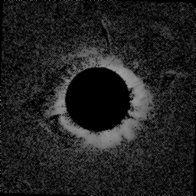
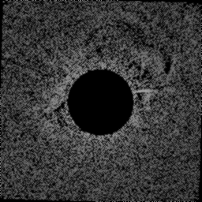
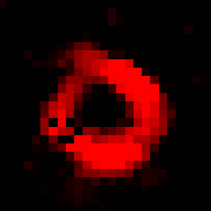
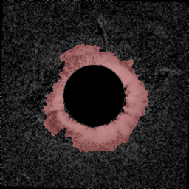
CMEs:
major cause of geomagnetic storms
Disruption of electrical systems
Communications
Navigation systems
Satellite hardware damage
…
Online CME Catalogs
Training
Machine Learning
Methods
Region Detection
Tracking
Notes:
we propose a new machine learninng architecture for cme detection and tracking. we train a convolution neural network to better learn semantic features of cme region. All these CNN descriptors can be used for further unsupervised region detection and new cme tracking.日冕物质抛射(CME)是行星际空间中大尺度、剧烈的活动现象,并通常携带大量的高能粒子。当一个CME传播到达地球时,会产生剧烈的地磁扰动。因此,对CME到达地球的实时预报对空间天气环境的监测十分重要。

Slide 3
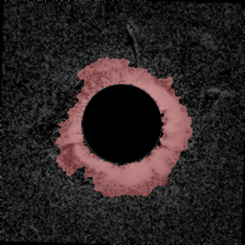

Pipeline
Online CME Catalogs
Training
Machine Learning
Methods
Region Detection
Tracking
Data Preprocessing
Notes:
here is our pipline, the first step is to do data preprocessing, after preparing all the training data, we obtain CME labels for training from online catalog. and train a CNN model. then a pca based co-locolization method is used for detecting the cme region in every image. graph cut method is used for cme boundary finely tuning. what follows is the tracking of the cme moving path in subsequent running-difference images

Slide 4
Pipeline
Online CME Catalogs
Training
Machine Learning
Methods
Region Detection
Tracking
CNN Feature Extraction

Slide 5
Pipeline
Online CME Catalogs
Training
Machine Learning
Methods
Region Detection
Tracking
Unsupervised CME Region
Detection

Slide 6
Pipeline
Online CME Catalogs
Training
Machine Learning
Methods
Region Detection
Tracking
Tracking CME in time series
and refinement

Slide 7
Data Preprocessing
LASCO C2 running-difference images (from 2011 to 2017)
resizing 256 x 256, denoising
collecting CME Labels from online Catalogs
for training binary classification CNN
Notes:
we use running-difference images with 256x256 resolution as input, the training labels are obtained from online CME catalogs which tell us if there is a cme event in this frame

Slide 8
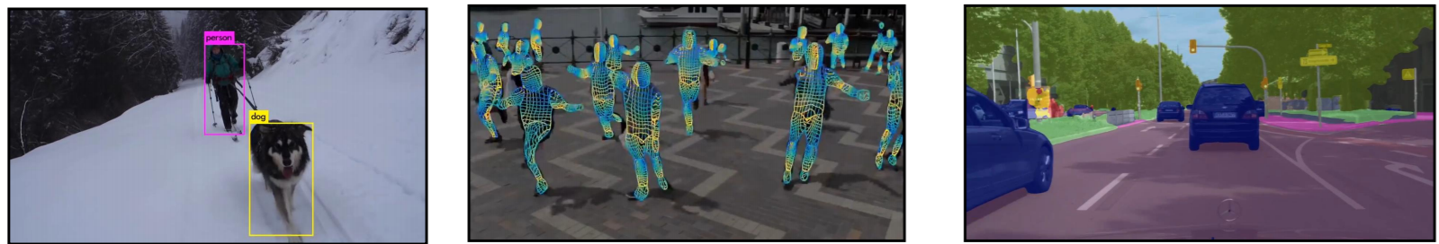
CNN Feature Extraction
convolutional neural networks have shown excellent performance on many computer vision tasks
CNN helps to learn more robust image features
Object detection
Human understanding
Autonomous driving
Notes:
convolutional neural networks have shown excellent performance on many computer vision tasks, such as object detection human action understanding auto-drving. CNN helps learn more robust image features, a pretrained CNN model can be used for transferring to other related task

Slide 9
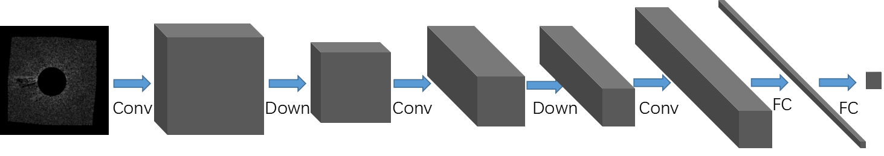
CNN Feature Extraction
we train a LeNet model (3 convolution layers, 2 down-sampling layers and 2 fully-connected Layers)
input 256 x 256 image, output the probability of a CME event
For training, we obtain whether a frame is labeled with or without a CME from online Catalogs for data of a few months
LeNet Model
Notes:
The detection of CMEs can be treated as a supervised image classification problem by assigning a given white-light coronagraph image to the "CME" or "non-CME" category. Here we use LeNet with 3 convolution layers, 2 down-sampling layers and 2 fully-connected Layers. the classification problem can be solved very well even used such a simple architecture. we extract the high level feature maps for further analysis

Slide 10
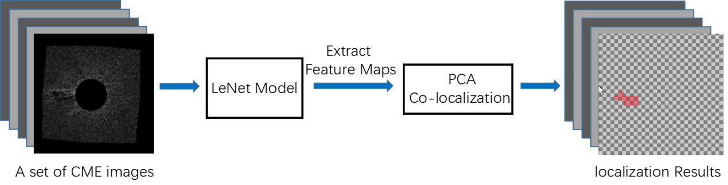
CME Region Detection
Each image's CNN feature map contains high level semantic information of CME region
Use PCA (Principal Component Analysis) to localize the CME region in an image set
Notes:
To mine the hidden information for segmenting the CME regions, we use Deep Descriptor Transforming an unsupervised image co-localization method, which utilize the Principal Component Analysis to localize the CME region in a image set

Slide 11
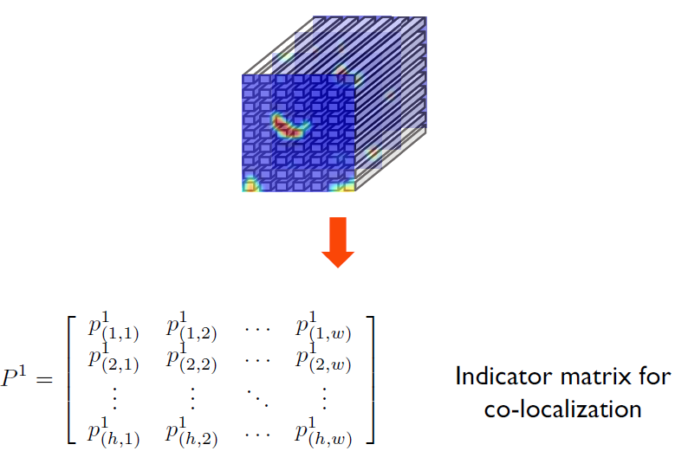
PCA Co-localization
PCA converts correlated variables
into uncorrelated variables
PCA transforming
The uncorrelated variable with the largest variance can be treated as an indicator of CME region
[Wei et al. 2017]
Notes:
PCA usually converts correlated variables into linearly uncorrelated variables , which called Principal Components.the first Principal Component correspond to the largest variance can be treated as an indicator of CME region , tells the probility of the cme region

Slide 12
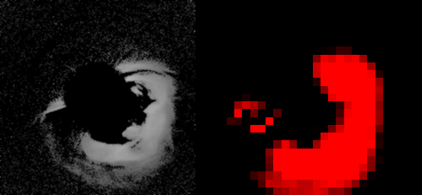
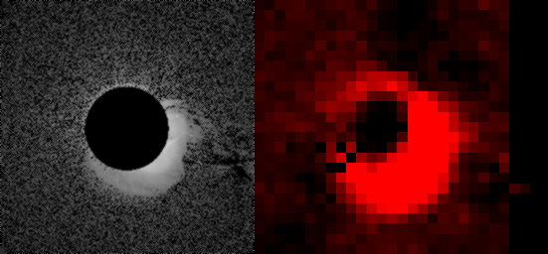
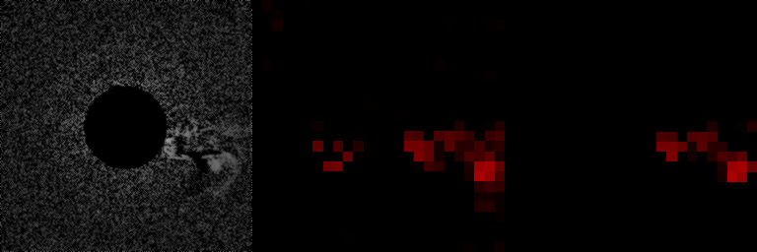
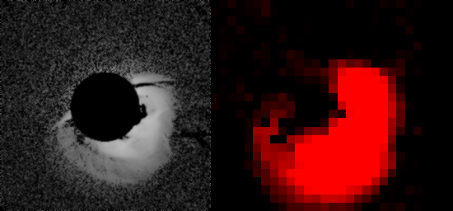
PCA Co-localization Results
Notes:
here we show some co-localization results

Slide 13
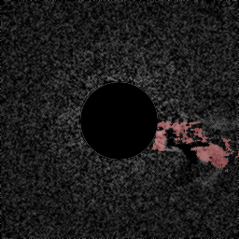
Refinement
graph cut method finely tune the CME region boundary
consider CME region probability and neighbor information
graph cut
origin image
CME region probability
refinement results
Notes:
after obtain a down-sampled rough boundary of cme regions, we use graph cut method[3] in computer vision which finely tunes the CME boundary. graph cut method consider the CME region probability computed by PCA co-localization and neighbor information from the origin image.

Slide 14
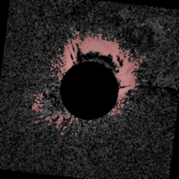
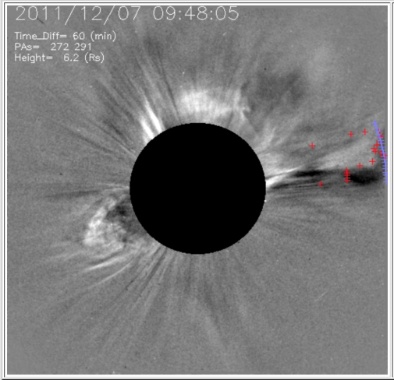
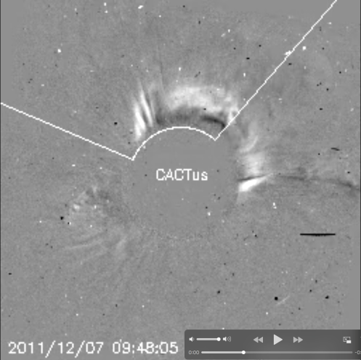
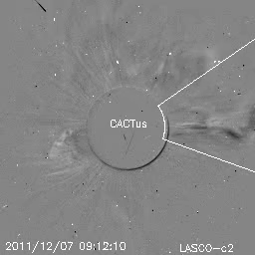
LeNet
SEEDS
Comparison of the detection
CACTUS
CACTUS
graphcut

Slide 15
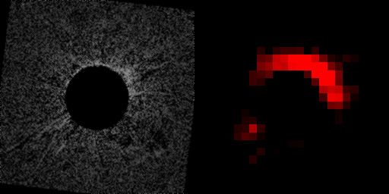
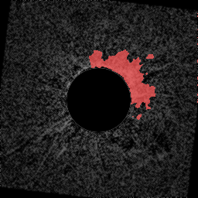
Tracking
new CME moves outward in at least two running-difference images [Olmedo et al. 2008]
robust to noise feature
Refinement + Tracking
new CME(in color Blue)
Notes:
in this part, we want to track the cme moving trajectory and the detect new cme. like previous method, we suppose CME must be seen to move outward in at least two running-difference images. we can use this rule to identify new CME event.

Slide 16

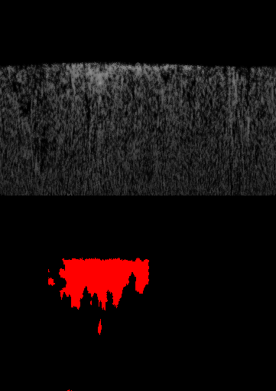
Tracking
convert to polar coordinate system
compute starting/ending position angles and maximal height for each angle
polar coordinate
Notes:
we first convert images and cme region mask to polar coordinate system. then compute starting and ending angle's postion and max-height for each angle

Slide 17
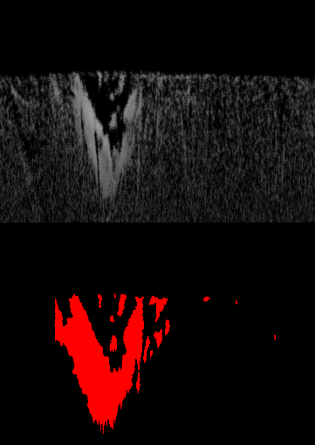
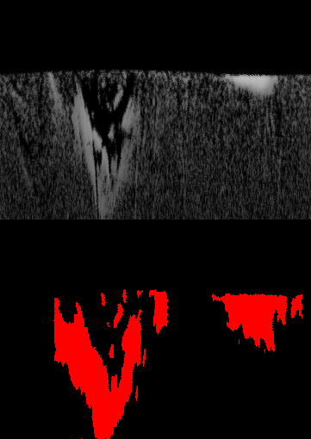
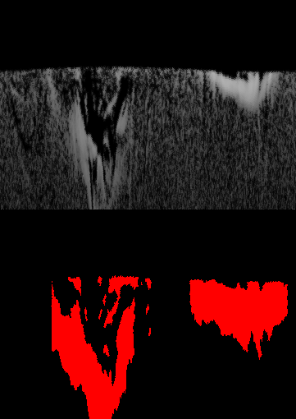
Tracking
consider next 2 running-difference images
Frame i-1
Frame i
Frame i+1
Notes:
by computing angular width overlap of frame i-1 and fram i, we notice that the right part of frame i-1 has cme feature noise which need to be removed. by considering frame i and frame i+1, the right part of frame i can be treated as a new detected cme event.

Slide 18
Tracking
consider next 2 running-difference images
compute angular width overlap: intersection set /union set > 0.1
noise
Frame i-1
Frame i
Frame i+1

Slide 19
Tracking
consider next 2 running-difference images
compute angular width overlap: intersection set /union set > 0.1
new CME
Frame i-1
Frame i
Frame i+1

Slide 20
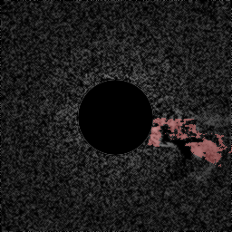
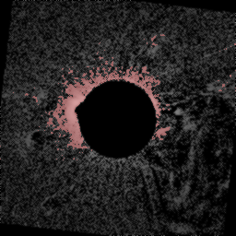
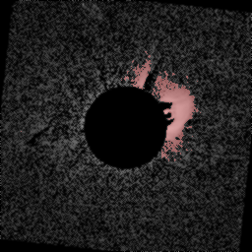
Summary and Outlook
We have developed a new tool for automated CME detection and tracking using the deep learning technique. CAMEL
An online catalog is being built with the key parameters of CMEs.
2011.2.15-2:34
2017.9.06-11:12
2011.12.03-11:09
2011.12.29-16:35
Notes:
here we show some final results

