Slide 1
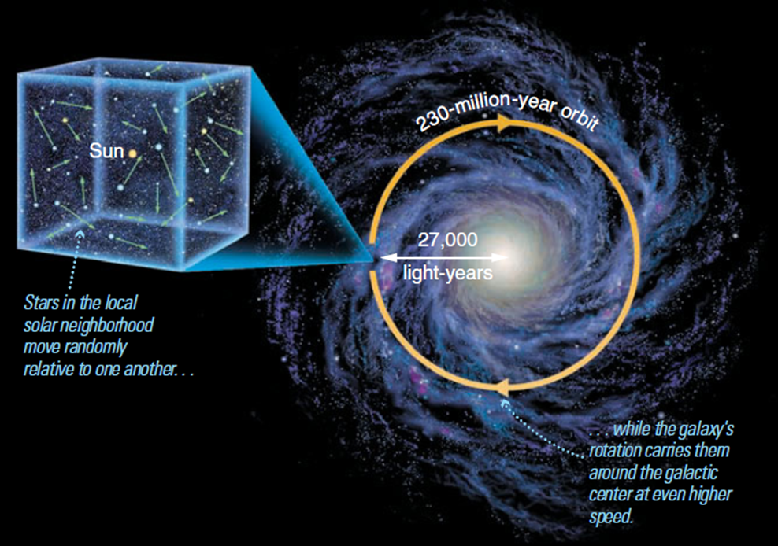
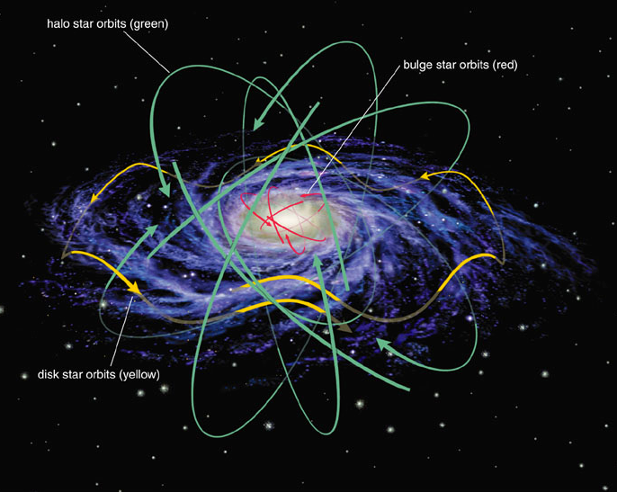
The Stellar Kinematics in Our Milky Way
Hai-Jun Tian, CTGU/MPIA
Collaborators: Chao Liu, Hans-Walter Rix, etc.

Slide 2
Outline

Slide 3
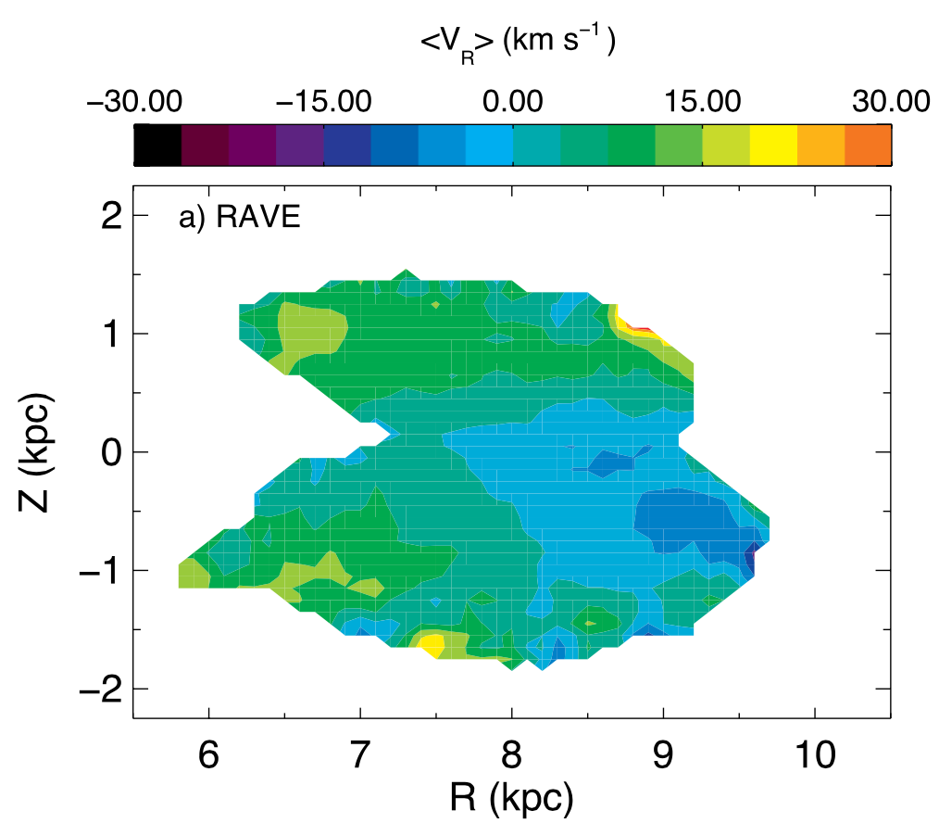
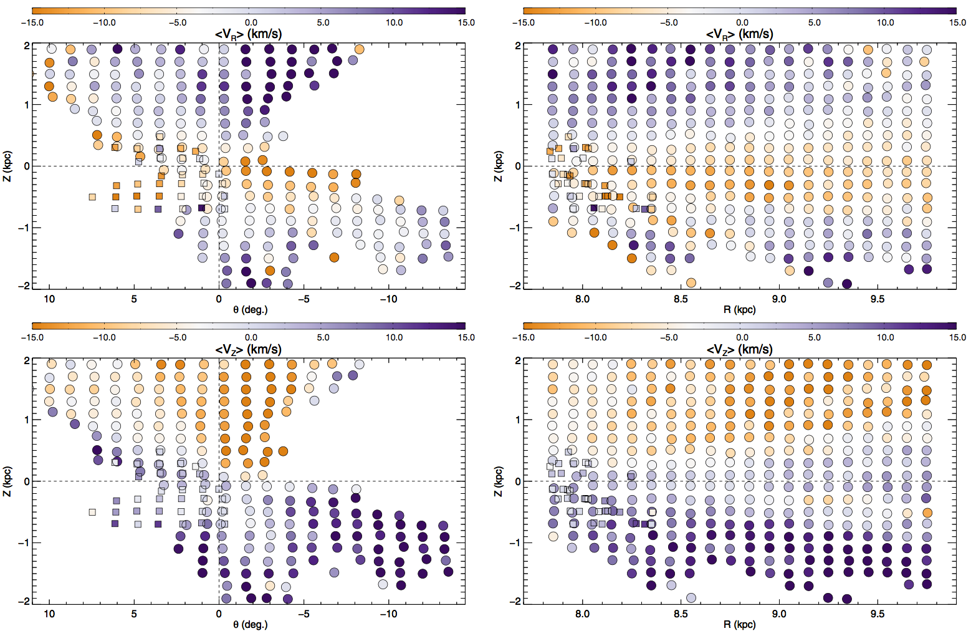
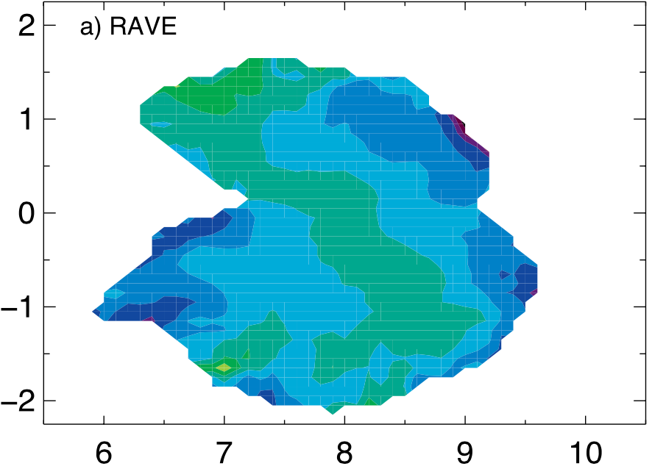
Bulk motions: Evidences
Negative
Positive
VR
VR
VR
Z(kpc)
Z(kpc)
Vz
Vz
VZ
R(kpc)
Azimuthal angle
R(kpc)
williams et al. 2013
Carlin et al. 2013
8kpc
Siebert et al. 2011; Widrow et al. 2012; Bovy et al. 2015; Sun et al. 2015

Slide 4
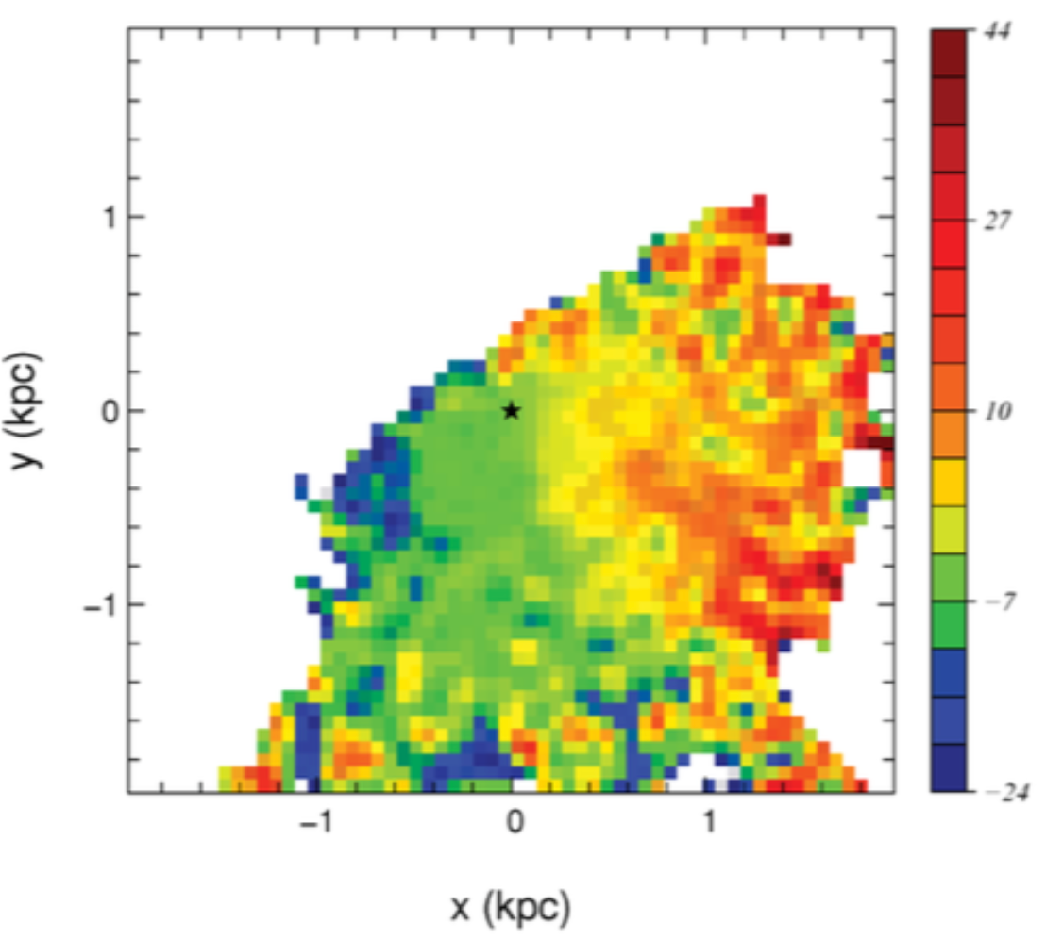
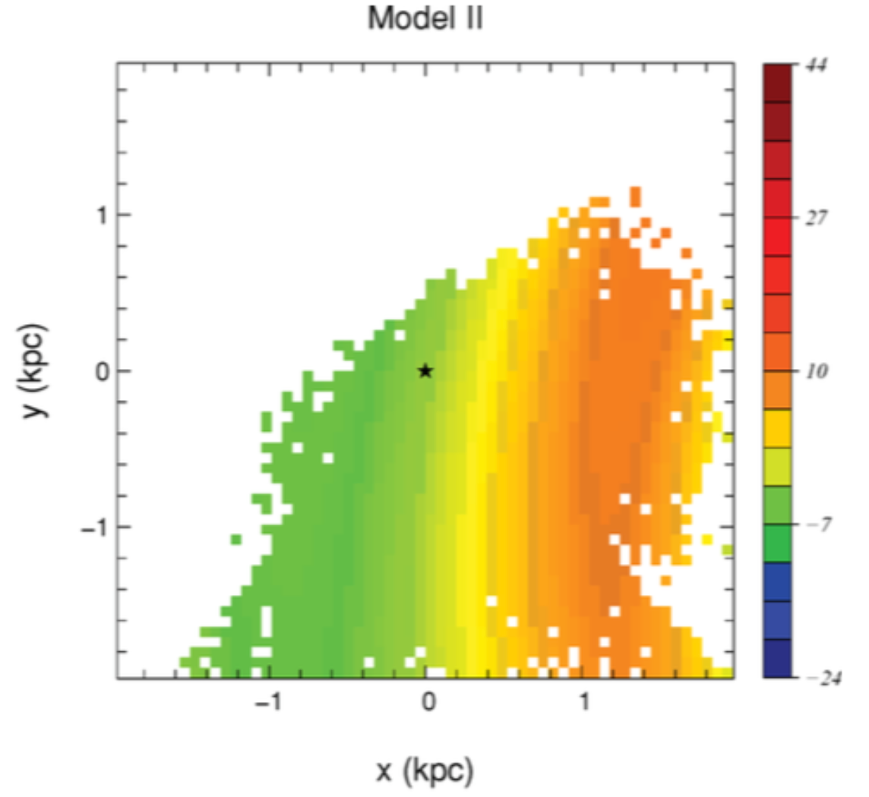
Bulk motions: explanations
Siebert et al. 2012
bulk motions in Vr:
VR
(1) Perturbation by arms (siebert+ 2012; Feure+2014);
(2) Perturbation by bar(Grand+2015);
(3) Ellipticity(Kuijken & Tremaine 1994; rix & zaritsky 1995)
2d density wave
bulk motions in Vz:
(1) Miner merging(Gomez+2013);
(2) Stellar warp(Drimmel+2000; López-Corredoira+2014)
Which mechanisms are true?
Perturbation from the spiral structure

Slide 5
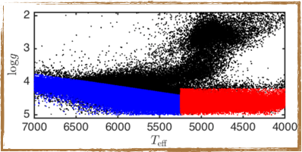
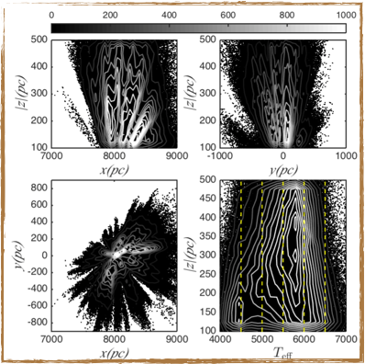
SOLAR NEIGHBOORHOOD: SAMPLE SELECTION
FG- stars with high temperature(blue points):
K- stars with low temperature(red points):
Additional criteria for all the FGK-stars:
Dividing method:
- 100<|z|<500, slicing 3 slices, overlapping 100pc each other
- teff from 4000K to 7000K, dicing 6 bins
- Finally, 209316 FGK stars (18 subsamples) left in total

Slide 6
SOLAR NEIGHBOORHOOD: METHOD
velocity projection
ellipsoid projection
Construct the Likelihood:
There are 9 free parameters:
we can obtain the best fit values by maximizing the likelihood.

Slide 7
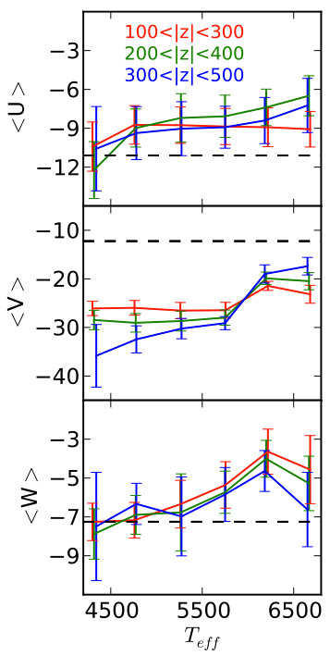
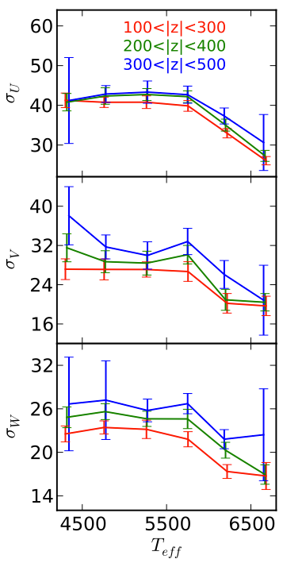
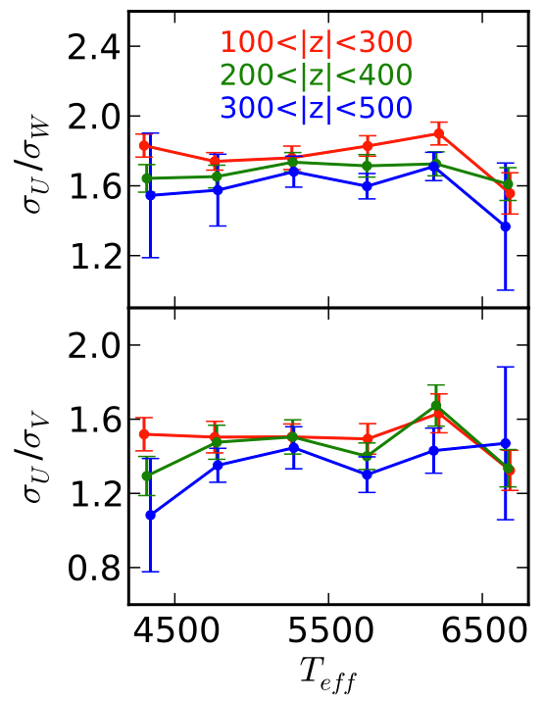
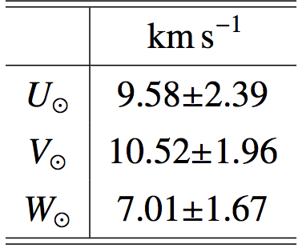
Results of LAMOST FGK
The real LAMOST sample, and calibrated by mock

Slide 8
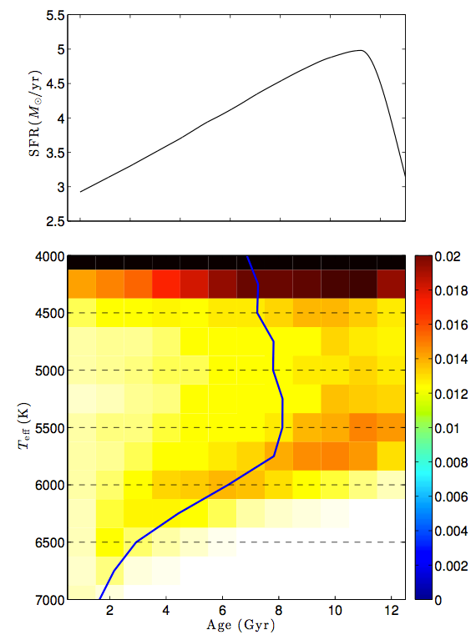
analysis
The age–Teff relation (to explain the non-zero net motions)
The abrupt change in age is perfectly consistent with our sudden change in the velocity dispersions.
Why: exist net asymmetric motion in all three orientations when Teff>6000! (Young).

Slide 9
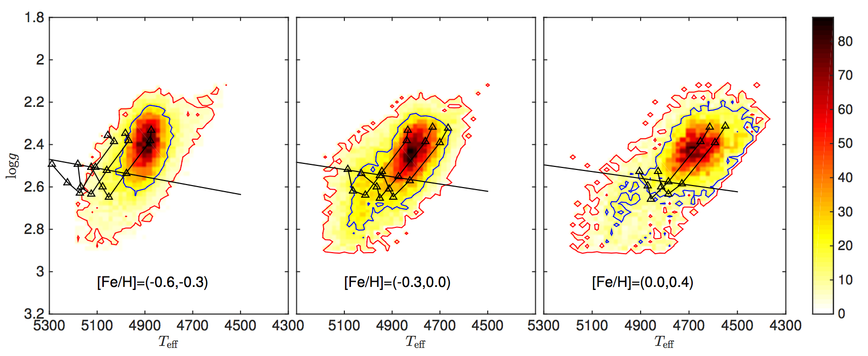
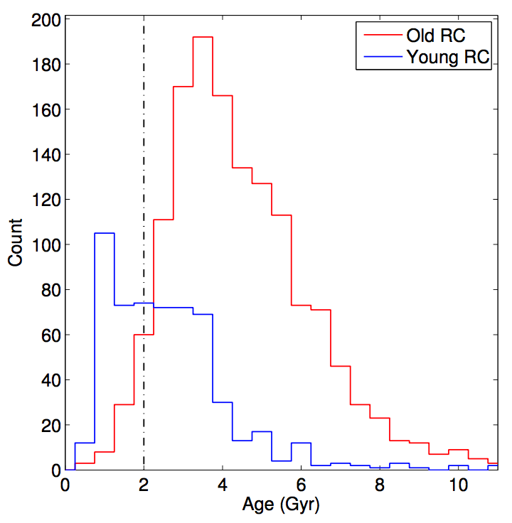
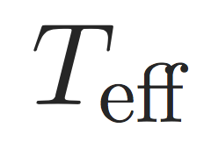
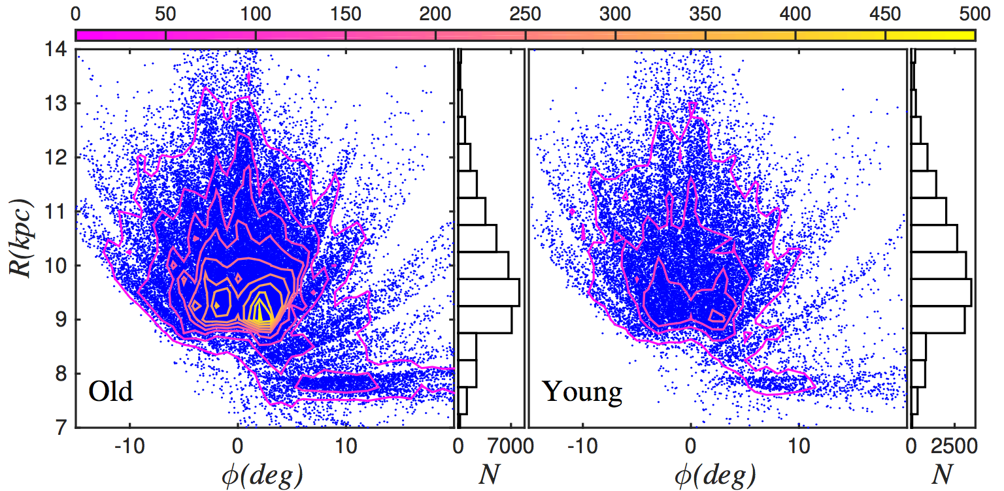
OUTER DISK: SAMPLE SELECTION
young
old
old RC
age from
Martig et al.2016
2 Gyr
young RC
2
Age(Gyr)
Young and old RCs are selected from 120 K RC candidates (Wan et al. 2015):
|Z| < 1kpc; 7<R/kpc<14
Old RCs ( > 2 Gyr): 40K
Young RCs ( < 2 Gyr): 20 K

Slide 10
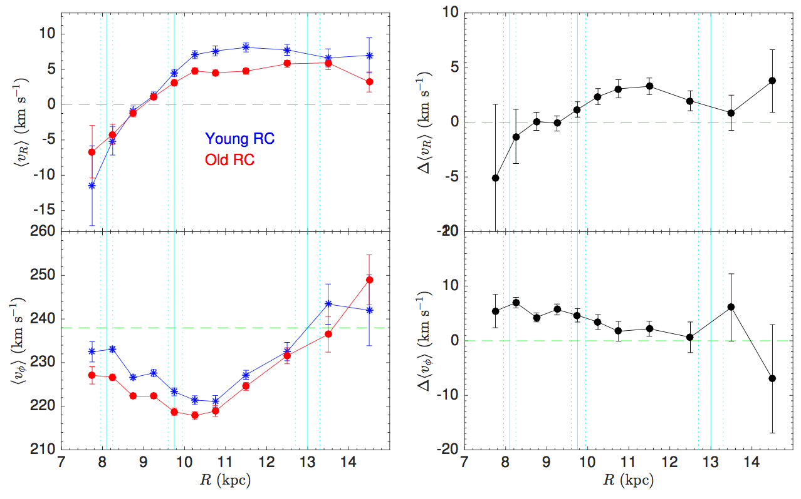
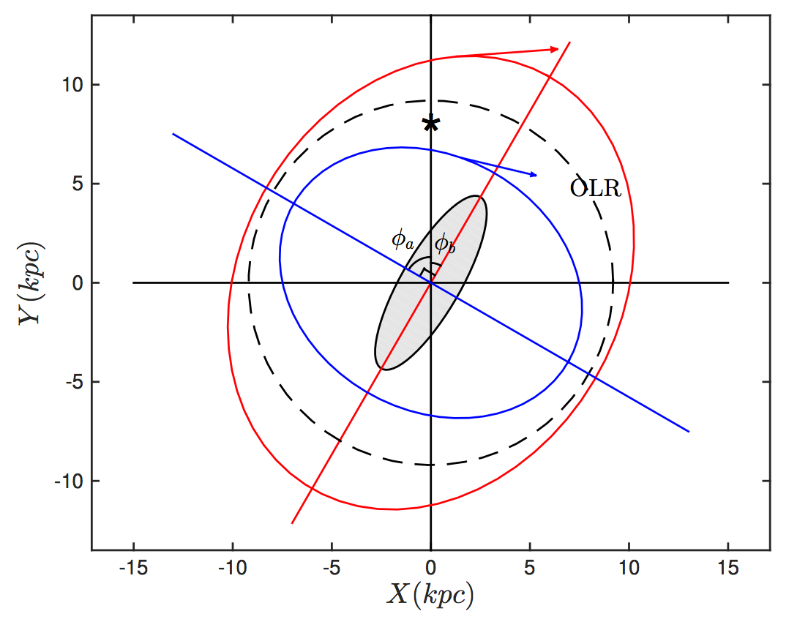
OUTER DISK: Radial & Azimuthal Velocity
in R<9.0kpc, both VR are negative; 0 km/s at R~9.0kpc; R>9.0kpc, vr~4-8km/s
VR are different (up to 3km/s).
U-shape Vphi
the young population rotates faster than the old by 5 km/s.

Slide 11
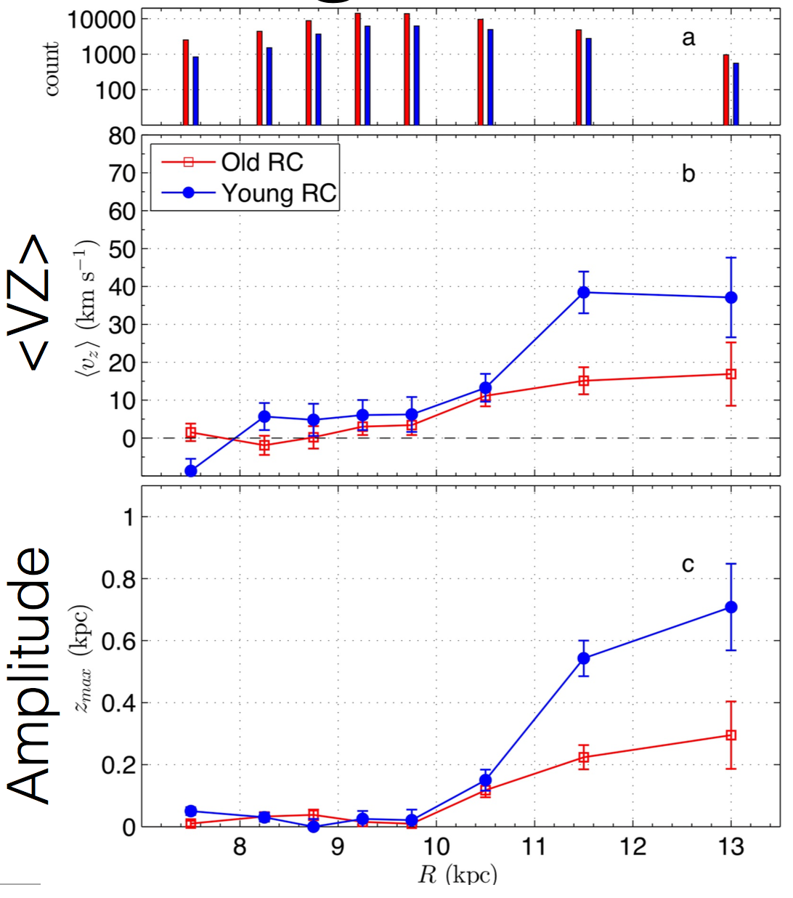
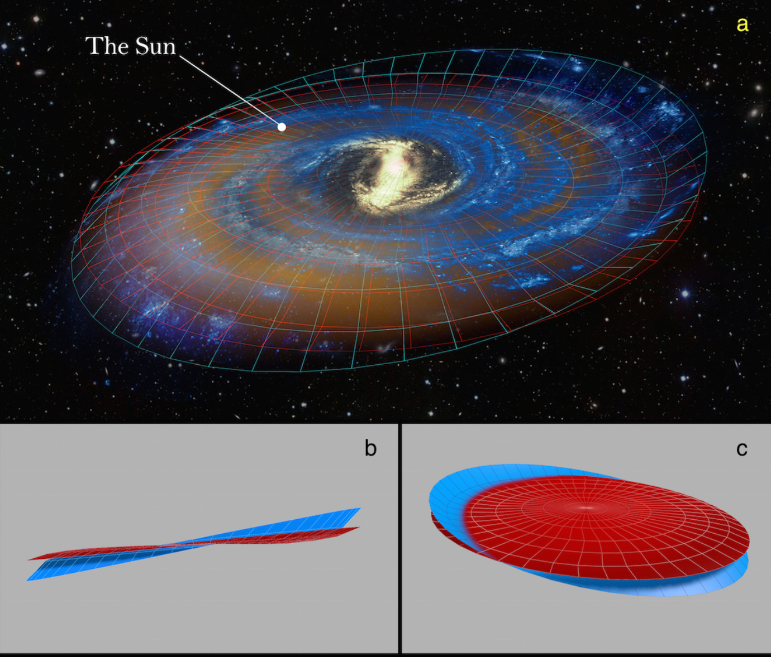
Age Variation in Warp: Vertical Velocity
Warp mechanism: dynamical torques (Shen+2006); misaligned infalling gas (Roskar+2010)
(Liu, Tian + 2016, submitted to Nature)

Slide 12
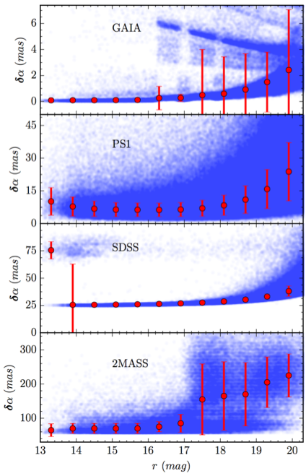
GPS1 Proper Motion Catalog: DATA
GAIA (1-year, <2mas)
PS1 (>4 years, ~10mas)
SDSS (~10 years ago, ~25 mas)
2MASS (~10 years ago, ~100 mas)
It is difficult to cross-calibrate sources in the different surveys

Slide 13
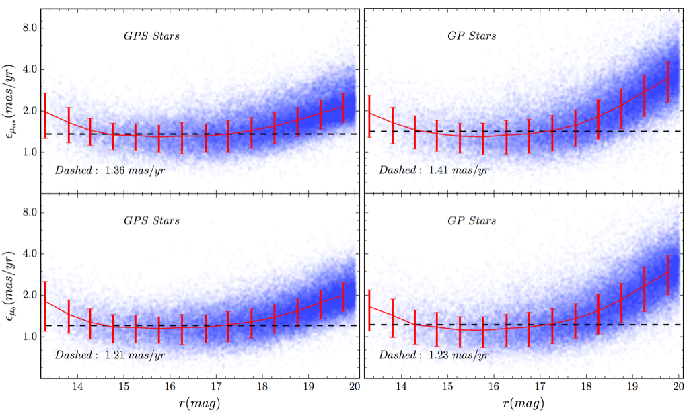
GPS1 Proper Motion Catalog: result
GPS(\alpha): 1.35 mas/yr
GP(\alpha): 1.41 mas/yr
GPS(\delta): 1.21 mas/yr
GP(\delta): 1.23 mas/yr

Slide 14
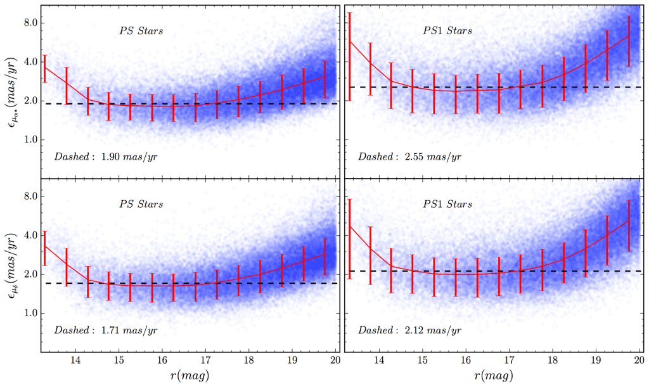
GPS1 Proper Motion Catalog: result
PD(\alpha): 1.91 mas/yr
PS1(\alpha): 2.55 mas/yr
PD(\delta): 1.71 mas/yr
PS1(\delta): 2.12 mas/yr

Slide 15
Conclusions: Taking-Home points
-- Bulk motions:
- Young stars (Teff>6000K) takes the born informations. (Tian + 2015)
- VR can be explained by Ellipticity of the disk induced by the rotating bar. (Tian + 2017)
- Vz can be explained by stellar warp, we favor the misaligned infalling gas warp mechanism. (Liu, Tian + 2016)
-- We derive the solar motion of (U⊙, V⊙, W⊙)=(9.58, 10.52, 7.01) km/s with respect to the local standard of rest. (Tian + 2015); The pattern speed of the bar is measured as 45 km/s/kpc. (Tian + 2017)
-- We construct a proper motion catalog (GPS1): ~350M stars across 3/4 sky region, down to mr<20; The systematic error <0.3 mas/yr (~10x better than PPMXL, UCAC4), the precision ~1.5 mas/yr. (~4x better).
- GPS2 after Gaia DR2

Slide 16
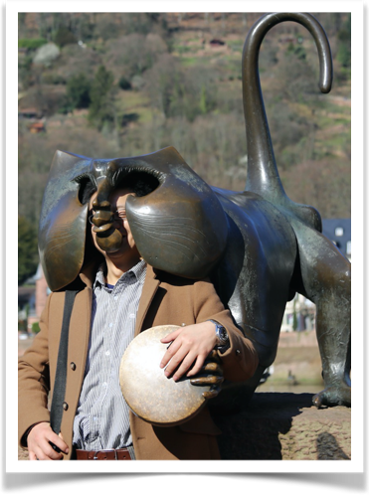
thanks

Slide 17
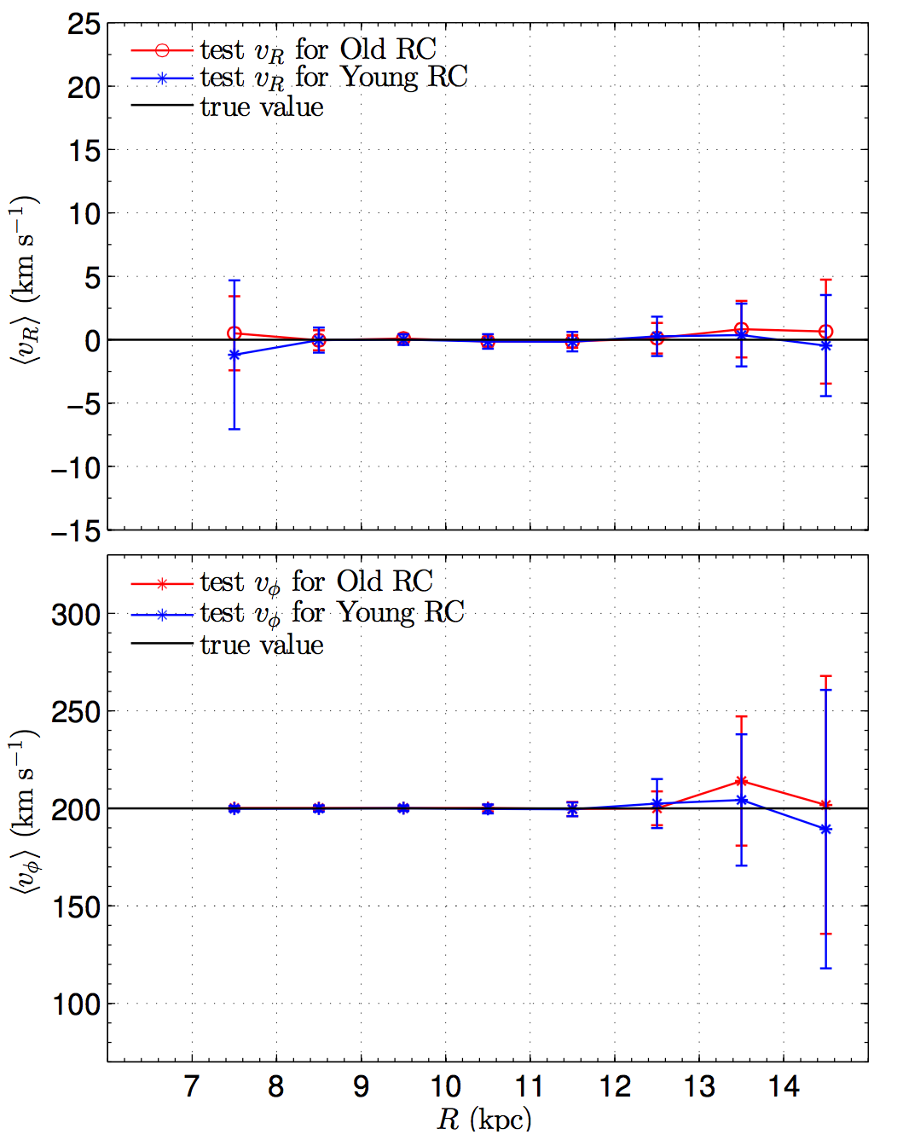
Validation of the Method

Slide 18
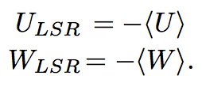
Results of the LAMOST sample
The Solar motion with respect to the LSR
The stars cooler than 6000K over all |z| bins are averagely old. Since they do not show significant gradient in <V> it is safe to assume that they are in equilibrium.
Eq.(4.228) of Binney&Tremaine(2008)
set h_R = 2.5; L~2*h_R=5.0 (kruit 1988)

Slide 19
Validation of the Method
Validation with GCS data
We selected a sub-sample of 3712 from the GCS dwarf stars with the criteria (5500K< Teff <6000K, U<200km/s, V<400km/s, and W<200km/s)

Slide 20
OUTER DISK (METHOD)
observed los Velocity in gsr
modeled los Velocity in GSR
Construct the Likelihood:
There are 3 free parameters:
we can obtain the best fit values by maximizing the likelihood.

