Slide 1
Chinese Virtual Observatory
十五年回顾与展望
Chenzhou Cui
Chinese Virtual Observatory
NAOC, CAS

Slide 2

Virtual Observatory (VO)
Virtual Observatory (VO) is a data-intensively online astronomical research and education environment, taking advantages of advanced information technologies to achieve seamless, global access to astronomical information.
  虚拟天文台是通过先进的信息技术将全球范围内的研究资源无缝透明连接在一起形成的数据密集型网络化天文研究与科普教育平台。
The Virtual Observatory (VO) aims to provide a research environment that will open up new possibilities for scientific research based on data discovery, efficient data access, and interoperability.
International Virtual Observatory Alliance
  --"facilitate the international coordination and collaboration necessary for the development and deployment of the tools, systems and organizational structures necessary to enable the international utilization of astronomical archives as an integrated and interoperating virtual observatory."
Notes:
2
我给虚拟天文台下了一个定义。“虚拟天文台是通过先进的信息技术将全球范围内的研究资源无缝透明连接在一起形成的数据密集型网络化天文研究与科普教育平台。”这里有几点我想强调一下儿。虚拟天文台是技术使能的，是先进的IT技术让它的梦想有了实现的可能。虚拟天文台利用的是全球范围内的资源，不仅局限于一个大学、一个天文台或者一个局域网。虚拟天文台中的资源是无缝透明地融合在一起的，用户不会感觉到它们在物理位置上的差异。还有，虚拟天文台是数据密集型的，它的目的是要让所有能够接触到互联网的人都可以得到真实而丰富的天文数据，进而充分发挥这些数据的科学价值。万维网的威力在于它的透明性，仿佛所有的资料都存在于你自己的PC上。虚拟天文台的目标也是要达到这样的透明性，把天文数据和相关信息带到你的PC上。

Slide 3
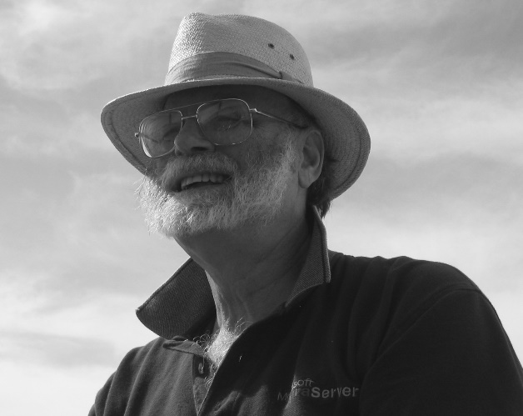
China-VO
Chinese Virtual Observatory (China-VO) is the national VO project in China initiated in 2002 by Chinese astronomical community leading by National Astronomical Observatories, Chinese Academy of Sciences.
China-VO became a member of the IVOA with the recommendation of Dr. Jim Gray
R&D Focuses
China-VO Platform
Unified Access to On-line Astronomical Resources and Services
VO-ready Projects and Facilities
VO-based Astronomical Research Activities
VO-based Public Education

Slide 4
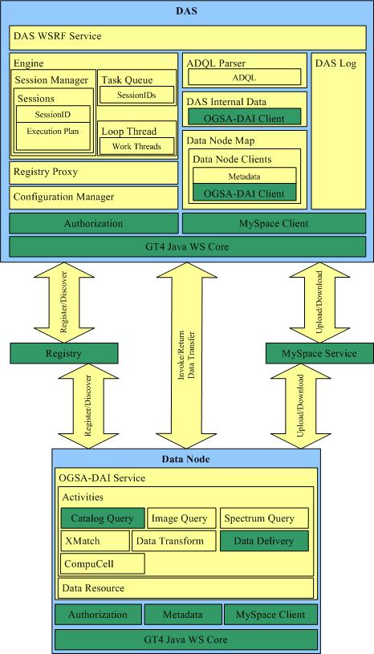

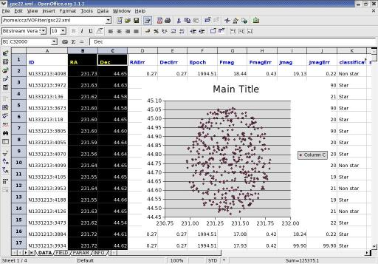
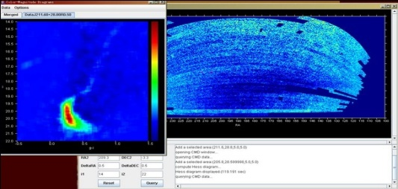
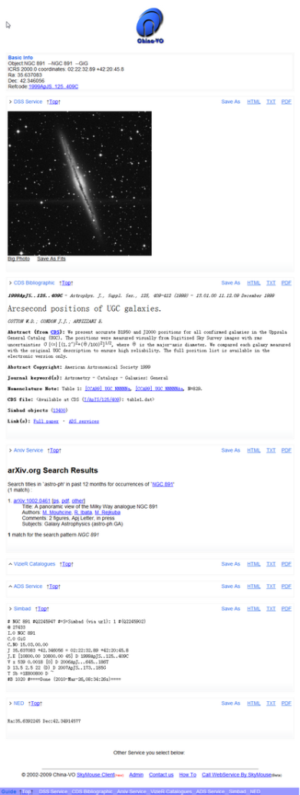
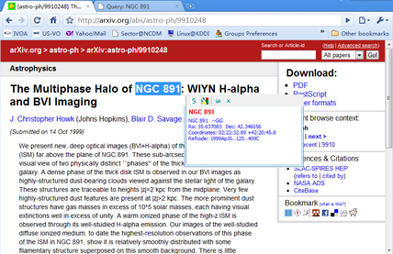
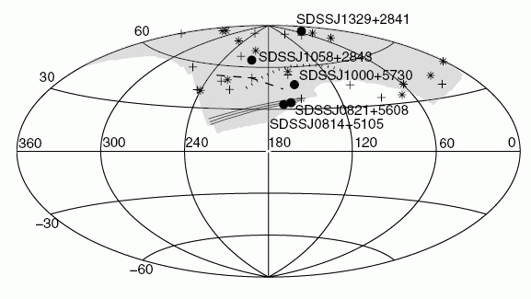
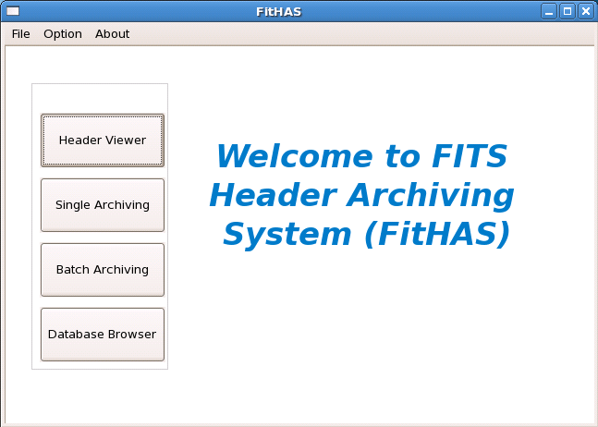
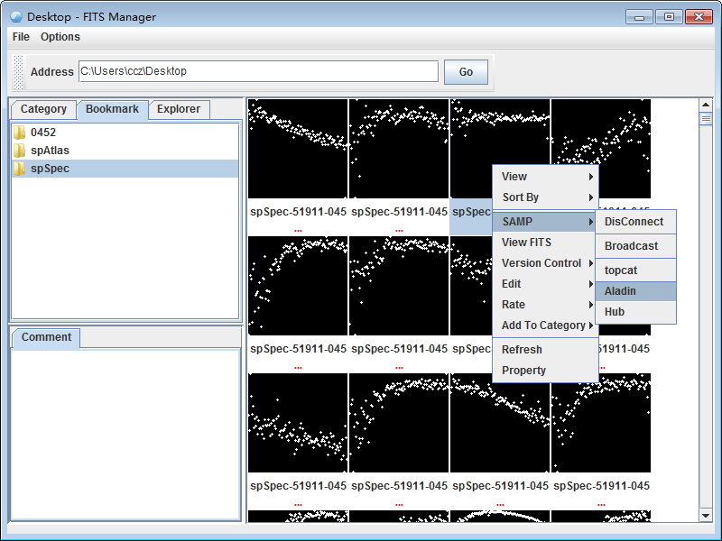
Development achievements in last decade
VO-DAS
VOFilter
SkyMouse
FitHAS
FITS Manager

Slide 5
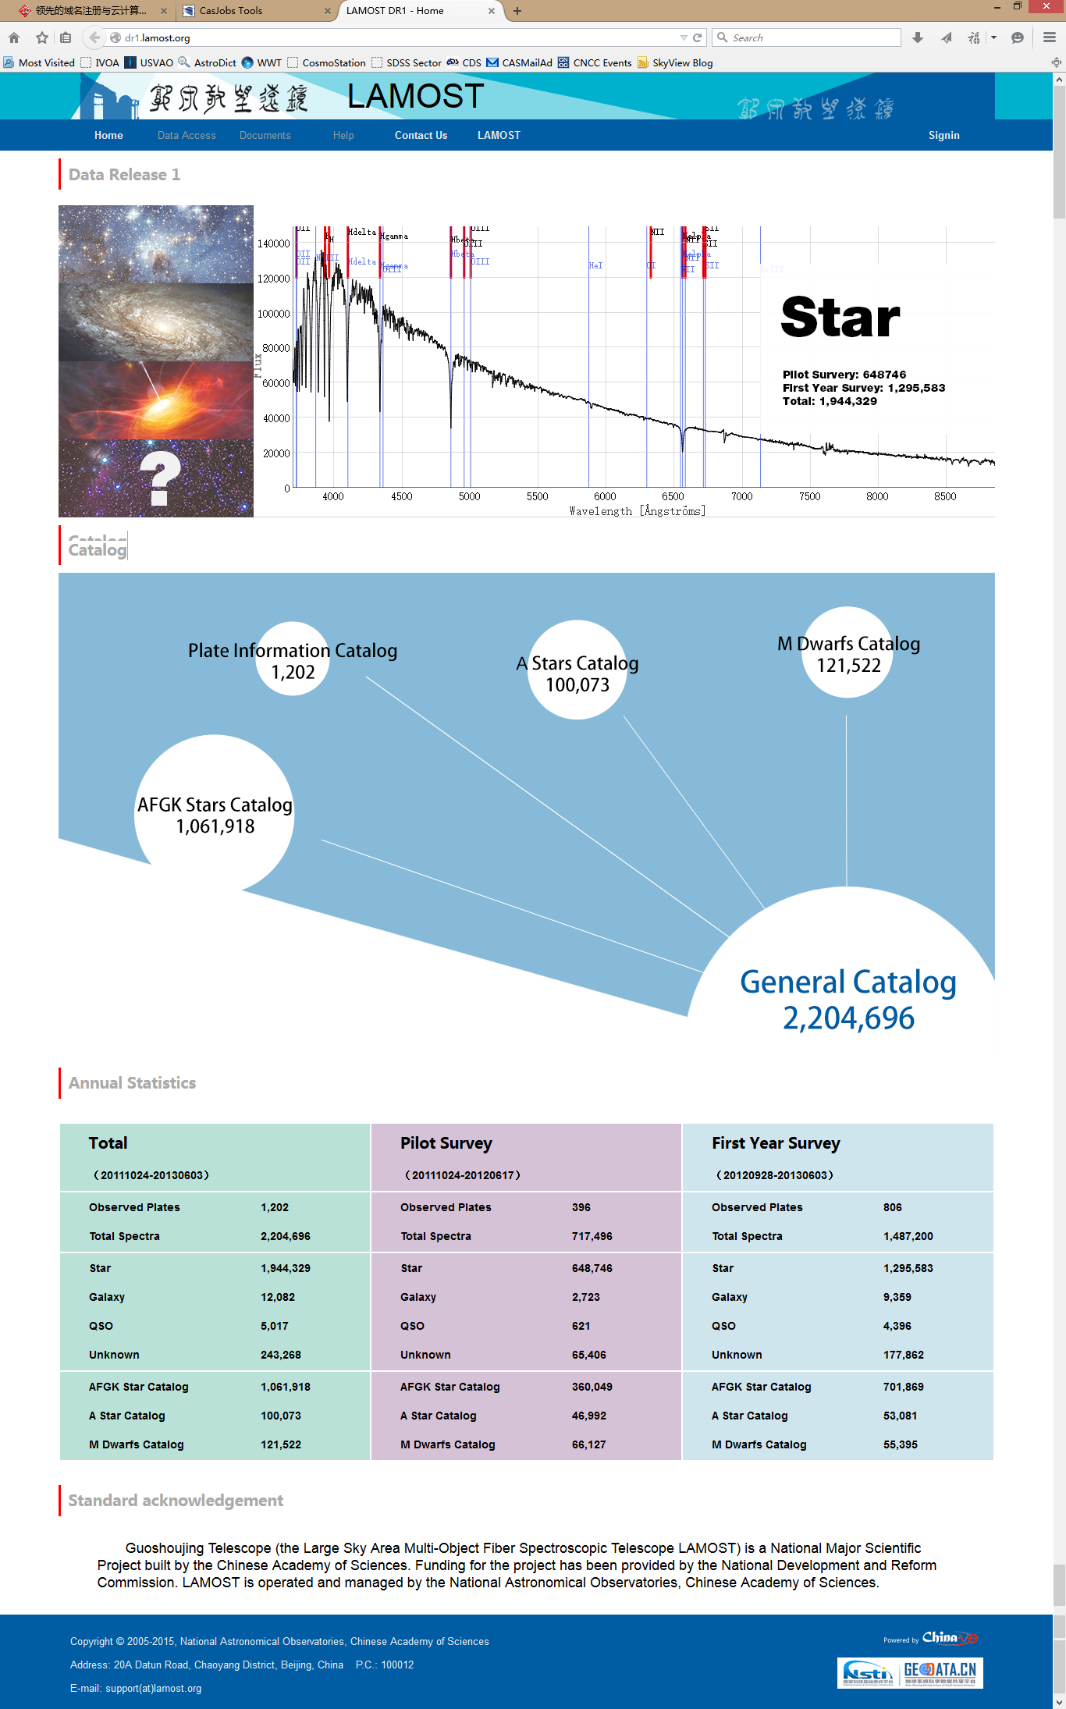
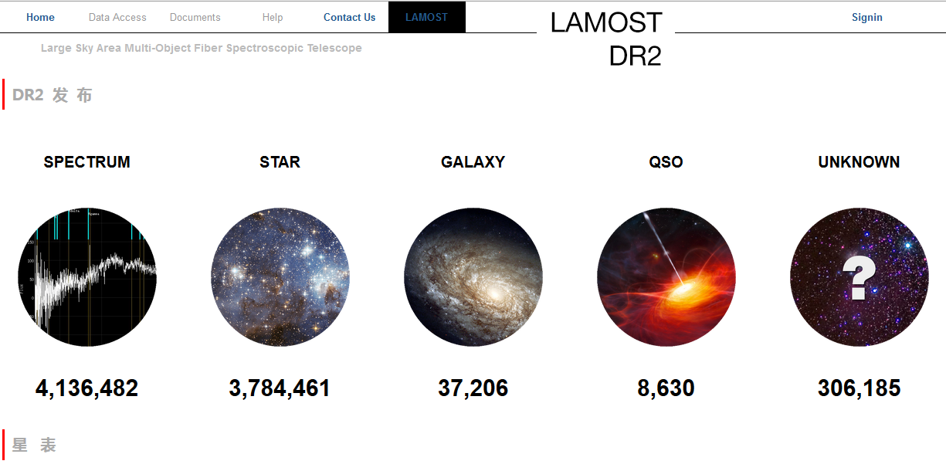
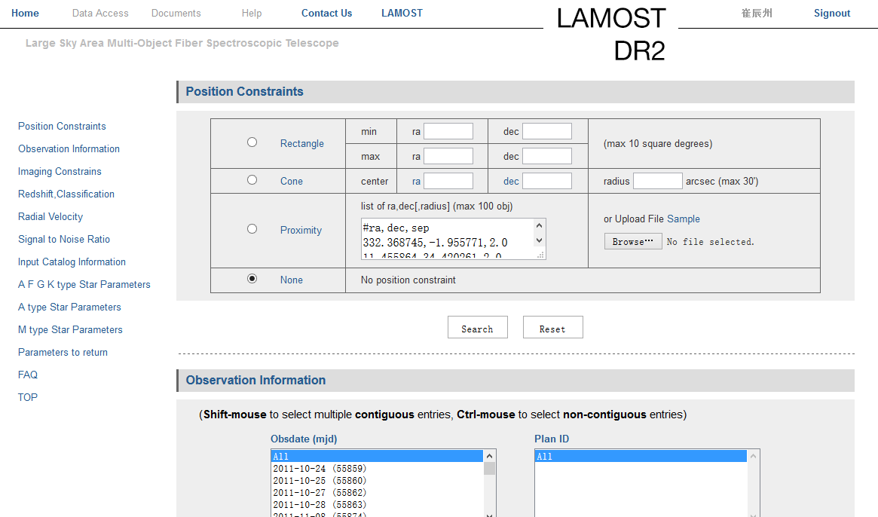
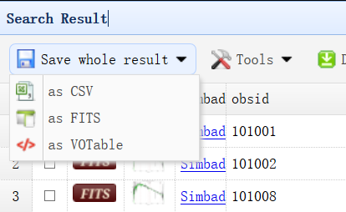
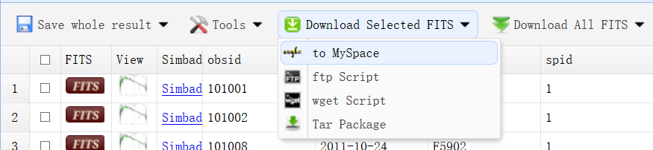
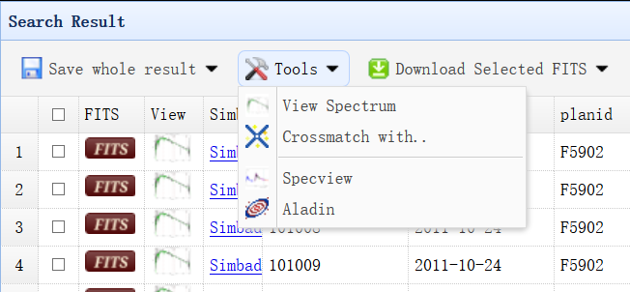
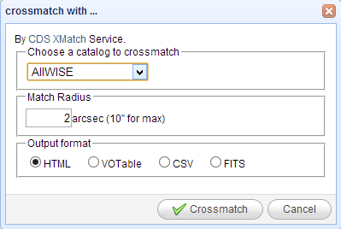
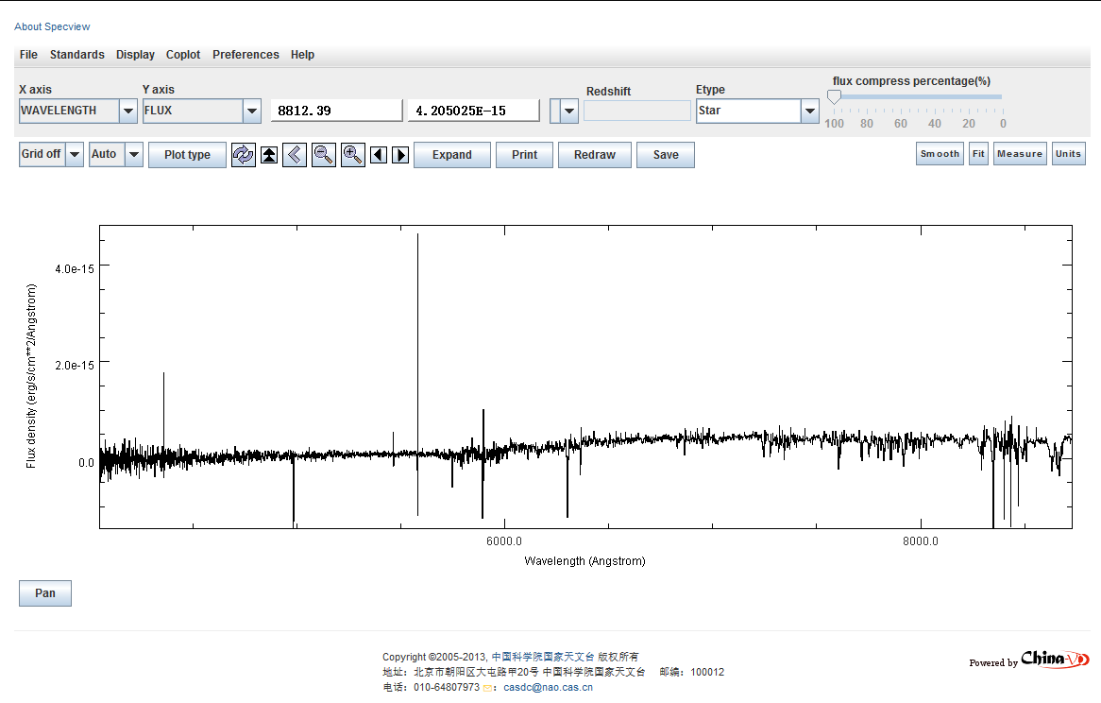
LAMOST Data Access

Slide 6
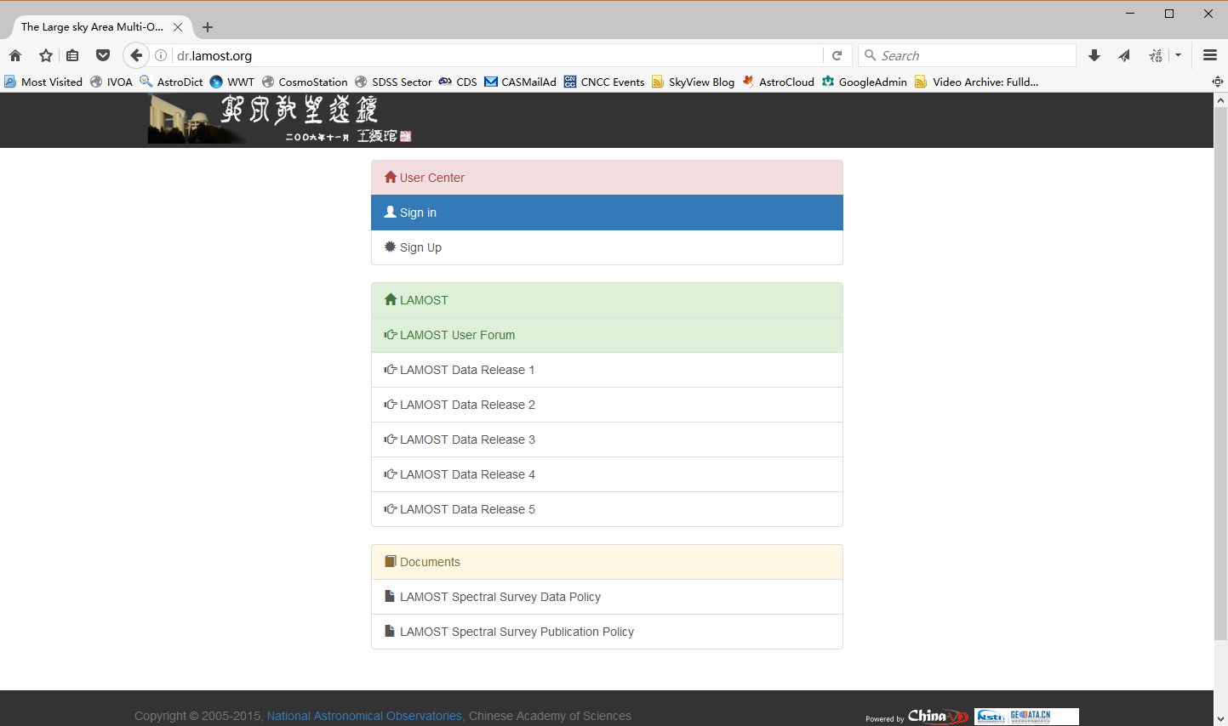

Slide 7
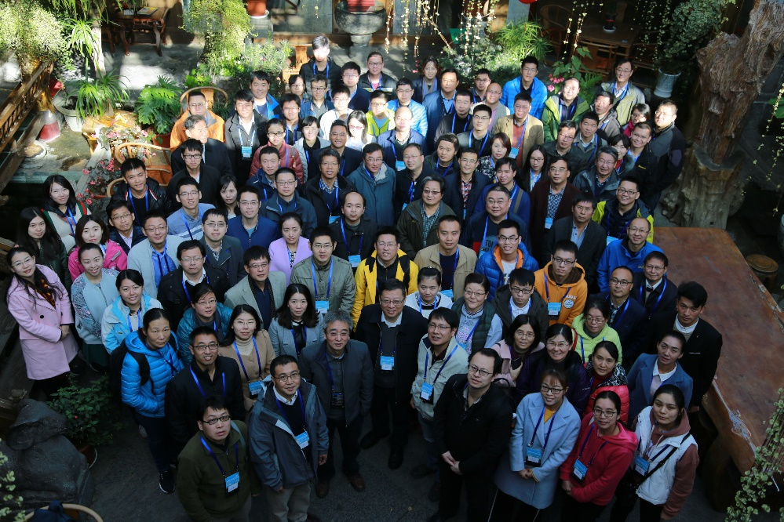
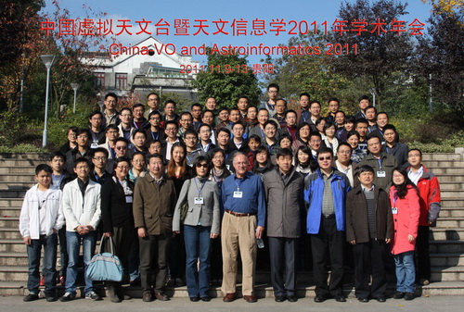
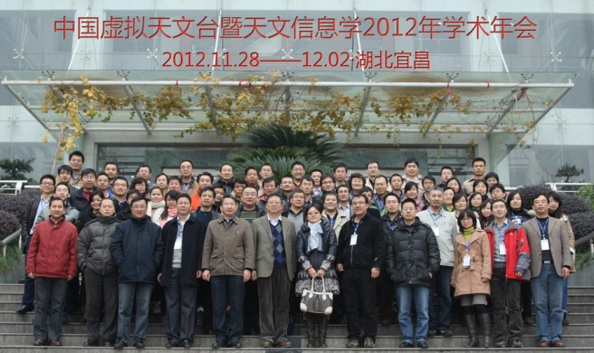
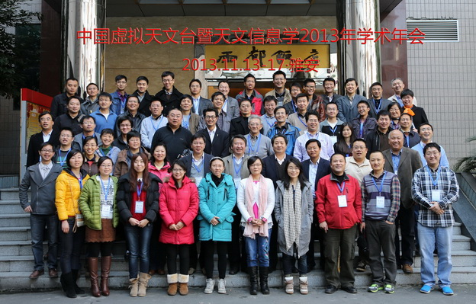
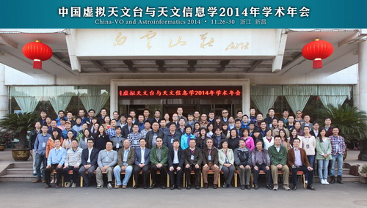
Community: China-VO annual meeting

Slide 8
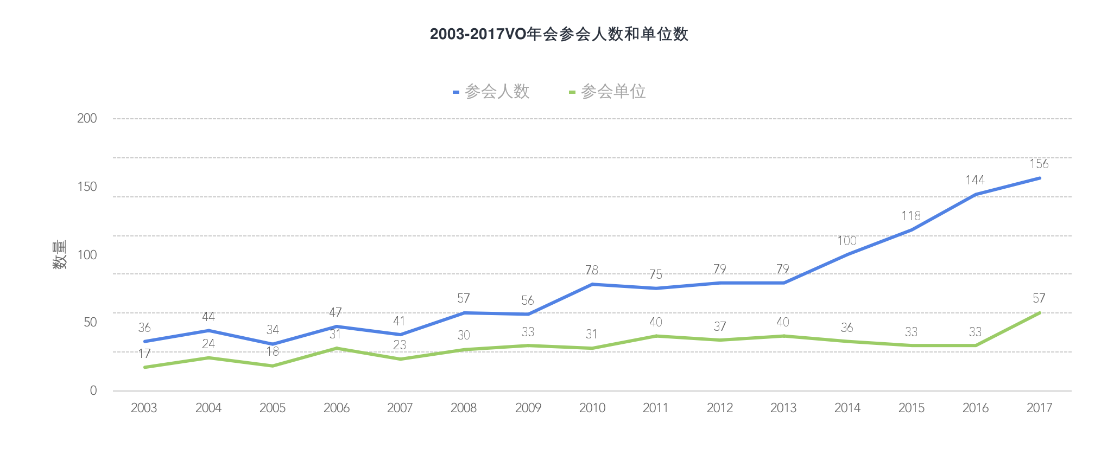
参会人员和单位数量变化

Slide 9
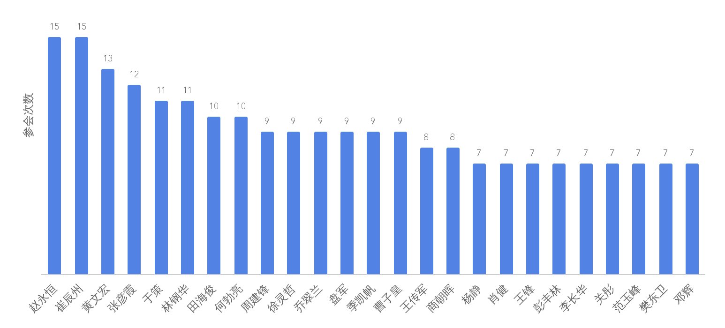
VO的铁杆粉丝

Slide 10
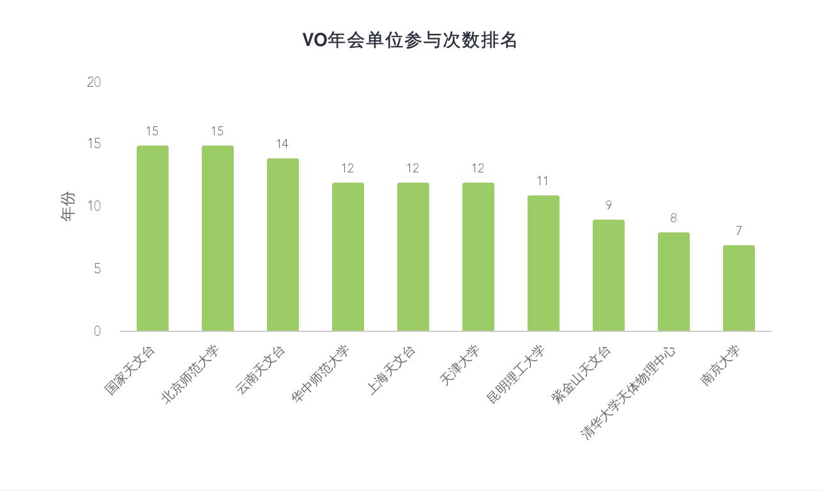
VO的铁杆单位

Slide 11
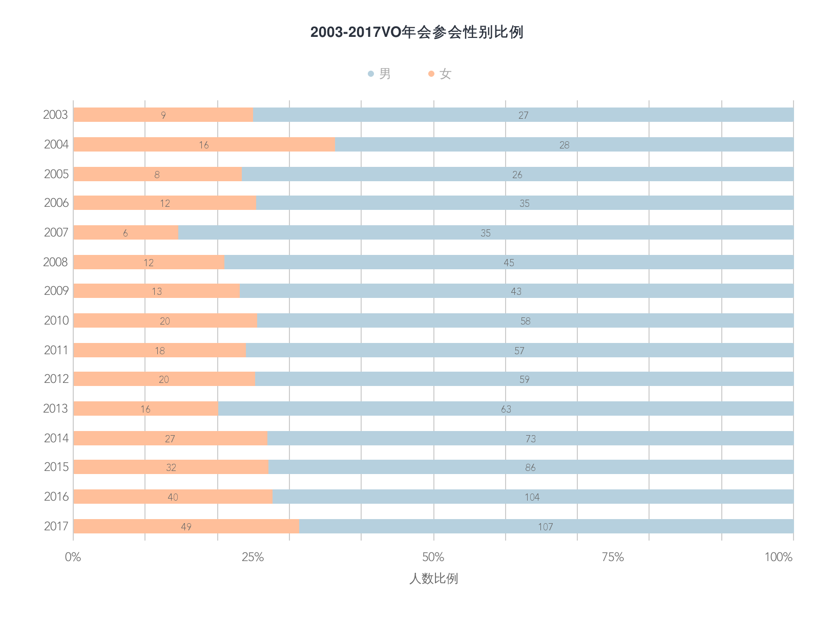
参会人员性别比例的变化

Slide 12
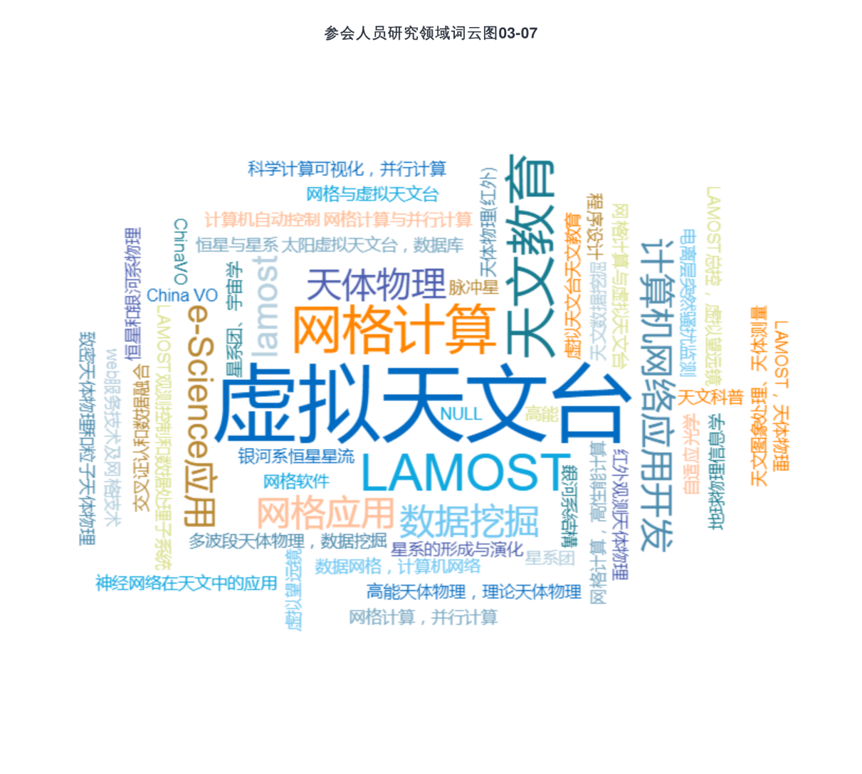
研究领域关键词云图

Slide 13
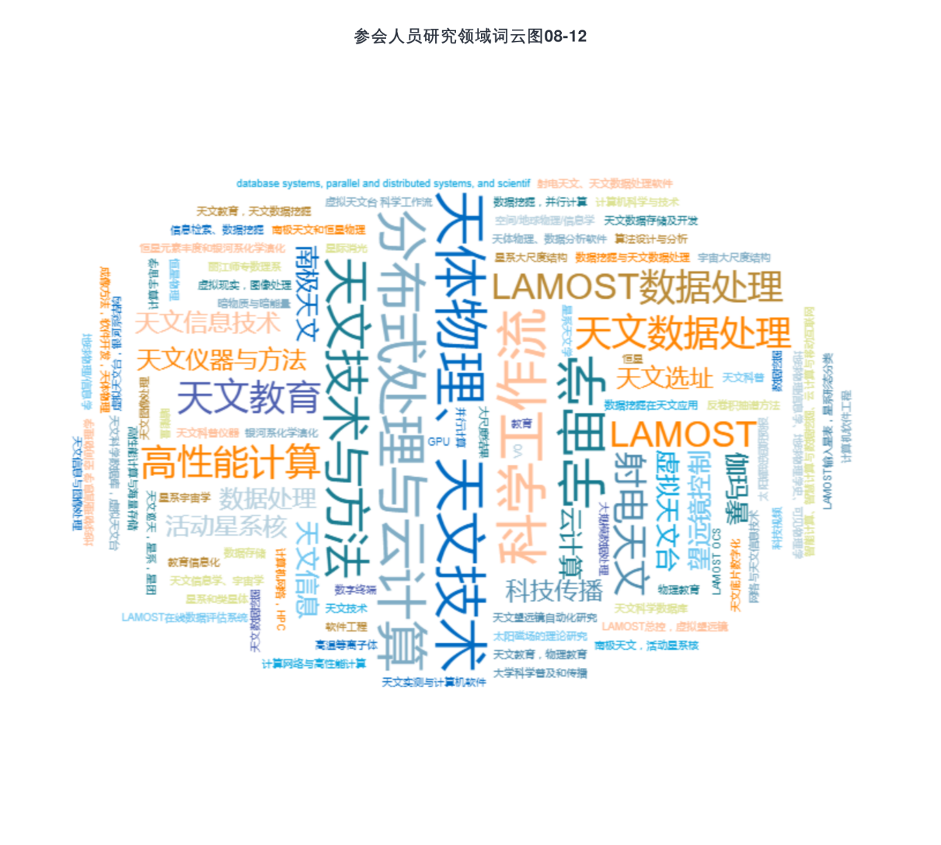
研究领域关键词云图

Slide 14

研究领域关键词云图

Slide 15

研究领域关键词云图

Slide 16
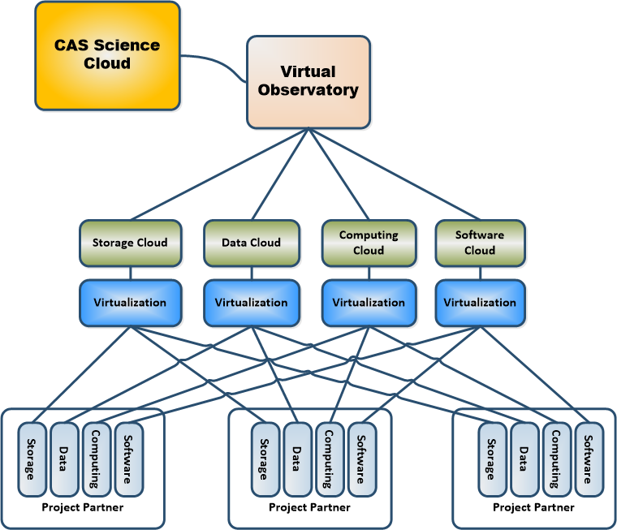
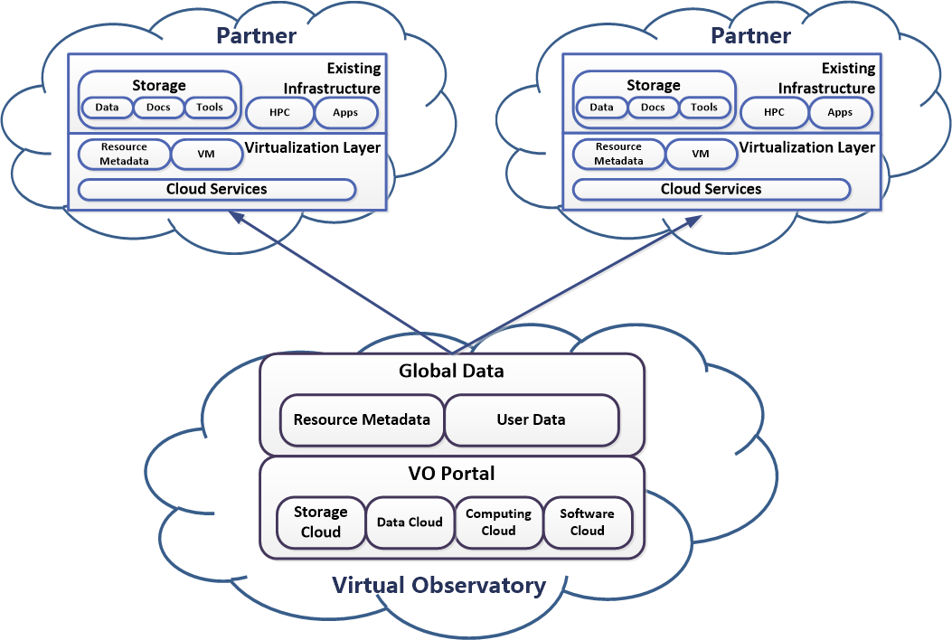
AstroCloud Project
National Astronomical Observatories, CAS
Purple Mountain Observatory
Shanghai Astronomical Observatory
Yunnan Astronomical Observatory
Xinjiang Astronomical Observatory
2013.3 – 2015.12
8M RMB (~1.3M USD)
Notes:
在充分调研和深入探讨的基础上我们完成了天文科技领域云的初步设计，利用云计算技术和虚拟化手段整合各个参建单位的存储、数据、计算、特色应用和专题服务，形成存储云、数据云、计算云和服务器，进而融合为统一的“天文学科技领域云”，最终纳入我院科技云平台。

Slide 17
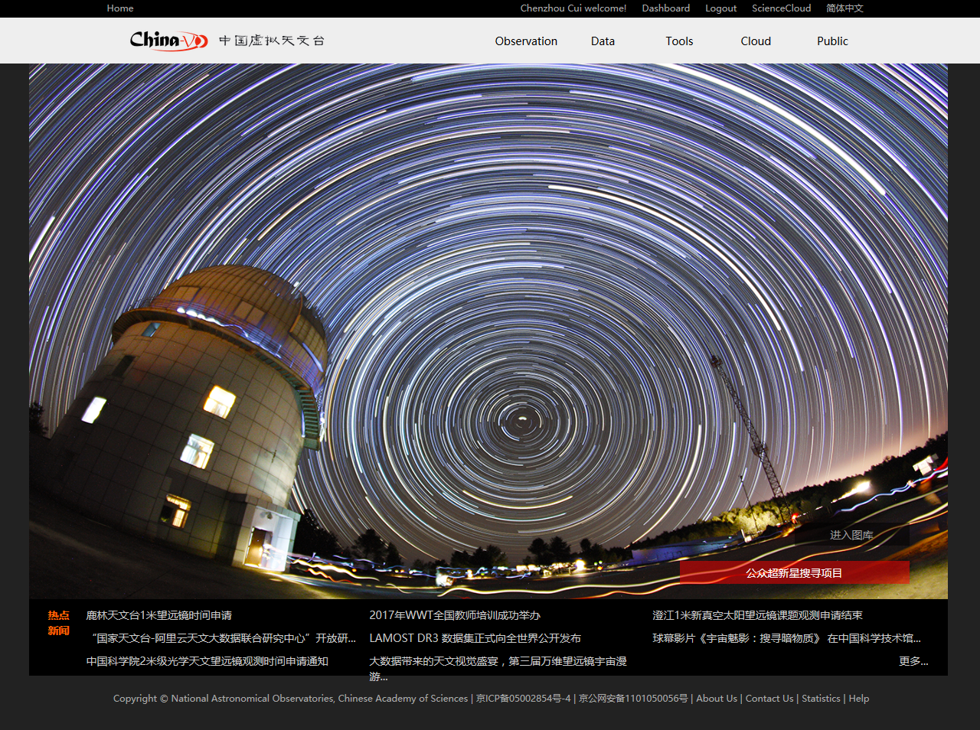

Slide 18
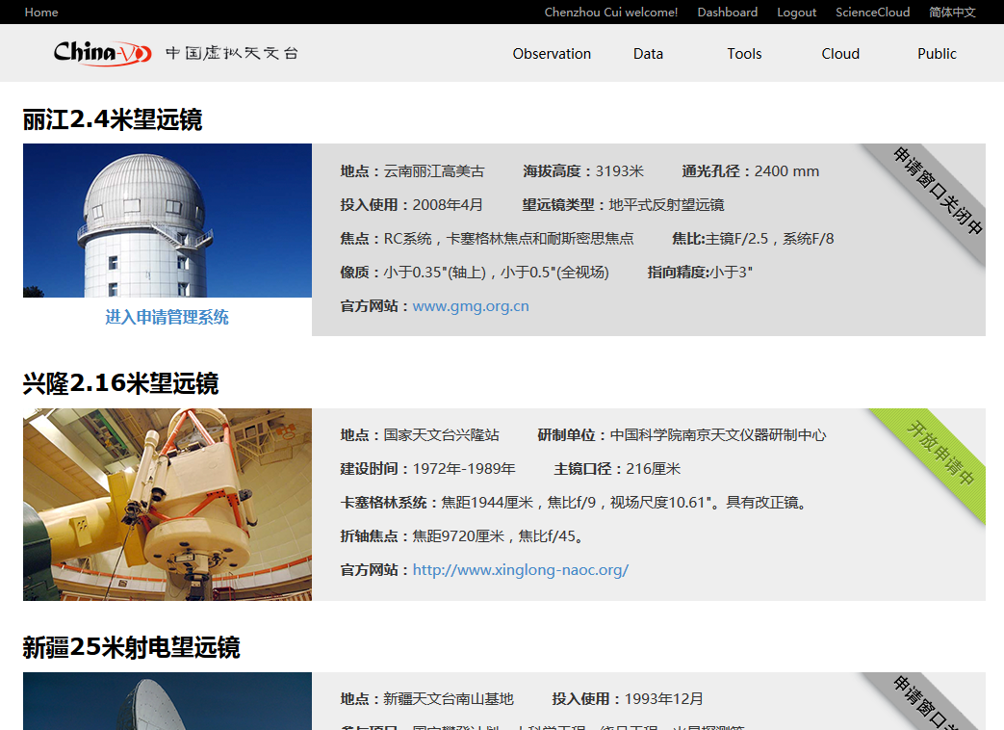
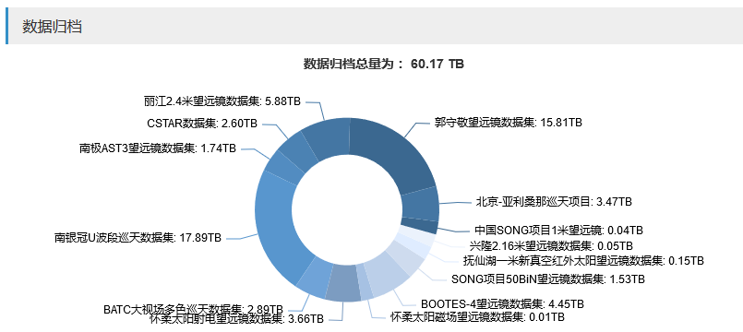
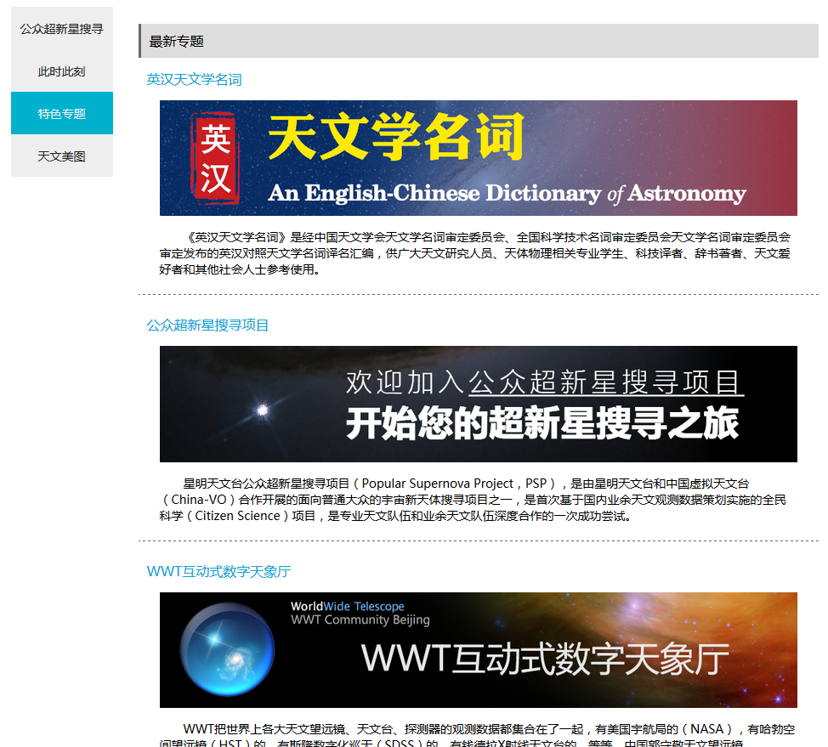
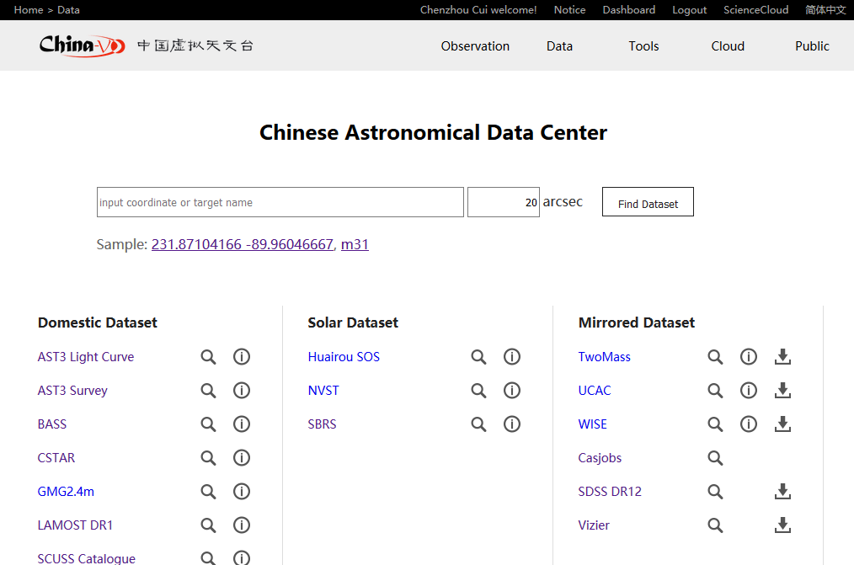
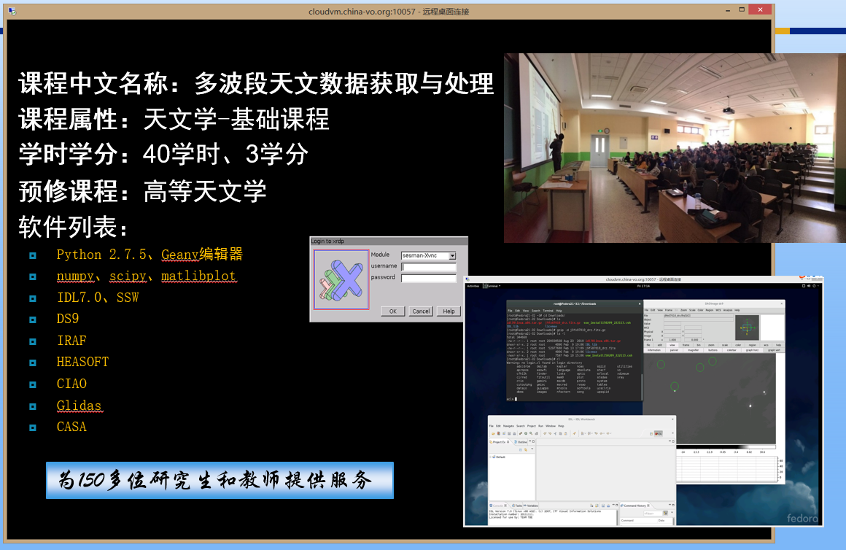
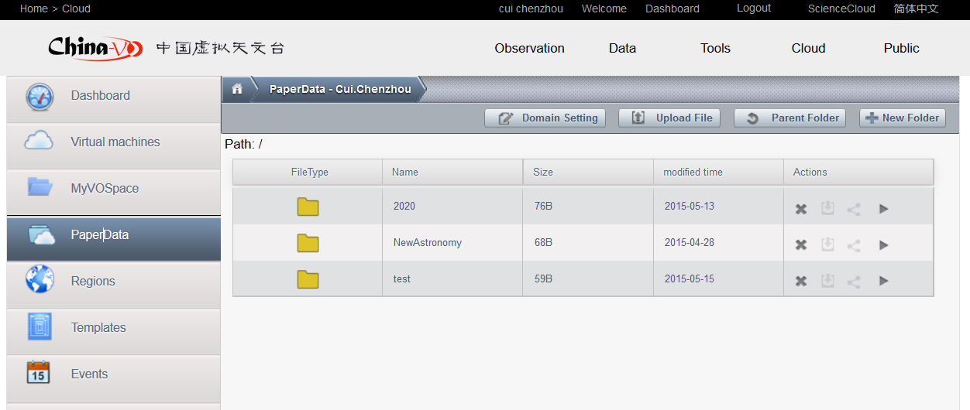
AstroCloud Channels
Observation
  Telescope Proposal Submission and Management
    2.4m, 2.16m, radio telescopes, public telescopes
Data Discovery and Access
  Virtual Observatory
  Seamless astronomy
Tools
  Selected VO tools and software packages
Cloud Computing
  Pre-installed data processing and analyzing environments
  China-VO paperdata, Cloud based storage
Public channel
  Public Supernova search Project (PSP)
  China-VO specials
    Observatory live video streams
    Astronomical Dictionary
    CosmoStation
    Gallery
    ……

Slide 19
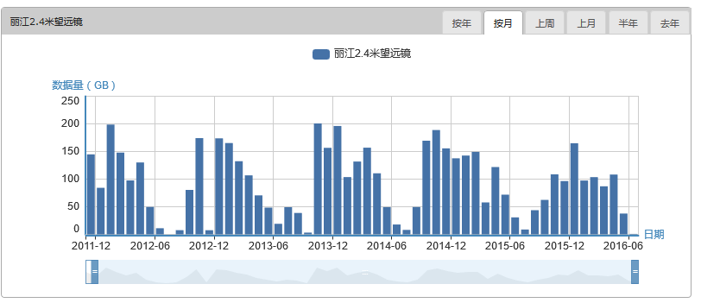
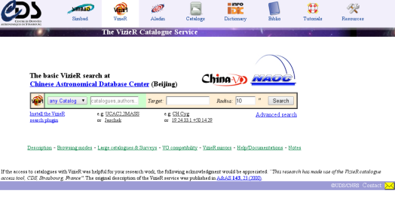
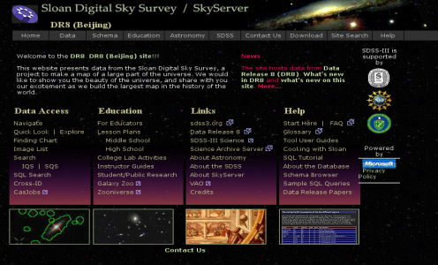
Data resources at the CAsDC

Slide 20
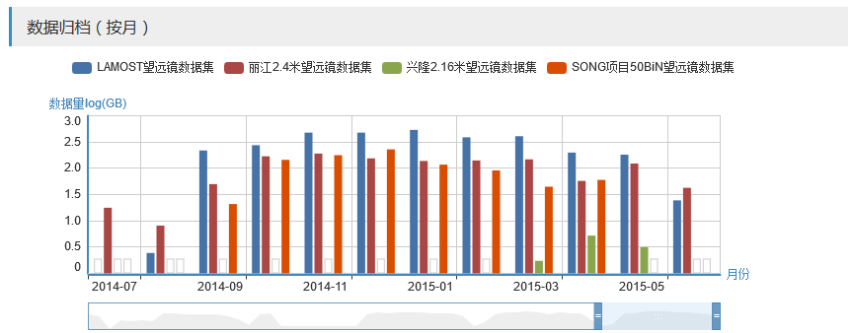
Current Status (without Alibaba Cloud)
Storage：
  1500TB
Computing：
  700Tflops+472 cores
Band width：
  155Mbps-300Mbps
  10Gbps/1Gbps
User support：
  25 py
Registered users：19,500+
Cloud nodes：6
VM instances：530
Telescopes for proposals：6
Domestic datasets：17
Software environments：6

Slide 21

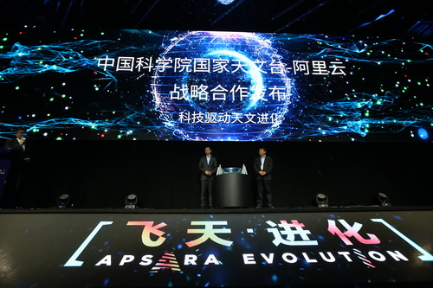
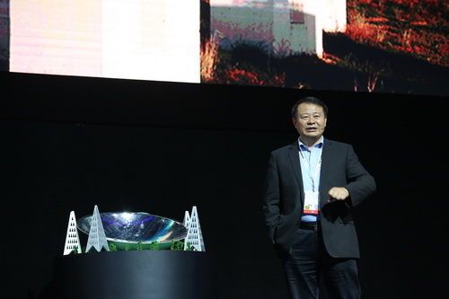
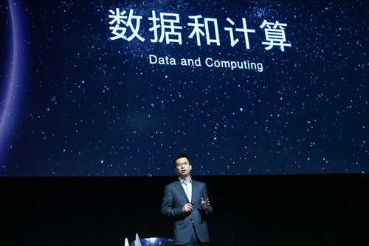

NAOC – Alibaba Cloud Partnership

Slide 22
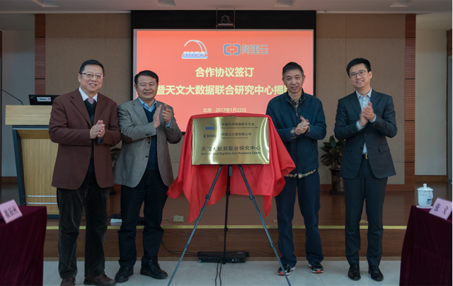
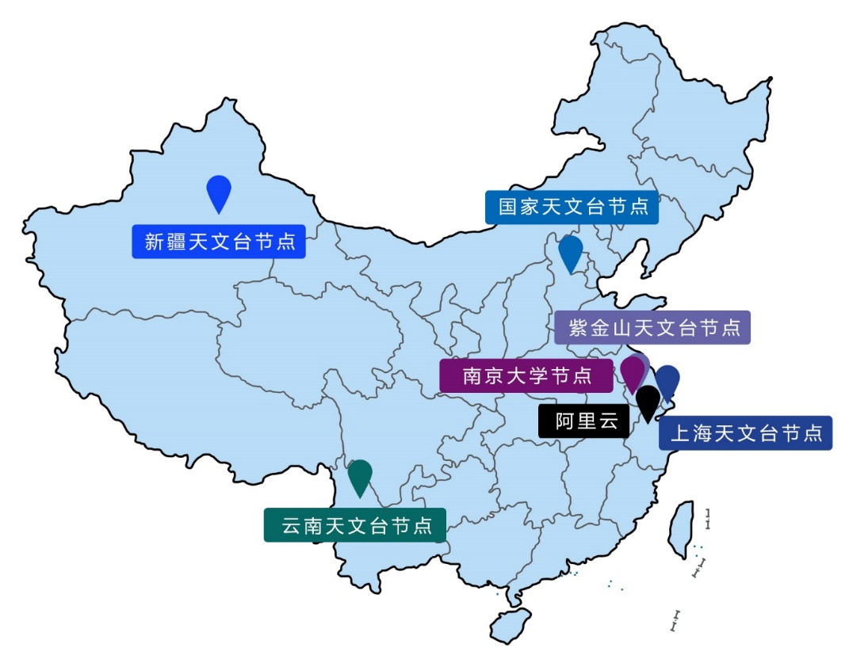
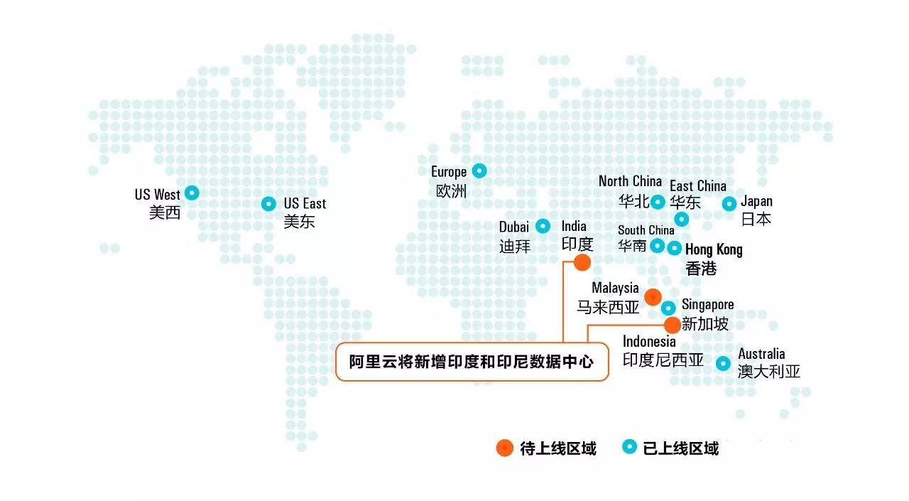
Global Cyber-infrastructure

Slide 23
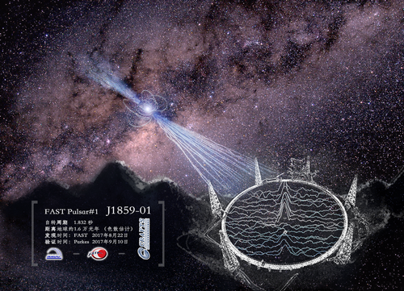
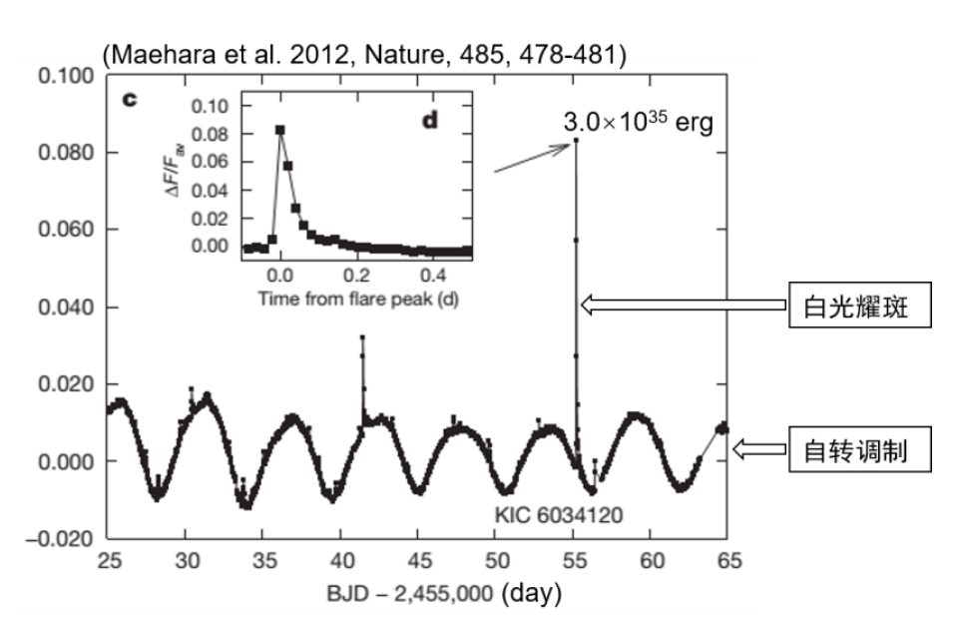
Open Projects and Postdocs
云计算加速脉冲星计时阵引力波探测：国家天文台青年千人、中科院百人计划入选者、研究员朱炜玮
基于 LAMOST 中分辨率巡天数据确定海量恒星近二十种元素的丰度：国家天文台研究员施建荣
黑洞吸积的风与喷流的广义相对论磁流体力学数值模拟：上海天文台研究员、上海天文台学术委员会主任袁峰
基于LAMOST 和GAIA 的移动星群研究：国家天文台研究员赵景昆
云环境下射电干涉阵海量数据处理框架关键技术研究：广州大学、昆明理工大学双聘教授王锋
基于天文大数据研究类太阳恒星磁场活动特征：国家天文台副研究员贺晗
Turku大学物理与天文学系Sarah Ann Bird博士
中国科学院紫金山天文台常江博士

Slide 24


Whole lifecycle management for astronomical data

Slide 25

Future Plans
Scientific requirements driven research and development
  Principles
  i.e. Time-domain, multi-messager astronomy
  i.e. SKA, FAST, PE, Mephisto, et al. projects leading
National Astronomical Data Center
  Infrastructure
Bring computing to (big) data
  Solutions
Discipline Construction
Data-driven and VO based EPO

Slide 26

Contact Us
http://astrocloud.china-vo.org
http://nalab.china-vo.org
http://www.ivoa.net
ccz@bao.ac.cn
Wechat: China-VO

