Slide 1
新疆天文台数据中心
张海龙
新疆天文台 计算机技术室
10/8/2016

Slide 3
OUTLINE
XAO Data Archive Portal
Custom Uploading Crossmatcher
Pulsar Data Release Environment
Taurus HPC Cluster

Slide 4
XAO Data Archive Portal
The XAO data archive portal is the primary repository for XAO data products and the main interface to the science user community.
http://data.xao.ac.cn
http://vo.xao.ac.cn

Slide 5
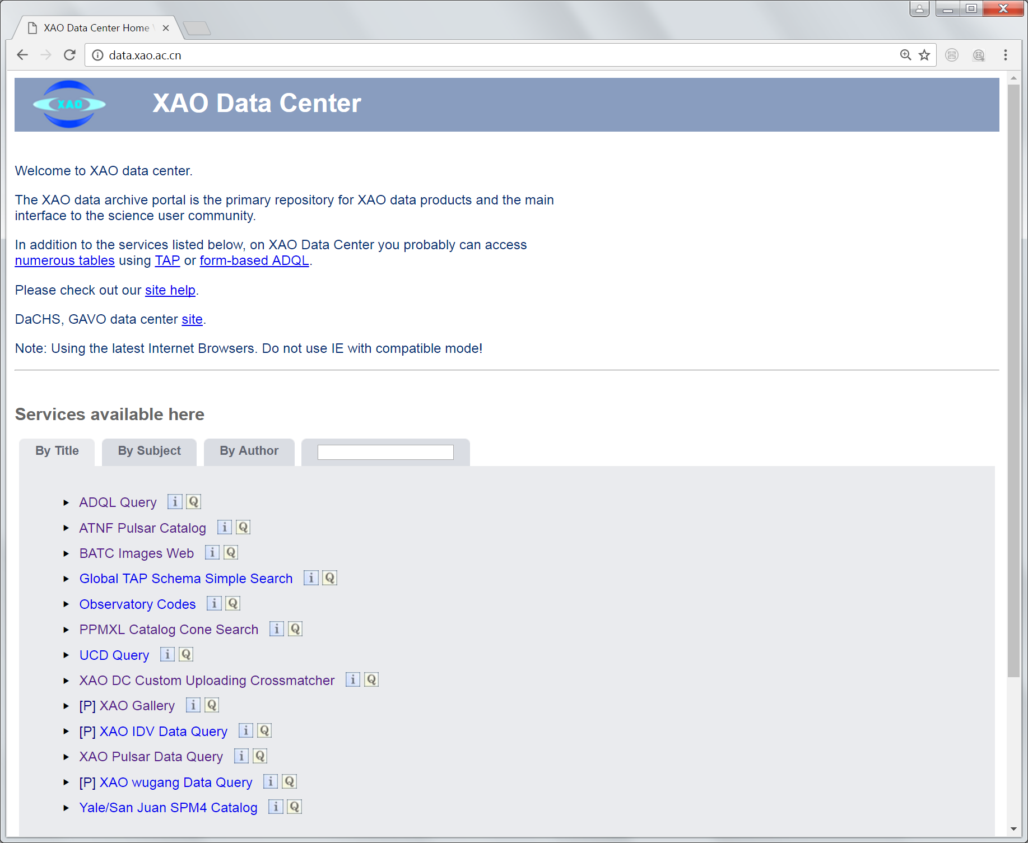
XAO Data Archive Portal

Slide 6
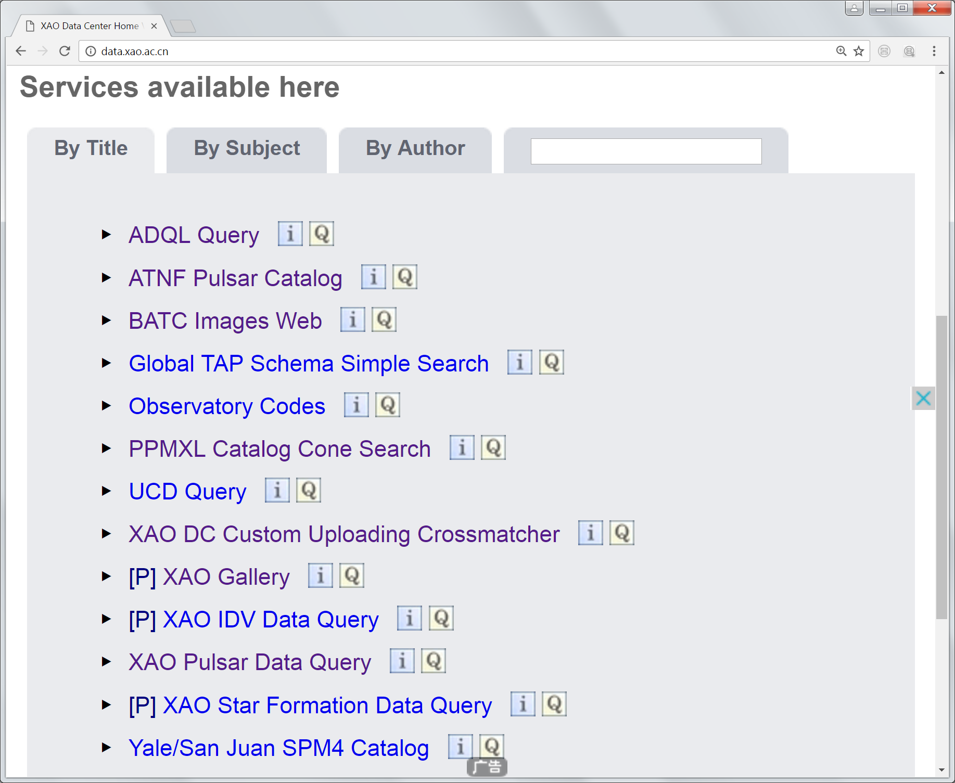
XAO Data Archive Portal

Slide 7
XAO Data Archive Portal
ADQL
SIAP
TAP
Cone Search
XAO DC Custom Uploading Crossmatcher
XAO Data release services
Catalogs(PPMXL, Yale/San Juan SPM4)

Slide 8
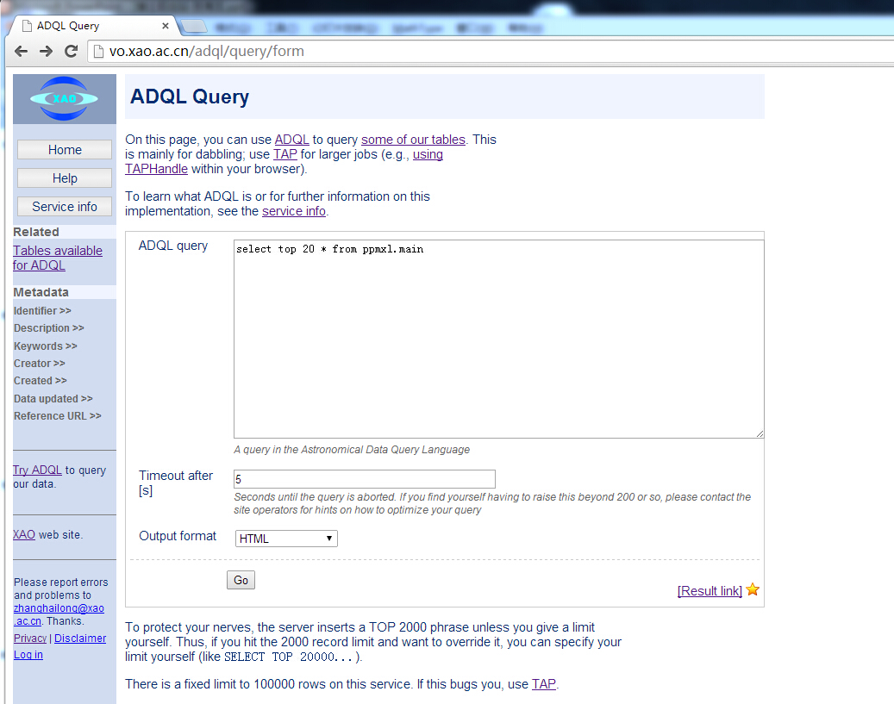
XAO Data Archive Portal

Slide 9
XAO Data Archive Portal ADQL
select * from obscode.data where name like '%Nanshan%‘
select count(*) from ppmxl.main
select top 10 from ppmxl.main
select name,code from obscode.data
select name,code from obscode.data where name like '%Nanshan%‘ and code like ‘%1’
select * from ppmxl.main where 1=CONTAINS (POINT('ICRS',raj2000,dej2000),CIRCLE('ICRS', 10.6847929 , 41.2690650,0.1))

Slide 10
OUTLINE
XAO Data Archive Portal
Custom Uploading Crossmatcher
Pulsar Data Release Environment
Taurus HPC Cluster

Slide 11
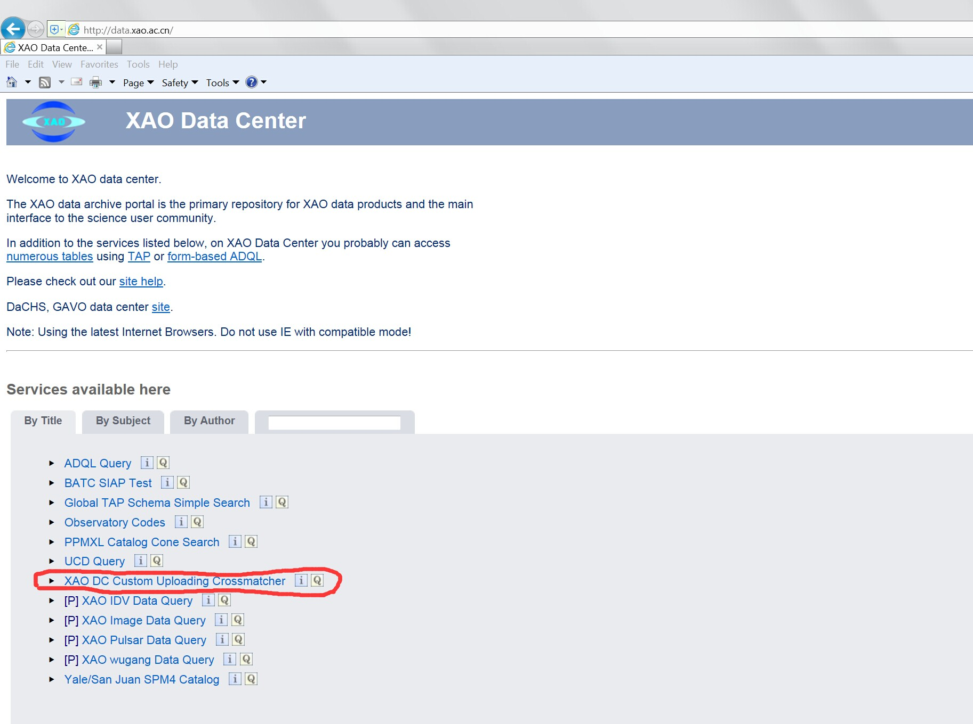
Custom Uploading Crossmatcher
Notes:
天体和宇宙中的物理过程在整个电磁波段上进行辐射，要全面理解这些过程必须开展全波段的研究
科技进步让天文学走出传统的光学波段，进入全电磁波段时代。全波段的天文学研究需要融合各个波段的数据

Slide 12
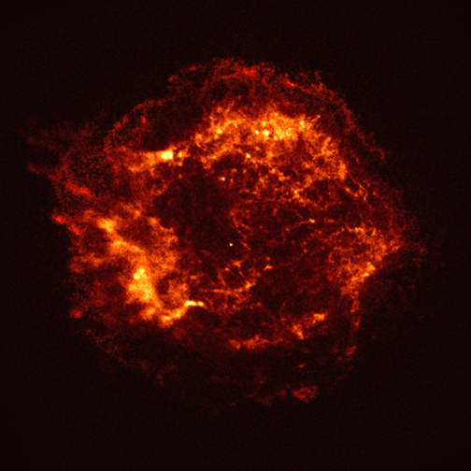
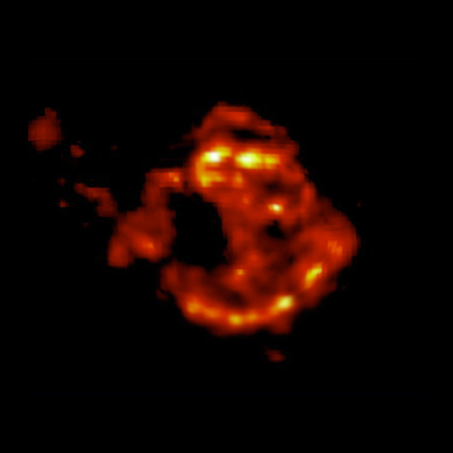
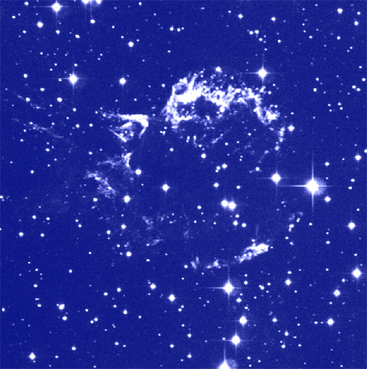
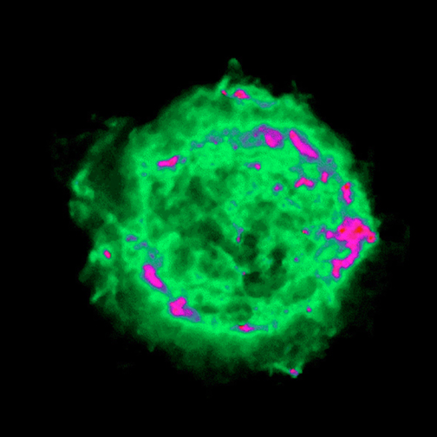
Custom Uploading Crossmatcher
X-ray
IR
Supernova
Optical
Radio

Slide 13
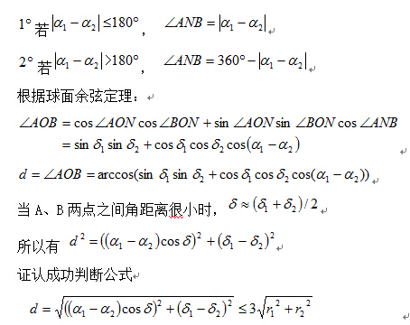
XAO Data Center cross-matcher

Slide 14
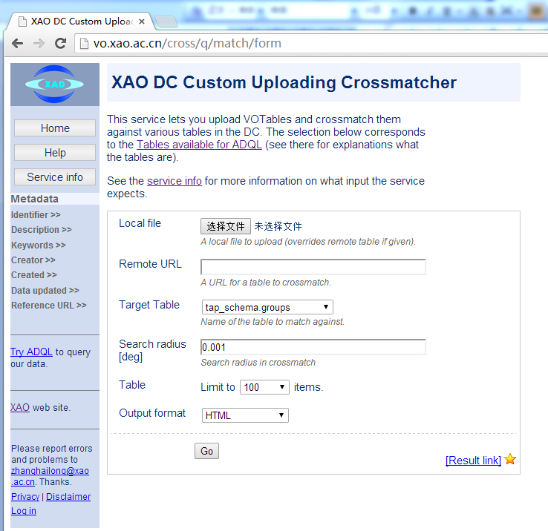
Custom Uploading Crossmatcher

Slide 15
Custom Uploading Crossmatcher
Experiment 1: Speed Test
PPMXL.main (Cone Search)
http://vo.xao.ac.cn/ppmxl/q/cone/form
Position/Name: m31
Search radius: 6.0 (arcminutes)
Experiment 2: Online Cross Match
Use URL (VOTable）:
http://vo.xao.ac.cn/static/cross_match
Crossmatcher Website:
http://vo.xao.ac.cn/cross/q/match/form
Choose Tables:
ppmxl.main

Slide 16
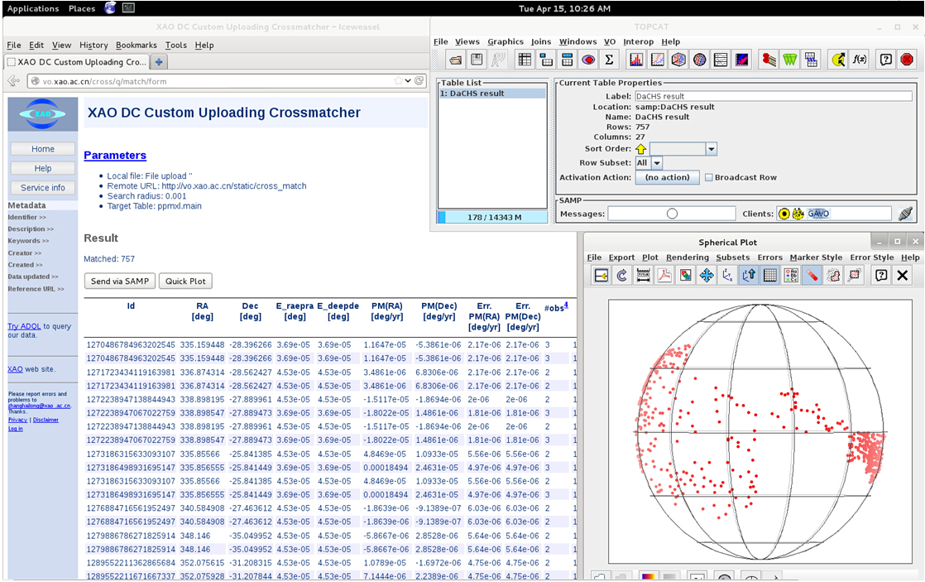
Custom Uploading Crossmatcher

Slide 17
OUTLINE
XAO Data Archive Portal
Custom Uploading Crossmatcher
Pulsar Data Release Environment
Taurus HPC Cluster

Slide 18
XAO Data Center ATNF Pulsar Catalog

Slide 19
XAO Data Center ATNF Pulsar Catalog

Slide 20
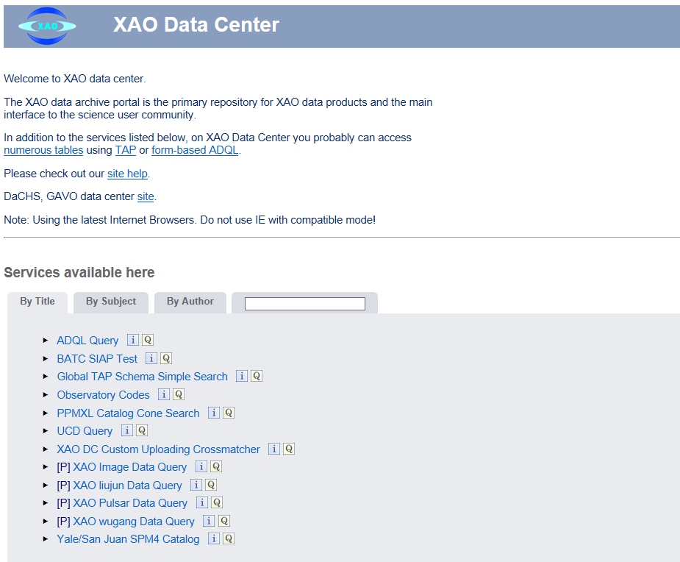
Pulsar Data Release Environment

Slide 21
Pulsar Data Release Environment
Data Format:
All of the pulsar data stored in the data archive follow the PSRFITS standard (Hotan,van Straten & Manchester 2004)
The data files and access methods are compatible with Virtual Observatory protocols.

Slide 22
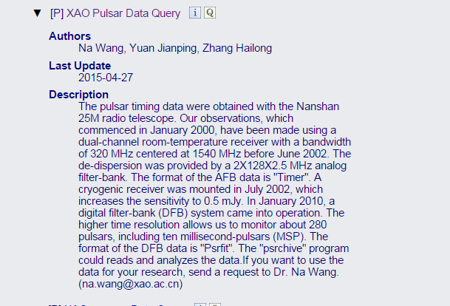
Pulsar Data Release Environment
Information
User:
pulsar
Passwd:
astronomy

Slide 23
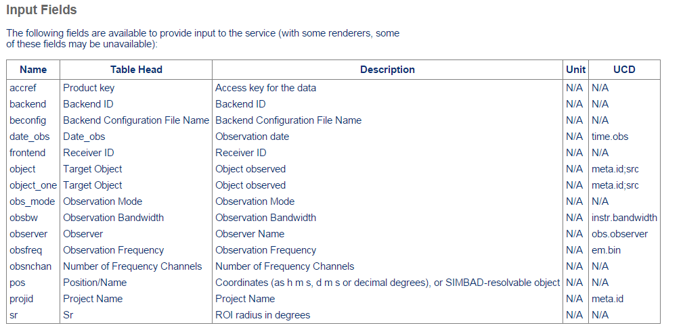
Pulsar Data Release Environment

Slide 24
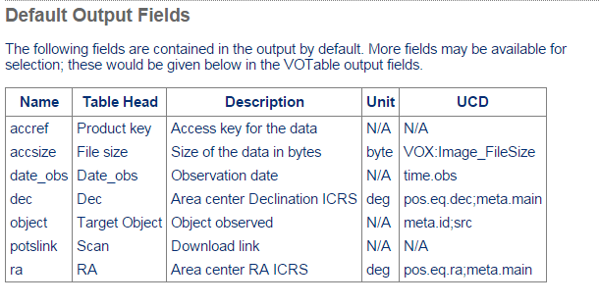
Pulsar Data Release Environment

Slide 25
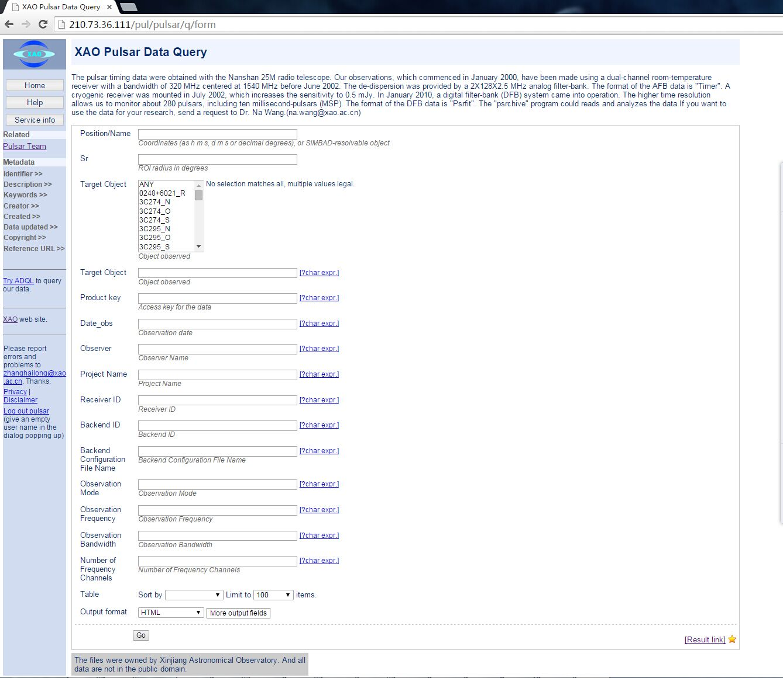
Pulsar Data Release Environment

Slide 26
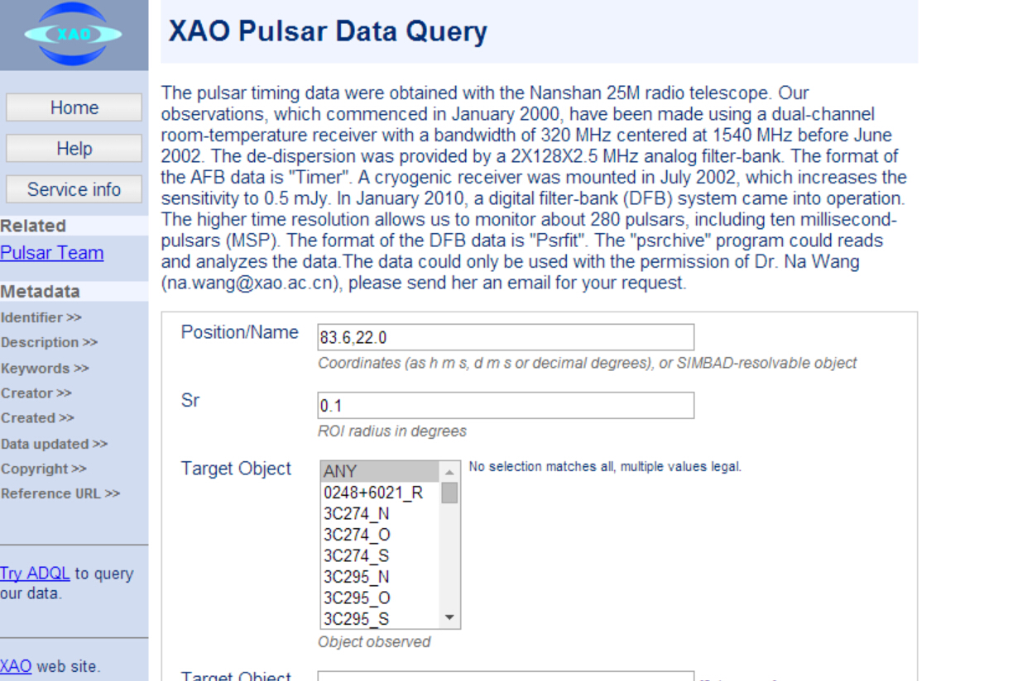
Pulsar Data Release Environment

Slide 27
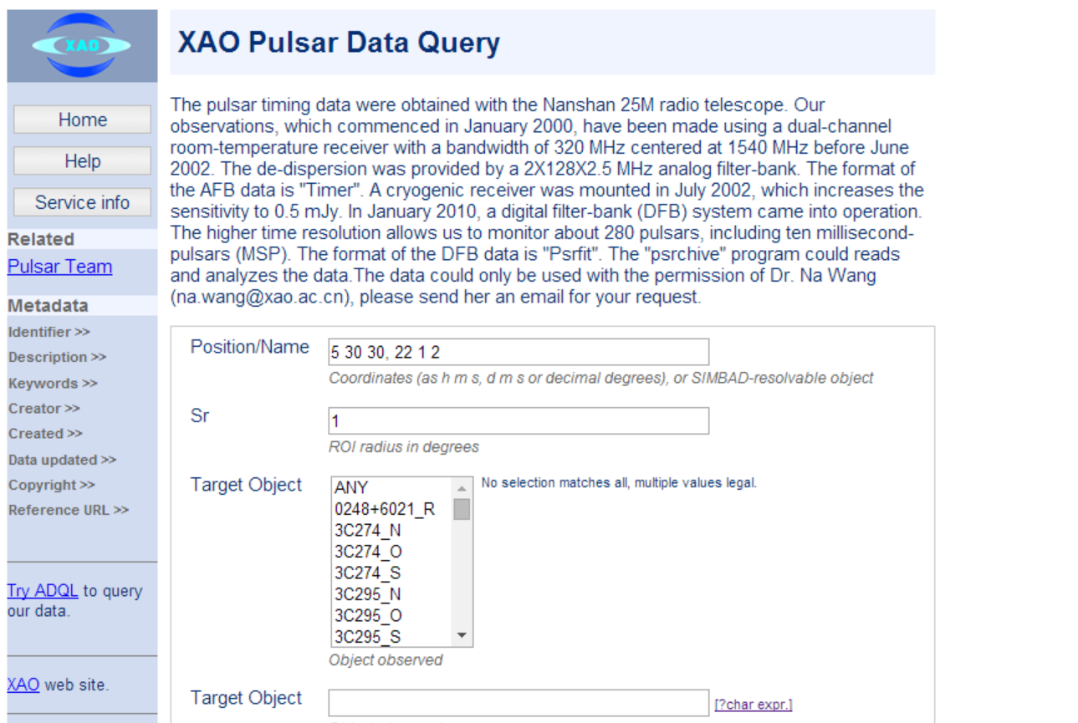
Pulsar Data Release Environment

Slide 28
Pulsar Data Release Environment
== -- matches if your input matches the entire input field literally, i.e., preserving case. This is the default when no operator is given, but it may be necessary to use the operator if, e.g., your pattern would be interpreted as an expression.
=~ -- Like ==, but ignoring case.
~ -- selects pattern matches of operand ignoring case.
= -- case-sensitive version of ~.
!~ -- reversal of ~ (i.e., matches when ~ doesn't). * ?
! -- reversal of =.
!= -- selects all but literal matches of the operand.
>=, >, <=, < -- selects strings larger or equal, larger, etc., than the operand. Comparisons happen according to ASCII value (i.e., in the C locale).

Slide 29
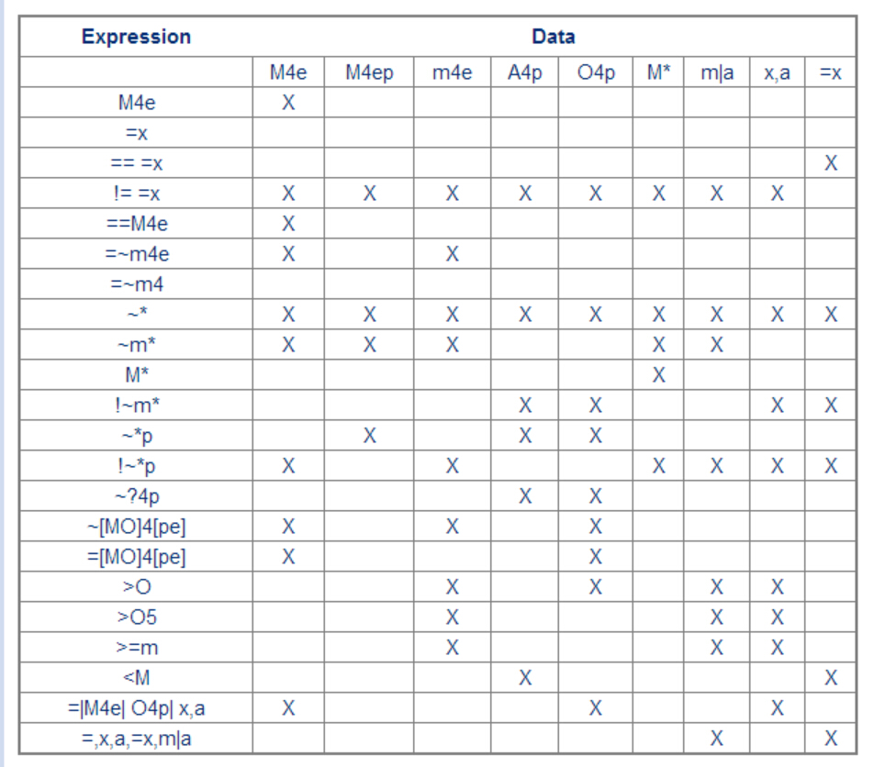
Pulsar Data Release Environment

Slide 30
Pulsar Data Release Environment
<2003-04-06 -- select values earlier than April 6th, 2003.
2003-04-06 +/- 4 -- select values four days around April 6th, 203.

Slide 31
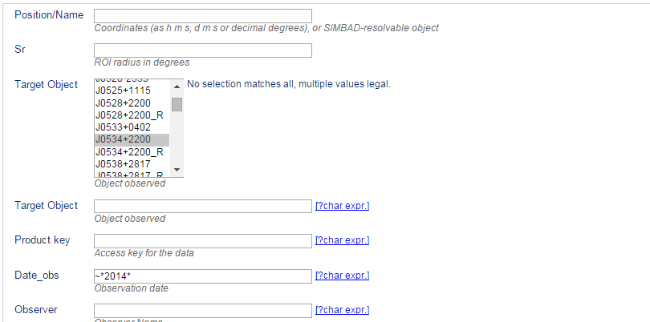
Pulsar Data Release Environment

Slide 32
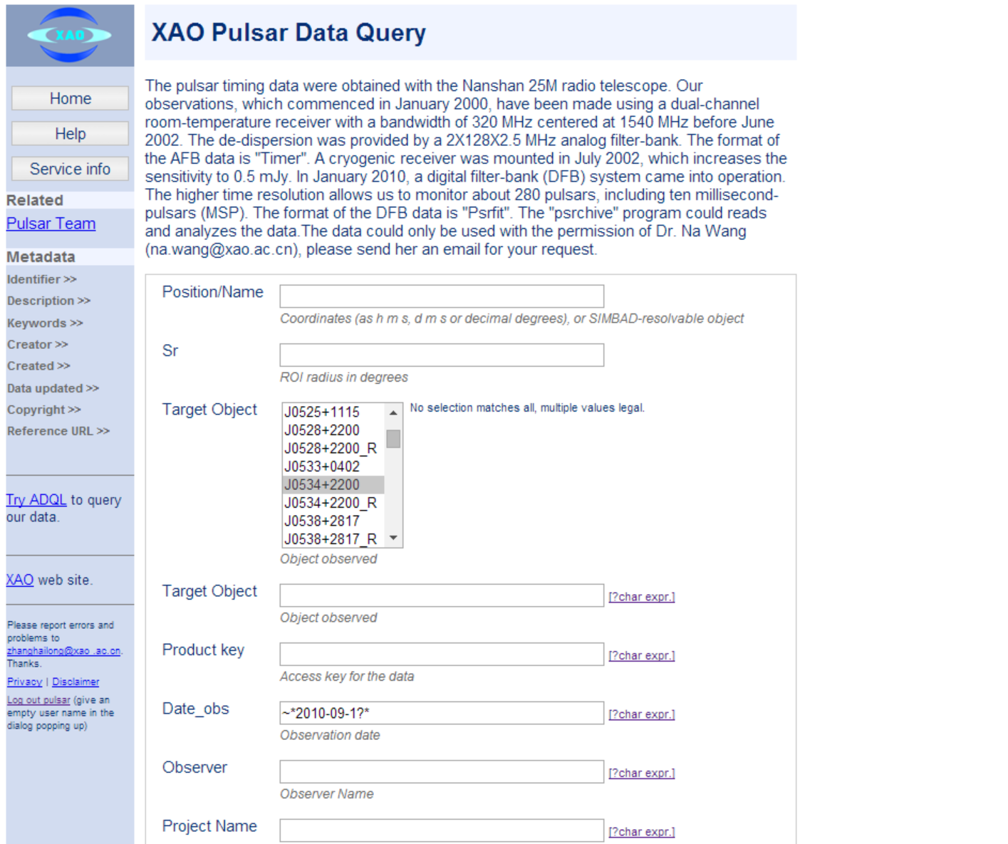
Pulsar Data Release Environment

Slide 33
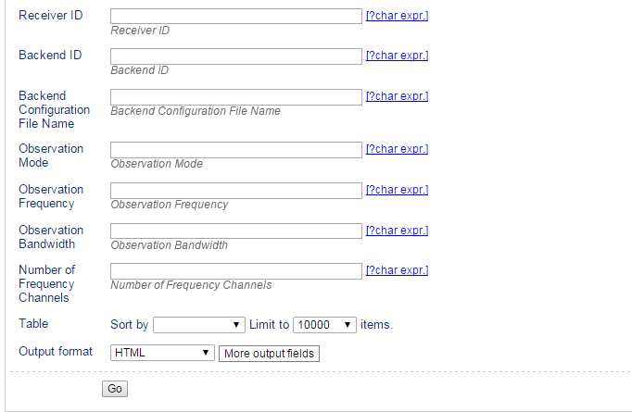
Pulsar Data Release Environment

Slide 34
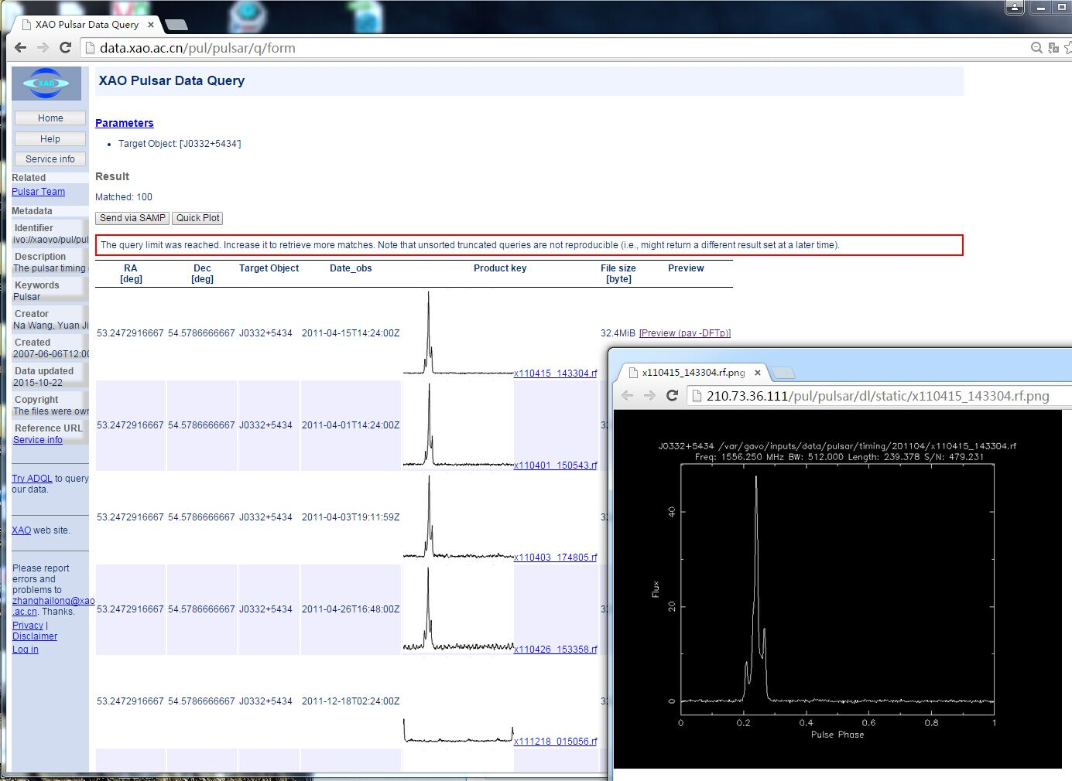
Pulsar Data Release Environment

Slide 35
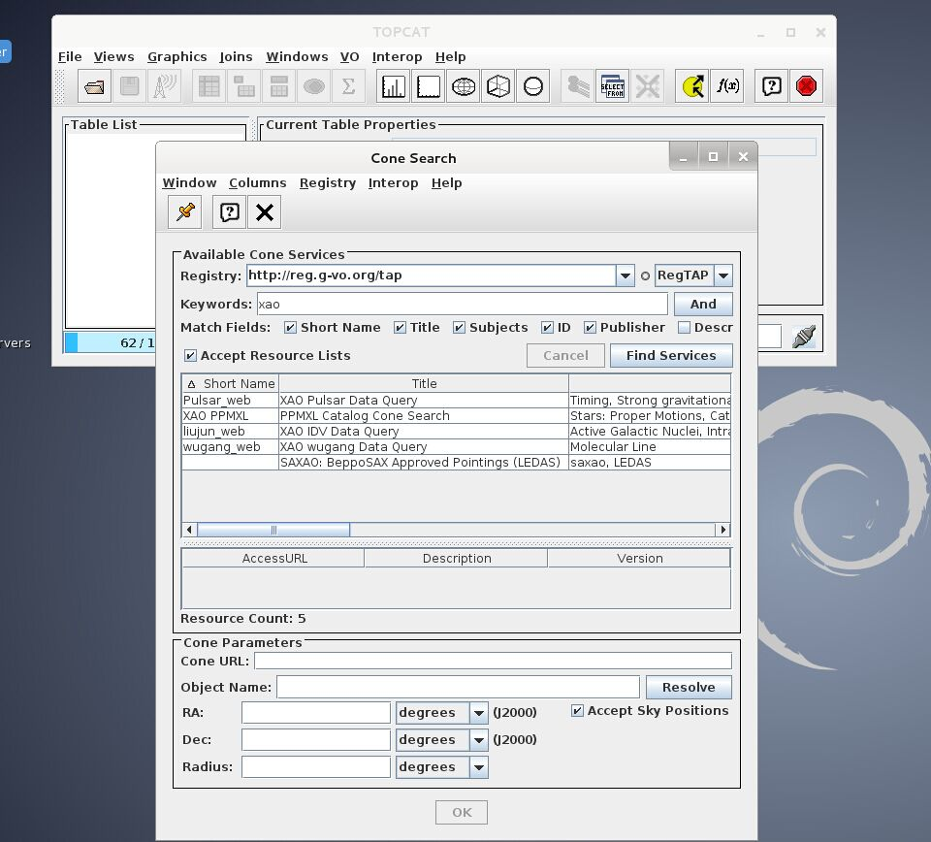
Pulsar Data Release Environment

Slide 36
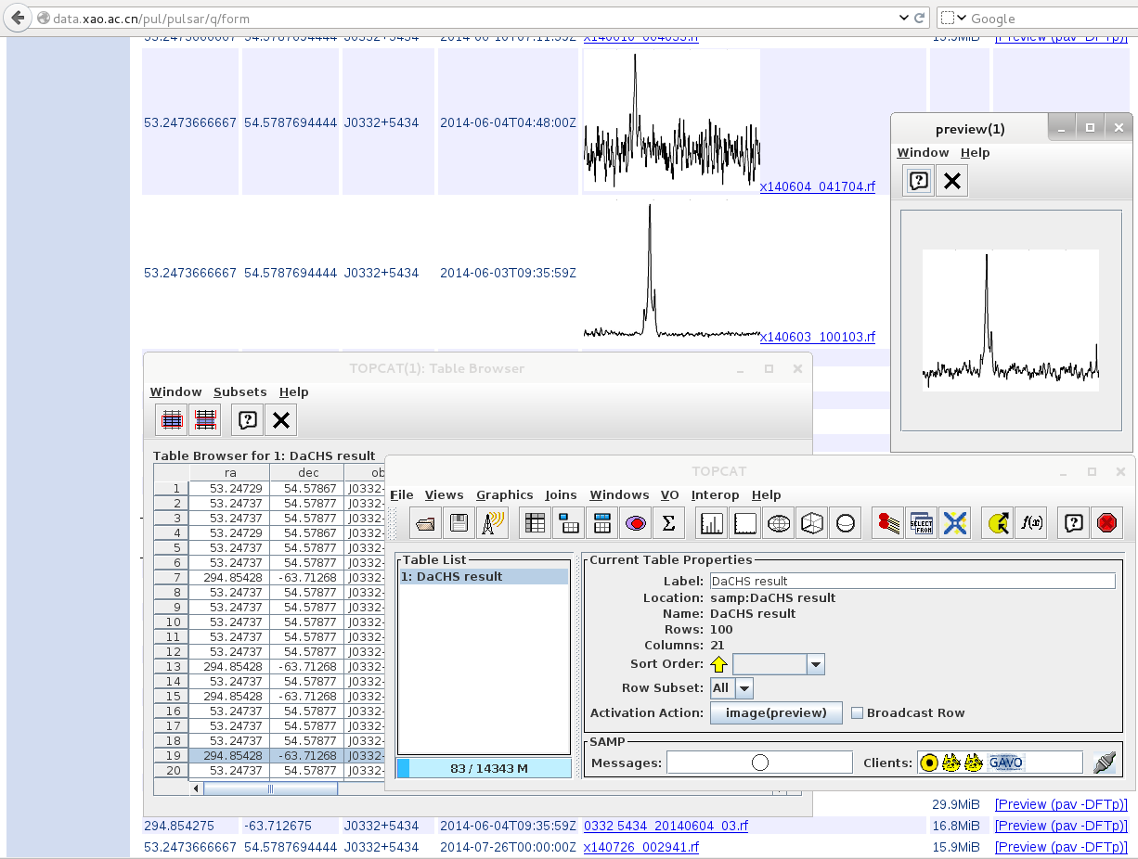
Pulsar Data Release Environment

Slide 37
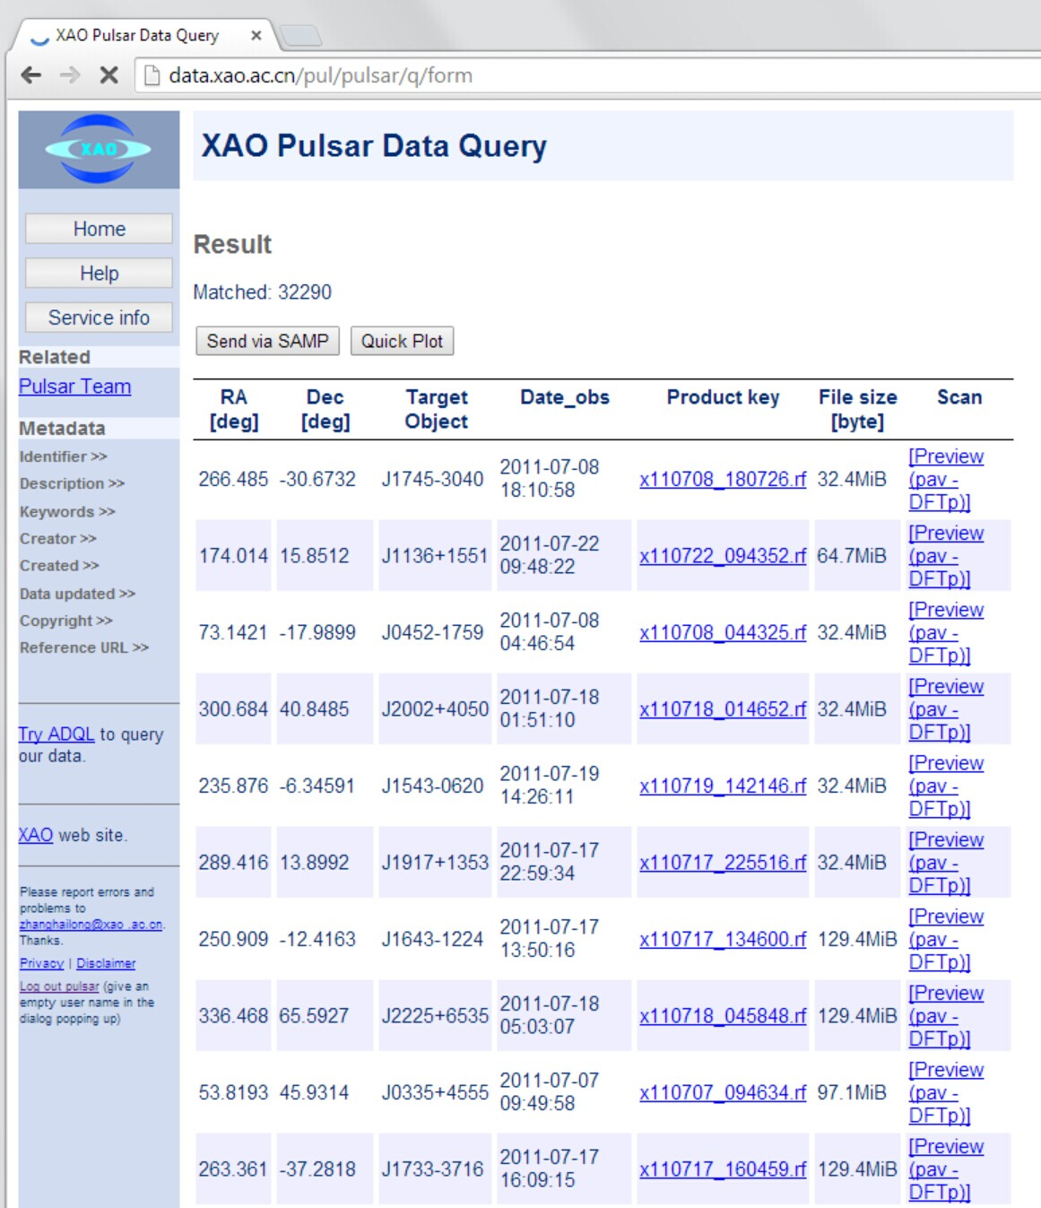
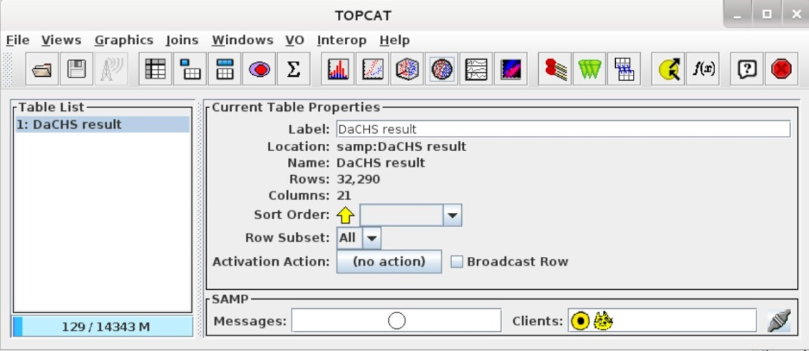
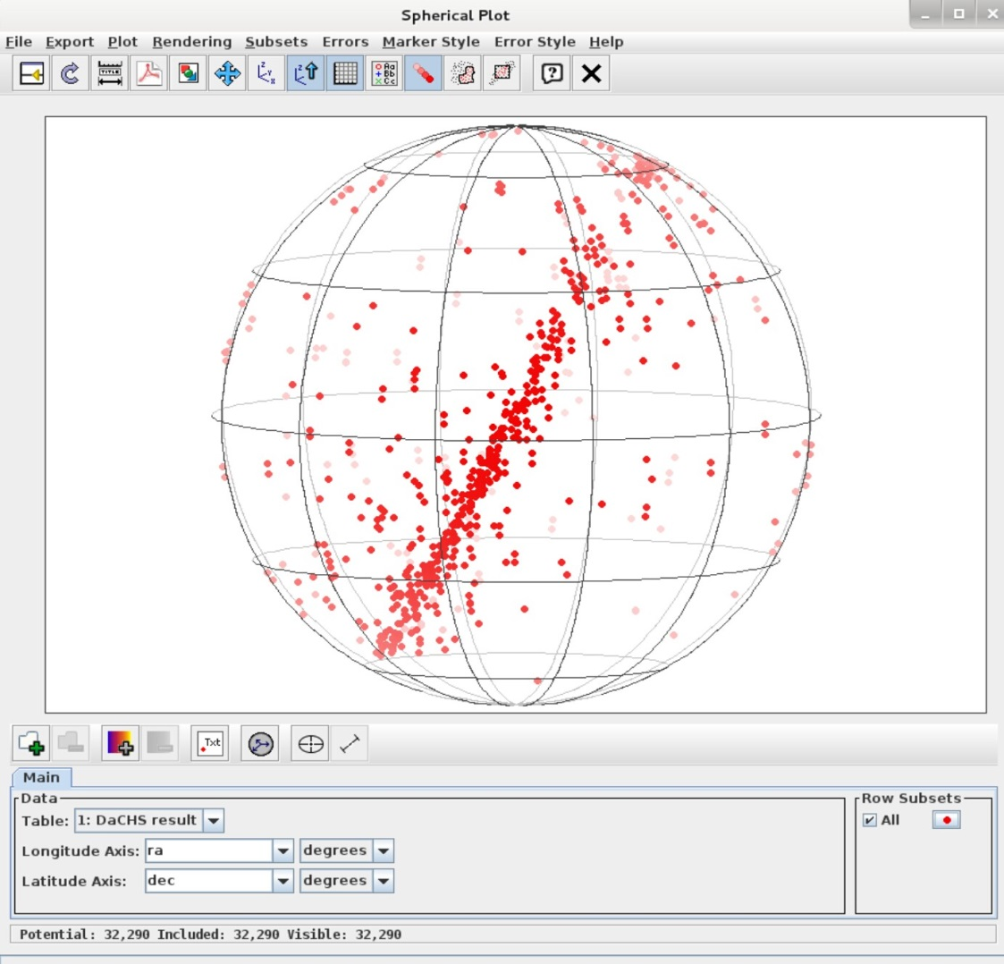
Pulsar Data Release Environment

Slide 38
Pulsar Data Release Environment

Slide 39
OUTLINE
XAO Data Archive Portal
Custom Uploading Crossmatcher
Pulsar Data Release Environment
Taurus HPC Cluster

Slide 40
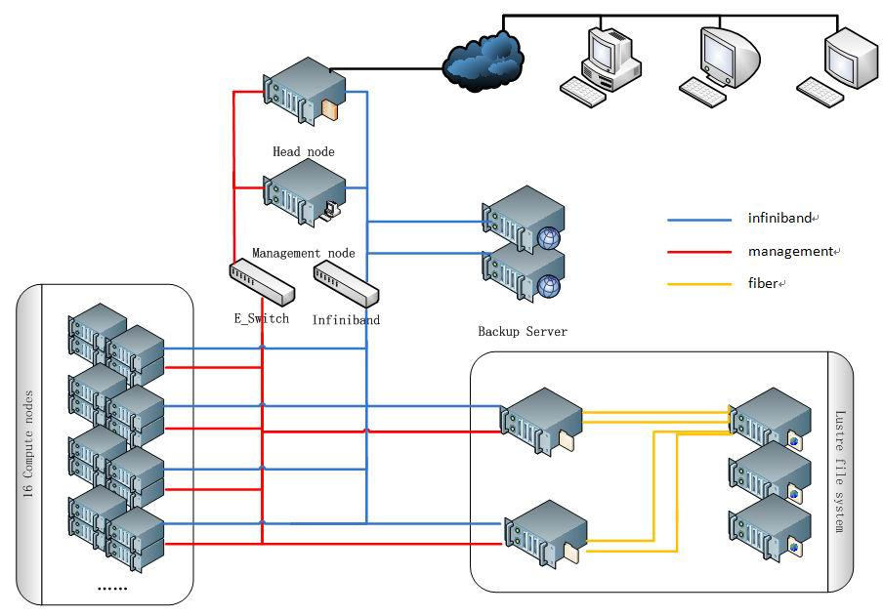
Taurus HPC Cluster

Slide 41
Taurus HPC Cluster
Performance Test Results:
CPU theoretical double precision float calculation
value: 2.2*8*16*24=6.7584Tflops
CPU actual doulbe precision float value 6.289Tflops
CPU efficiency: 6.289/6.7584≈93%
=========================================
GPU theoretical double precision float calculation
value: 18.72Tflops (single GPU value:1.17Tflops)
Single GPU test DPFCV is 1.01Tflops (86%)
GPU actual test value:14.88Tflops (16 GPUS)
GPU efficency 14.88/18.72≈80%

Slide 42
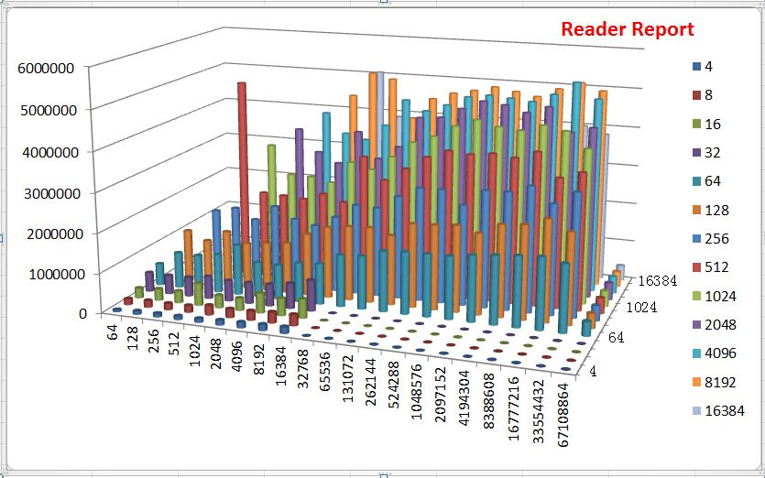
Taurus HPC Cluster Hard disk I/O

Slide 43
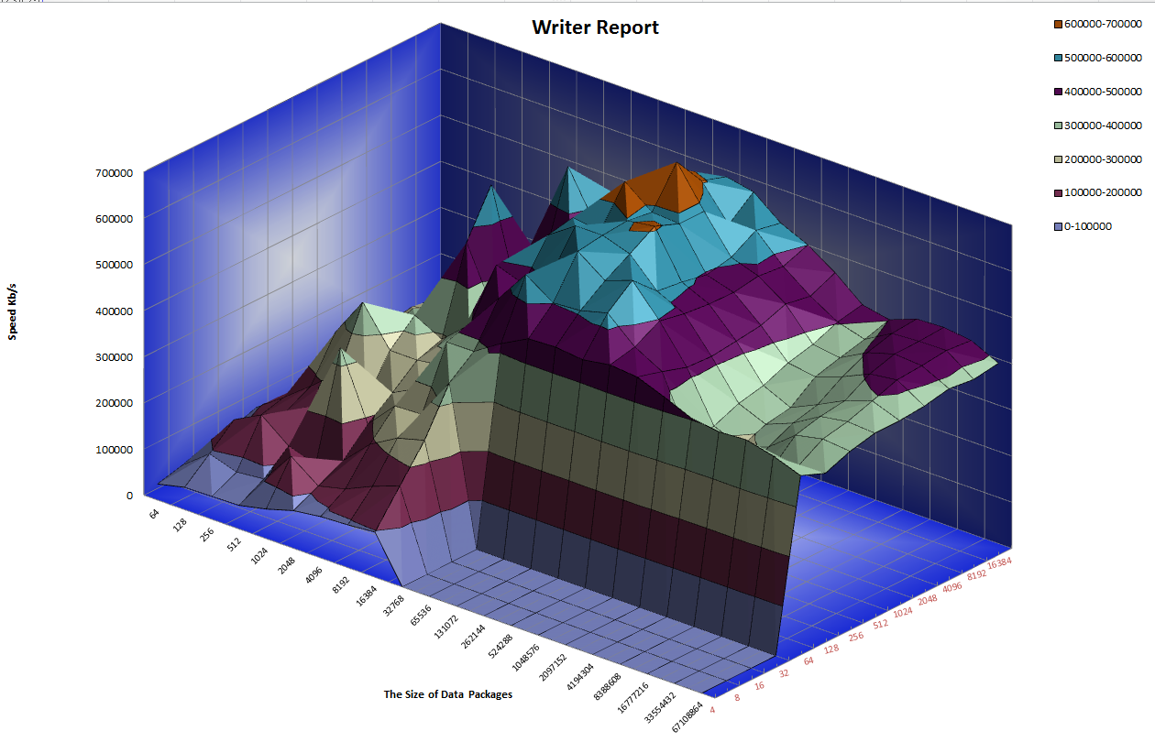
Taurus HPC Cluster Hard disk I/O

Slide 44
Taurus HPC Cluster
About how to use Taurus, check the website:
http://taurus.xao.ac.cn/

Slide 45
Summary
XAO Data Archive Center
Custom Uploading Crossmatcher
Pulsar Data Release Environment
Taurus HPC Cluster

Slide 46
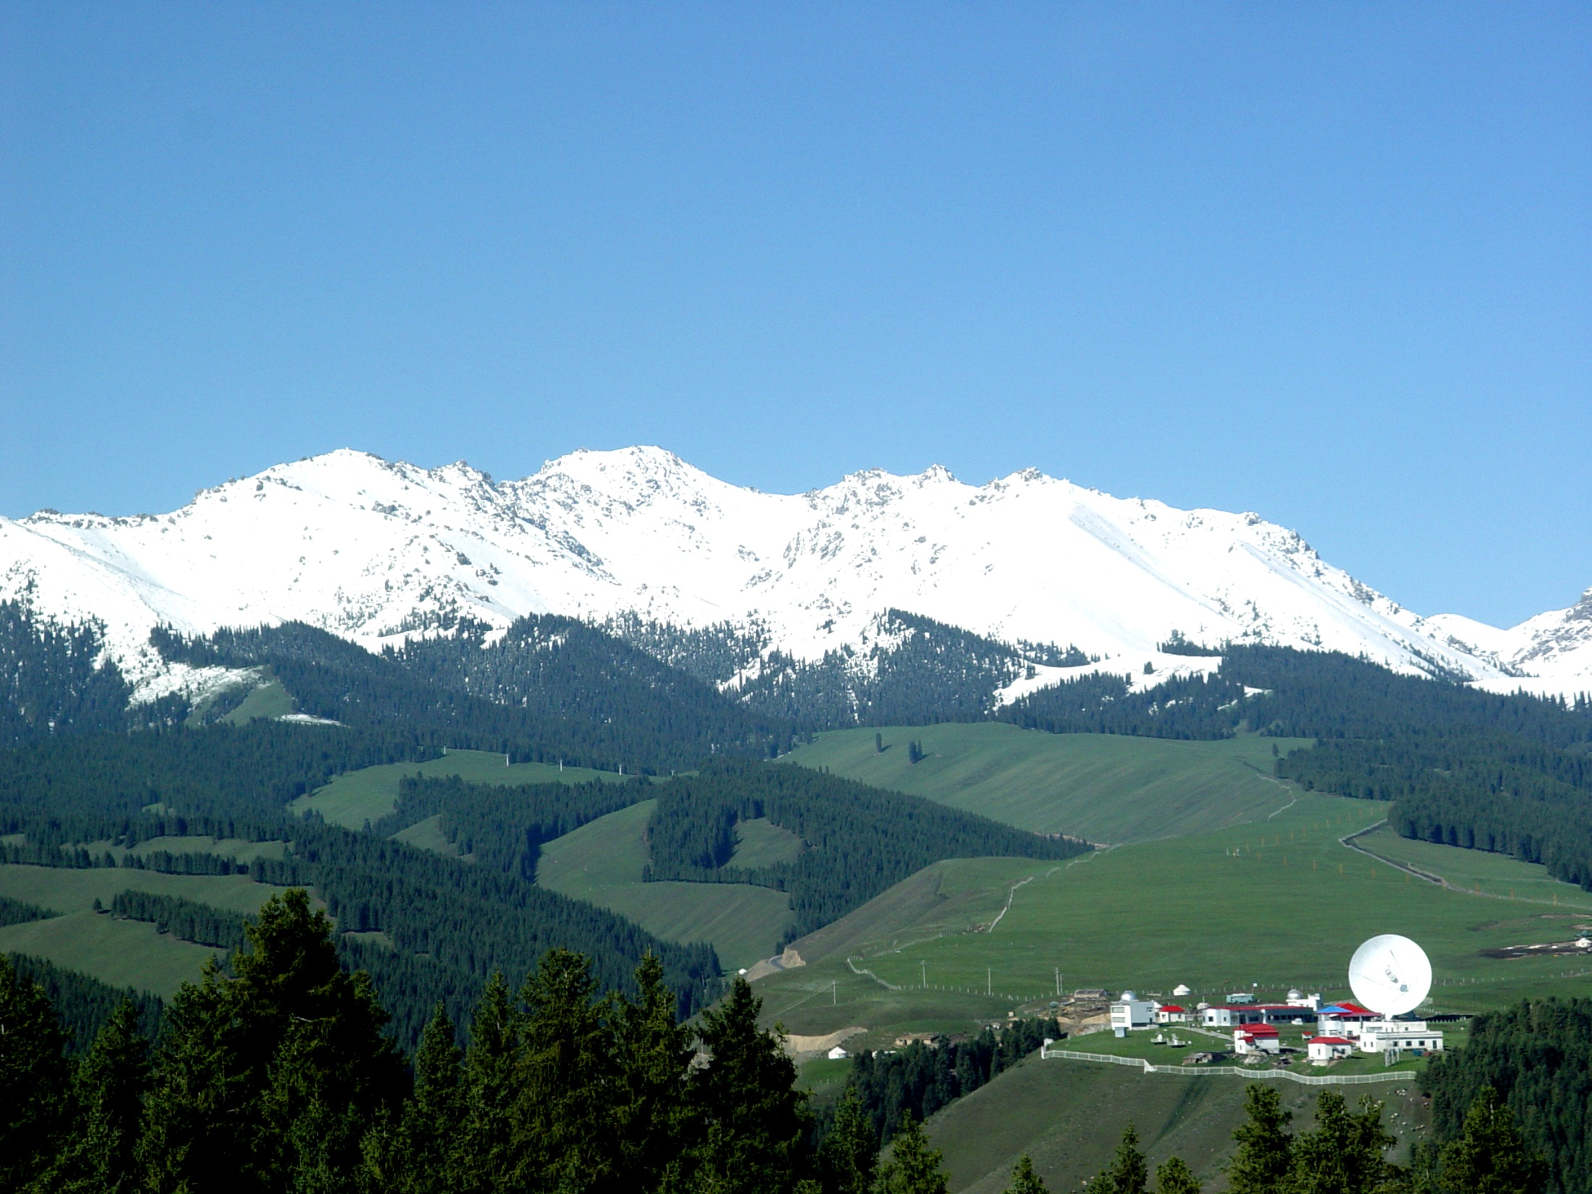
Thanks！

