Slide 1
China-Chile Astronomical Data Center
中智天文数据中心：进展和展望
National Astronomical Observatories, CAS
（国家天文台）
The Chinese Academy of Sciences’ South America Center for Astronomy
（中科院南美天文中心）
Lei Zhu
（朱磊）

Slide 2
outline
Background
    CASSACA
    Motivation of the data center
Progress
    Construction
    Hardware
    Software
  Prospect
Notes:
2

Slide 3
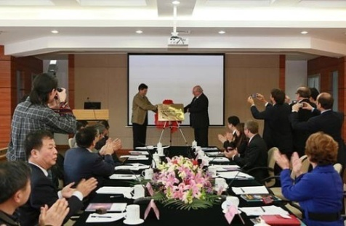
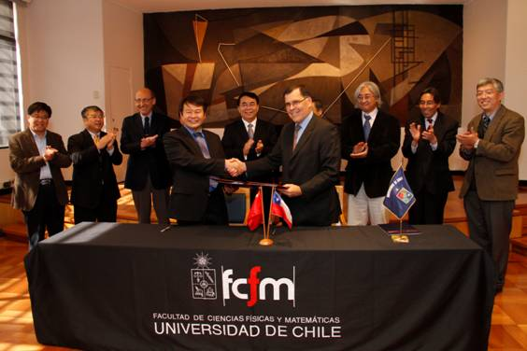
CASSACA
CAS South America Center for Astronomy: www.cassaca.org
CASSACA was established in 2013 with offices in both Beijing and Santiago. The Santiago office is located at the campus of University of Chile and the Chilean National Observatory
CASSACA is one of the first long-term overseas research centers CAS has established under its new guidelines of “reaching out” to the world’s scientific communities, with wide-ranging collaborations as its primary goal

Slide 4
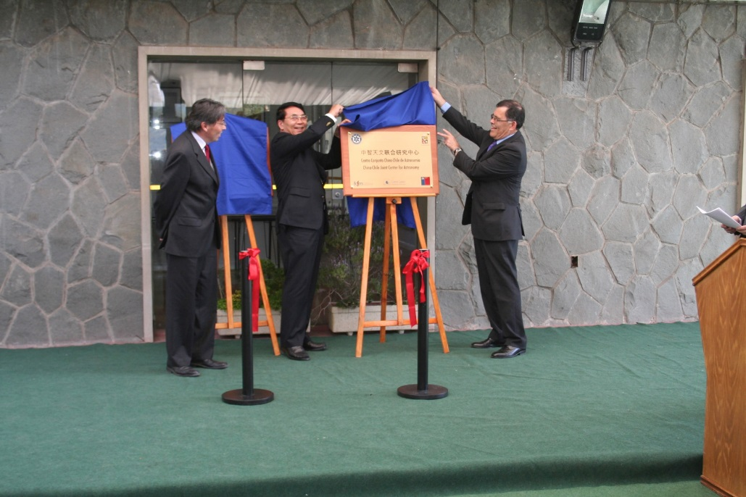
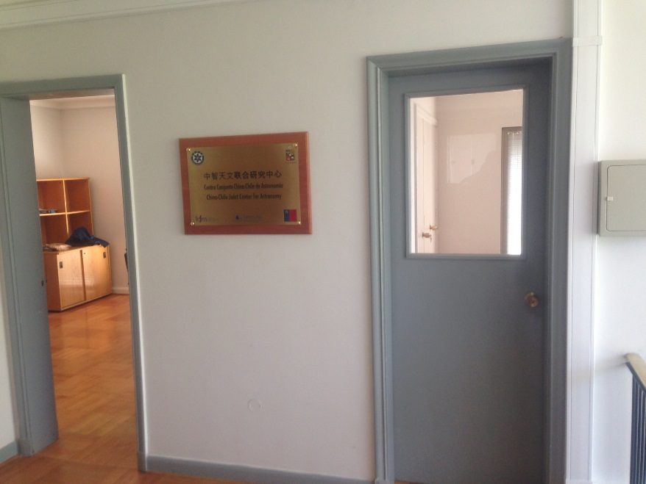
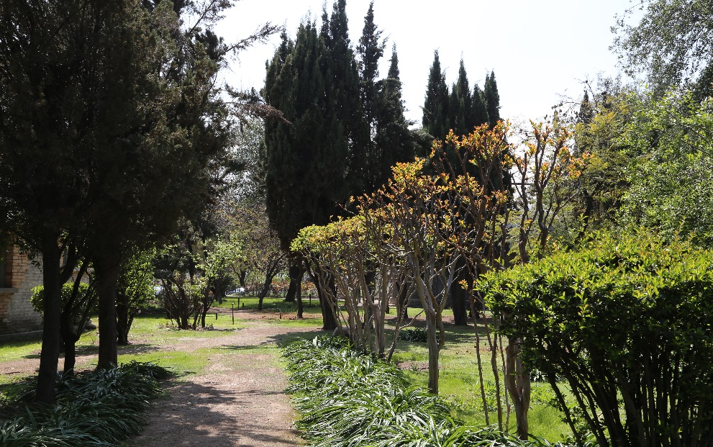
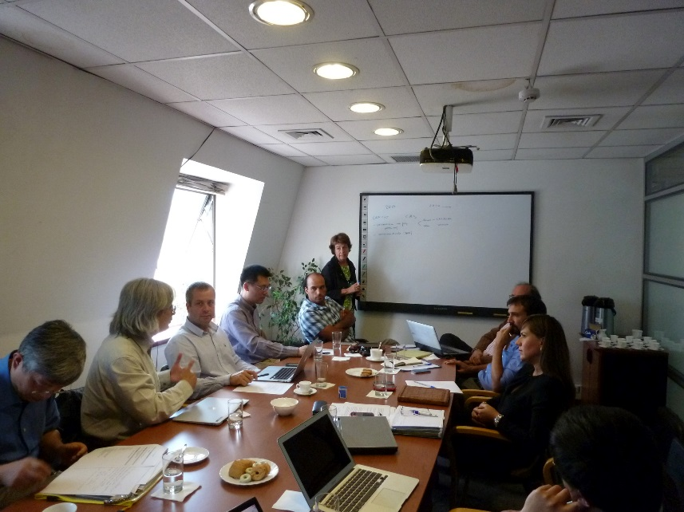
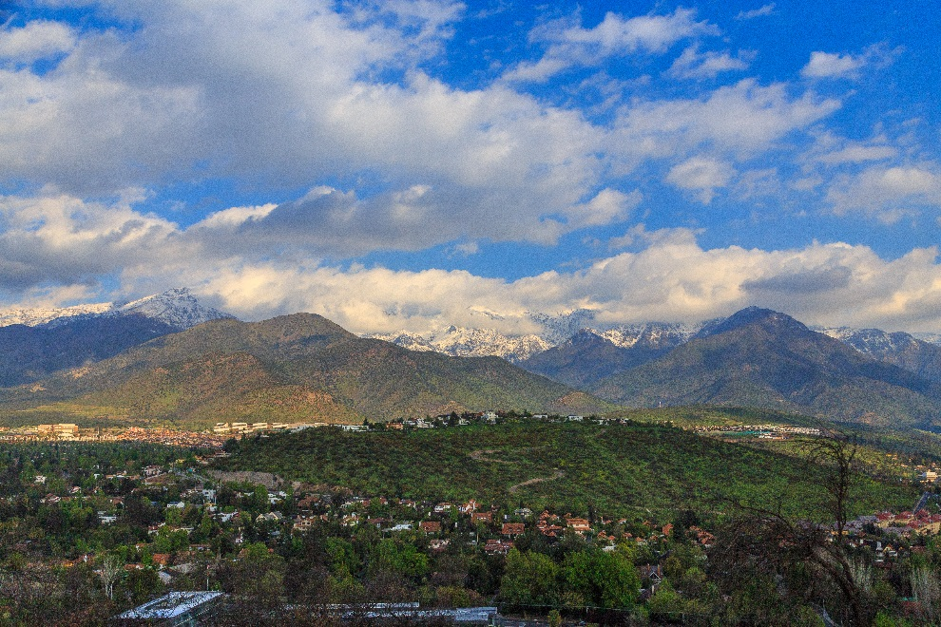
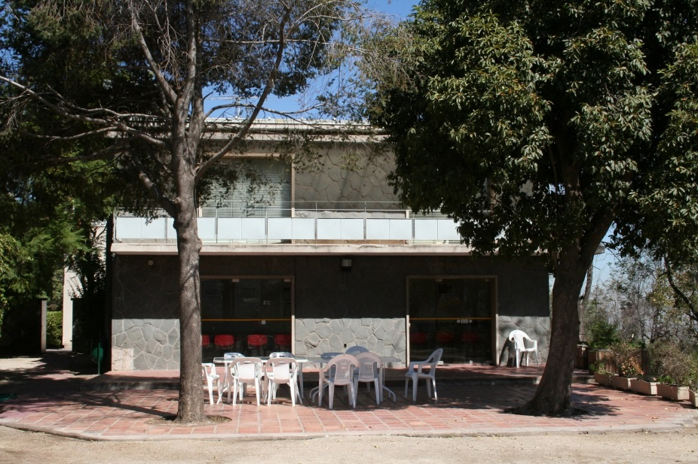
Start of CASSACA (Cerro Calan, Santiago) Operations: 2013.10

Slide 5
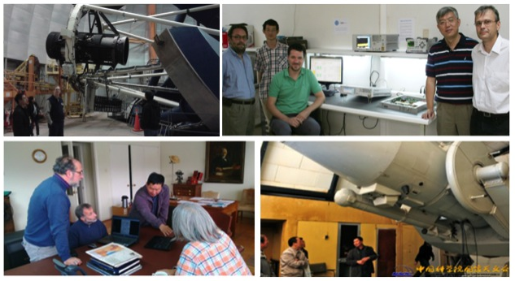
The first Overseas Research Center for the CAS
Collaborative Universities
  University of Chile
  Catolica University
  Andres Bello University
  University of Diego Portal
  University of Valparaiso
  University of Concepcion
  University of La Serena
  University of Antofagasta
  Catolica University in Northern Antofagasta

Slide 6
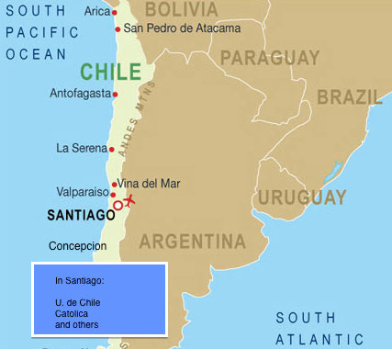
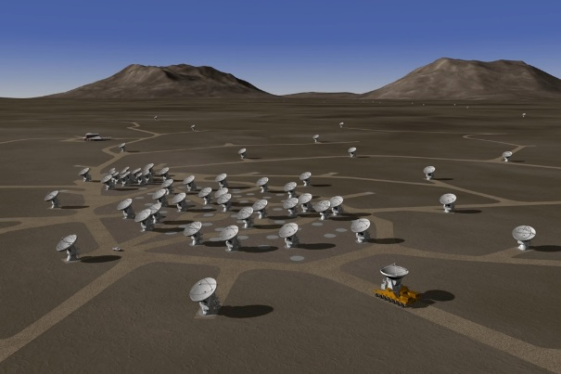
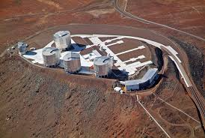
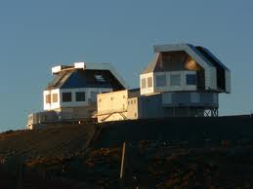
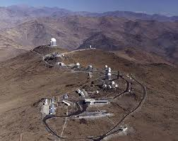
Why Chile?
Chile has the most number of cloudless nights and the best night sky conditions for astronomical research from the ground
Many international research organizations have long established a large number of observational facilities in Chile; numerous exciting large facilities in the future
Like in China, the Chilean astronomical community is fast-developing and the strengths of the two countries are complementary
Chile provides the most comprehensive governmental and societal support for astronomical research, as well as the excellent infrastructure support for the developing future facilities
The Chilean government maintains a extremely cordial relationship with its Chinese counterpart

Slide 7
Why A Data center (for ALMA)?
As the most expensive ground-based telescope in operation, ALMA is an unprecedented powerful instrument in millimeter/sub-millimeter astronomy
Chile is part of the ALMA Consortium (while China is not YET!) and have 10% of ALMA time
There are significant number of ALMA staff scientists working in Chile
Brazil is also joining the ALMA program
Visiting scholars and postdocs in Chile supported by CASSACA are eligible to apply for ALMA time and are actually already deeply involved in existing ALMA program.
There is currently no plan for ALMA to provide scientific data distribution and analysis capabilities in Chile
ALMA has a 12-month proprietary data policy, after which the data is released into public domain
There is a general lacking of utilization of ground-based observational data for archival research (compared to large space telescopes). It is ALMA’s intention to change that!

Slide 8
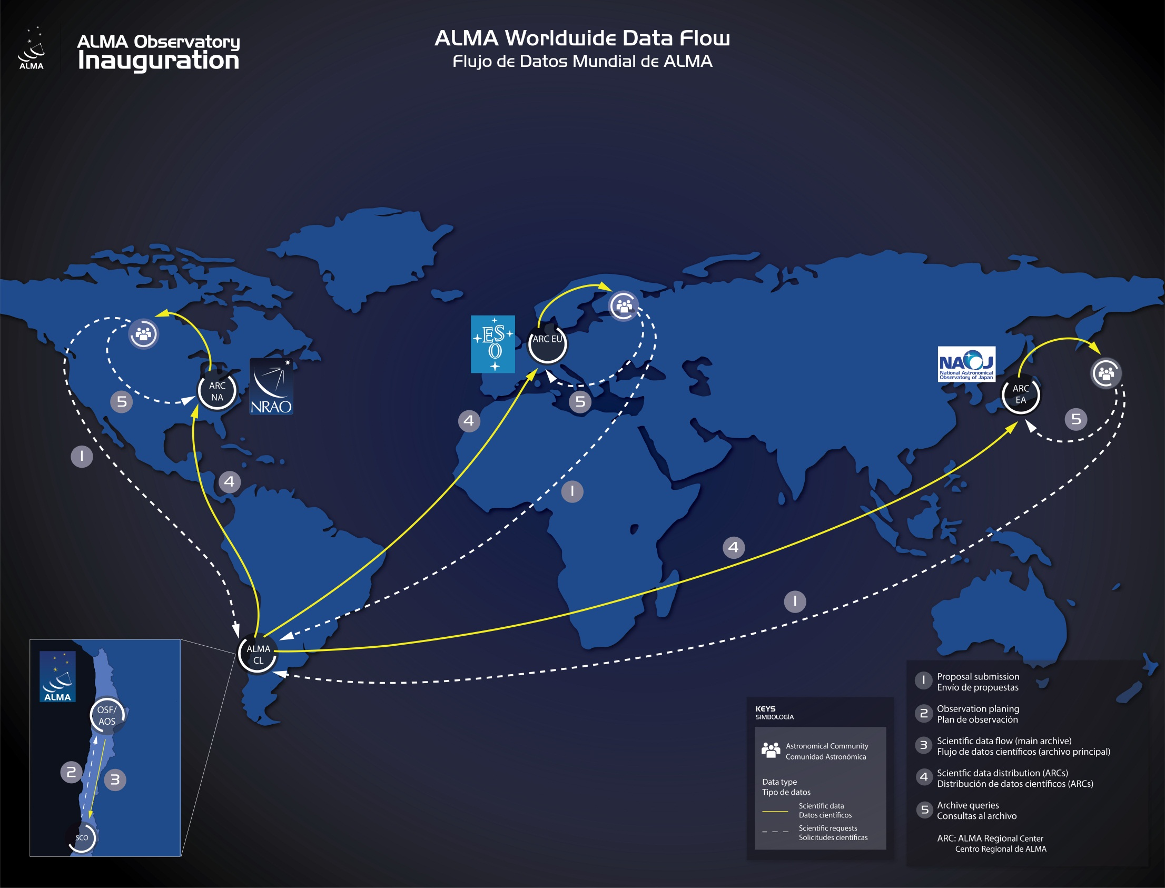
SCO -> OSF: observation planning; OSF -> SCO: data archiving
SCO -> ARCs: scientific data distribution
ARCs: archive, scientific data processing, science support, etc.

Slide 9
ALMA Regional centers
Data archived
  Persistent archiving and retrieval for observational data
  Metadata
  Datacubes produced by the pipeline
  Technical and environmental data
Data processing
    Lustre: MDS + OSS
    Computing node
Data access
    Data base: oracle
    Archive system: NGAS
Networking
    1-10 Gbps Ethernet
    40 Gbps InfiniBand
Notes:
9

Slide 10
CCADC: overview
The first stage: ARCs as our blueprint
Chilean partner: Federico Santa María Techinial University (UTFSM)
    Location: San Joaquín Campus, Santiago
    Infrastructures, physical deployment, power supply
    networking connectivity: REUNA (Red Universitaria Nacional, national universities network)
    Installation of database software, virtual machines etc.
    ChiVO
Hardware supplier: Huawei
  Hardware: HPC, InfiniBand, storage, racks, cooling, UPS etc.
  OS installation
  Service: 12-month free; has a branch in Santiago
Notes:
10

Slide 11
CCADC: Collaborations
ALMA
  Design
  Data: agreed to share the ALMA data archive (proprietary rules still apply!)
  Software: archive system, NGAS, helpdesk etc
  Consulting
UChile
  Chilean representative in ALMA
  ChiVO
Chile SOCHIA
Notes:
11

Slide 12
CCADC: Construction
中智天文数据中心已于2015年9月15日正式挂牌成立
2015.5.25: Signing ceremony
2015.9.15: First power-on
2015.10: Hand-over from Huawei to CASSACA and UTFSM
Notes:
12

Slide 13
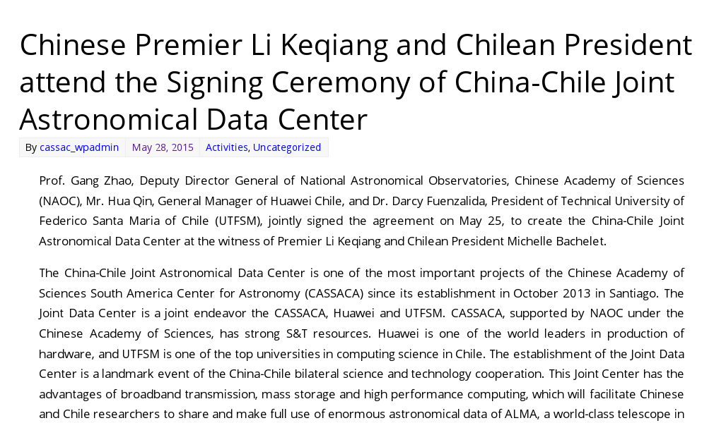
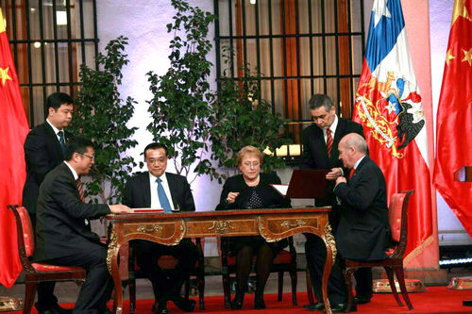
Signing Ceremony of CCADC on May 25, 2015
Notes:
13

Slide 14
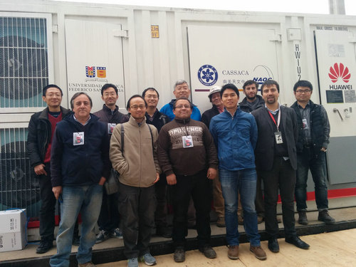
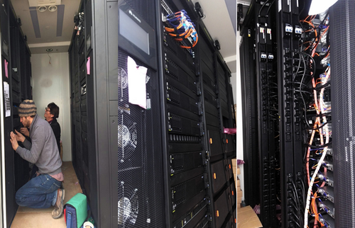
Power-On of CCADC on July 15, 2015
Notes:
14

Slide 15
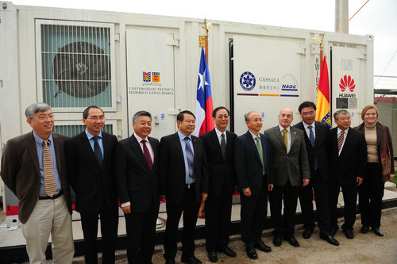
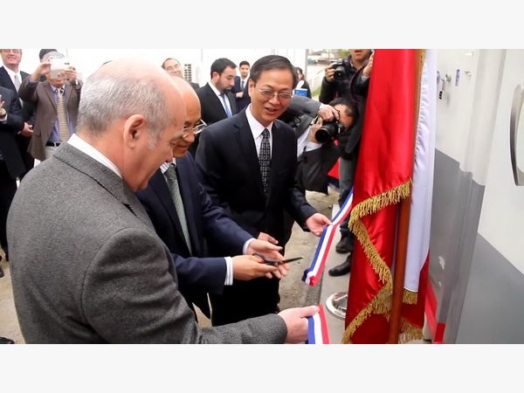
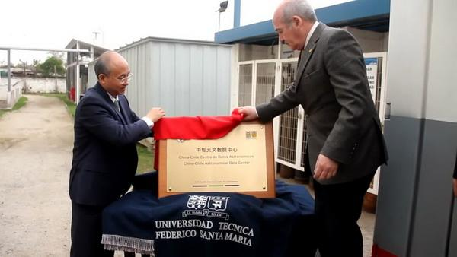
Unveiling CCADC on September 15, 2015
Notes:
15

Slide 16
CCADC: Current Status
Current status
  Hardware & OS installation from Huawei: Finished
  Construction from UTFSM: almost finished, still waiting for high-speed network connectivity
  Installation of database and archive system from UTFSM: ongoing
  Expected to begin science-related work in March, 2016
Notes:
16

Slide 17
CCADC: Hardware
Data Processing Capabilities
    Lustre: MDS + OSS
    Computing node (665 Gflops)
Networking
    1-10 Gbps Ethernet
    40 Gbps InfiniBand
Data Volume
    ~600 Tb (total storage) now
  1.5 pb/yr future capacity
    MEM AS/BD/OSS/MDS p/s 128 Gb
Ethernet
InfiniBand
Oracle
NGAS
Computing
Node
Lustre
MDS/OSS
Storage

Slide 18
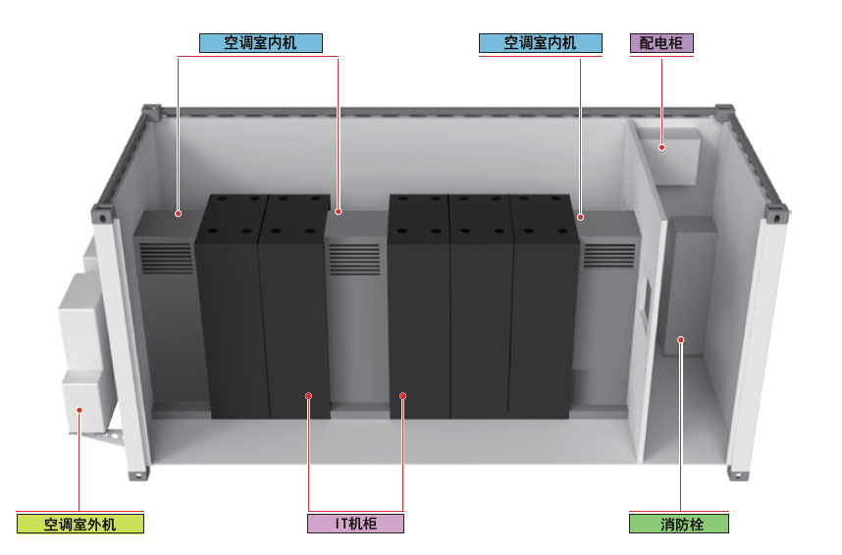
*Huawei’s Solution: A Mobile Data Center
数据中心基础设施:集装箱数据中心
工作环境湿度 | 5%～100%
工作环境温度 | –33℃～+45℃ （低温及高温工况定制解决）
海拔要求 | 0～3000m
太阳辐射强度 | ≤1120W/m²
隔热层 | 聚氨酯夹芯板 （四壁40mm、顶部75mm）
综合布线设计 | 上走线设计 电源线与信号线分开
空调管路布局 | 地板下走管
外部防护等级 | IP56
消防系统 | 七氟丙烷气体消防系统
箱体：标准20英尺海运集装箱箱体
机柜：按业务量需求单箱支持4个机柜
制冷：风冷直膨式精密空调，2+1备份
配电：UPS 2+1备份，备电10分钟
支持IT负载：20 kW(实际)
功率密度：5kW/柜 （实际功率）

Slide 19


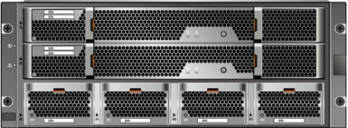

Huawei’s Solution: A Mobile Data Center
IB Computer Net
Ethernet Management Net
FC Storage Net
IB Switch
GE Switch
Hardware Monitoring Net
RH2288 V3
Lustre Manager
RH2288V3 MDS
RH 2288V3
OSS
RH2288 V3
Cluster Manager
8 * RH1288 V3
Computer Nodes
S5600T Storage
…

Slide 20
CCADC: Hardware
Resources | NAASC | EUARC | EAARC | CCADC
CPU Power Comp. Node | ~2048 GFLOPS | ~768 GFLOPS | ~240 GFLOPS | ~665 GFLOPS
MEM Comp. Node | 24 GB | 24 GB | 64 GB | 128 GB
Tot. Storage (GB) | 528 | 400 | 1440 | 540
Ethernet (Gbps) | 1-10 | 1 | 1 | 2.5
InfiniBand (Gbps) | 40 | 40 | 40 | 40
Consump. (Kwh) | 60-120 | 30-60 | 25-50 | 20-40

Slide 21
CCADC: Software
Open source:
  CASA+Pipeline: Main data reduction tool for ALMA
  NGAS: ALMA Archive System
  Lustre
  Red Hat + CentOS repository
  ALMA helpdesk system
  ChiVO
Proprietary
  Oracle data base software: for metadata

Slide 22
CCADC: ChiVO
Chilean Virtual Observatory: http://www.chivo.cl/
Launched on April 24, 2015
An initiative of the five most prestigious universities in the country, supported by the ALMA and REUNA.
To manage and analyze great amounts of data that the country’s astronomical observatories gather (e.g., 1TB/day from ALMA) with better algorithms for intelligent processing of astronomical data
Store the data in local to optimize the observation time of the Chilean astronomers.
Also be useful for the students of schools, especially of schools of rural areas.
CCADC provides a great platform for ChiVO, while ChiVO is an ideal tool for CCADC to release the scientific results of the public data, mainly from ALMA at this stage
Notes:
22

Slide 23
CCADC: Human resources
Currently we have only 2 science operators, 1 technical operators and 1 administrative staff from Chinese side
Welcome to join us!!
Notes:
23

Slide 24
Prospect
Short-term: ~3 yr, focused on the ALMA data
  Providing an excellent facility to access and reduce ALMA data for Chilean Astronomical community and visiting Chinese astronomers
  Digging the public ALMA archive data along with other data gathered (mainly from ChiVO): better treatment of CASA Pipeline for early data; call for ideas; develop tools to handle big data
  Works as an ARC:
  may include: QA and delivery of the proprietary data from 10% Chilean time; Helpdesk
  may not include: Proposal, Observation preparation, CASA development
  Providing a good platform for deep collaborations between Chinese astronomers and Chilean astronomical community
  Training young scientists and engineers on astronomical data reduction and big data management and mining
Notes:
24

Slide 25
Prospect
Long-term: up to 15 year
  Expect a ~7 billion US dollar investment on the astronomical facilities in Chile in the following decade: lots of opportunities of our data center!
  Next: LSST?
We need more companies like Huawei!
Thank you!
Notes:
25

