Slide 1


Progress of AIRE Linux in 2015
Benda Xu（续本达）, Chuan Peng（彭川）, Zhuoxi Huo（霍卓玺） and JianfengZhou（周建锋）
Tsinghua Center for Astrophysics,
Multi-Band Imaging(MBI ) Lab
2015-11-28, 甘肃•天水，China-VO 2015

Slide 2



Motivation
Observational astrophysics is more and more data-driven.
Astronomers
How to bridge the gap?
Developers
Facing up with a non-trivial environment setup: difficult and time-consuming to deploy one from a variety of data processing tools.
Facing up with a non-trivial portability: need to consider a variety of software environments.
Notes:
1、安装、维护麻烦；2、只能胜任一小部分工作；

Slide 3
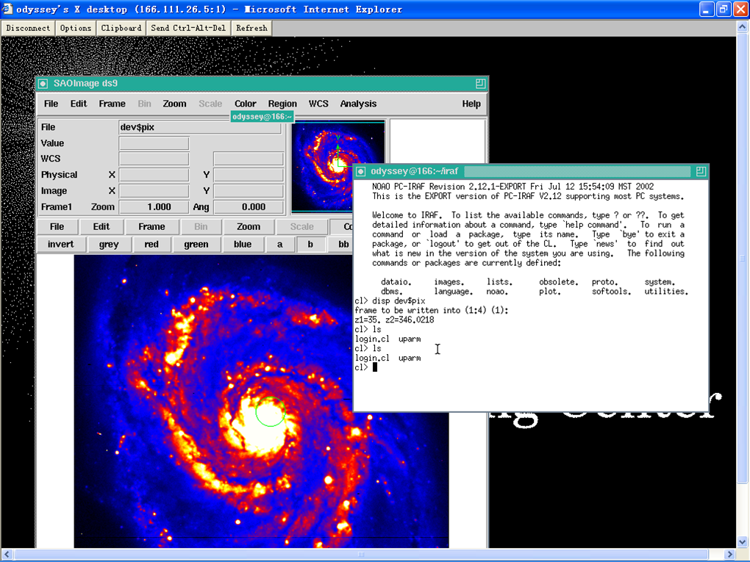
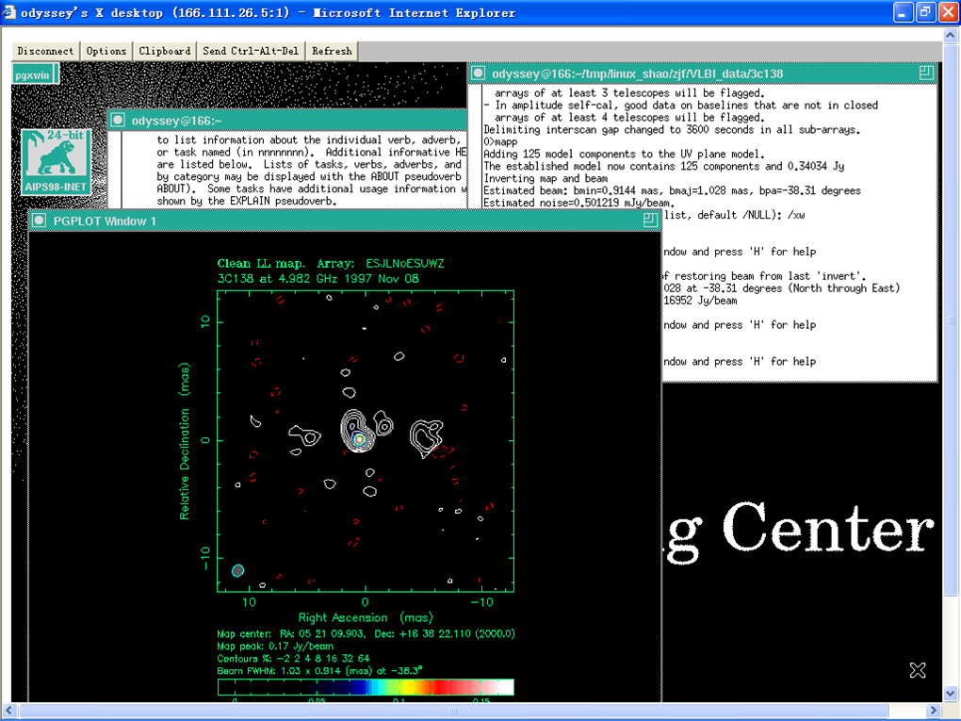
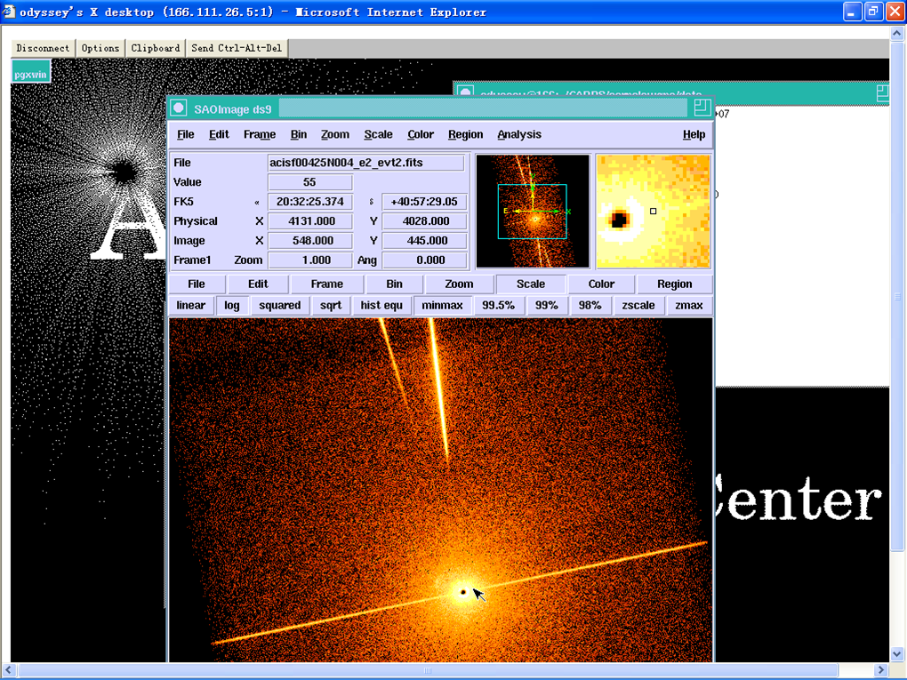
Motivation
AIRE : Astrophysical Integrated Research Environment
Notes:
1、安装、维护麻烦；2、只能胜任一小部分；

Slide 4

100+ Linux Distributions, none is for Astronomers

Slide 5
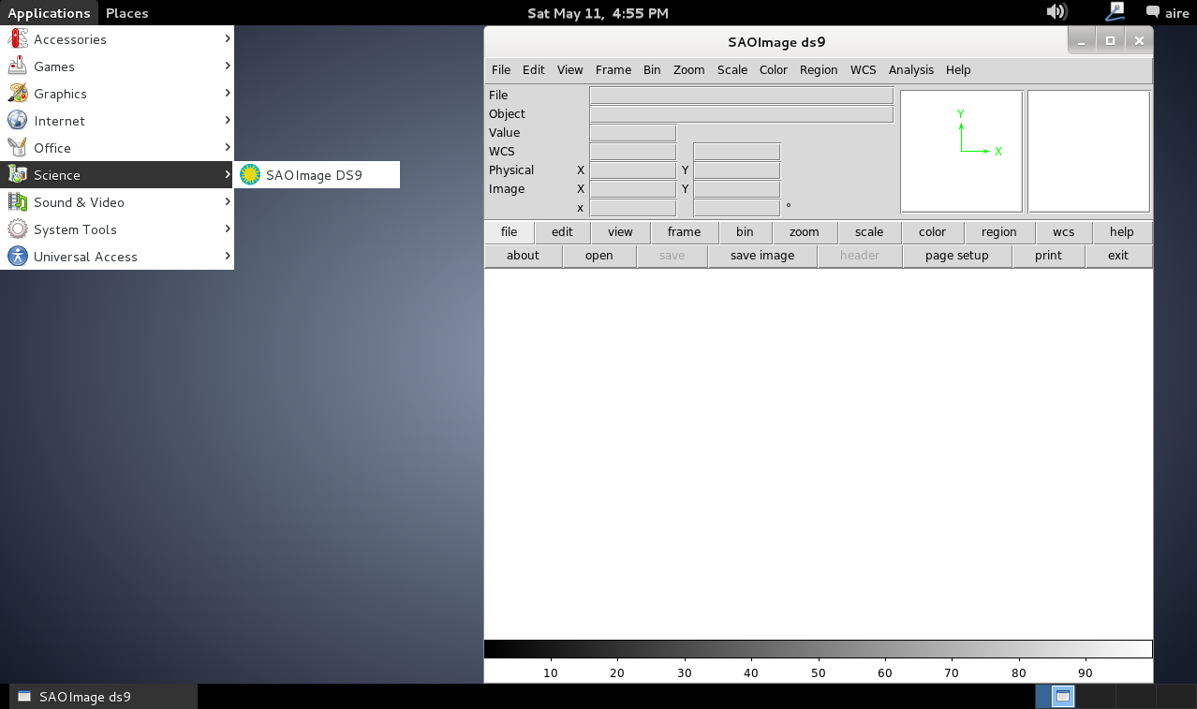

AIRE Linux: Made for (and by) Astronomers

Slide 6
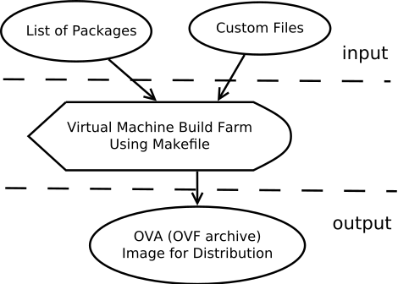
Architecture
Supported by APT (Advanced Packaging Tool), e.g.:
apt-get install iraf

Slide 7


Packages
Installable
Being reviewed

Slide 8
Packages
Working in progress
HEASoft
(High Energy Astrophysics Software)
Shipped
FV
(The Interactive FITS File Editor)

Slide 9
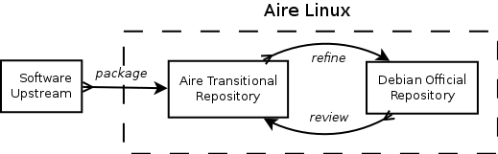
Workflow
We collaborate closely with Debian Astronomy Group.
A repository (http://ftp.airelinux.org) is maintained to serve staging astrophysical packages being reviewed by Debian.

Slide 10
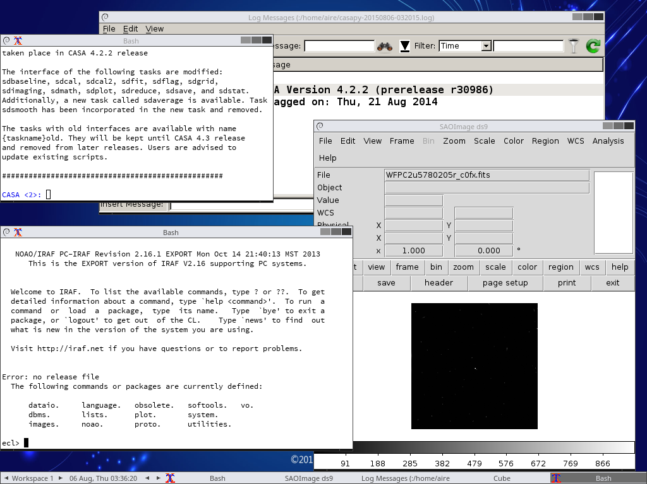
Screenshot (Iraf, casapy and ds9)

Slide 11






Released as Virtual Machines
Running on ALL Platforms
Cloud
Desktop

Slide 12
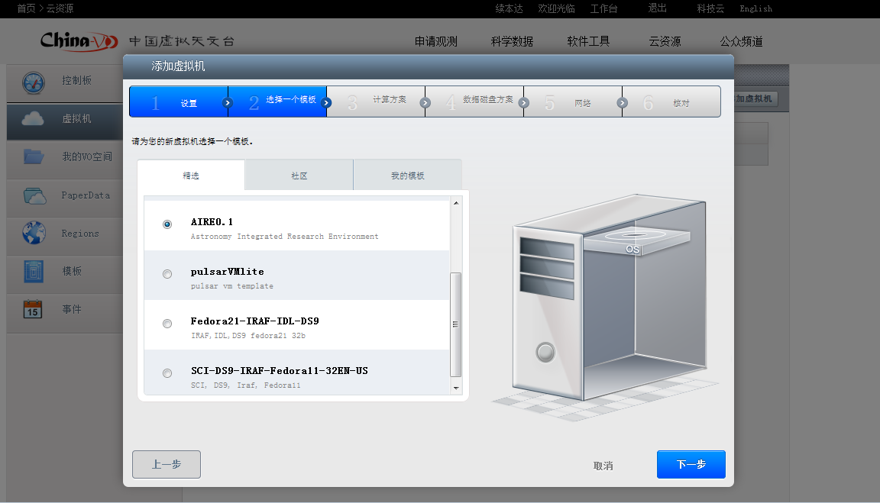
China-VO AstroCloud

Slide 13


Welcome to Join US!
We are actively looking for collaborators and user feedbacks.
Homepage: http://www.airelinux.org
Email: devel@l.airelinux.org
Sourceforge: http://sourceforge.net/projects/aire

Slide 14


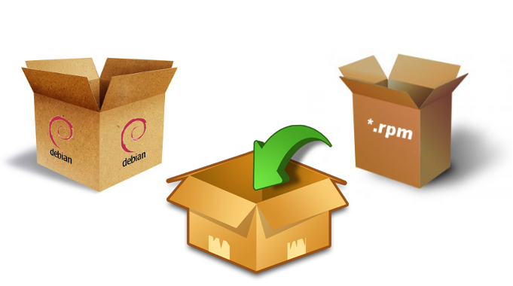
How can I help?
Download & use it in your project
http://airelinux.org/download.html
Report & squeeze bugs
http://sf.net/p/aire/tickets
Join our package team
Get more useful tools work

