Slide 1
Recognition and Measuremeant for LAMOST Galaxy Spectra
张健楠 天水 2015

Slide 2
Contents
Introduction :
Galaxy Module (GM) : LAMOST galaxy spectra recognition
and measurement program;
GM function , key method, and output products;
Some test results and performance.
Summary

Slide 3
4
Background of the Work
Redshifts survey of galaxy and QSO is one of the primal science goals of LAMOST.
Products of LAMOST 1D pipeline
Galaxy、QSO、Star（sub-class of star）、Unknown ，and redshifts for Galaxies and QSOs RVs for Stars 。
DR1 and DR2 release：
DR1: 1944,000 spectra released.
DR2: 4136,400 spectra released.
1D pipeline: work well for star spectra, but not as well for extra-galactic spectra recognition and redshift measurement.

Slide 4
Analysis of LAMOST DR2 galaxy spectra
Galaxy spectra in DR2 (galaxy:37404)：
33.91% of galaxies spectra are recognized by 1D pipeline. Others are mainly picked out by a complicated method (eyecheck and GM) .
51.61% of galaxies spectra: Obj type of star.
Galaxy in DR2 | Gal by 1D | Others by eye and GM
37404 | 12685 | 24719

Slide 5
Analysis of LAMOST DR2 galaxy spectra
SNg<=2 | SNg<=5 | SNr<=5 | SNr<=10
4122 | 23386 | 18561 | 23034
11.02% | 62.52% | 49.62% | 61.58%

Slide 6
Reasons for 1D Pipeline performance on galaxy spectra：
Key algorithm ：PCAZ；
LAMOST spectral data ：flux calibration; low SNR

Slide 7
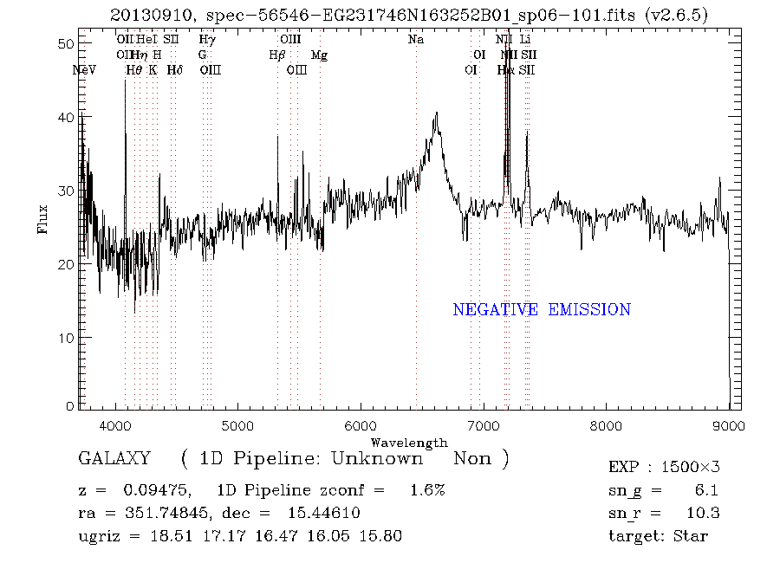
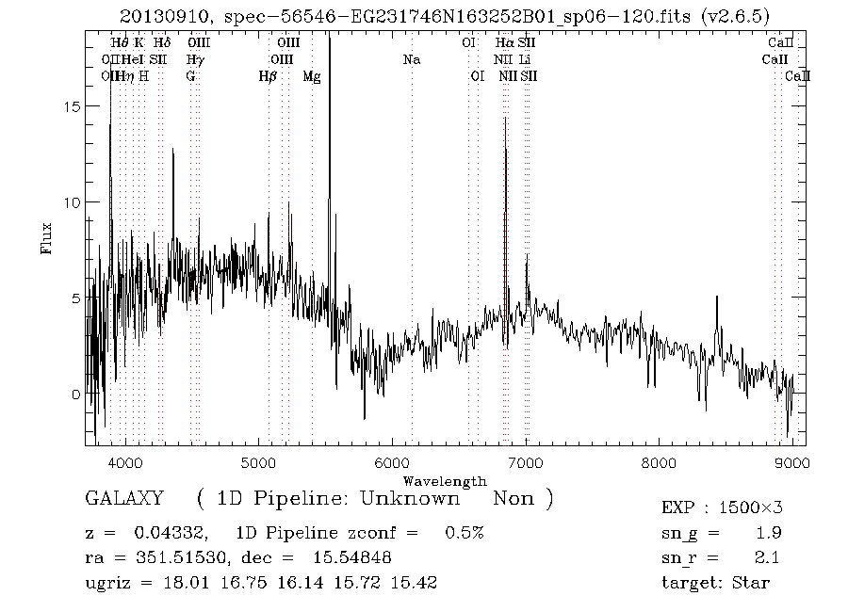
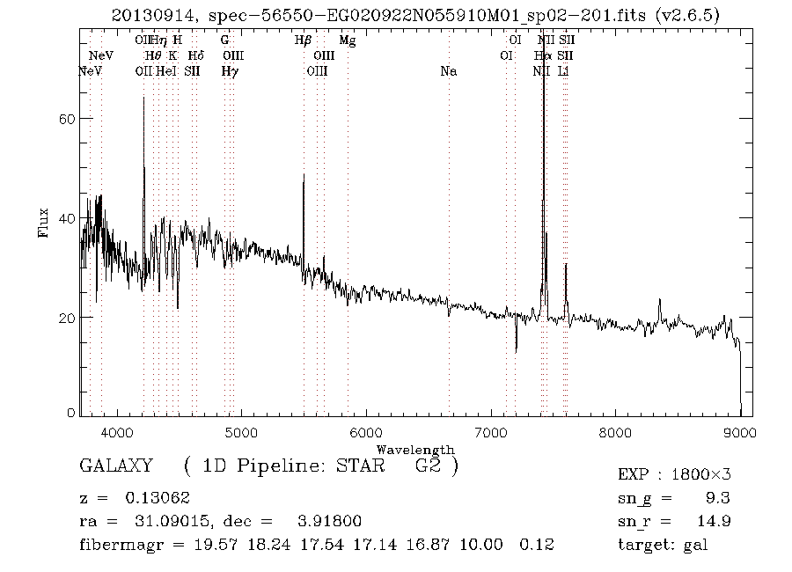
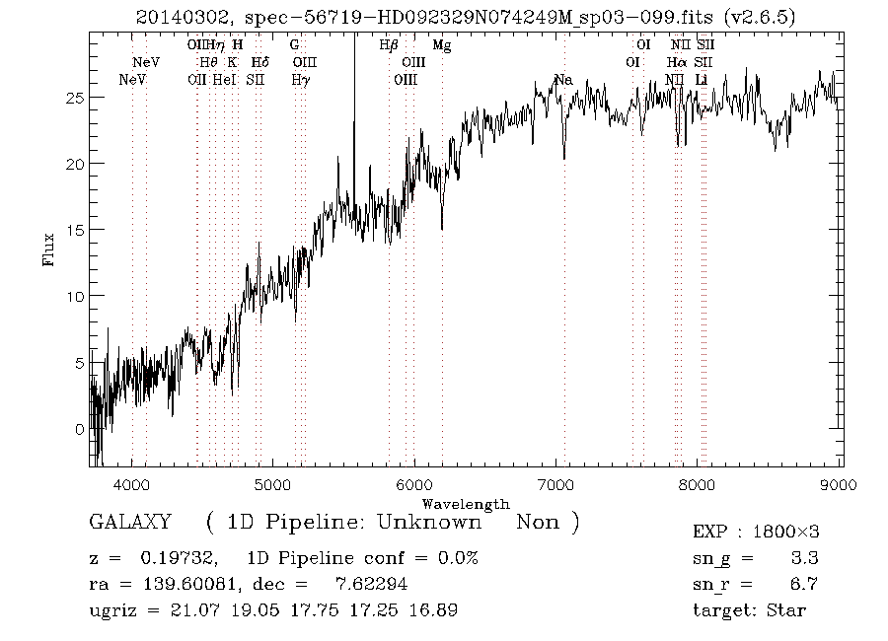
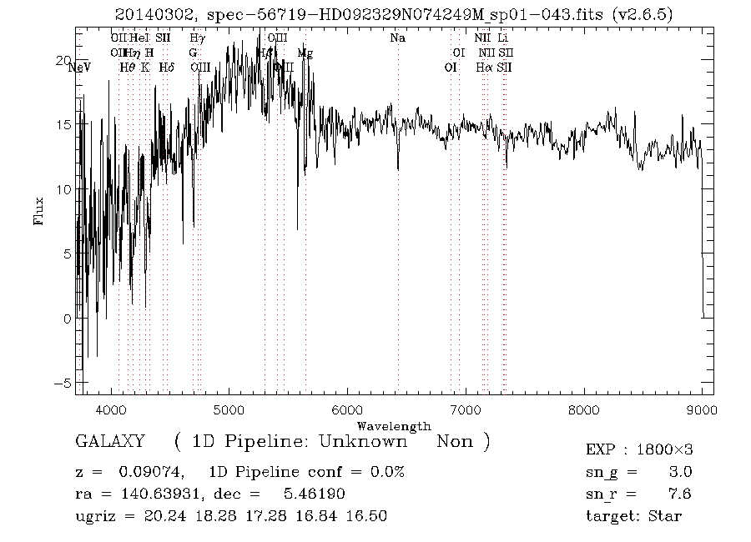
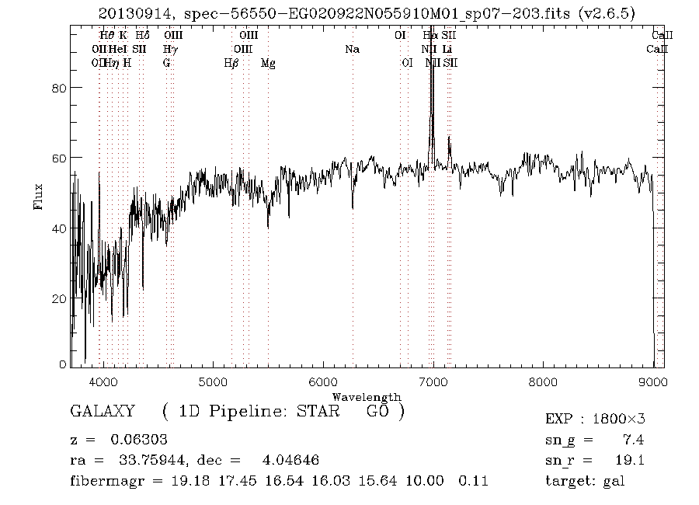
LAMOST galaxy spectra:
flux calibration; low SNR

Slide 8
5
PCAZ：spectra templates matching method based on PCA fitting
Short coming of spectra templates matching：strongly affected by the quality of flux calibration.
key procedure： low order polynomial to remove the influence of flux calibration and extinction.
LAMOST：extra-galactic plan: M and F plans，magnitude range: 16~20（r mag）.
SDSS：for the reason of effective flux calibration through photo magnitude and flux standard star, the error of flux-calibration is less 10%, which could be corrected effectively by low order polynomial.
模板类型
是否应用主成份
模板主成份数量
多项式阶数
  恒星
  类星体
  星系
  NO
  YES
  YES
  （183个恒星模板）
  4
  4
  5
  5
  5

Slide 9
My work: LAMOST Galaxy Module (GM)
Key method：extracting spectral lines information to realize the galaxy spectra recognition and redshift measurement.
Functions：spectral lines extraction and measurements; galaxy spectral lines recognition and redshift measurement; spectral lines parameters measurement (center wavelength, EW, indice of lines, et al. ); galaxy type.

Slide 10
Galaxy Module
星系模块接口
GAL_M
谱线提取与测量searchline
谱线识别与红移测量getz
谱线参量测量
linepara
星系类型
galtype
其它参量测量
Progress:
v1.0 complete;
v2.0 now

Slide 11
11
How to extract lines from low SNR spectra effectively
Low SNR:
false lines extracted
Weak lines merged
Sky lines confusion

Slide 12
12
Procedure of galaxy module
Noise processing: A Gaussian filter with sigma of 1.5 times of wavelength step was applied to the spectrum to eliminate noise.
Spectrum nomalization: Spectrum was extracted the continuum with median filters: firstly a median of width 60 smoothed the continuum and the points out of 3σof continuum were set to the continuum flux value; Then a median of width of 300 smoothed the processed spectrum above to obtain the final continuum. Normalized spectrum was achieved through original spectrum minus final continuum.
Outlier flux points detection: Search all the lines points that the flux point outlier of the normalized spectrum of 2σ where σ was determined through local normalized spectrum flux.
Candidate lines measurement: Search all the lines peak points and the wing points, then fit the lines points with Gaussian function to determine the line center, width and height.

Slide 13
Hight weight lines: Select the top 20% ( or 4) strongest lines, mask with high weight.
Lines matching:
1) Match all the lines centers with the galaxy lines. If most of the galaxy lines list were matched successfully with all the lines of high weight such as H_alpha, OII, H_beta, OIII, NII for emit galaxy or NaD, Mgb, CaII H, CaII K for absorption galaxy were matchedand the corresponded z was the raw redshift value of the spectrum.
2)For every raw redshift, matching the normalized spectrum with three type galaxy templates. The spectrum was set to be galaxy if the template matching success.
3) Confidence of template matching: 20%
Redshift: Average the lines redshifts to obtain the final spectrum redshift.
Notes:
13

Slide 14
14
Example 1: procedure of lines detection and measurement
Fig. Process of spectral lines extraction
and measurement

Slide 15
15
Example 2: procedure of lines detection and measurement
Fig. Process of spectral lines extraction
and measurement

Slide 16
Galaxy spectral templates
Method: K-mean cluster from 3178 galaxy spectra of DR2 with sng>10 snr>15 z:0.001-0.3
Galaxy spectra template construction

Slide 17
Galaxy spectra templates

Slide 18
Galaxy spectra templats

Slide 19
Galaxy spectra templates

Slide 20
Test data 1：
20140301 HD133100N262324M01 : 3500 spectra
20140302 HD121616S031407M ： 3250 spectra
20140309 HD145243N315530M : 2250 spectra
20140401 HD123204S014620M01: 1750 spectra
Crossing with SDSS DR12 catalog, we got 1351 identical galaxy source
which have galaxy spectra in SDSS.

Slide 21
Result and analysis
1351 test spectral data vs. SN
Left：histogram of SNg for test data
Right： histogram of SNr for test data

Slide 22
Result and analysis
LAMOST galaxy module (v.2) test result
 | all | SNg <2 | SNg>=2 | SNr<2 | SNr>=2
Test data: galaxy spectra | 1351 | 1064 | 287 | 668 | 683
Correct classification by GM(v2.0) | 781 | 496 | 285 | 132 | 649
Correct classification ratio | 57.81% | 46.62% | 99.30% | 19.76% | 95.02%
Wrong classification ratio | 42.19% | 53.38% | 0.70% | 80.24% | 4.98%

Slide 23
Result and analysis: recognized gal spectra
Left：histogram of galaxy number with SNg
Right： histogram of galaxy number with SNr

Slide 24
unrecognized gal spectra
Left：histogram of unrecognized galaxy number with SNg
Right： histogram of unrecognized galaxy number with SNr

Slide 25
Correct ratio of galaxy classification VS. SNR
Red line: correct ratio with SN_g; Blue line: correct ratio with SN_r
Correct galaxy recognition ratio

Slide 26
Test data 2: redshift measurement
Test data：781 recognized galaxy spectra by GM.
Method : Comparison of the z_SDSS and z_GM (ours work)
Z_SDSS: PCAZ with all spectra template matching method；
Z_GM: spectral lines measurement.
Redshift measurement of the Galaxy Module：
Fitting each line with Gauss function;
Determining the centers of lines ;
Computing the redshifts of the lines;
Averaging clustered lines redshifts to be the spectra redshift.

Slide 27
781 spectra: z_SDSS vs. z_ours
Comparison between the redshifts of 781 LAMOST galaxy
spectra recognized and measurement by galaxy module and the redshifts of SDSS galaxy spectra.

Slide 28
781 identical galaxy source of LAMOST and SDSS
ΔZ (z_GM-z_SDSS)
μ | δ
0.0000 | 0.0002（60km/s）

Slide 29
Test data 3:
Goal : Test the performance of GM for the non-galaxy spectra, how much the
GM mistake the non-galaxy spectra as galaxy.
Test data 3 selection:
20140309 HD145243N315530M : 2250 spectra
take out the crossing verified galaxy spectra : 393 spectra
select the spectra which objtype is ‘star’, ‘QSO’, ‘FS’:
1352 spectra left.
Eye check the 1352 spectra:
6 galaxy, others are star, QSO or unknown type.;
Test data3: 1346 spectra.

Slide 30
Result of test data 3:
Test data 3: Non-galaxy spectra | Classified as galaxy by GM(v2.0) | Classified as star or unknown or othertype | Wrong classification ratio
1346 | 27 | 1319 | 0.0205

Slide 31
Summary
SNg >2, correct rate >90%;
SNr>8 , correct rate >90%;
wrong classification occurs on the data with sn between 0~6
  The accuracy of redshift measurement of galaxy model:
the systematic difference and the standard deviation of the
difference are
μ：0.0000
δ：0.0002 (about 60km/s)

Slide 32
Thanks！

