Slide 1
AQUAdex: A Highly Efficient Indexing and Retrieving Method for Astronomical Big Data of Time Series Images
Zhi Hong （洪智）
School of Computer Software,
Tianjin University, Tianjin 300350, China

Slide 2
Outline
Background
Related Work
AQUAdex Indexing Method
Experimental Result
Conclusion & Future Work

Slide 3
Background
The problem of increasingly massive data sets
an ocean of data available
only a cup of that is really usefully for a specific demand
In the field of astronomy
China-VO accumulated over 100TB of observation data
a standard file type: FITS (ASCII metadata)
Time Series Image
Notes:
Big data: has attracted attention from both the industry and the academia
FITS: Flexible Image Transport System

Slide 4
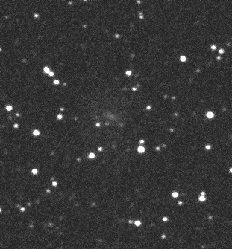
Related Work
Hadoop
SciDB
Hadoop-GIS
SDS/Q
PostgresRAW
Starcatalog
Notes:
Hadoop, which is based on the MapReduce model, is widely used in Big Data applications like data warehouse, data mining, etc.
SciDB, specially designed to work on multi-dimensional data
Hadoop-GIS, capable of efficient spatial queries, used in map applications as well as in medical image processing.
SDS/Q: specializes in processing HDF5 data
PostgresRAW: supports queries on a starcatalog file as large as 12GB.

Slide 5
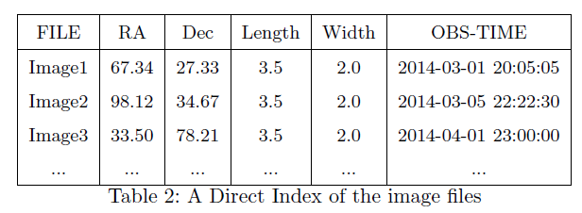
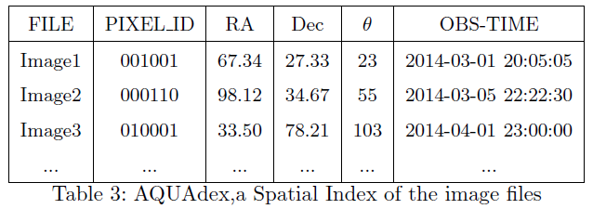
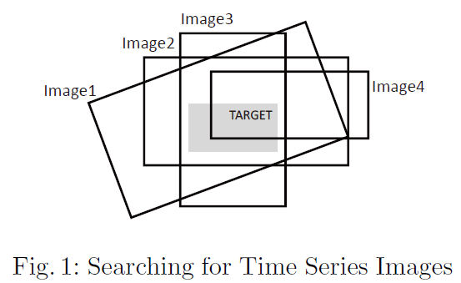
Querying for Time Series Images
Direct Indexing
AQUAdex
$$θ$$

Slide 6
Sky Partitioning with HEAPlix
A
E
D
B
C
Notes:
HEALPix (Pixels)
Neighboring pixels (have common edge)
From point to area
下一页开头说明data from AST3

Slide 7
Experimental Results
Indexing building overhead
Within acceptable range
Only a one-time thing
Easily expendable
Notes:
Data is provided by the AST3 team. This is actual observation data collected during the first 3 months in Mohe, China.

Slide 8
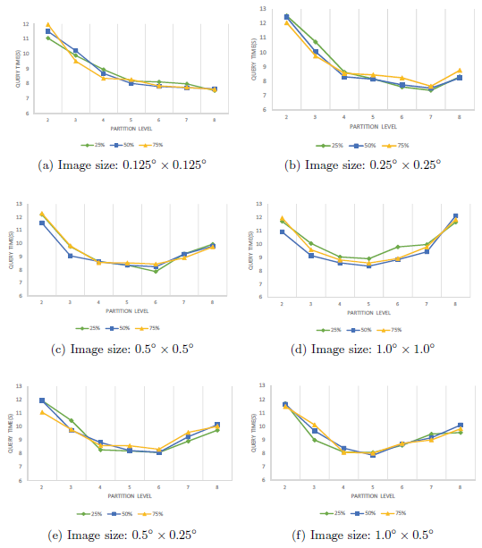
Experimental Results
Partition level N
Image size
Target size
Notes:
As the image size quadrupled, the optimal partition level decreased by 1
The longer side is the deciding factor for rectangular (not square) images

Slide 9
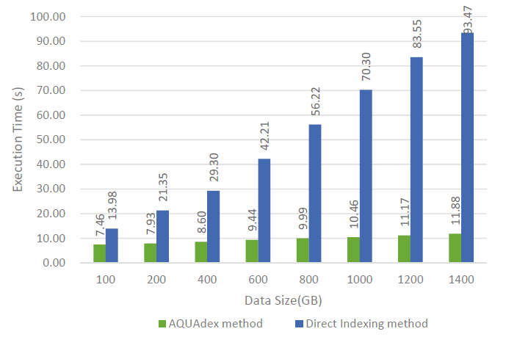
Experimental Results
Query Performance

Slide 10
Conclusion & Future Work
AQUAdex, an spatial indexing and querying method of astronomy image files is presented.
Speed up the query up to 9X faster by partitioning the sky into pixels.
Adaptability

Slide 11
Thank you!
Feedback…
- Astronomers ?
- CS researchers ?
Zhi Hong @ China-VO 2015
2015/11/18

