Slide 1
观测数据归档
何勃亮
国家天文台，中国虚拟天文台
hebl@nao.cas.cn

Slide 2
Outline
目标
思路
进展
结语

Slide 3
DATA

Slide 4
目标
数据归档的地位？
数据线
数据生命周期管理
数据是核心，贯穿于生产、管理、使用、产出等各个环节
对内、各个层次数据的收集与归档
对外，对各个不同需求提供接口

Slide 5
流程
望远镜
节点数据中心
本地存储
数据库
归档
数据中心
网络信息中心
备份存储

Slide 6
数据库
元数据
TELESCOPE
INSTRUMENT
LAMOST
TABLE / VIEW COLUMN
GMG240
YFOSC
SUMMARY_OBJ
ARCHIVE_LOG
SUMMARY_MON
TRANSFER_LOG
SUMMARY_DAY

Slide 7
归档程序功能 v1.0
生成含MD5 cheksum的文件列表
根据文件列表提取头信息生成入库脚本
本地数据入库（星表，观测日志，归档日志）
观测数据、观测数据库传输
传输日志入库，数据中心数据入库

Slide 8
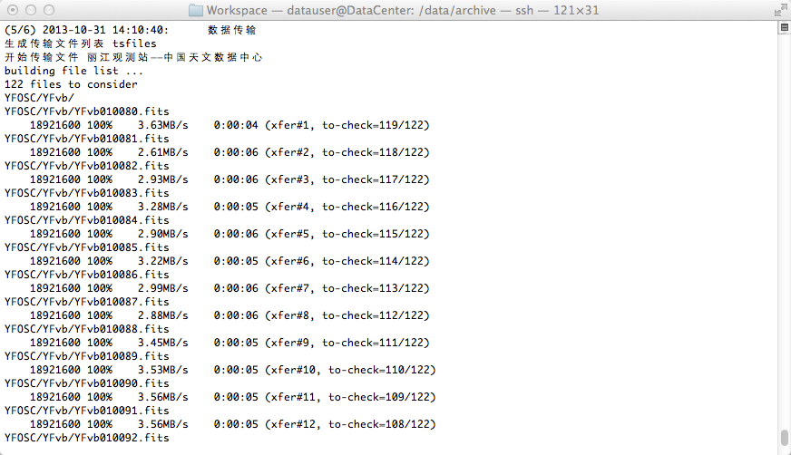
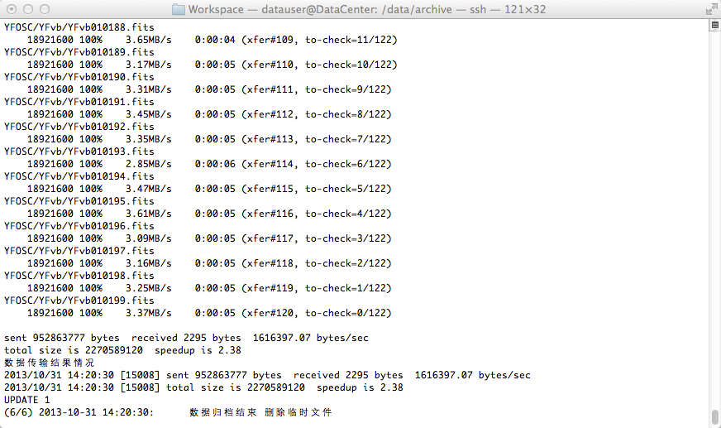

Slide 9
归档程序功能 v2.0
定期自动扫描归档文件夹，生成含MD5 cheksum的文件列表
根据文件列表提取头信息生成入库脚本
本地数据入库（星表，观测日志，归档日志）
观测数据、观测数据库传输
传输日志入库，数据中心数据入库

Slide 10
归档数据库访问
管理人员
观测者
数据拥有者
API
数据库
文件
日志

Slide 11
进展
GMG240观测数据归档程序v1.0
数据库访问
数据可视化

Slide 12
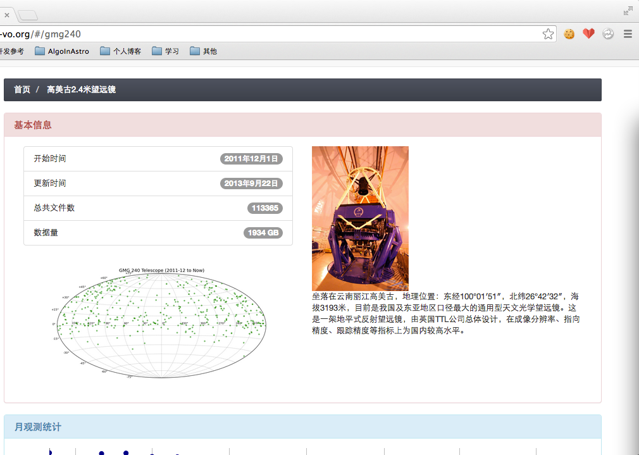

Slide 14
466

Slide 15
字段(151)
Column | Type |
------------+-----------------------------+-
id | integer |
bitpix | smallint |
extend | boolean |
bzero | bigint |
bscale | smallint |
dateobs | timestamp without time zone |
instrument | character varying(20) |
detname | character varying(20) |
chipid | character varying(20) |
creator | character varying(20) |
xoversc | character varying(10) |
yoversc | character varying(10) |
yaprtnm | character varying(20) |
yaprtid | smallint |
yaprpos | smallint |
yaprstp | integer |
yfltnm | character varying(20) |
yfltid | smallint |
yfltpos | smallint |
yfltstp | integer |
ygrnm | character varying(20) |
ygrid | smallint |
ygrpos | smallint |
ygrstp | integer |
yfocus | smallint |
ycenwav | character varying(10) |
yafltid | smallint |
yafltnm | character varying(20) |
yafltpos | smallint |
ybfltnm | character varying(20) |
ybfltid | smallint |
ybfltpos | smallint |
clamp1 | smallint |
clampnm1 | character varying(20) |
clampid1 | character varying(20) |
clamp2 | smallint |
clampnm2 | character varying(20) |
clampid2 | character varying(20) |
clamp3 | smallint |
clampnm3 | character varying(20) |
clampid3 | character varying(20) |
clamp4 | smallint |
clampnm4 | character varying(20) |
clampid4 | character varying(20) |
cmirror | smallint |
faretard | character varying(20) |
faretang | character varying(20) |
yaprslx | real |
yaprsly | real |
ra | numeric(12,8) |
dec | numeric(12,8) |
radecsys | character varying(10) |
altpos | real |
azmpos | real |
airmass | real |
rotpos | real |
obsgeox | numeric(14,4) |
obsgeoy | numeric(14,4) |
obsgeoz | numeric(14,4) |
telstate | character varying(10) |
qcrdate | character varying(10) |
object | character varying(48) |
observer | character varying(48) |
imagetyp | character varying(10) |
obs_mode | character varying(10) |
imagecat | character varying(10) |
serrtemp | numeric(6,2) |
airtemp | numeric(6,2) |
windspd | numeric(6,2) |
pressure | numeric(7,2) |
humidity | numeric(6,2) |
source | character varying(24) |
equinox | character varying(10) |
epoch | character varying(10) |
tcsstate | character varying(10) |
azmstate | character varying(10) |
altstate | character varying(10) |
rotstate | character varying(10) |
m2state | character varying(10) |
m1state | character varying(10) |
wmsstate | character varying(10) |
rotangle | numeric(8,4) |
telfoc | numeric(7,3) |
rotmode | character varying(10) |
telra | numeric(12,8) |
teldec | numeric(12,8) |
mjd | numeric(10,4) |
lst | character varying(12) |
exptime | numeric(7,3) |
amplmode0 | smallint |
amplmode | character varying(10) |
detwin1 | character varying(30) |
datamin | bigint |
datamax | bigint |
ccdtemp | numeric(7,2) |
ln2temp | numeric(7,2) |
p_dewar | real |
shstat | character varying(10) |
detxbin | smallint |
detybin | smallint |
nwindows | smallint |
tsam | smallint |
fpix | smallint |
vshi | real |
vslo | real |
vphi | real |
vplo | real |
xtension | character varying(10) |
naxis | smallint |
naxis1 | smallint |
naxis2 | smallint |
pcount | smallint |
gcount | smallint |
bunit | character varying(10) |
ccdname | character varying(10) |
ctype1 | character varying(20) |
ctype2 | character varying(20) |
crval1 | real |
crval2 | real |
cunit1 | character varying(10) |
cunit2 | character varying(10) |
crpix1 | real |
crpix2 | real |
cd1_1 | double precision |
cd1_2 | double precision |
cd2_1 | double precision |
cd2_2 | double precision |
dark | real |
qcddate | character varying(16) |
rdnoise | numeric(4,1) |
gain | numeric(5,2) |
extname | character varying(10) |
imageid | smallint |
inherit | boolean |
ccdsum | character varying(10) |
zero00 | smallint |
gain00 | real |
vbha00 | real |
vbhb00 | real |
vbhc00 | real |
vbla00 | real |
vblb00 | real |
note | character varying(256) |
obsv | integer |
assistant | character varying(32) |
folder | character varying(128) |
filename | character varying(64) |
filesize | integer |
checksum | character varying(64) |
rectime | timestamp with time zone |

Slide 16
下一步工作
可视化
观测数据Footprint可视化
观测日志可视化
报表
数据底层访问API
文件获取
文件打包

Slide 17
结语
数据全生命周期管理是个非常重要的基础性工作
需要各方面的配合

Slide 18
谢谢！

