Slide 1




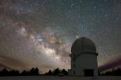
丽江BOOTES-4自主天文台
范玉峰
Fanyf(at)ynao.ac.cn
云南天文台 丽江观测站
http://www.gmg.org.cn
2011 贵阳

Slide 2
主要内容
China-RAON计划
Burst Optical Observer and Transient Exploring System介绍
丽江BOOTES-4项目
BOOTES-4进度和计划
参与BOOTES合作

Slide 3
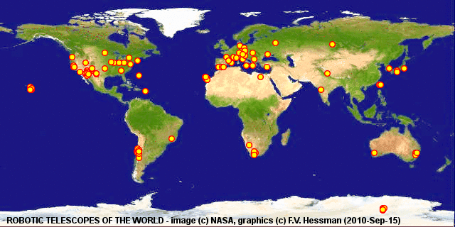
China-RAON计划
程控自主天文台
野外台站、变源长期监测、机会源余辉观测需求。
Robotic Autonomous Observatory（RAO）遍地开花、结果。
中国程控自主天文台-丽江节点计划 2011.3-？。

Slide 4
China-RAON计划
需求与技术
数据的交互处理，反馈环节的深度>>数据源和质量控制
野外选址和长期观测的专用设备
逾越“远程观测”与“程控自主”间的技术鸿沟（遥控飞机和无人机的区别）
硬件是保障
软件是关键

Slide 5
China-RAON计划
技术路线
四步走：
  学习、目标、尝试、完善
技术方案：
  开源系统（如RTS） vs. 商业软件（ACP）

Slide 6
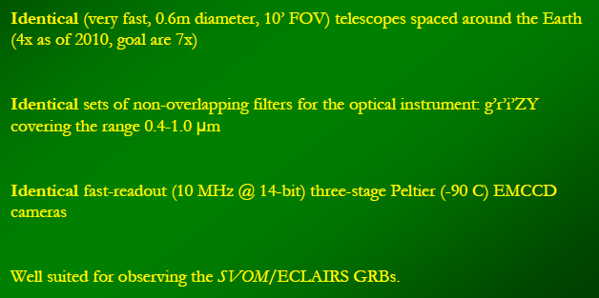
BOOTES介绍
BOOTES自主天文台网络
BOOTES: Burst Optical Observer and Transient Exploring System
(A world wide Network of Robotic Telescopes)

Slide 7
GRB观测
GRB及其观测的意义
GRB是宇宙空间γ射线短时间突然增加的现象。
GRB时间特征：波形复杂；持续时间1ms-1000s；变化的时标1ms,甚至0.1ms。
一般认为GRB长暴主要起源于大质量恒星塌缩过程，短暴则与致密星并合有关，各向同性能量10⁵³erg。
GRB余辉(GRB970228)发现使对GRB的观测获得极大进步，按主流理论，喷流撞击到暴源周围的气体或尘埃时会形成余辉，同时喷流的反向激波形成激闪（Peter Meszaros）,喷流前导会随速度降低而释放X射线与可见光，可以确定伽玛暴的红移。

Slide 8
GRB观测
GRB观测的难点
GRB持续时间短，短暴少于2秒
空间时间分布随机
GRB本身除短暂发生的γ射线外，几乎没有其他波段的对应体
定位精度低，难以确认对应天体，认为与超新星成协
现有余辉模型需要观测从极端相对论、高辐射到非相对论、绝热阶段的变化过程，Swift标称反应约在100秒，但是60s以内的光变几乎来不及探测，2012年UFFO标称60秒？
GCN地面观测网及VO-GCN标准化天文瞬变事件通知机制

Slide 9
GRB观测
GRB探测率和暴发率
理想状态下，地球上每天可探测到两到三个伽玛暴
上世纪70年代Vela，探测率10-20个/年;
80年代 50-100个；
90年代康普顿伽玛射线天文台探测率为300,
BeppoSAX和HETE-2为50个左右，
2005年至2010年Swift探测到超过500个,85%探测到X射线,约60%探测到光度，164个探测到红移，以及定位了52个短暴
2008升空的Fermi望远镜对伽玛暴的探测率近150个

Slide 10
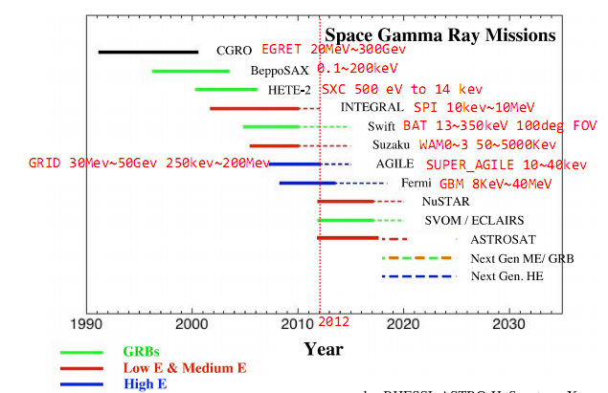
GRB观测
GRB空间探测器
可见光 ~5ev
X射线几kev~几百kev
伽玛射线 2Mev
http://fermi.gsfc.nasa.gov/workshops/da2010_india/Neil_Gehrels_Instrumentation.pdf
Notes:
可见光 ~5ev
X射线几kev~几百kev
伽玛射线 2Mev

Slide 11
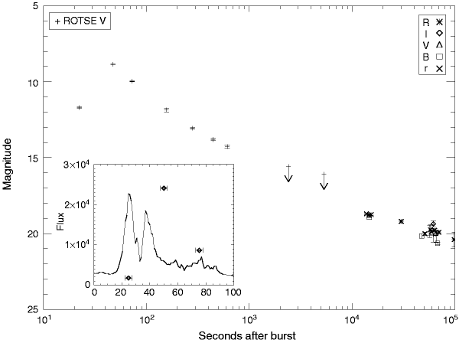
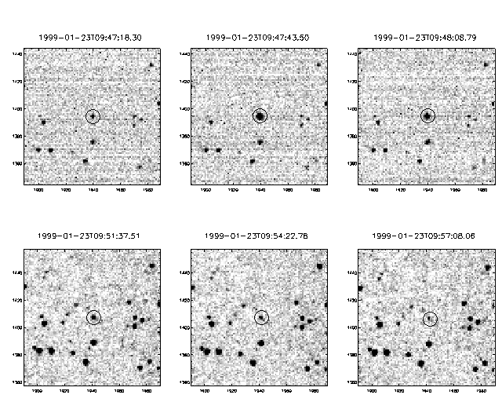
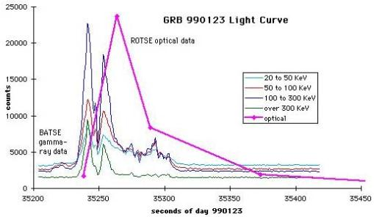
GRB观测
GRB光学余辉探测
GRB990123的余辉光变曲线和伽玛射线曲线
ROTSE拍摄的光学图像
来自 http://rotse1.physics.lsa.umich.edu/summary/defs/grb990123.html

Slide 12
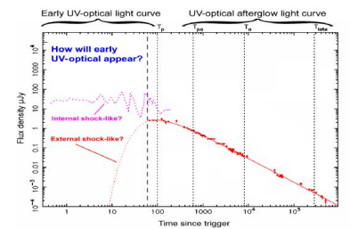
GRB观测
GRB光学极早期余辉探测
60S以前的数据是什么情况？

Slide 13
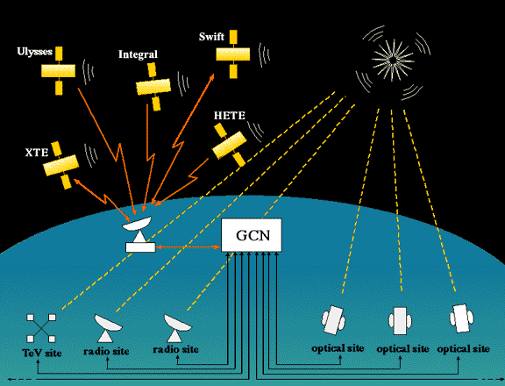
GCN及地面观测网
GCN:The Gamma-ray Coordinates Network 1997
(VO-GCN NASA 2008)
PS：GCN，当年的BACODINE。由于CGRO的BATSE的记录设施损坏，因此无法象预计的那样定期经由跟踪和数据传输卫星系统中转将数据批量传回地面，只好随时解决传输问题。

Slide 14
GCN及地面观测网
The GCN Various Source of GRB Locations
(Current Missions)
SOURCE | TIME DELAY | ERROR BOX SIZE | RATE | COMMENTS
IPN_POS | 0.5-1.5 days | 5-20' dia | 3/month | Small FOV telescopes
INTEGRAL_WAKEUP | 60 sec | 10' | 1/month | Small FOV.
INTEGRAL_REFINED | 60-100 sec | 5' | 1/month | Small FOV.
INTEGRAL_OFFLINE | 60-200 sec | 3-5' | 1/month | Small FOV.
Swift-BAT_POS | 13-40 sec(1) | 1-5' dia | 2/week | Fast and Small.
Swift-XRT_POS | 30-80 sec(1) | 5" dia | 2/week | Fast and Small.
Swift-UVOT_POS | 0.2-9 hrs(1) | 2" dia | 1/week | Fast and Small.
SuperAGILE | 20-40 sec | 20' dia | 1/month | Small FOV.
Fermi-GBM | 20 sec | 4-10 deg dia | 15/month | Large FOV telescopes.
Fermi-LAT | 100 sec | 10-30' dia | 1/month | Small FOV telescopes.
MAXI_Unknown | 2-200 min | 1deg dia | 1/month | Small FOV.
MAXI_Known | 2-200 min | 0.5deg dia | 1/week | Small FOV.
http://gcn.gsfc.nasa.gov/gcn_describe.html

Slide 15
GCN及地面观测网
GRB COORDINATES DISTRIBUTION METHODS
TIME DELAY | METHOD/MEDIA | COMMENTS
0.1-0.5 sec | Socket (160B binary) | Fast & suited for automated instruments.
0.1-0.5 sec | Socket (VOEvent XML) | Fast & suited for automated instruments.
2-30 sec | L-mail (text) | To any network address (johndoe@machine.domain).
5-100 sec | E-mail (text) | To any network address (johndoe@machine.domain).
5-100 sec | E-mail (XML) | To any network address (johndoe@machine.domain).
5-180 sec | Pager | RA,Dec,UT,Intensity displayed on your cellphone/pager.
5-180 sec | Short Pager | RA & Dec displayed on your cellphone/pager.
5-180 sec | Subject-only | RA & Dec displayed in the Subject-line to your cell/pager.
5-180 sec | SubjHHMM-only | RA, Dec, Time, & Intensity displayed in the Subject-line in RA=HH:MM:SS format.
0.3 sec | Dedicated phone | Continuous phone/modem connection. (no longer available)
30-90 sec | Dialed phone | Slower but much cheaper than Dedicated. (no longer available)

Slide 16
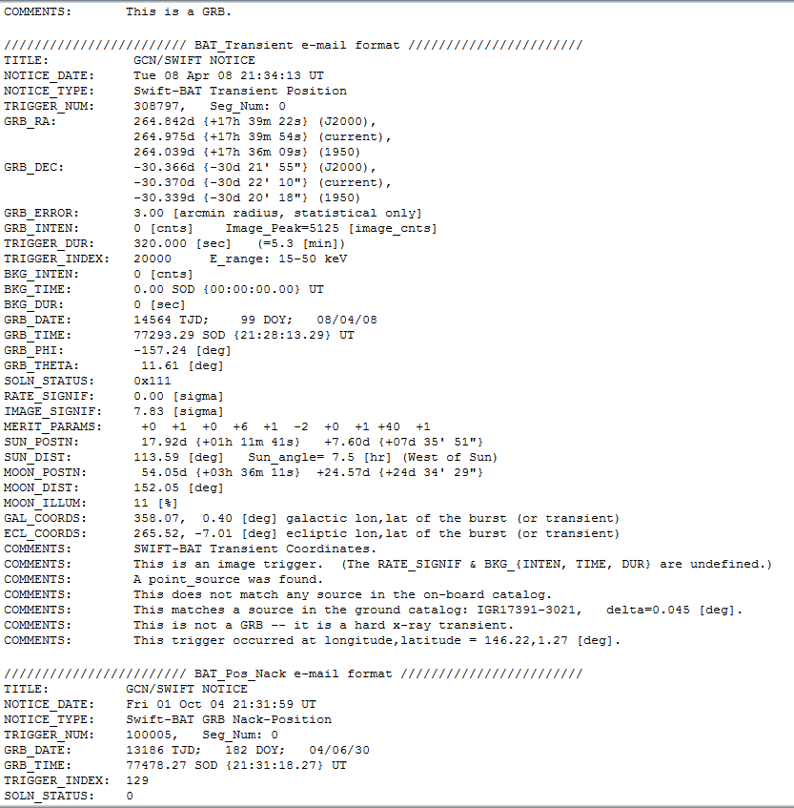
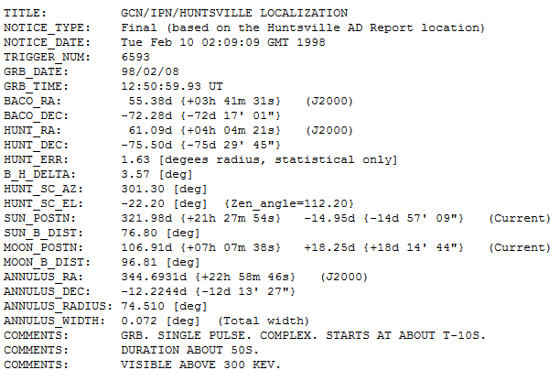
GCN及地面观测网
GRB COORDINATES DISTRIBUTION Format
Swift Notice Email example
GCN/IPN Email example
http://gcn.gsfc.nasa.gov/ipn.html

Slide 17
GCN及地面观测网
地基伽玛暴监测网
联网接收GCN数据的中小型望远镜网
ROTSE GRB990123 促成喷流说的兴起，ROTSE-III 45cm 2.6°FOV，35°/秒
Super-LOTIS 17″x17” FOV，60cm，极限星等18.5等(60s曝光)，典型响应时间小于25秒，覆盖爆发最初几十秒到几小时的红外CCD及多色测光
RAPTOR 4X85mm+1X400mm(4°X4°)其中85mm镜头作实时数据反馈闭环分析，200度/秒，发现GRB041219A爆发光学闪
KAIT Lick天文台，76cm，全套滤光片，6.7′X6.7′，21.5m(300s)
REM La Silla意大利国家天体物理研究所项目 60厘米快速反应望远镜，2002年 10´X10´，
GROND 马普学会2.2米望远镜上的7通道照相机，近红外波段，确定伽玛暴测光红移
参考：http://bzhang.lamost.org/website/archives/unsung_telescopes/

Slide 18
GCN及地面观测网
EAFON
East-Asia GRB Follow-up Observation Network
EAFON 东亚地区伽玛暴地基监测网
2004年成立，包括日本木曾天文台的1米望远镜、日本理化研究所的WIDGET、中国国家天文台兴隆观测站的80厘米TNT望远镜、1米EST望远镜和2.16米望远镜、云南天文台高美古观测站的2.4米望远镜、台湾鹿林天文台的1米望远镜，及韩国普贤山光学天文台的1.8米望远镜
反应速度最快的是TNT，1分钟多，多站联合，基本上可以保证每天至少有一个台址拥有可观测的晴夜

Slide 19
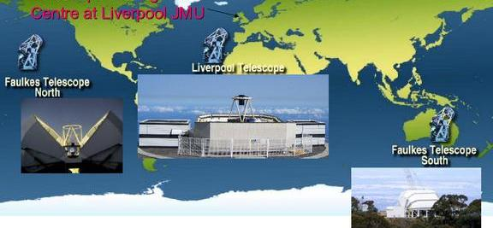
GCN及地面观测网
RoboNet-1.0
英国利物浦John Moores大学，全球2米级望远镜网络，伽玛暴与系处行星搜索，TTL公司2m级全自动大型望远镜，最快响应时间2至5分钟，斯隆标准滤光片，低分辨率光谱仪，
利物浦望远镜还有偏振计RINGO与红外照相机

Slide 20
BOOTES介绍
发展历史
西班牙安达卢西亚天体物理研究所发起的全球范围的全自动天文望远镜
BOOTES-1 1998 First Light
BOOTES-2， BOOTES-3， BOOTES-IR
BOOTES-4 2011

Slide 21
BOOTES介绍
仪器配置（1998-2004）
Commercial Nikkor 50-mm wide-field lens, attached to two ST8 SBIG CCD cameras, covering the error box of GRB source.
Powerful DSP The frames taken at each station at the very beginning of the night will be loaded into memory (the primary frames). During the rest of the night, successive frames (secondary frames) could be compared with the primary frame, If a real flash were detected in the secondary frames, the coordinates of the flashing object and the images themselves would be transferred to LAEFF-INTA.
Exceptionally, when information on a GRB position would be obtained from the GCN ,the cameras used to provide images of the corresponding GRB error boxes.

Slide 22
BOOTES介绍
软件系统
A modular software (1998-2004)
Simultaneous and quasi-simultaneous observations of the GRB error boxes sources from GCN (Electronic mail/Modem line/GSM/ Internet TCP/IP connection (0.1s~2s)).
1. Dome Control Monitor. Automatic dome opening system
Meteorological data analysis: precipitations, temperature, humidity, sunrise and sunset.
Remote control via GSM and SMS system: status report, system failures (blackouts, TCP/IP errors).
Telescopes switch on and off.
FTP client to supervise the observatory in the Internet by means of a webcam.
2. Telescope Control Monitor.
- GRBs alerts receptions:
Management of the telescopes’ automatic survey programs.
E-mail client to send astronomical images.
Optical Transient Monitor. Astronomical images acquisition through digital cameras:
Regular sky monitoring in the I and V bands.
Search for recurrent optical transient emissions. study of comets, meteors, asteroids, variables stars, novae, supernovae
3. Images Analysis Monitor.
- Analysys and detection of optical flashes of cosmic origin
E-mail client to send data of possible transient.
150 Gb database.
The RTS2 Operating System (since 2004)

Slide 23
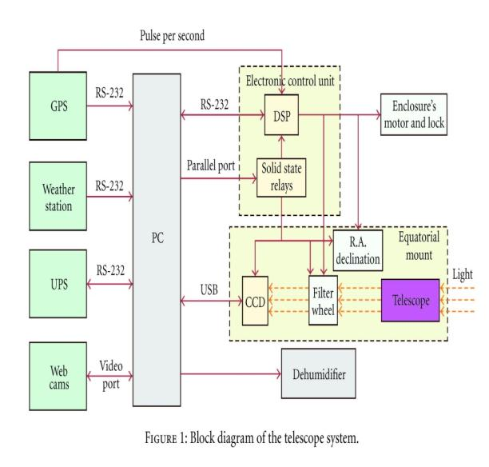
BOOTES介绍
BOOTES系统框图

Slide 24
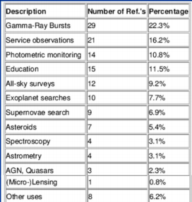
BOOTES介绍
观测结果
The observation of the GRB error box simultaneously to the GRB occurrence.
The detection of optical flash (OTs) of cosmic origin.
The observation of the sky in the I and V filters ,as a part of the preparations for the ESA’s satellite project INTEGRAL. BOOTES considered part of the preparations for the ESA's satellite project INTEGRAL(2002-2014).
The monitoring of several objects.

Slide 25
BOOTES介绍
发展和计划
Life cycle | Observatory | Location | Primary mirror | CCD properties | filters | React time
1998-2000 | BOOTES-1A | El Arenosillo (Spain) | 0.2m F/10 | 40′X30′FOV 16° x 11° <14m (300s) <12m (30s) | I ,V | Within 1 minute (BeppoSAX,RossiXTE)
2001 | BOOTES-1B | El Arenosillo (about 100m away from BOOTES-1A) | 0.3m F/10 | <18m 30′ x 20′ FOV Spectrographs 43′x28′ (<13.5m 30s) Wide field CCD 400 mm f/2.8 lens: 5°X 5°FOV | I,R,V | Within 1 minute (BeppoSAX, RossiXTE, HETE-2, INTEGRAL and SWIFT)

Slide 26
BOOTES介绍
发展和计划2
Life cycle |  | Location | Primary mirror | CCD properties | filters | React time
2001 | BOOTES-2 | La Mayora (Málaga,Spain ) | 0.3m F/10 (2009) 0.6m F/8 | <18^{m} (2009) <20.5^{m} (2011) <16^{m} (Spectroscopy with COLORES) | clear, Johnson R, Sloan g′ r′ i′ UKIRT Z and Y -band filters | Within 1 minute 100deg/s,20deg/s² (BeppoSAX, RossiXTE, HETE-2, INTEGRAL and SWIFT)
2004 | BOOTES-IR/T60 | Spain | 0.6m | 2009 Near-IR(0.8-2.5)
2009 | BOOTES-3 | Vintage Lane, New Zealand | 0.6m RC F/8 | EMCCD <20.5^{m} 10'x10' FOV |  | With 10 second (INTEGRAL, SWIFT and FERMI)
2011 | BOOTES-4 | Lijiang, China | 0.6m RC F/8 | EMCCD <20.5^{m} 10'x10' FOV

Slide 27
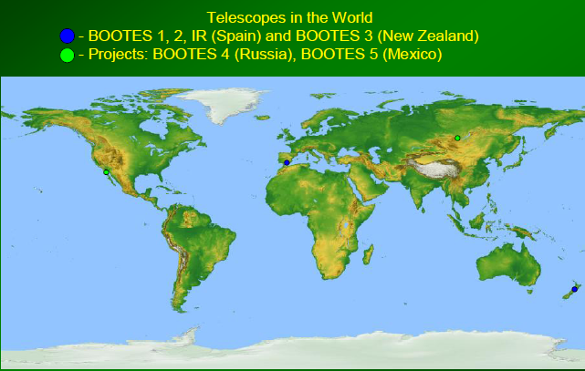
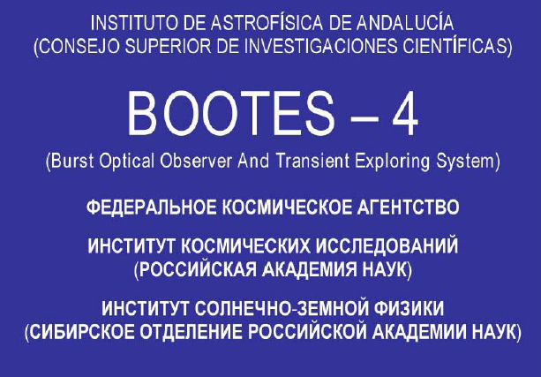
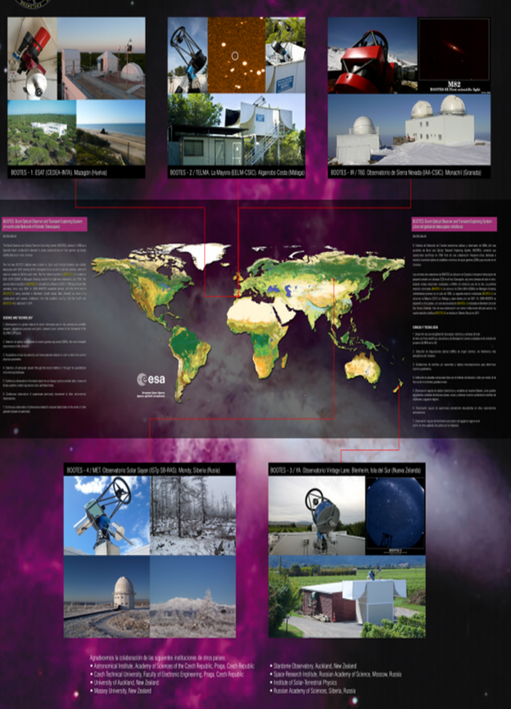
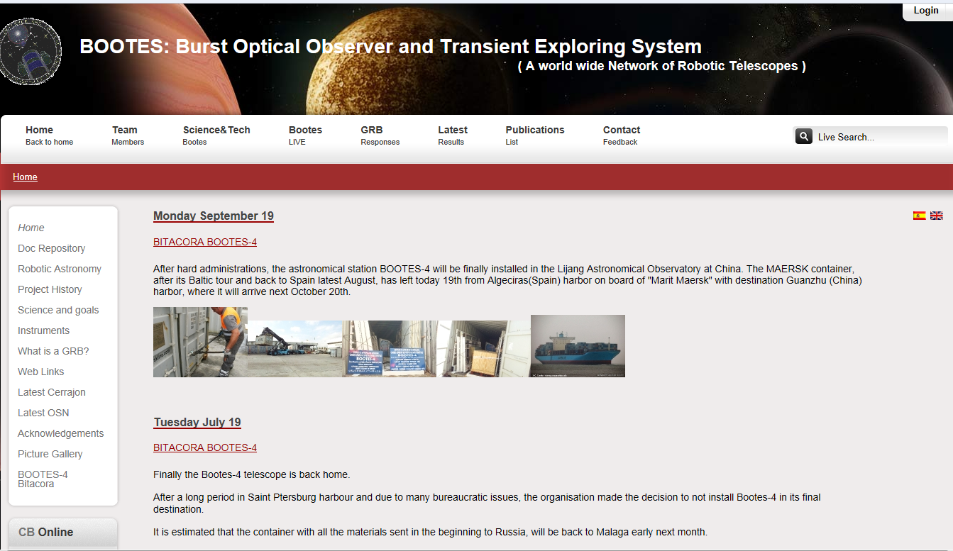
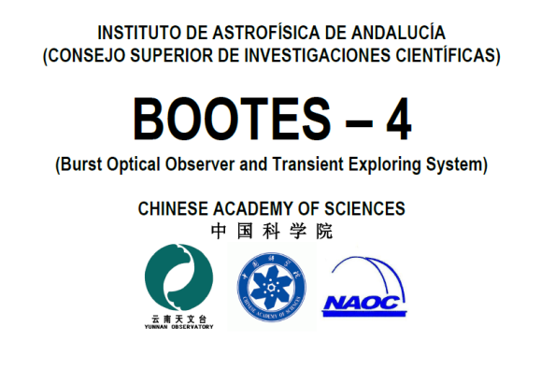
丽江BOOTES-4项目
合作机缘

Slide 28
丽江BOOTES-4项目
BOOTES-4系统构成
ASTELCO Mount NTM-502 Technical Description
Slewing Speed | 20°/s
Acceleration and Deceleration | 20°/s²
Absolute positioning accuracy | <5″ RMS
Tracking accuracy without autoguider | <1″/120 min
Tracking accuracy with autoguider | <0.3″
ASTELCO 0.6mRCLW Telescope Primary mirror diameter is 0.6m。The diameter of second mirror is 210mm ，focal ratio is F/8。
Andor scientific EMCCD camera (Andor iXon DU-888E-C00-#BV, which is a C-mount standard back illuminated device with 10,5 &3MHz@14-bit and 1MHz @16-bits,Active pixels is 1024X1024, pixel size 13X13 ̊um; frame rate is 9(full frame per second);read noise 1 to 47e@10Mhz

Slide 29
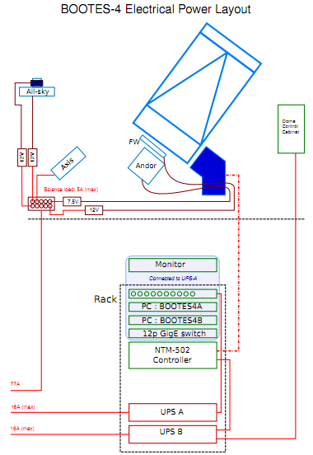
丽江BOOTES-4项目
BOOTES-4系统构成2
Enclosure: houses the telescope and all equipment, drive by electrical motor
Axis & Web camera: monitor the whole observatory, observatory image is available via internet.
Thies Rain sensor: type 5.4103.10.000. detect status of precipitation(rain, snow, hail etc.),drop size>0.2mm, switch-on within 50 sec for 1~15 incidences.
Linux servers with RTS system: are used to control the telescope mount, dome, and other equipment. All computers can be accessed from internet. GCN alerts can trig the ToO observation.
UPS two SUA3000RMI2U （3000VA ） connected to the computer through a serial port. The UPS will shut down the computer in case of persistent power failure and turn it on again when the power is recovery.

Slide 30
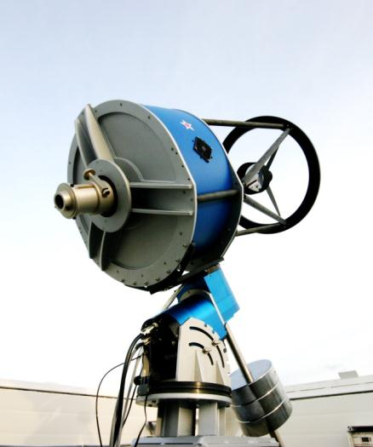
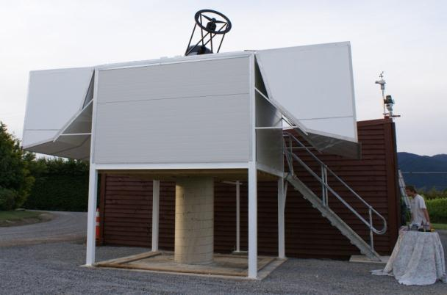
丽江BOOTES-4项目
BOOTES-4外观
BOOTES Robotic Observatory
BOOTES-4(BOOSTES-3)
equatorial mounting 0.6m-RC Telescope

Slide 31
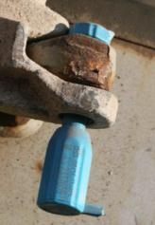
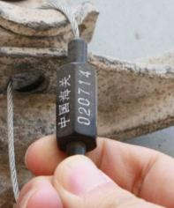
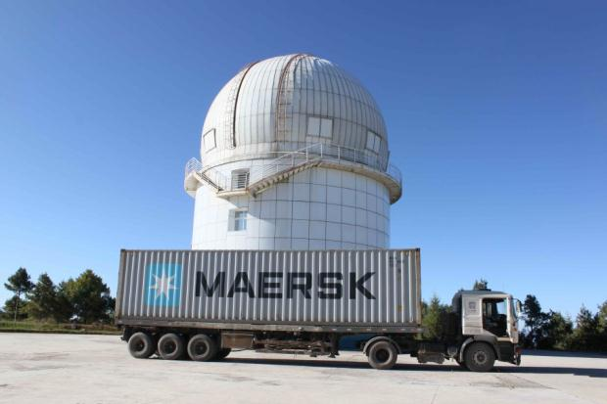
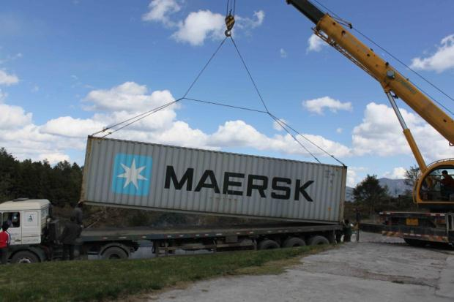
BOOTES-4进展与计划
运输与进口
14-19th Oct. 2011, passed Nansa Port.
21st Oct., arrived Huangpu Port.
31th Oct., container arrived Kunming Customs.
2nd Nov., truck arrived Lijiang Observatory.

Slide 32
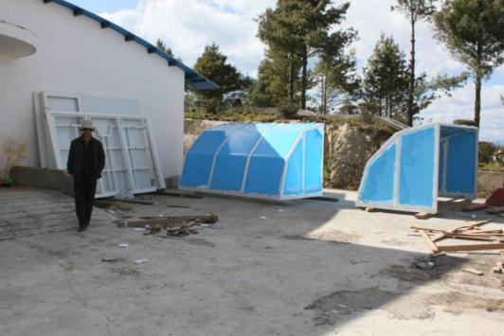
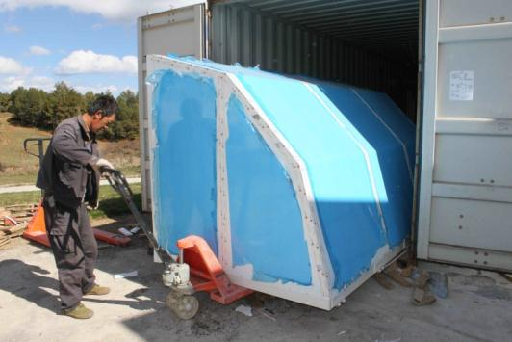
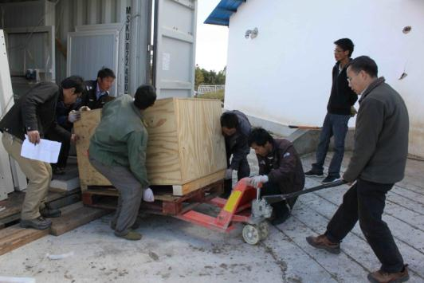
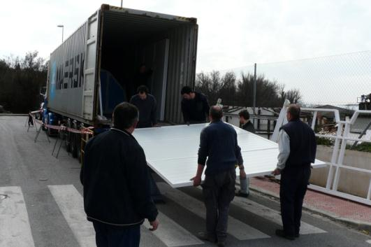
BOOTES-4进展与计划
BOOTES-4 (parts) in Lijiang

Slide 33
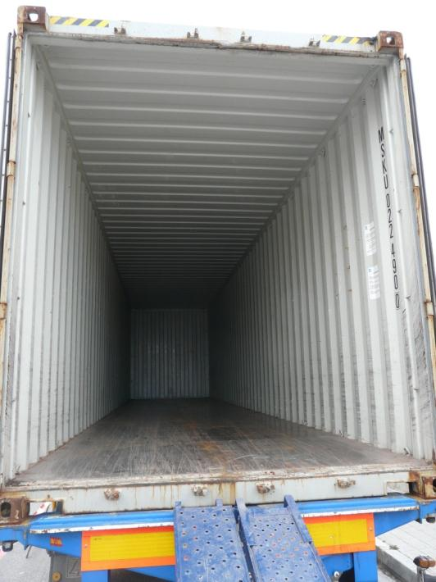
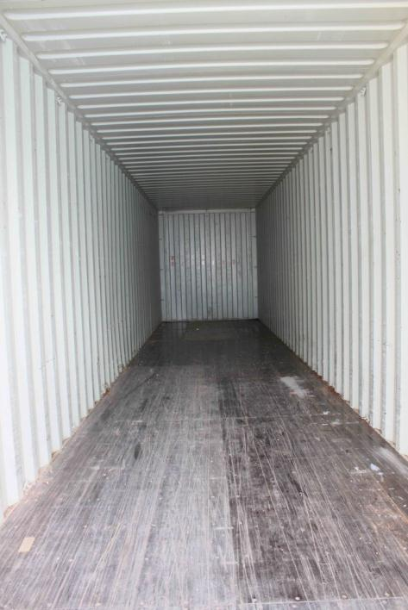
BOOTES-4进展与计划
The expensive dust from Spain

Slide 34
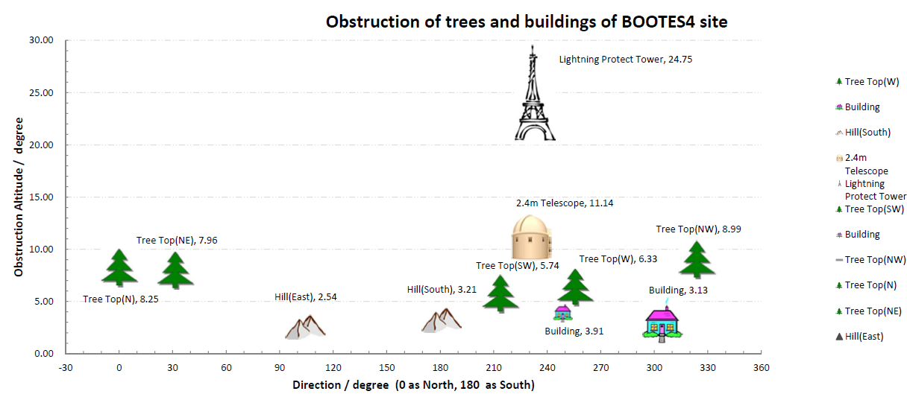
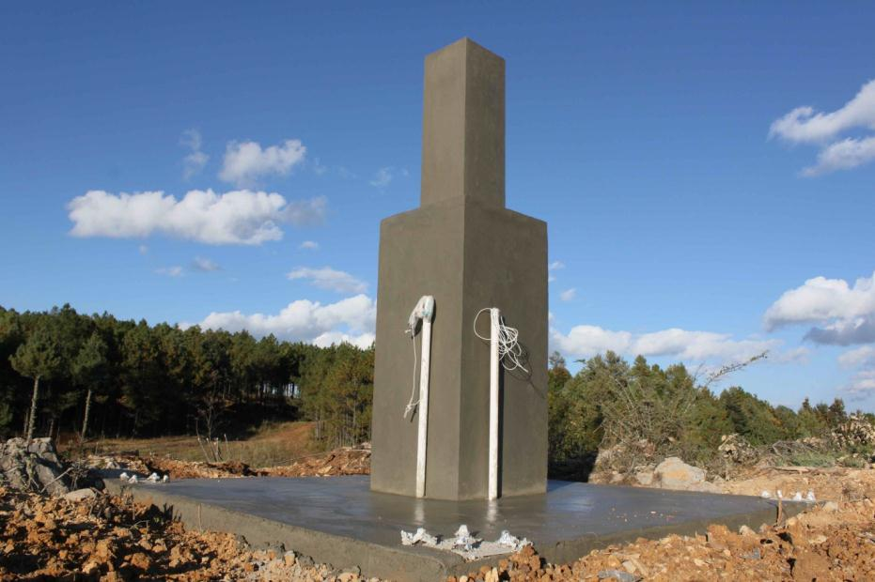
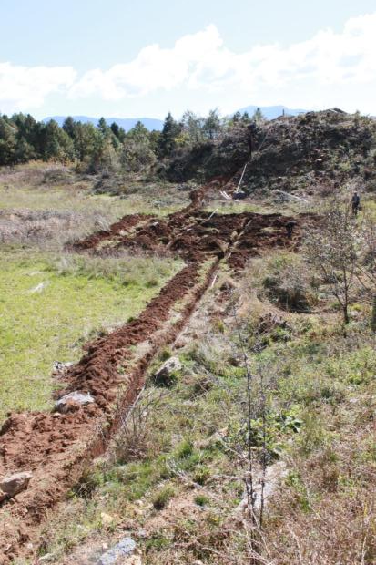
BOOTES-4进展与计划
基建与三通

Slide 35
BOOTES-4进展与计划
安装准备和计划
13.11 Germany and Spain team arrived Lijiang Observatory.
14.11 Start installation.
21-22.11 Finish dome installation.
21.11 Start telescope installation
25.11 Finish T. installation.
26.11 Start operation and all system testing.
3.12 End.

Slide 36
欢迎参与BOOTES合作
使用望远镜观测时间
  10% on BOOTES-4
  5% on BOOTES-X
GRB等方面研究
RAO实验平台

Slide 37
谢谢！
预祝大会圆满成功！

