Slide 1
程控自主天文台网络
研究现状与应用需求
崔辰州
中国科学院国家天文台

Slide 2
Robotic Autonomous Observatory
自动执行望远镜（Automated Scheduled Telescope [机器人]）：一架可以执行预先编制好观测流程而无需远程观测者实时干涉（例如不需要观测者手动调解赤道仪）的望远镜。
远程操作望远镜（Remotely Operated (remote) Telescope [遥操作式机器人]）：一套按照观测者的要求执行远程观测的望远镜系统。
程控自主天文台（Robotic Autonomous Observatory [自主式机器人]）：一架能够执行各种远程观测并且能够在任务执行过程中在没有任何人为协助的情况下自主适应各种变化的望远镜（例如，天气监测，系统不能危及人类等）。
程控智能天文台（Robotic Intelligent Observatory [智能机器人]）：一个由人工智能系统进行决策的程控天文台。这是下一步努力的方向。

Slide 3
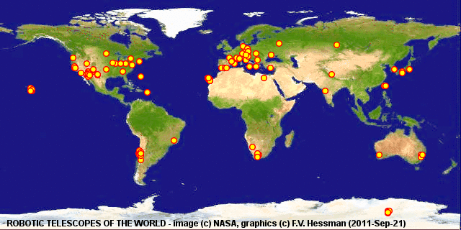
RAO发展阶段
1968－1975：自动执行望远镜时代
1975－1984：远程操作望远镜
1984－2000：远程自主天文台时代
2001年至今：自控天文台网络时代
时代划分不等于我们的现状

Slide 4
自主望远镜和远程望远镜的区别
观测请求提交
  远程望远镜：望远镜
  自主望远镜：程序
问题解决
  远程望远镜：人
  自主望远镜：程序
望远镜远程控制的施动者是人，望远镜系统只需要实现了程序控制网络接口就基本达到目的了。而自主天文台的施动者是程序或者说天文台自身。天文台系统自己根据外界条件自主决定是否能够观测和观测哪些内容，对智能化有极高的要求。

Slide 5
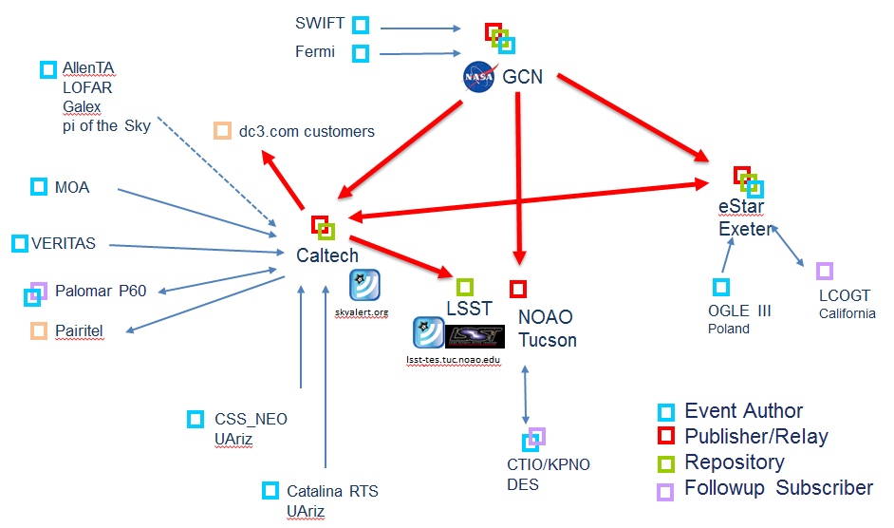
RAON projects
MONET (south+north)
Bootes (I, II, III, IR…)
eSTAR
SONG
GONG
LCOGT
  Las Cumbres Observatory Global Telescope

Slide 6
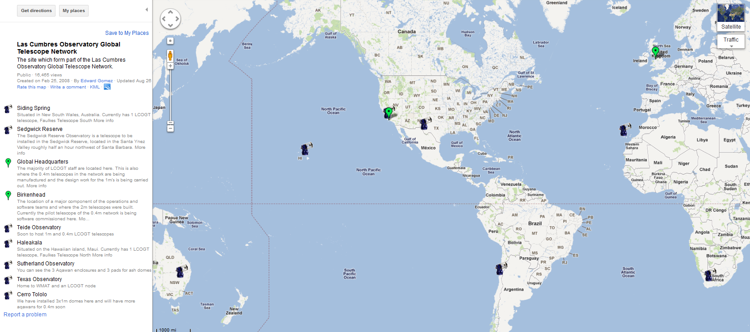

Las Cumbres Observatory Global Telescope (LCOGT)
Currently LCOGT has 2 operational telescopes: Faulkes/North and Faulkes/South. There will be 3 main classes of telescope, categorized by the size of the primary mirror: 2m, 1m and 0.4m

Slide 7
Las Cumbres Observatory Global Telescope (LCOGT)
About Us: Las Cumbres Observatory Global Telescope Network is a private operating foundation, building a global network of telescopes for professional research and citizen investigations
Network: Building a global network of robotically controlled telescopes to keep you in the dark
Education: Building a global community so you can be part of citizen science investigations on our global telescope network
Science: Building a durable scientific institution dedicated to time-domain astrophysics

Slide 8
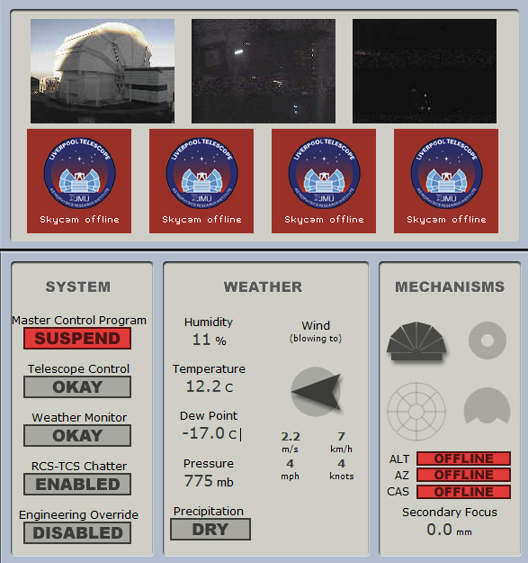
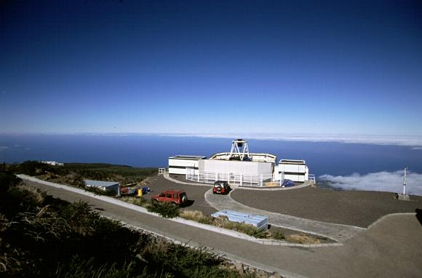
Liverpool Telescope
A 2.0 metre unmanned fully robotic telescope on the Canary island of La Palma, Spain, owned and operated by Liverpool JMU.
Although the Liverpool Telescope (LT) is a robotic telescope, by "robotic" we do not mean that the telescope is operated by remote control. Instead, the telescope runs autonomously; that is, it runs by itself with no human being at the controls.

Slide 9
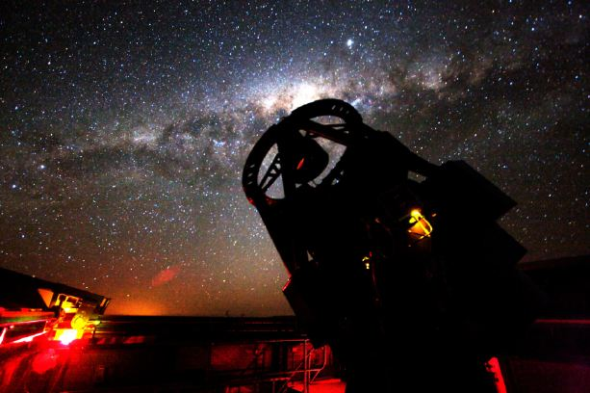
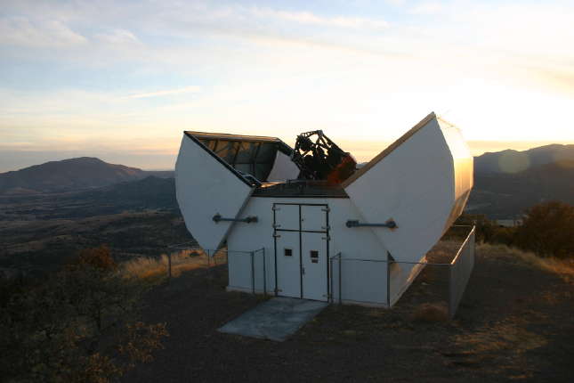
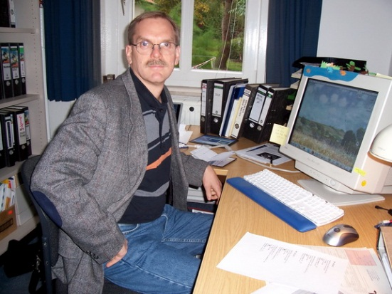
MONET
MOnitoring NEtwork of Telescopes
The MONET (MOnitoring NEtwork of Telescopes) project is a network of two 1.2m telescopes operated by the Georg-August-Universität Göttingen, the McDonald Observatory, and the South African Astronomical Observatory.
Frederic V. "Rick" Hessman
Project Manager of the MONET / Astronomie & Internet Projec
Main contributor of RTML
MONET/South
MONET/North

Slide 10
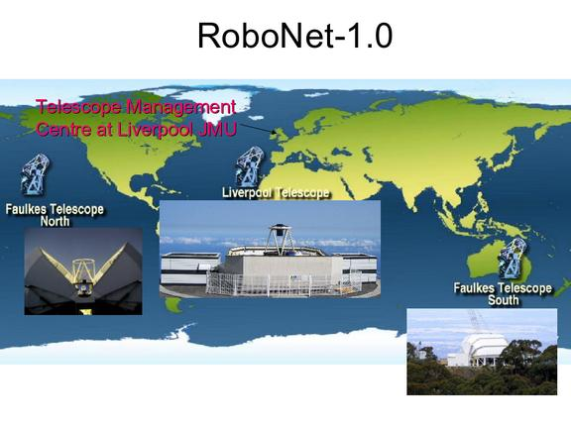

RoboNet-1.0 (2004-2006)
RoboNet-1.0 is a prototype global network of large (2m) robotic telescopes. Our principal technological aims are:
  To integrate a global network of telescopes to act effectively as a single instrument. ;
  To apply developments in e-Science to maximise scientific return.
The RoboNet-1.0 project was formulated in late 2003 and presented to PPARC's Projects Review Panel in early 2004. Funding was approved in April 2004 by the research council's Science Committee and the project commenced in earnest in August 2004.

Slide 11
HTN Consortium
The HTN Consortium represents a number of major research groups in the field of robotic telescopes. The organization has three primary aims:
  Interoperability between robotic telescope networks
  Interoperability with the Virtual Observatory for event notification
  Establishment of an e-market for the exchange of telescope time

Slide 12
HTN Participants
  The HTN Consortium is formed from a loose network of projects:
  The eSTAR Project
  The Robonet-1.0 Consortium
  Los Alamos Thinking Telescope Project
    RAPid Telescope for Optical Response (RAPTOR )
    Telescope ALert Operations Network System (TALONS).
  The MONET Project
  NASA SGM Project
  Las Cumbres Observatory Global Telescope (LCOGT)
  The Super-WASP Project
  Joint Astronomy Centre, Hawaii (JACH)
  The ROTSE Project
  The STELLA Project
  EUDOXOS network
  The Pilot Small Telescope Network (PSTN)
  The TAOS Project
  The PROMPT Project

Slide 13

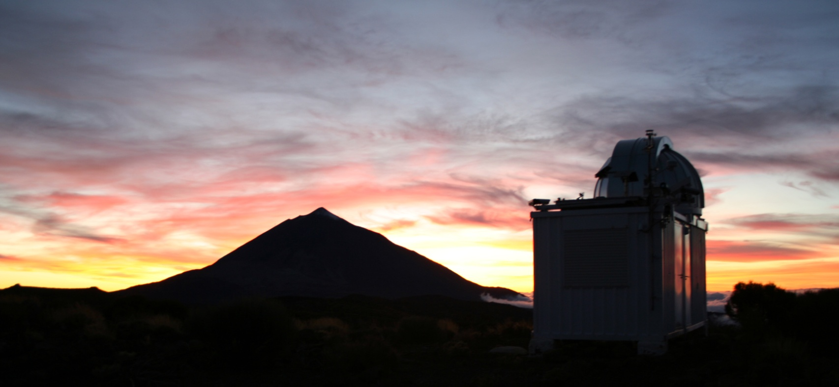








The Bradford Robotic Telescope

Slide 14
The Objectives:
To provide a research tool for astronomy
To provide a learning and teaching resource for the first steps in astronomy:
  For all the school children in the UK focussed on the National Curriculum
  For all the kids with internet access

Slide 15
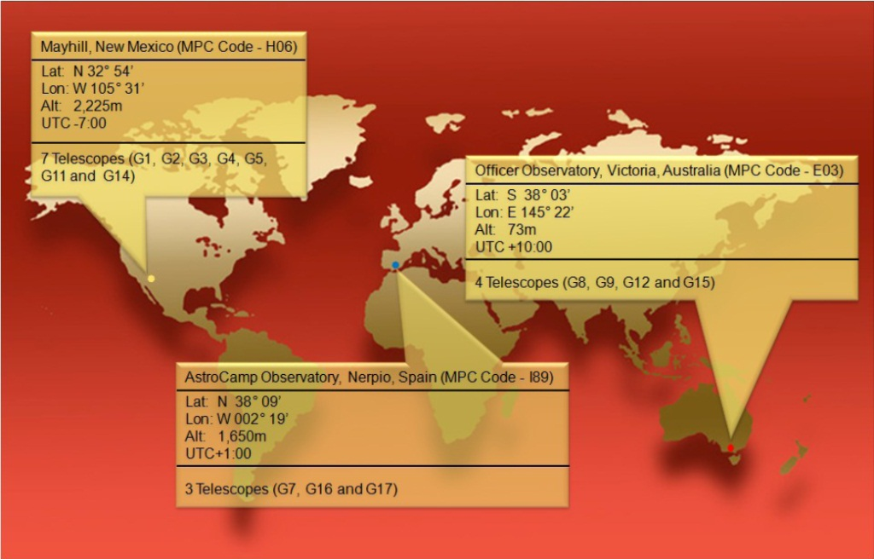
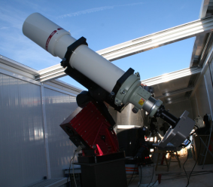
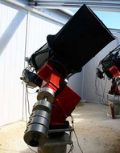
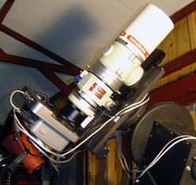
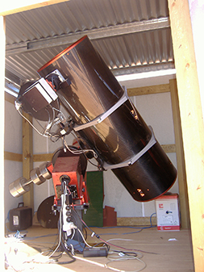
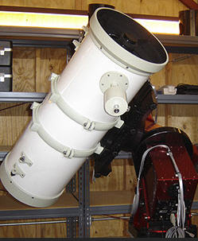
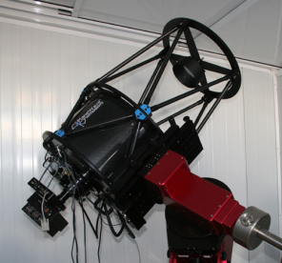
Global Rent a Scope，GRAS
国际上最大的远程望远镜网络项目之一，从2001年开始运作。目前有分布于美国新墨西哥州、澳大利亚、西班牙的14台望远镜向用户提供租赁服务。7架在美国新墨西哥州的Mayhill天文台（MPC代码H06），4架在澳大利亚堪培拉附近的Officer天文台（MPC代码E03），3架在西班牙南部Nerpio的AstroCamp天文台（MPC代码I89）。
详见《天文爱好者》2011年第11期文章

Slide 16
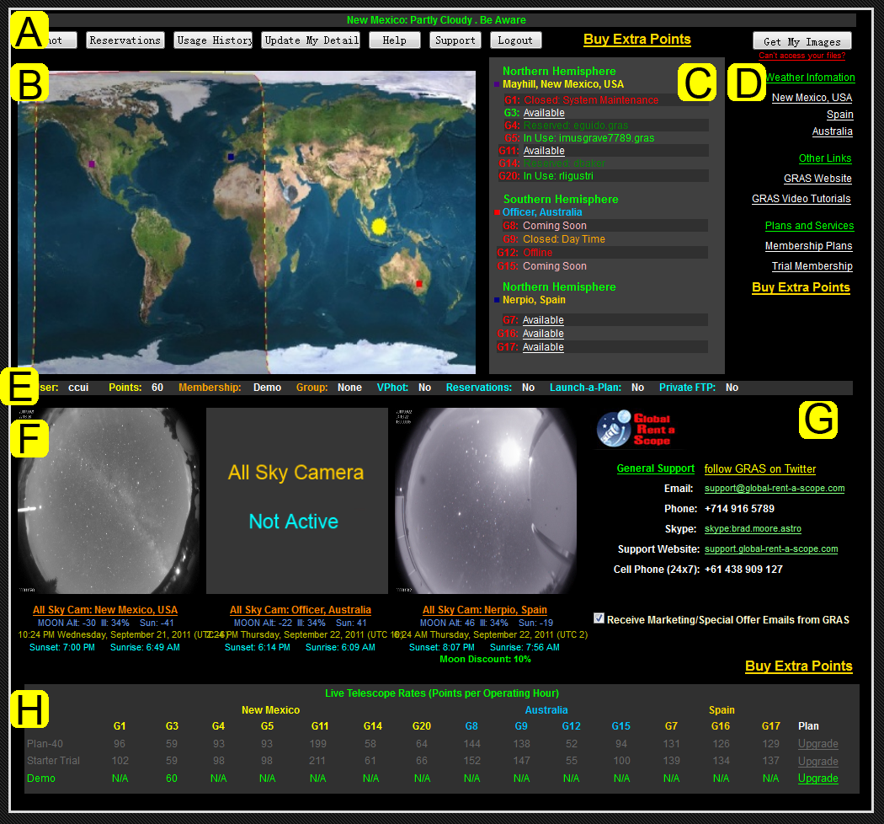
GRAS Information Center
顶部菜单区，链接到用户的其它信息版块和GRAS站点
GRAS天文台站日夜分布图
GRAS望远镜状态和登录链接
GRAS相关站点链接以及天气信息
用户账号信息
全天相机信息区，各个台站全天相机图像、天气信息、站点相关信息
用户支持和帮助信息
GRAS望远镜租赁报价信息
全球望远镜租赁（Global Rent a Scope，GRAS）项目：http://www.global-rent-a-scope.com

Slide 17
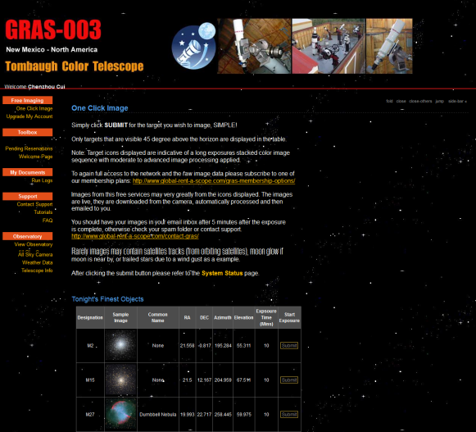
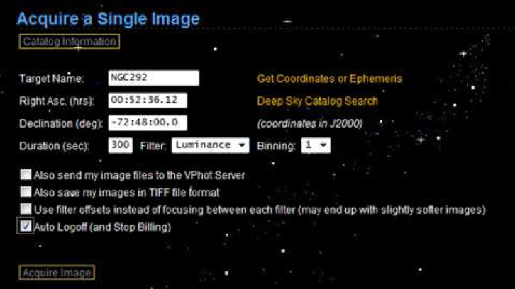
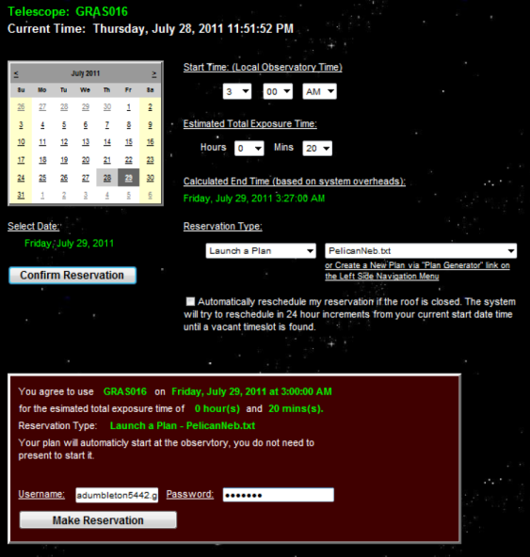
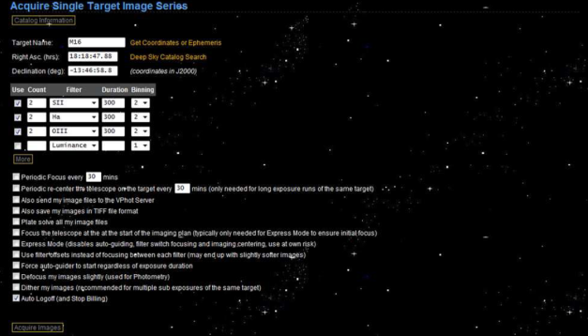
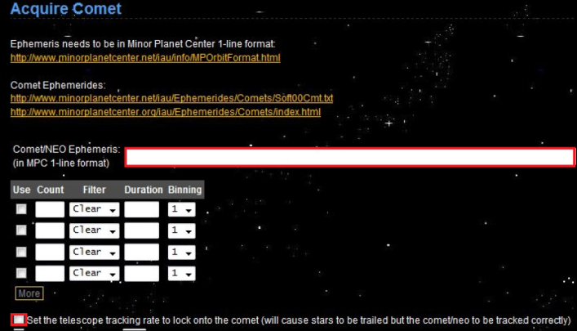
Imaging use GRAS telescope
“One Click Image”（单击成像）
“Single Image”（单次成像）
“Run Image Series”（拍摄图像系列）
“Make a Reservation”（申请预订）
“One Click Comet”（单击彗星）
“MPC 1-Line”

Slide 18
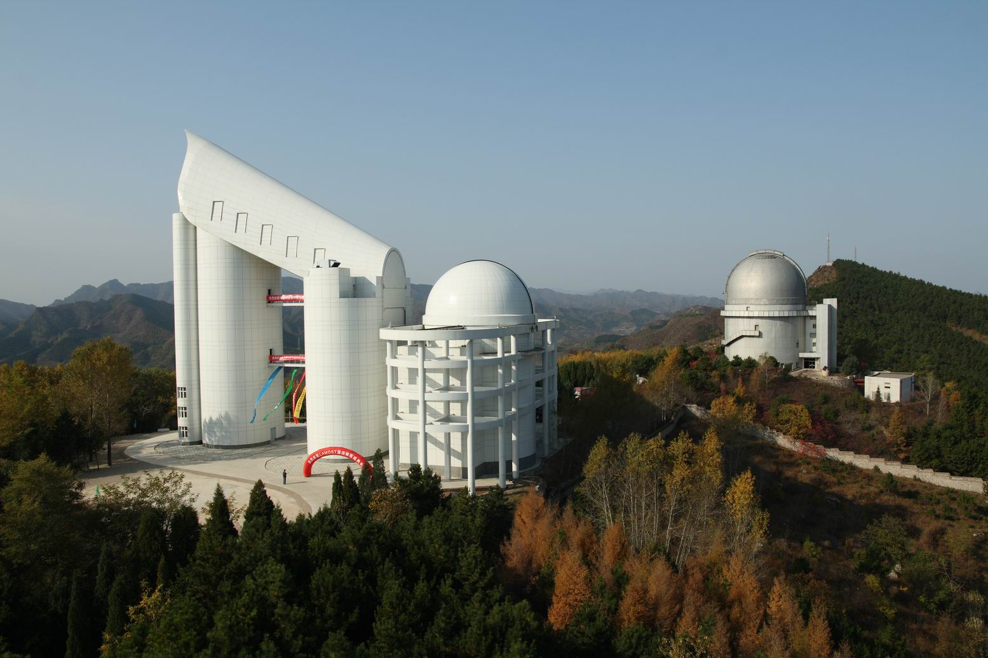
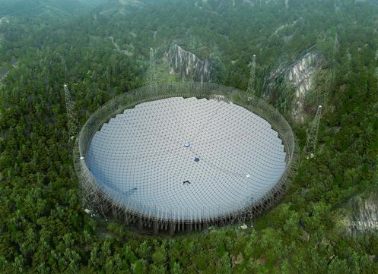
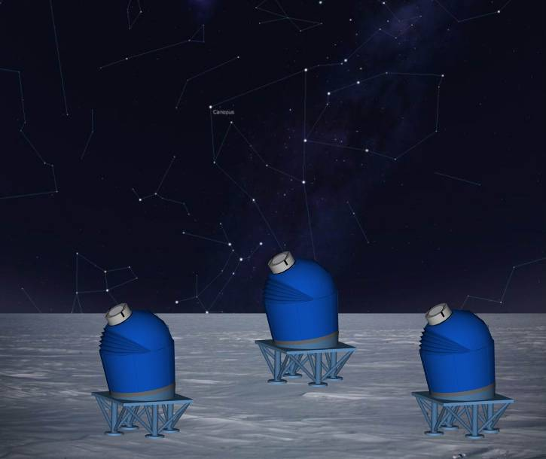
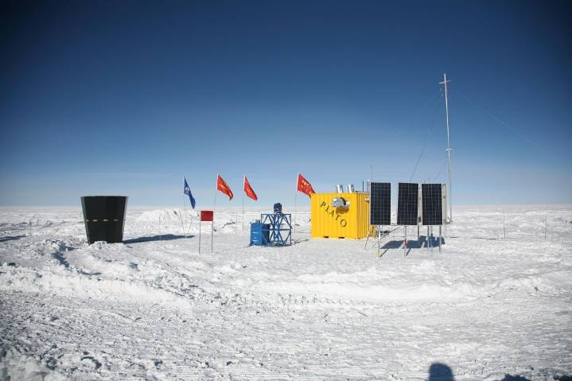
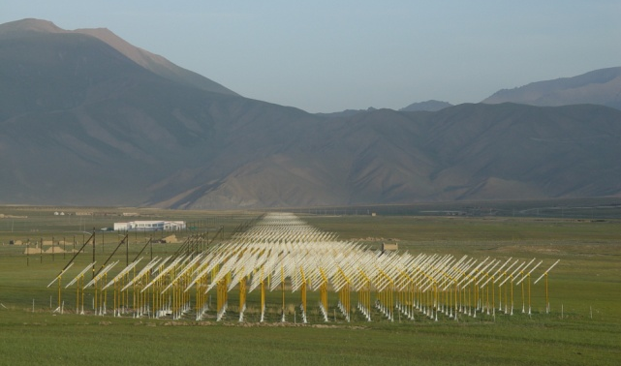
CSTAR

Slide 19
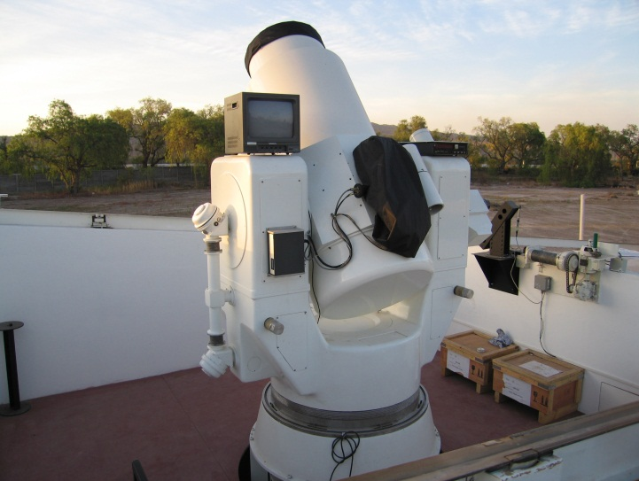

RAO requirements in China
Antarctic Observatory
Tibet Observatory
Argentina Observatory (San Juan Univ.)
Lunar-based astronomy
International projects: SONG, SVOM, …
School education
Amateur observation
……
CSTAR
Huge Market in China

Slide 20
China-RAON
填补国内在程控自主天文台研究领域的空白；
充分利用在虚拟天文台等领域多年来的知识和技术积累；
提供通用、开放的RAON解决方案，同时服务于天文学研究和科普；
不是一个具体的RAO项目，而是一个技术支撑计划；
为中国用户提供解决方案和技术支持，是China-VO的一项新服务；

Slide 21
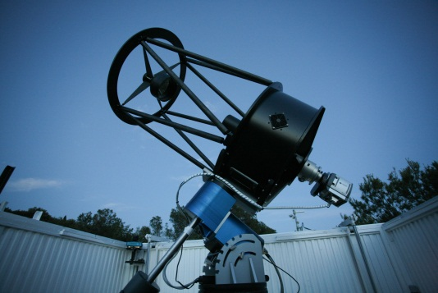
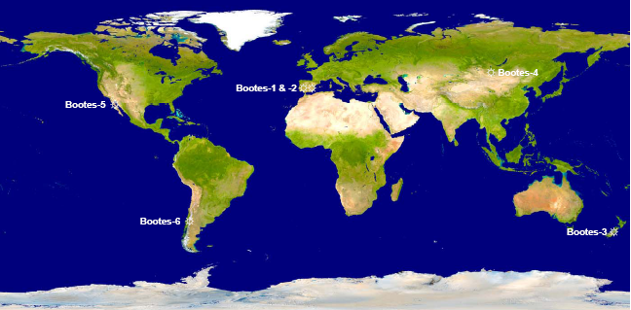
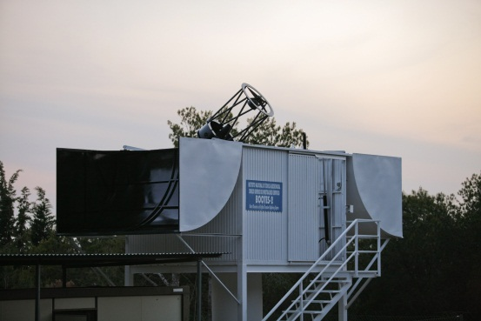
The BOOTES Network Philosophy
Identical telescopes spaced around the Earth
Identical filter sets: g’r’i’ZY
Identical CCD cameras
Impact on several scientific fields and public outreach
Boo-2 & 3 integrated in:

Slide 22
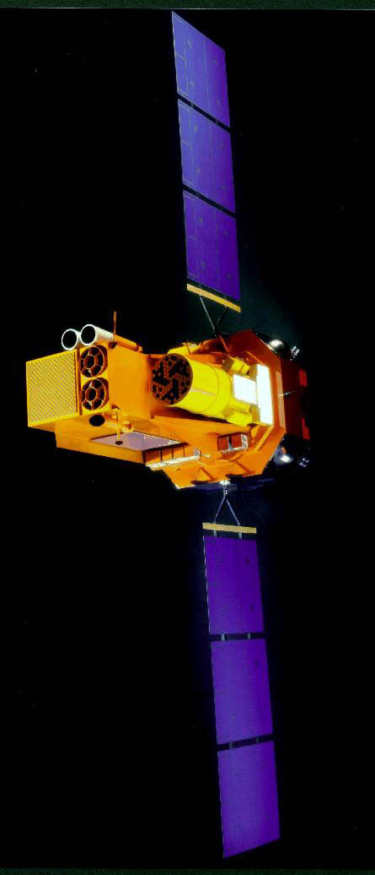

The BOOTES Network Philosophy
主要科学目标包括伽玛射线暴光学对应体的同步观测、微引力透镜研究、系外行星探测、宇宙起源光学闪的探测、高能目标的光学监测、著名天体的长期监测、空间科学计划的地面观测支持、程控自主天文台控制系统研究等方面。
INTEGRAL
SWIFT
UFFO @ Lomonosov
2002- 2004- 2012-

Slide 23
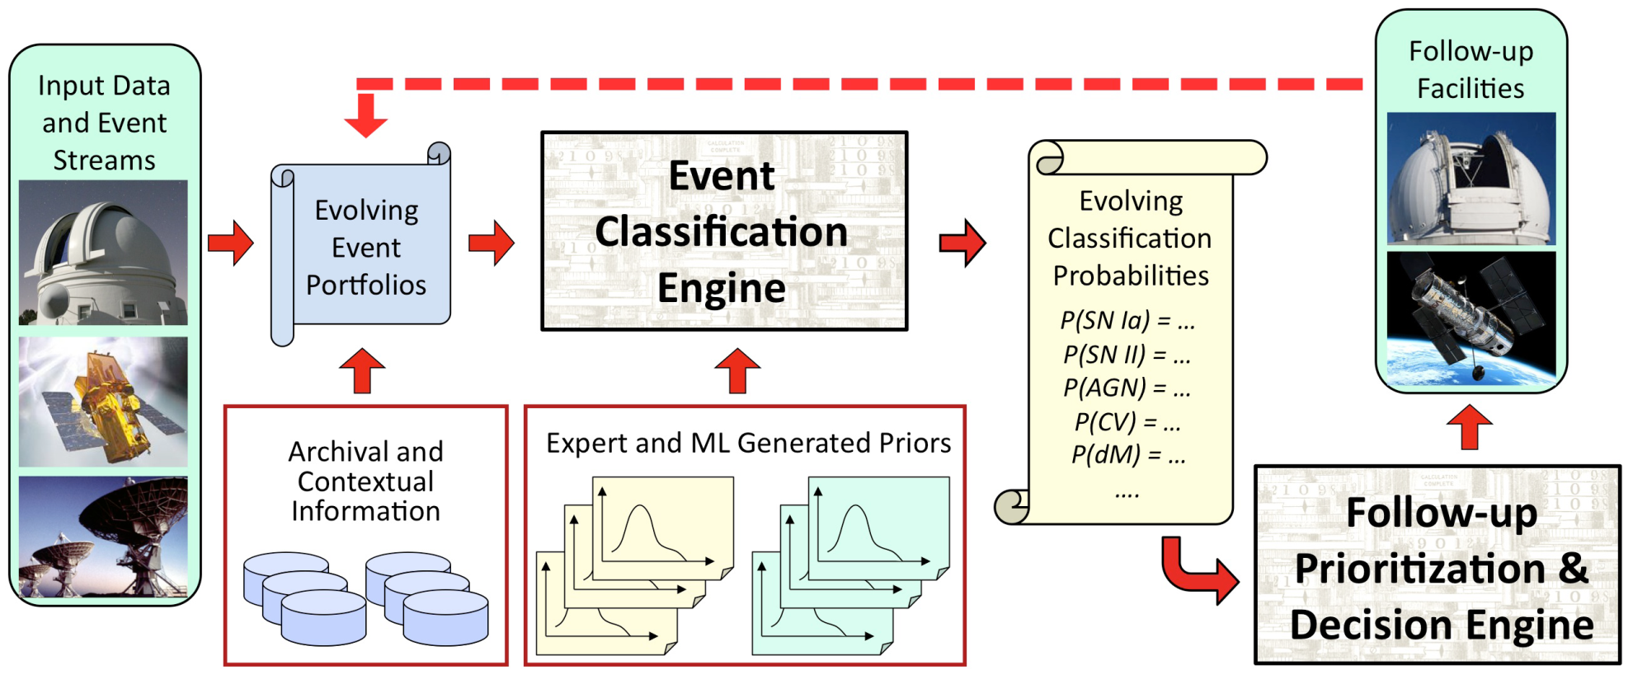
An automated, iterative, real‐time classification of transient events discovered in synoptic sky surveys
RAO Ecosystem
Courtesy of S. G. DJORGOVSKI, et al.
Notes:
The initial input consists of the
generally sparse data describing transient events discovered in sky surveys,
supplemented by archival heterogeneous measurements from external, multiwavelength
archives corresponding to this spatial location, if available (e.g. radio flux
and distance to nearest galaxy). Data are collected in evolving electronic portfolios
containing all currently available information for a given event. These data are fed
into the Event Classification Engine; another input into the classification process is an
evolving library of priors giving probabilities for observing these particular
parameters if the event was belonging to a class X. The output of the classification
engine is an evolving set of probabilities of the given event belonging to various
classes of interest, which are updated as more data come in, and classifications
change. This forms an input into the Follow‐up Prioritization and Decision Engine,
which would prioritize the most valuable follow‐up measurements given a set of
available follow‐up assets (e.g., time on large telescopes, etc.), and their relative cost
functions. What is being optimized is: (a) the new measurements which would have
a maximum discrimination for ambiguous classifications, and/or (b) the follow‐up
measurements which would likely yield most interesting science, given the current
best‐guess event classification? New measurements from such follow‐up observations
will be fed back into the event portfolios, leading to dynamically updated/iterated
classifications, repeating the cycle.

Slide 24
Thank You

