Slide 1
Virtual Observatory Activities during the last 10 years in China
Chenzhou Cui
Chinese Virtual Observatory (China-VO)
National Astronomical Observatory of China

Slide 2
Contents
A Brief History of China-VO
Data Access Services
Software and Service Development
Scientific Research
Education and Public Outreach
Future Directions

Slide 3
China-VO
Virtual Observatory (VO) is a data-intensively online astronomical research and education environment, taking advantages of advanced information technologies to achieve seamless, global access to astronomical information.
Chinese Virtual Observatory (China-VO) is the national VO project in China initiated in 2002 by Chinese astronomical community leading by National Astronomical Observatories, Chinese Academy of Sciences.
China-VO became a member of the IVOA with the recommendation of Dr. Jim Gray
R&D Focuses
China-VO Platform
Unified Access to On-line Astronomical Resources and Services
VO-ready Projects and Facilities
VO-based Astronomical Research Activities
VO-based Public Education

Slide 4
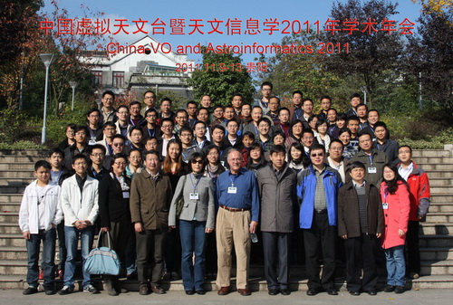
Community: China-VO annual meeting
year | attendees
2001
2003 | 36
2004 | 30
2005 | 27
2006 | 47
2007 | 40
2008 | 57
2009 | 63
2010 | 78
2011 | 75

Slide 5
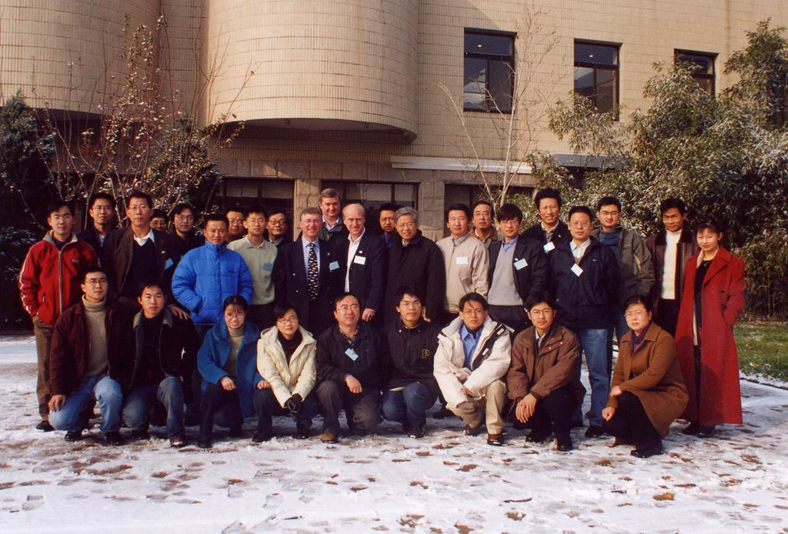
Small project meeting, Beijing
26-28 November 2003: Beijing, China
Main topics:
  Advantages and disadvantages of small projects.
  The role of small projects in the IVOA.
  R&D focus of small projects.
  Collaboration among small projects and with big VO projects.
  Implementation of IVOA standards and infrastructures developed by other VO projects.
39 participants from Korea, Japan, India, Europe, UK and China

Slide 6
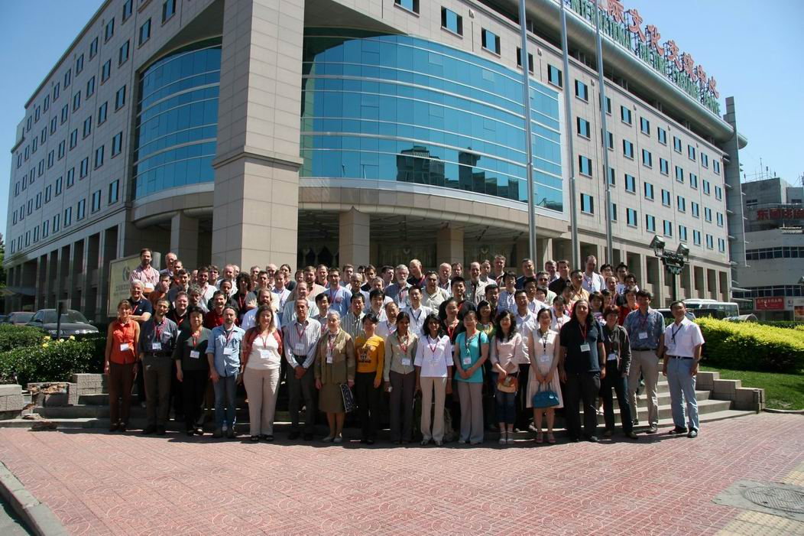
IVOA 2007, Beijing

Slide 7
China-VO Team
Partners
NAOC (Beijing): Yongheng Zhao (PI), Chenzhou Cui (PM), Ganghua Lin, Yanxia Zhang, Boliang He, Wei Gao, Yue Chen, Yiming Teng, Zihuang Cao, Dongwei Fan, Wangwei Chu, Haijun Tian, Zheng Li,
TianJin Univ. (Tianjin): Jizhou Sun, Ce Yu, Jian Xiao, Qing Zhao, Xu Liu, Ao Yuan
CCNU (Wu Han): Xiaoping Zheng, Cuilan Qiao, Qin Wang, Junli Jia
Kunming Univ. of Science and Tech: Feng Wang, Kaifan Ji, Hui Deng
Collaborators:
Computer Network Information Center, CAS (Beijing): Baoping Yan, Kai Nan, Jianhui Li, Kevin Dong, Yongzheng Ma, Lianglin Hu
Purple Mountain Astro Obs (Nanjing): Ji Yang, Liang Liu, Dengrong Lu
Shanghai Astro Obs (Shanghai): Yipeng Jing, Weipeng Lin, Xiao Chen, Shuhe Wang, Jianhai Zhao, Haiming Tang
Yunnan Astro Obs: Yufeng Fan, Chuanjun Wang
Tsinghua Univ.: Jianfeng Zhou, Zhihui Du
External collaborations:
JHU, MSR, Caltech, IUCAA, CDS, ICRAR (Australia), NAOJ (Japan)…

Slide 8
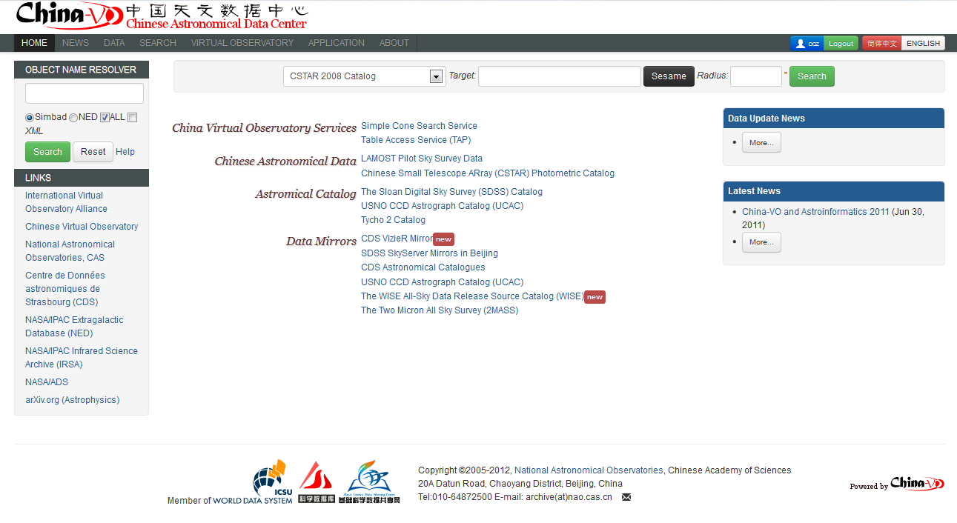
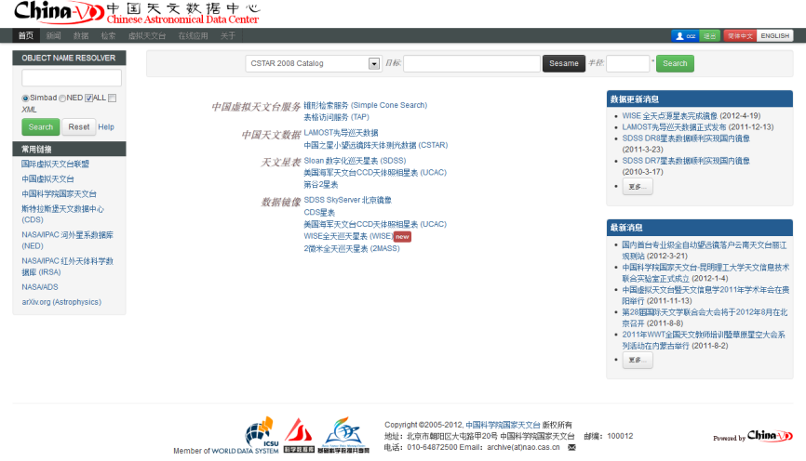
Data Access Services

Slide 9
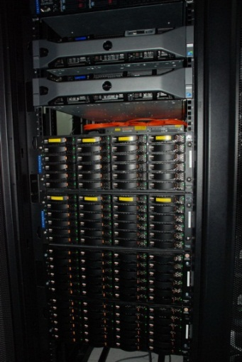
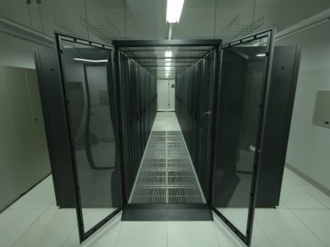
Data resources at the CAsDC
From China
LAMOST Pilot Data Release
LAMOST Commission Data
The South Galactic Cap U-band Sky Survey (SCUSS)
CSTAR
BATC
LAMOST Sky Survey
Xinjiang radio telescope (25m)
Lijiang 2.4m telescope
Bootes-4 robotic observatory
Astronomical plates digitalization archive
International Mirrors
CDS Vizier
SDSS SkyServer
2MASS
WISE
Chandra
UCAC
USNO
ADS

Slide 10
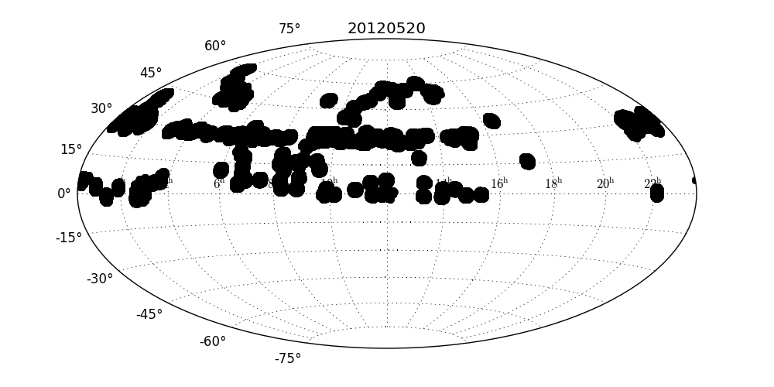
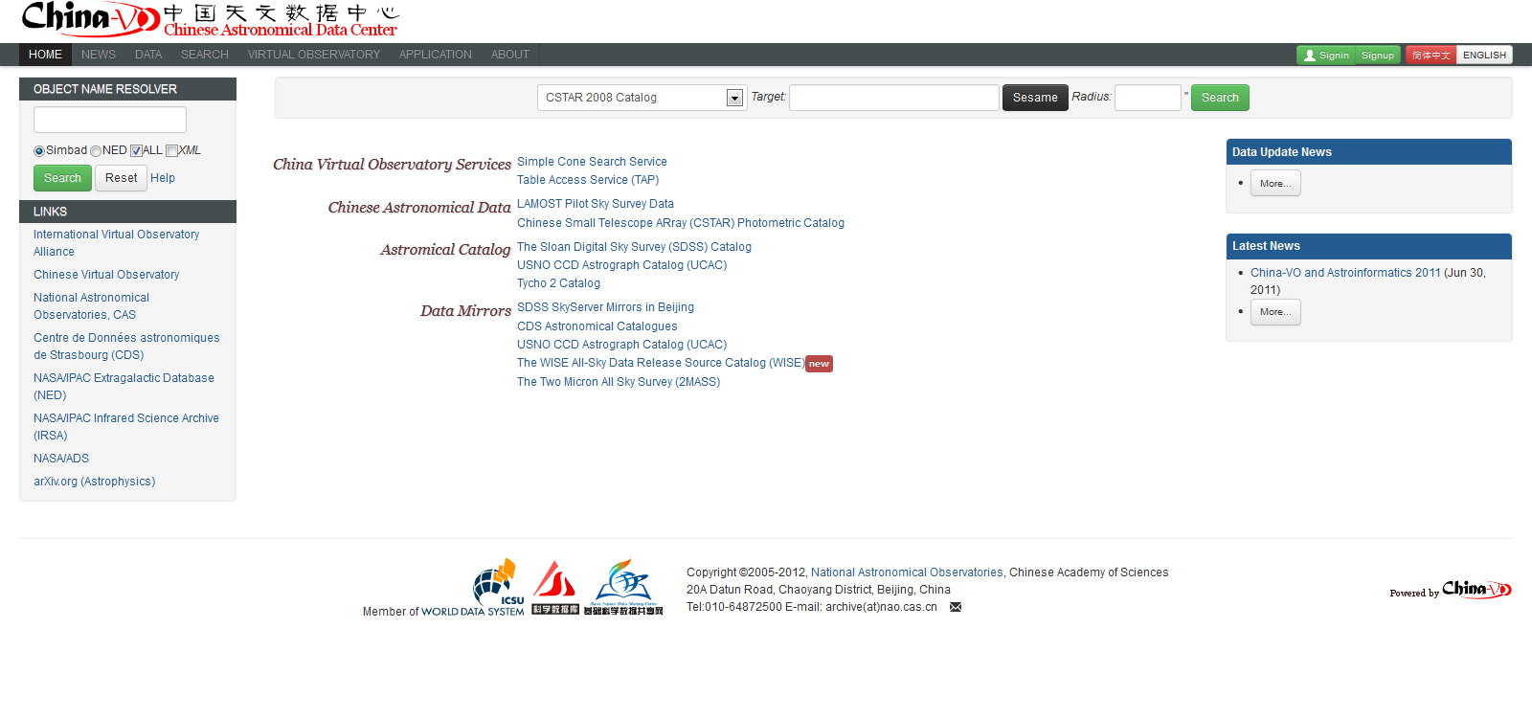
LAMOST Pilot Sky Survey
From 2011-10 to 2012-4
Plan: 302, Run: 309, archived: 478,699 (+ low SN <160,000)
Spectra Catalog 478,699

Slide 11
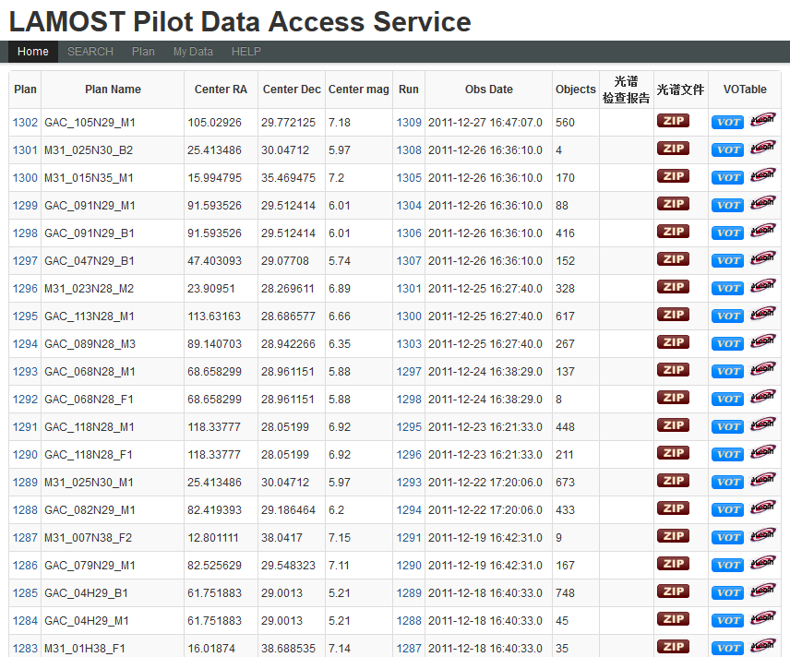
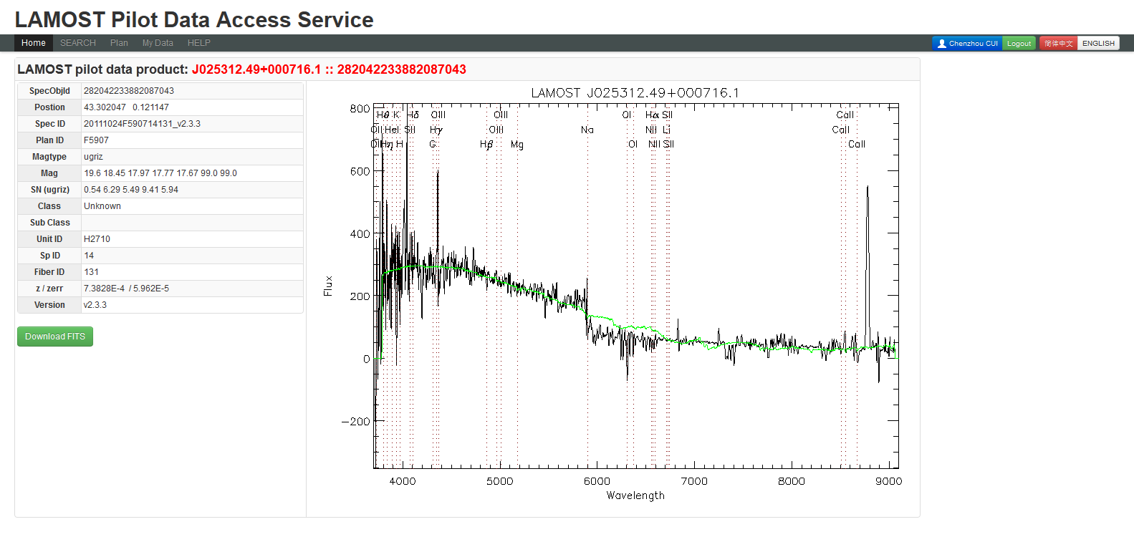
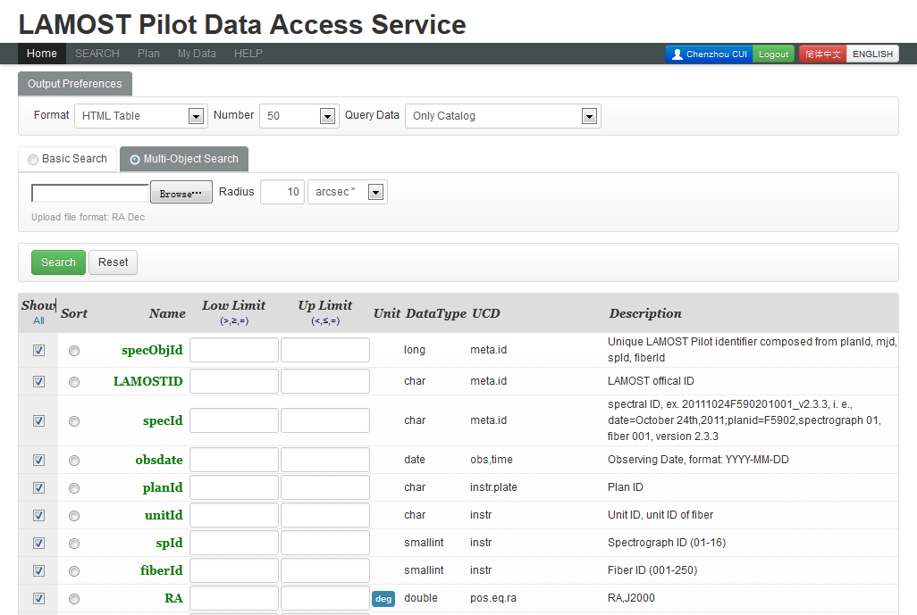
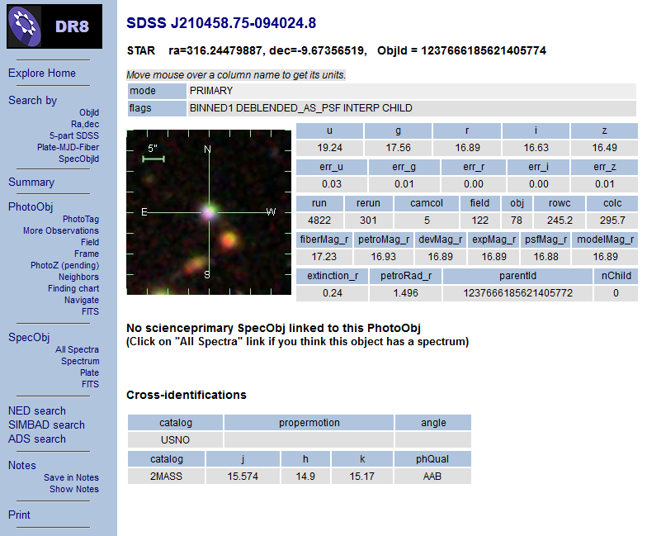
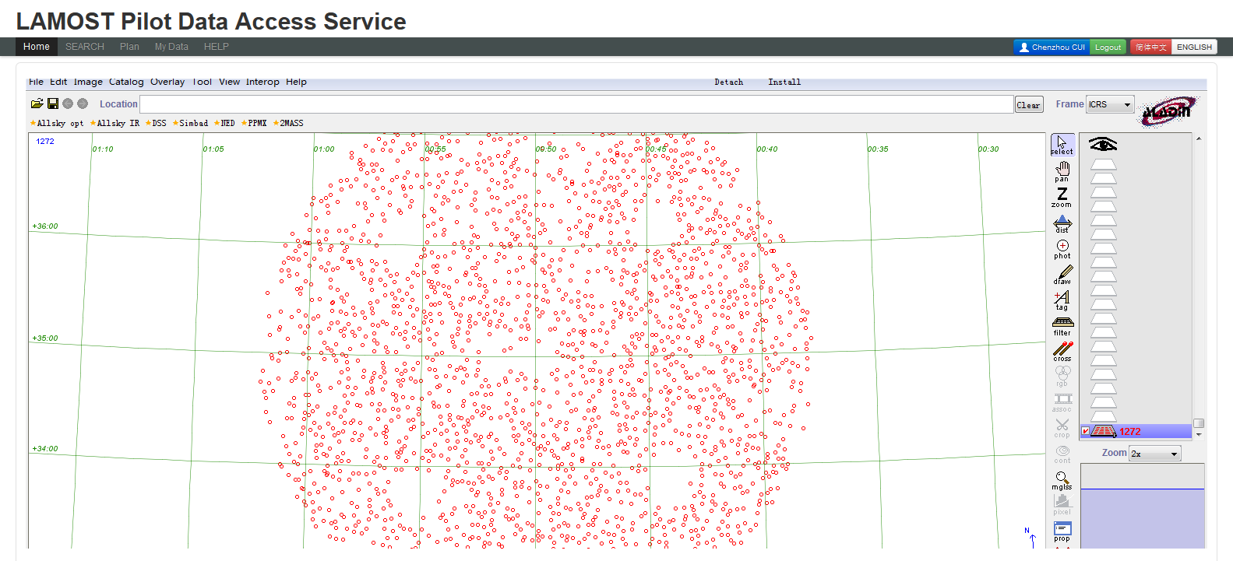
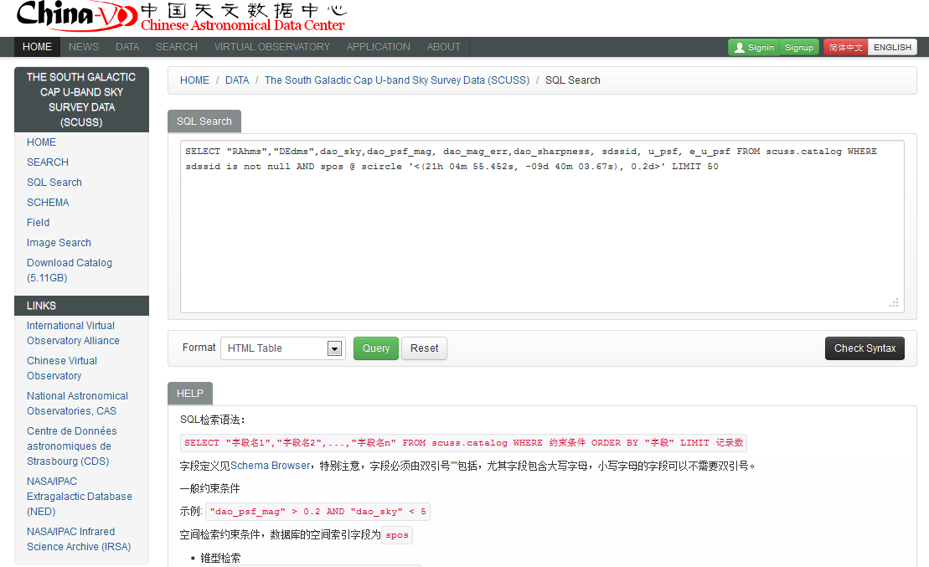
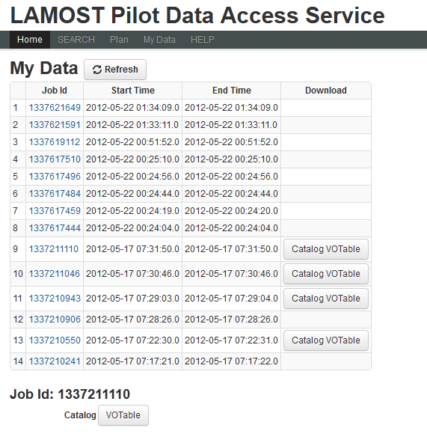
Many Data Access Ways
Web form
VO Interfaces
CLI

Slide 12
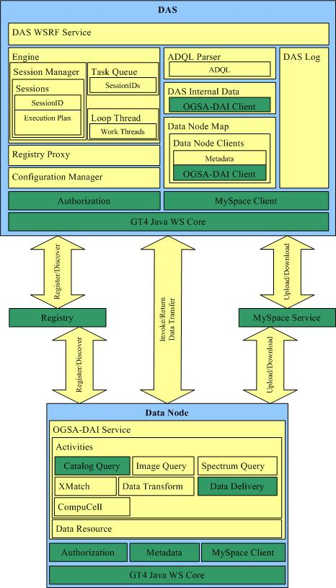

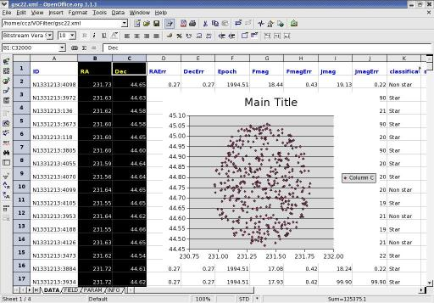
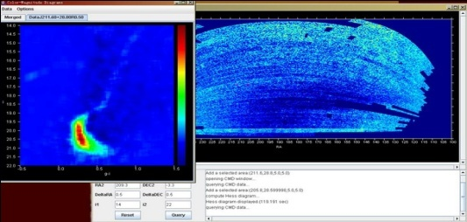
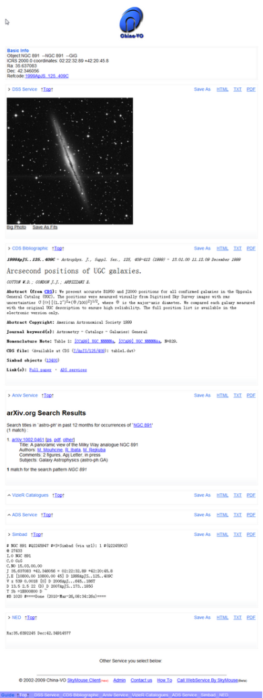
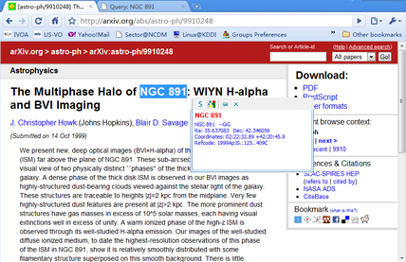
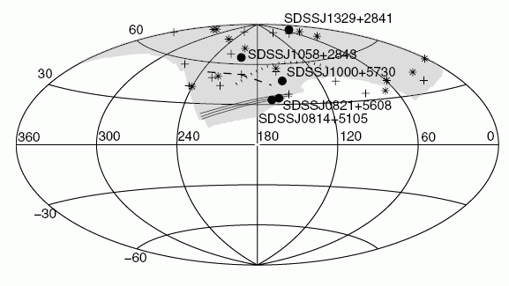
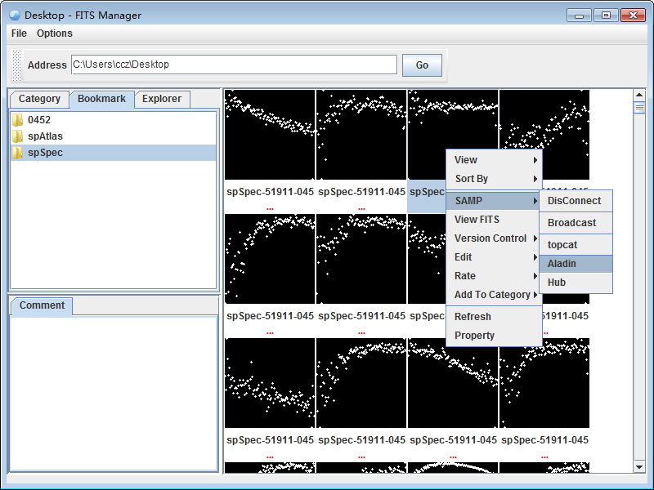
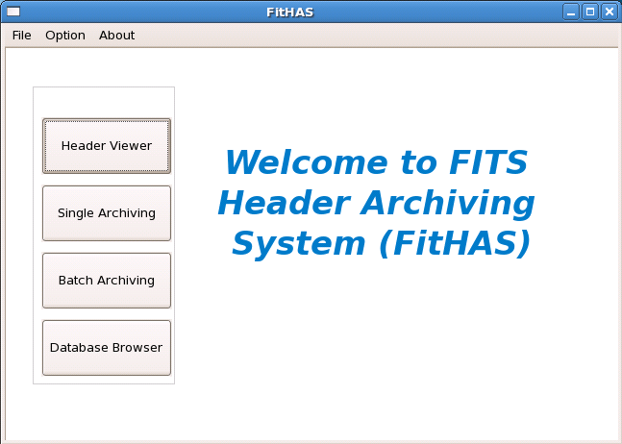
Development Achievements
VO-DAS
VOFilter
SkyMouse
FitHAS
FITS Manager

Slide 13
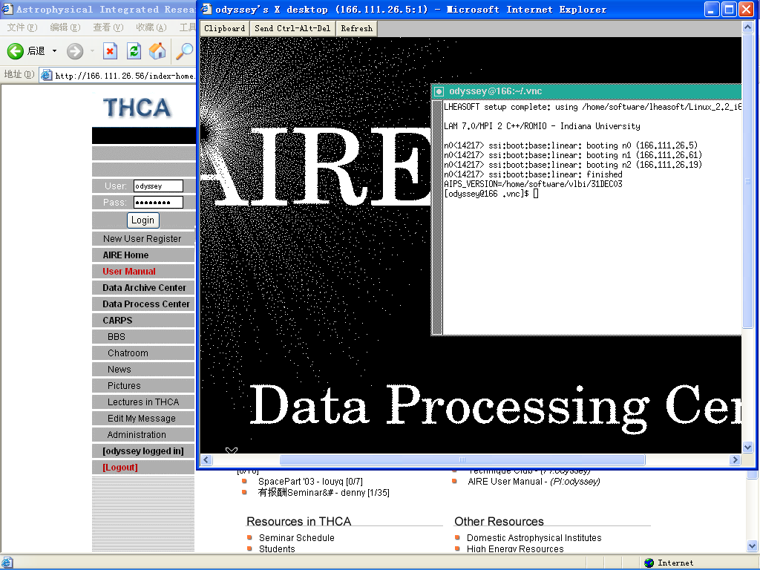
Astrophysical Integrated Research Environment (AIRE)
Provide a web-based collaborative research environment
Radio : Interferometry …, AIPS, AIPS++, Difmap…
Optical : Photometry … , IRAF, MIDAS …
X-ray : Coded-mask …, HEADAS ….
Contributed by Tsinghua University

Slide 14

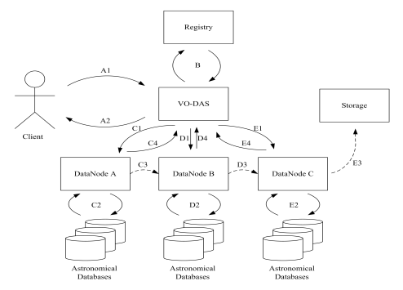

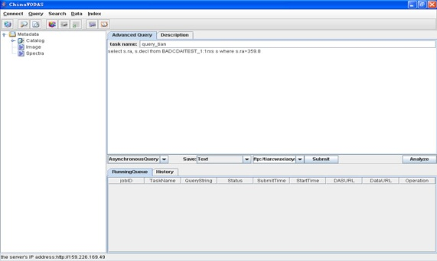
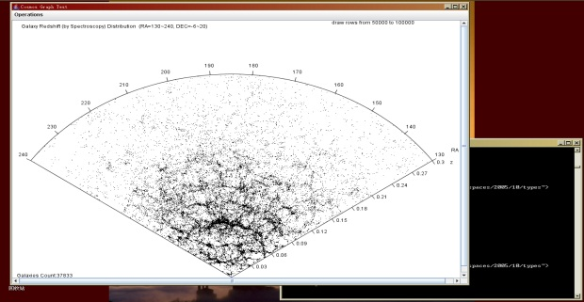
VO Data Access Service (VO-DAS)
An OGSA-DAI based service system to provide unified access to astronomy data, including catalogs, images and spectra.
Goals of VO-DAS
  Supporting high volume data query
  Interlinking distributed and heterogeneous archives
    catalogs, images, spectrums
  Providing a software that works for astronomers
  The first public version will be release in summer.

Slide 15

AstroBox
A plug-in package for MATLAB to provide an astronomical data mining application service, supporting VO protocols and tools.
A high-level data analysis environment supporting:
  PLASTIC
  VOTable
  Local DB
  VO-DAS client
  Astronomical algorithms
The first version will be released in the year
VO Tools
(Aladin, TOPCAT)
PLASTIC
Local
DB
VOTables
MATLAB
Database Toolbox
Java
Libraries
AstroBox
MATLAB
VO-DAS Client
VO-DAS

Slide 16
First Science Paper from China-VO
Candidate Milky Way satellites in the Galactic halo（Liu et al., 2008, A&A)
SDSS DR5 photometric data were searched for new Milky Way companions or substructures in the Galactic halo.
Data analysis procedures were based on the VO-DAS.
Five candidates are identified as over-dense faint stellar sources that have color-magnitude diagrams similar to those of known globular clusters, or dwarf spherical galaxies.

Slide 17
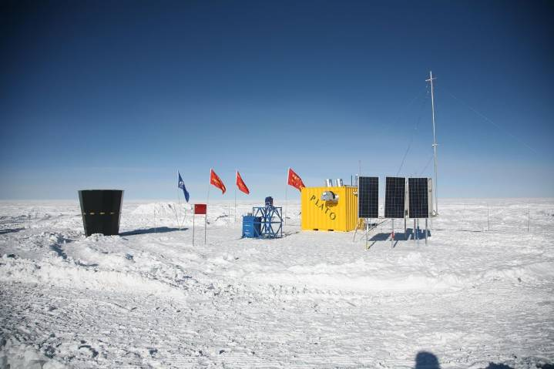
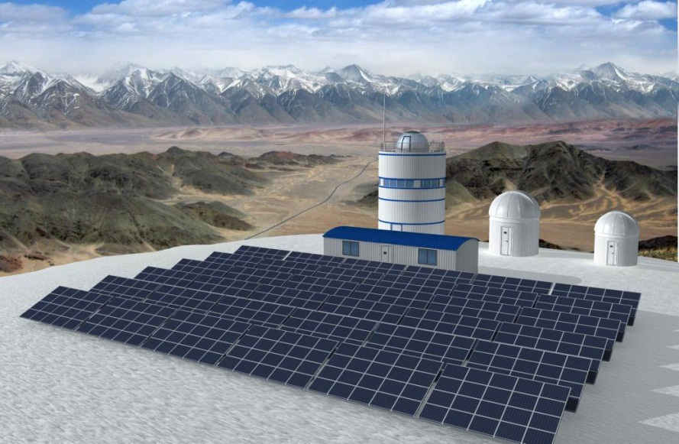
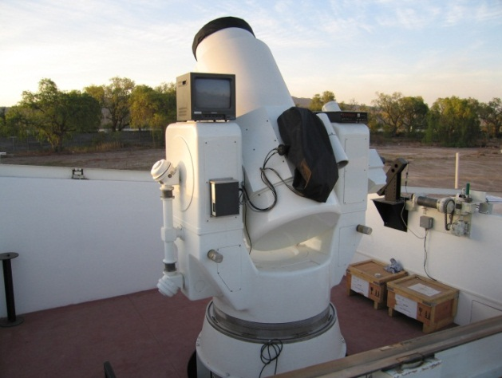
Time Domain Astronomy and VO
RAO requirements in China
Antarctic Observatory
Tibet Observatory
Argentina Observatory (San Juan Univ.)
Lunar-based astronomy
International projects: SONG, SVOM, …
School education
Amateur observation
……
CSTAR
Huge Market in China

Slide 18
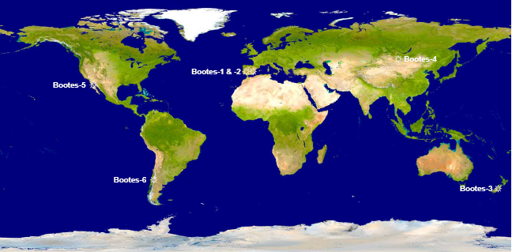


The BOOTES Project: A world wide network of robotic telescopes
Boo-2 & 3 integrated in:
Identical telescopes spaced around the Earth
Identical filter sets: g’r’i’ZY
Identical CCD cameras
Impact on several scientific fields and public outreach

Slide 19
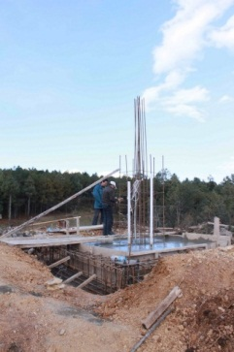
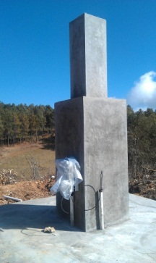
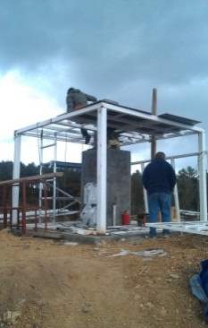
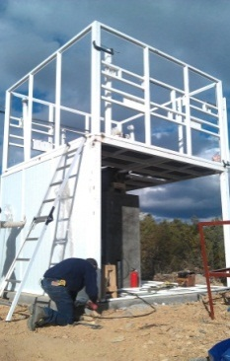
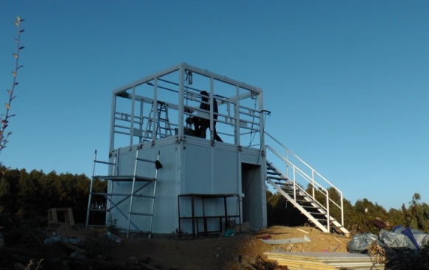
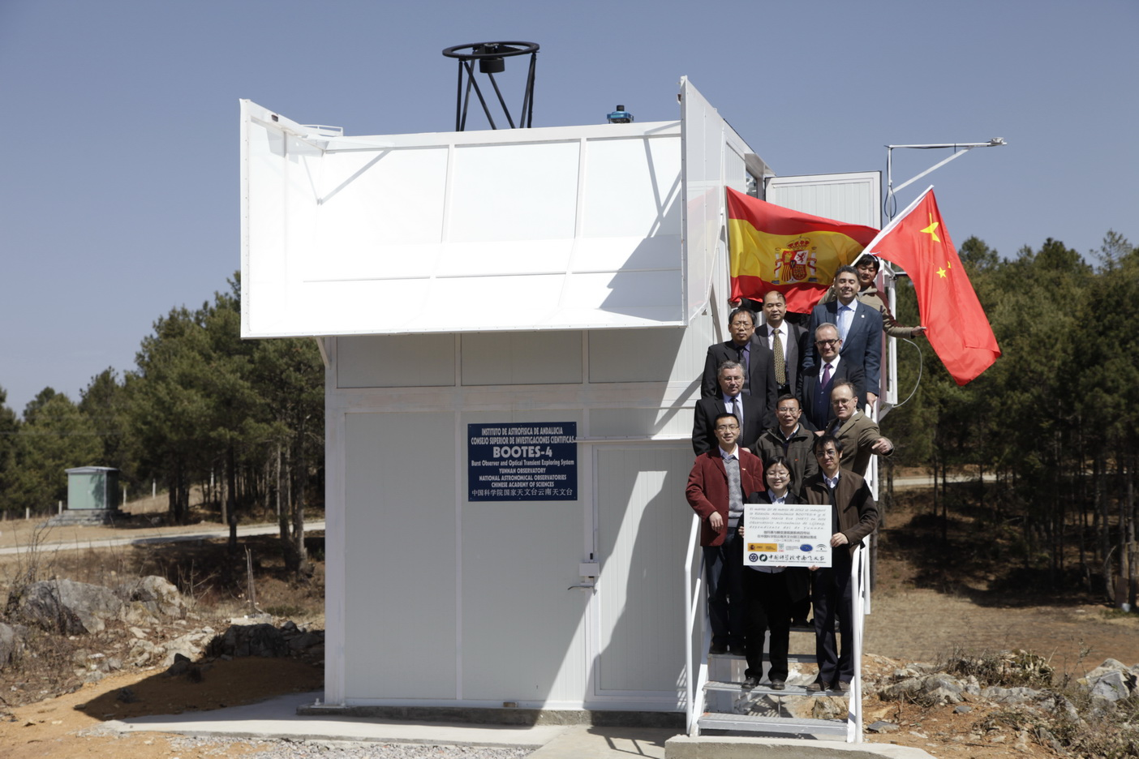
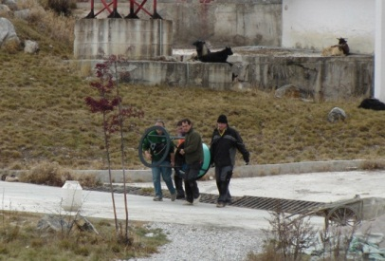
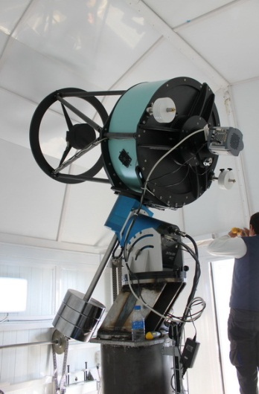
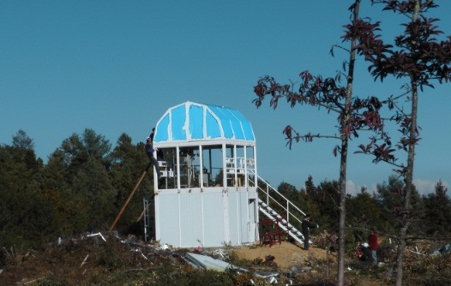
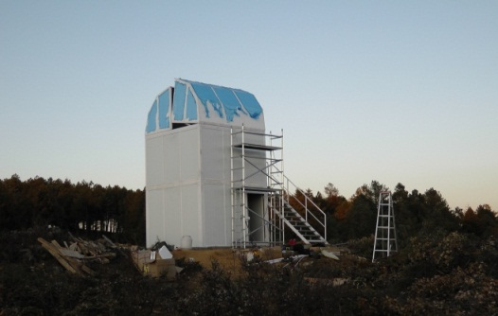
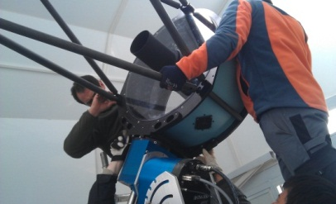
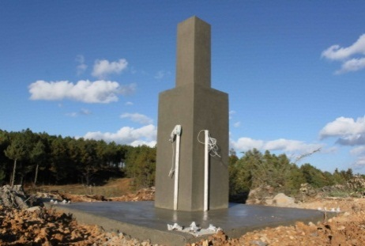
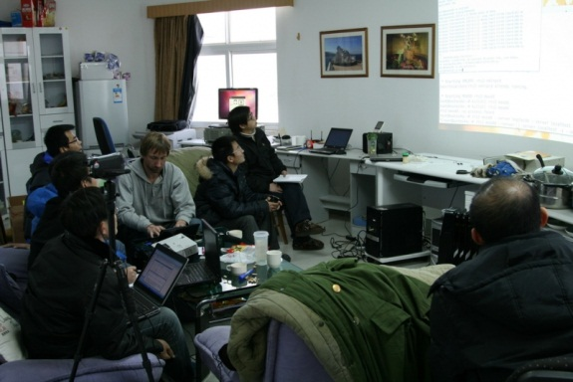
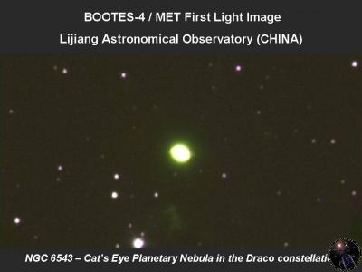
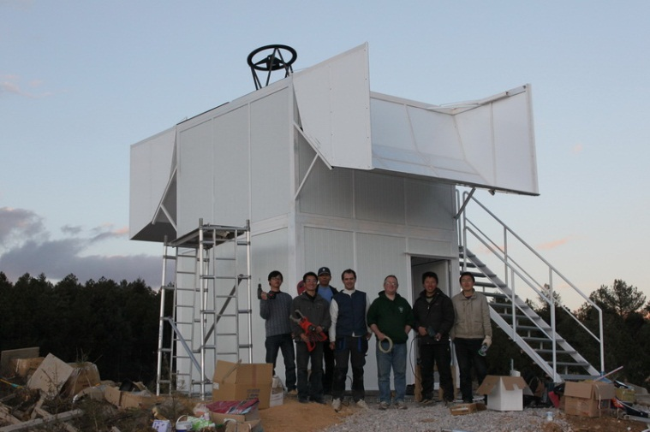
Bootes-4, history review

Slide 20





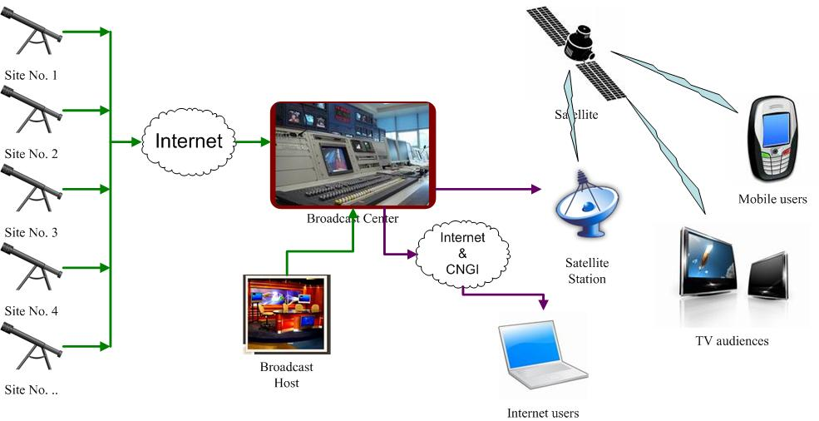
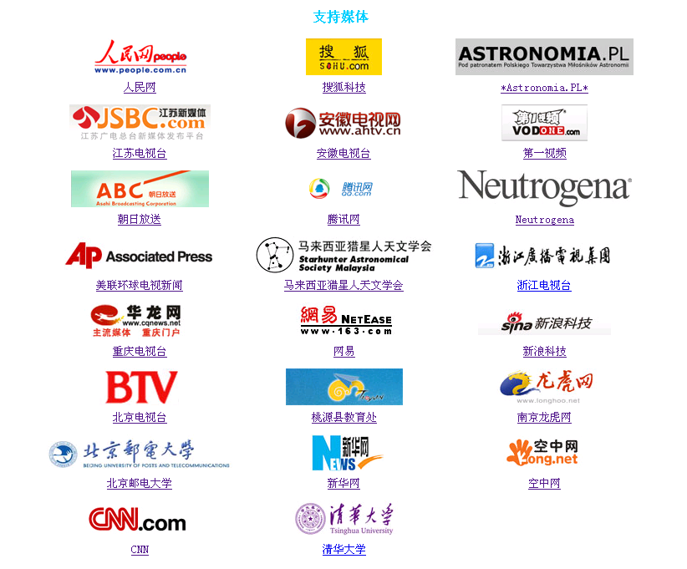
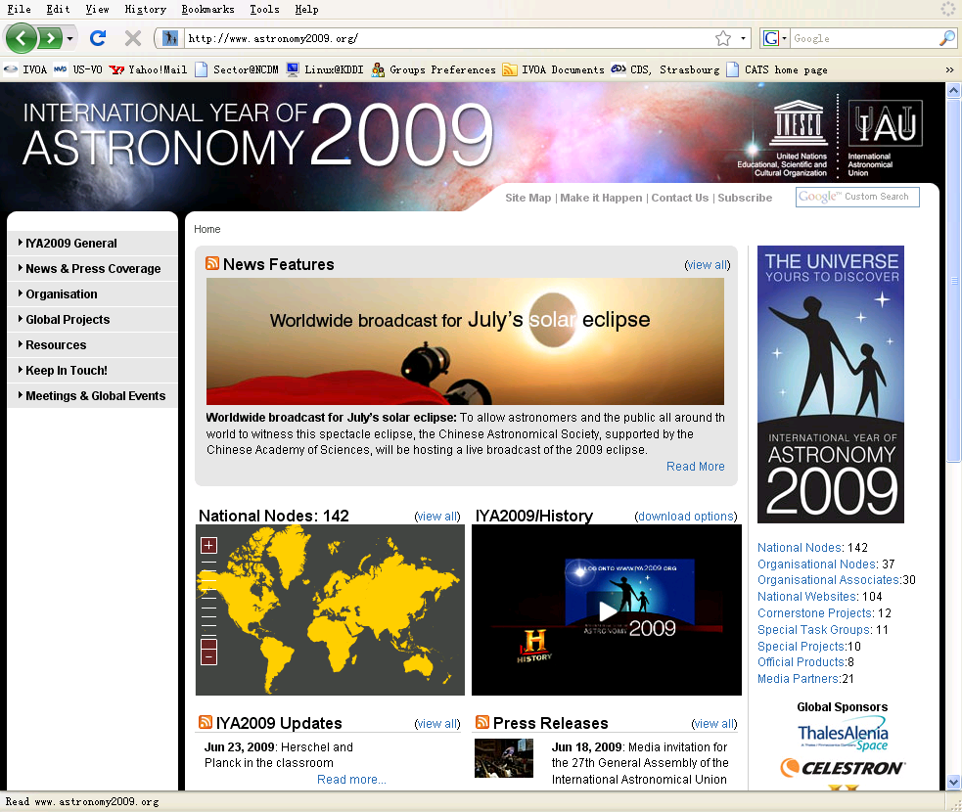

Total Solar Eclipse Live Broadcast in IYA2009
Huge Audience
30 signed clients
Network portal: 17
TV station: 10
Mobile portal: 1
IPv6 portal: 2
Website click: > 230M
~500 volunteers involved

Slide 21



WWT Guided Tour Design Contest
It is just under going …

Slide 22



Award Ceremony (2010.11.9)
@ Beijing Planetarium

Slide 23




WWT Lectures

Slide 24




WWT in class

Slide 25





WWT Teacher Training
WWT teacher training 2010, Aug. 1-3, 2010
WWT teacher training 2011, Jul. 22-26, 2011
WWT teacher training in Haidian, Aug. 25-26, 2011
WWT teacher training in Xinjiang, Apr. 25-26, 2012
WWT teacher training 2012, Jul. 18-20, 2012

Slide 26

CosmoStation, Web Host Service
Since 2002
Hosted hundreds of websites
  Associations
  Individual amateur astronomers
Professional astronomy benefits from here

Slide 27
Future Directions
Data archiving, management, and access
  CAsDC, a national astronomical data center, data curation and long-term service
Closer collaboration with astronomers and astronomical projects
  Specific requirement targeted research and development
  astroinformatics
Scientific data based education and public outreach
  Training the next generation
    Computational thinking
    Citizen science

Slide 28
Thank You

